Slide 1
Paediatrics Revision☝️
Compiled by
Nawa Mutonga
5th year MBChB student/ Environmental Health Technologist

Slide 2
The running man 💪
Wave 1: 1 to 10
Wave 2: 11 to 19
Wave 3: 20 to 29
Wave 4: 30 to 39
Wave 5: 40 to 49
Wave 6: 50 to 59
Wave 7: 60 to 69

Slide 3
Content 🙏
Station 1: Cerebral Palsy
Station 2: Diarrhea
Station 3: Celiac Disease
Station 4: Burkett's Lymphoma
Station 5: Hodgkin's and Non Hodgkin's Lymphoma
Station 6: Pneumonia
Station 7: Dehdration
Station 8: Splenomegaly in SCA
Station 9: Ex /o Newborn
Station 10: RBC Processes
Station 11: SAM
Station 12: Hydrocephalus

Slide 4
Station 13: Shock Management
Station 14: Tetralogy of Fallot
Station 15: Lumbar Puncture
Station 16: NGT Insertion
Station 17: Epilepsy
Station 18: Developmental milestones
Station 19: Primitive reflexes
Station 20: Neonatal sepsis
Station 21: Vaccinations
Station 22: Bronchiolitis
Station 23: Croup
Station 24: Foreign body aspiration

Slide 5
Station 25: Neonatal Jaundice
Station 26: CXR Signs
Station 27: Down Syndrome
Station 28: Approximate weight for age
Station 29: SCD,SCA and SCT
Station 30: Cyanotic and A cyanotic HD
Station 31: Urinalysis
Station 32: Botulism
Station 33: Tetanus
Station 34: Diphtheria
Station 35: Kaposi Sarcoma
Station 36: HIV
Station 37: TB
Station 38: Sickling test vs HB ectrophoresis
Station 39: CXR Reading
Station 40: Respiratory Examination

Slide 6
Station 60: Hexagon
Station 61: Heptagon
Station 62: Duality
Station 63: Scarlet Fever

Slide 7
Station 41: TAPVR
Station 42: Transposition of great arteries
Station 43: Coarctation of Aorta
Station 44: DKA
Station 45: Abdominal Examination
Station 46:Cardiovascular Examination
Station 47: Whooping Cough
Station 48: Enteric Fever
Station 49: Dubin johnson syndrome
Station 50: Rota syndrome
Station 51: Congenital Syphilis
Station 52: Poisoning
Station 53: Malaria
Station 54: SSSS
Station 55: NEC
Station 56: Asthma
Station 57: Nephroblastoma
Station 58: Leukemia
Station 59: COPD

Slide 8
Station 1: Cerebral Palsy
What is cerebral palsy?
It is a congenital static disorder of the CNS that affects movement, muscle tone, and posture.
How does cerebral palsy occur?
It results from abnormal brain development before, during or after birth.
What are the types of cerebral palsy?
Spastic: Stiffness and tight muscles.
Ataxic: Involves improper balance and coordination

Slide 9
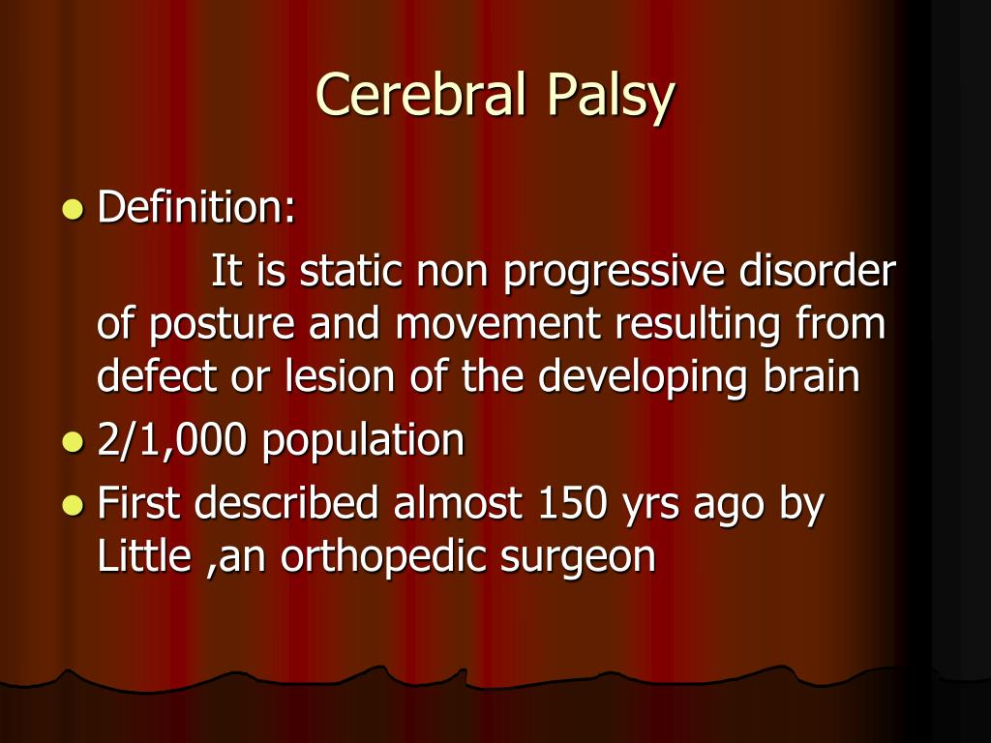

Slide 10
Dyskinetic: Involuntary movements and fluctuating muscle tone.
Mixed: A combination from different types.
How do you make a diagnosis of cerebral palsy?
Medical history
Developmental assessment
Physical Examination
Imaging and diagnostic tests
Within what age range is brain damage considered cerebral palsy?
Before the age of two years.

Slide 11
What are the complications of cerebral palsy?
Contractures
Skeletal abnormalities
Seizures
Cognitive impairment
Dysarthria
Language delay
Vision and hearing problems
Swallowing difficulties: Baclofen
Constipation
Weakened respiratory muscles.
Anxiety and depression
Learning disability
Osteoporosis and obesity

Slide 12
Station 2: Diarrhea
What is diarrhea?
Having more than 3 watery stools in one day.
What are the types of diarrhea?
Osmotic: Too many solutes in the intestines. Preventing water absorption e.g lactose intolerance and sorbitol.
Secretory: Excessve secretion of water. E.g cholera, drugs, toxins and hormones
Inflammatory/Infection: Damage to the intestinal mucosa 2° infections like rota, E.coli, salmonella.
Motility-Related diarrhea: Fast intestinal movements.

Slide 13
Cystic fibrosis transmembrane conductance regulator (CFTR)
It is a protein that functions as a chloride (cl-)and bicarbonate (hco3-) Ion channel
On the surface of epithelial cells
Plays a critical role in maintaining the balance of salt and water across the surfaces of organs
Like lungs, 🫁 🫁, pancreas, intestinal and sweat glands
This protein (CFTR) is encoded by CFTR gene
Located on chromosome 7

Slide 14
Pathophysiology of Secretory Diarrhea
Occurs when the intestines secrete excessive amounts of water and electrolytes into the lumen, overwhelming the absorptive capacity of the gut.
This process is driven by the activation of chlorine channels in intestinal epithelial cells
Particularly the cystic fibrosis transmembrane conductance regulator (CFTR)
Leading to increased chloride secretion
Na and H2O flow passively

Slide 15
Resulting in large volume watery stools.
The most well known cause is CHOLERA TOXIN
Caused by Vibrio cholerae
Which stimulates adenylate Cyclase
The purpose of adenylate cyclase is to increase intracellular cAMP
The goal of cAMP is to keep the chloride channels OPEN

Slide 16
This leads to uncontrolled fluid loss
Other bacterial enterotoxin can similarly trigger secretory diarrhea for example Escherichia coli
Unlike osmotic diarrhea, secretory diarrhea persists despite fasting
As it is driven by active secretion rather than malabsorption
It can also be as a result of congenital defects in ion transporters, hormone imbalances e.g VIPomers or certain medications

Slide 17
Classify diarrhea according to duration
Acute: less than 2 weeks
Persistent: lasts beteen 2 to 4 weeks.
Chronic: lasts more than 4 weeks.
What are the compications of diarrhea?
Dehydration
Malnutrition
Electrolyte imbalance
Weight loss
Secondary infections
Irritation and damage to the intestines

Slide 18
How can you differentiate infectious from non infectious diarrhea?
The cause: Stool mcs will identify
Onset: infectious is often acute and associated with outbreaks.
Symptoms: infectious is associated with fever, nausea and vomiting. Non infectious has no fever in most cases.
Diagnostic clues: negative stool mcs in non infectious, no fecal leukocytes

Slide 19
How do you treat diarrhea?
Fluid and electrolyte replacement
Antidiarrheal agents e.g lopiramide. Should be avoided in infectious diarrhea.
Bismuth subsalicylate may reduce Sx
Abx but not needed in viral cases
Probiotics: restore normal flora.
Which fluids are given?
ORS
Normal saline
Half strength Darrows

Slide 20
Why should Lopiramide should be avoided in infectious diarrhea?
Lopiramide slows intestinal motility
This can trap pathogens and toxins in the gut
Potentially worsening the infection
Lopiramide posses a risk of Toxic mega colon a life threatening condition
Where the colon becomes massively dilated and loses its ability to expel toxins
This happens in cases of enterocoli e.g salmonella, shigella and campylobacter.

Slide 21
Further more, lopiramide can prolong the infection by reducing gut motility, lopiramide delay the clearance of infectious agents potentially leading to more severe illnesses
Lopiramide is not recommended for diarrhea associated with clostridium difficile as it may worsen colitis.
Paediatrics concerns, guidelines strongly advise against it's use in children with acute infectious diarrhea due to safety concerns

Slide 22
However, in travelers diarrhea lopiramide can be cautiously used alongside antibiotics to reduce Sx duration
But only when there is no fever or blood in stool

Slide 23
What investigations are done in a diarrhea case?
Stool mcs
Fecal leukocytes and lactoferrin
Stool pH and reducing substances
RFTs: U and Es, Cr
FBC
Serum IgA and anti-tissue trans glutaminase antibodies: Celiac disease
Endoscopy with biopsy

Slide 24
Fecal leukocytes and lactoferrin
Fecal leukocytes and lactoferrin are markers of intestinal inflammation
Often used to differentiate between infectious and non infectious causes of diarrhea
Fecal leukocytes:
WBCs found in stool
Indicates inflammation
In other words inflammatory diarrhea
Their presence suggests bacterial infections

Slide 25
Bacterial infections like shigella, salmonella, campylobacter or clostridiodis difficile
Traditionally detected via microscopy but this method has limitations due to variability in sample preparation and WBC degradation
Fecal lactoferrin:
Lactoferrin is an iron binding protein found in neutrophils
It is more stable in stool than in WBCs
Detected in Enzyme Linked Immunosorbent Assays(ELISA)
High levels indicate active inflammation, seen in inflammatory bowel syndrome like Crohn's disease and ulcerative colitis or bacterial infections
It is replacing fecal leukocytes test due to its high sensitivity

Slide 26
Stool pH and reducing substances
These tests asses carbohydrate malabsorption
And differentiate osmotic and secretory diarrhea
Stool pH:
Normal pH is slightly acidic around 6.0 due to fermentation of carbohydrates
A low pH (<5.5) suggests carbohydrates malabsorption, commonly seen in lactose intolerance or disaccharide deficiencies
A high pH (>7.0) may indicate secretory diarrhea, colitis or villous adenoma

Slide 27
Reducing substances:
These are unabsorbed sugars e.g glucose, lactose, fructose, galactose that can be detected in stool
Used to screen for carbohydrates malabsorption
Particularly in infants with suspected lactase deficiency or glucose-galactose malabsorption
Benedict's test and clinitest is commonly used to detect reducing substances
Positive result indicate osmotic Diarrhea
Often due to disaccharide deficiencies or short bowel syndrome

Slide 28
Station 3: Celiac disease
What is celiac disease?
In simple terms, it is an autoimmune disorder where the ingestion of GLUTEN triggers an immune response THAT damages the small intestine.
What is gluten?
A protein in wheat, barley and rye.
What symptoms do you see in a patient with celiac disease?
Diarrhea
Bloating
Abdominal pain
Fatigue
Anemia
Osteoporosis
Neurological Sx

Slide 29
Which serological test is done?
Anti-tissue trans glutaminase antibodies
What do you see when you do a small intestine biopsy?
Villous atrophy
What's the treatment?
Strict life long gluten free diet.

Slide 30
Anti-tissue Trans-glutaminase Antibodies
It is a serologic marker primarily used for diagnosing Celiac disease 🪰
An autoimmune disorder triggered by gluten ingestion
It is one of the most and specific tests available for detecting gluten-induced intestinal damage
Tissue Trans-glutaminase is an enzyme involved in cross-linking proteins and modifying gliadin a component of gluten
In celiac disease by mistake target tissue Trans-glutaminase

Slide 31
Producing IgG and IgA anti-tissue Trans-glutaminase antibodies
These antibodies contribute to intestinal inflammation leading to villous atrophy, malabsorption and Systemic complications
Indications:
Chronic diarrhea
Malabsorption syndrome
Unexplained iron deficiency anemia
Dermatitis herpetiformis
Type 1 DM-Screen for celiac disease 🪰
First degree relatives of celiac patient

Slide 32
Test methodology:
Sample: Serum (Blood test)
Technique: Enzyme-linked Immunosorbent Assays
Antibodies types: IgG (used in IgA deficient patients) and IgA (Most sensitive)
Reference range: <20 U/mL varies by laboratory

Slide 33
Interpretation of results:
Negative (<20 U/mL); unlikely celiac disease
Borderline (20-30 U/mL): possible celiac disease 🪰 consider further testing
Positive (>30 U/mL): Strongly suggestive of celiac disease 🪰
Confirmatory test: a positive anti-tissue Trans-glutaminase antibodies test should be followed by the following:

Slide 34
Endoscopic biopsy of the duodenum to assess villous atrophy
Other serologic markers
Genetic testing for HLA-DQ2/DQ8 useful in ambiguous cases
Limitations:
False negatives in IgA deficiency, use IgG anti-tTG instead
False positive in other autoimmune diseases like Type I DM, IBD
Not diagnostic alone -biopsy remains the gold standard

Slide 35
Clinical application:
Screening tool for celiac disease 🪰
Monitoring adherence to gluten free diet - levels decline with strict gluten free diet
Assessing disease severity in symptomatic patients

Slide 36
What are the complications of celiac disease?
Malabsorption
Nutritional deficiencies
Osteoporosis and osteopenia
Iron deficiency anemia
Lactose intolerance
Neurological disorders: Neuropathy, ataxia, cognitive impairment
Infertility and pregnancy complications
Risk of cancer

Slide 37
Station 4: Burkett's Lymphoma
What is Burkett's Lymphoma?
A highly aggressive form of non Hodgkin's lymphoma.
Primarily affects mature B cells in the lymphatic system and the T lymphocytes.
One of the fastest growing malignancies
What are the types of Burkett's Lymphoma?
Endemic: common in sub Saharan Africa and is associated with Epstein Barr virus. Sx: jaw or facial tumors
Sporadic: North America and Europe, Sx-Abdominal tumors.
Immunodeficiency associated: Hiv related: SX- ABDOMINAL TUMORS.

Slide 39
What are the clinical features?
Rapid tumor growth
Nausea, vomiting and bowel obstruction
Painless lymph node enlargement
Bone marrow involvement: anemia, Thrombocytopenia
Diagnosis?
Histopathology: starry sky appearance
Immunophenotyping: CD 20 +Ve b cells
Genetic testing: c-myc translocation
Bone marrow and CSF analysis

Slide 40
What's the treatment?
Chemotherapy: intensive and intrathecal
Supportive care

Slide 41
Station 5: Hodgkin's and Non Hodgkin's Lymphoma
What is the difference between Hodgkin's and Non Hodgkin's lymphoma?
They are both cancers of the lymphatic system
But they differ in pathophysiology, presentation and treatment
Hodgkin's; Reed-Sternberg cells-Large abnormal B cells
NHL: no Reed-Sternberg cells. Include B and T lymphocytes.
NHL-Older adults>60 and HL: young 15-40 and > 55
Both: night sweats, fever, weight loss, swollen lymph nodes
HL- spread is predictable while NHL is unpredictable

Slide 42
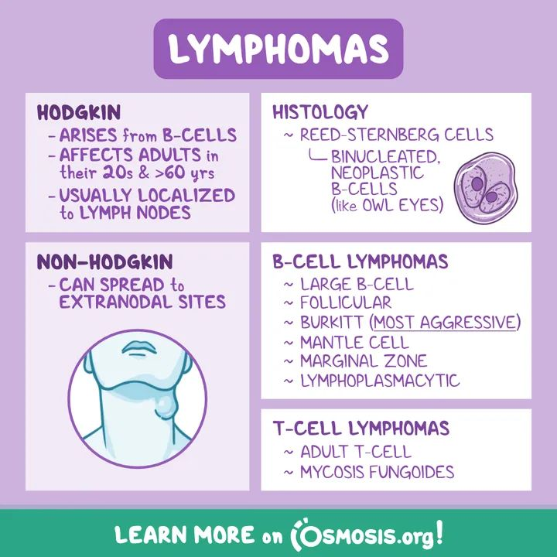

Slide 43
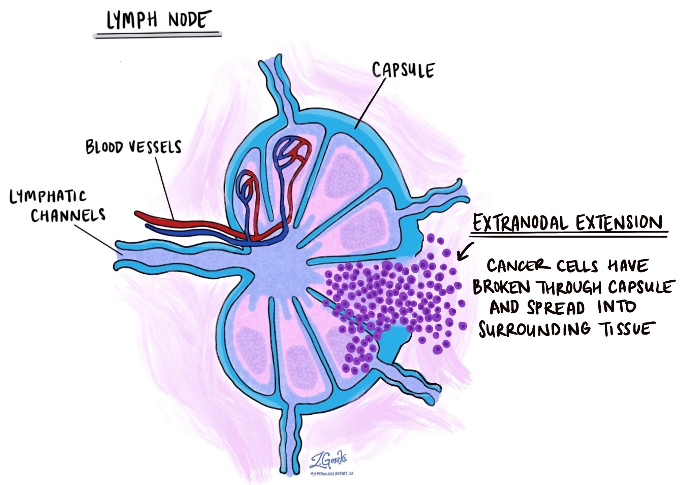

Slide 44
What's the pathophysiology of HL?
Arises from clonal transformation of B cells
This leads to the formation of Reed-Sternberg cells
The genes become more susceptible after infection with Epstein Barr virus
B cells become abnormal
This abnormality leads to improper immunoglobulin GENE rearrangement
This leads to down regulation of HLA class I
This will prevent Cytotoxic T cell recognition

Slide 45
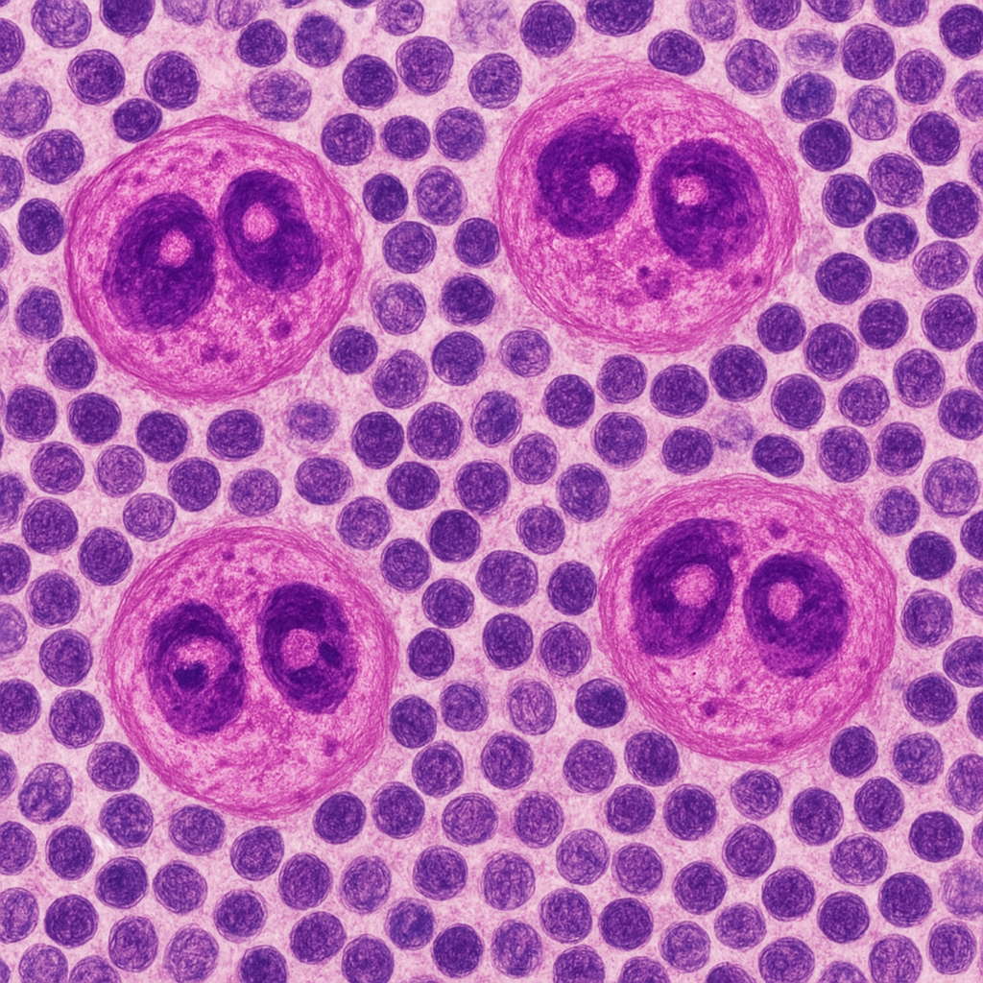
Reed-Sternberg cells
Large abnormal lymphocytes
Hallmark of Hodgkin's lymphoma
They are multinucleated
Have bilobed nucleus with prominent eosinophilic nucleoli
Giving them an "Owls eye" appearance
The cells originate from B lymphocytes
But they loose their normal B characteristics

Slide 46
Continuation of pathophysiology.
Reed-Sternberg cells secrete cytokines and chemokines which attract immune cells
The tumor environment attract suppress Th1 and Cytotoxic T cells

Slide 47
Station 6: Pneumonia
Define typical pneumonia;
Inflammation of the lung parenchyma
Bacterial lung infection that causes alveolar inflammation and consolidation
What is atypical pneumonia?
Inflammation of the lung parenchyma 2° to organisms that do not typically appear on gram stain or grow on standard culture.

Slide 48
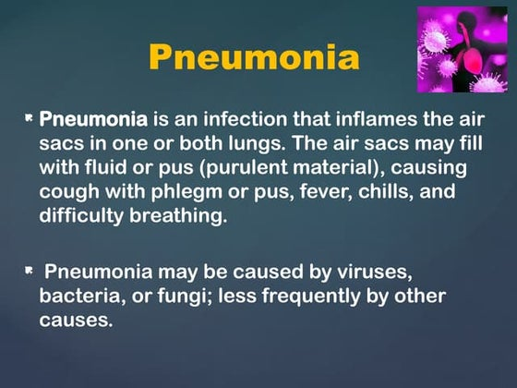

Slide 49
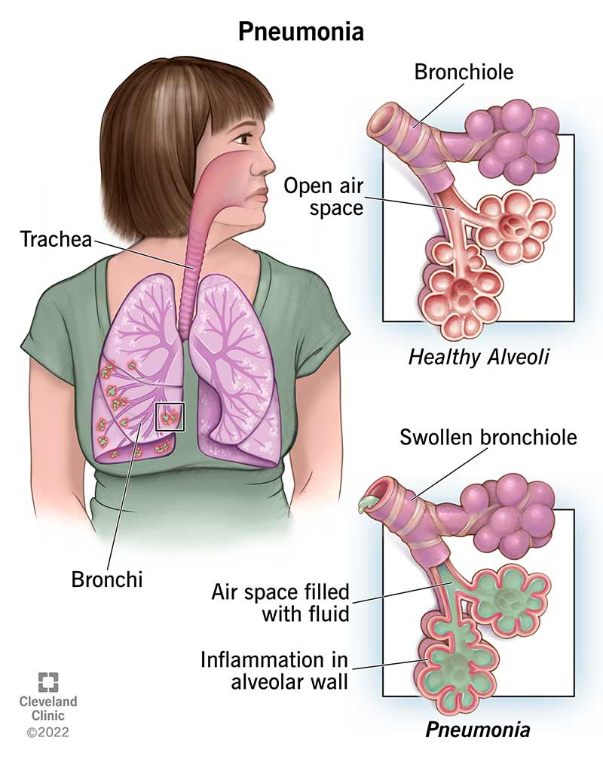

Slide 50
What are the differences between typical and atypical?
Causative agent
Onset: AP gradual, TP acute
Symptoms: AP low grade fever, dry cough, headache, fatigue. TP high fever, productive cough, pleuritic chest pain, dyspnea
CXR findings
Response to antibiotics: TP beta lactam e.g pen and ceph. AP respond to macrolides e.g azithromycin, tetracyclines and flouroquinolones
Common patient group: TP adults with comorbidities. AP younger individuals, c.outbreaks

Slide 51
What causes Typical pneumonia?
Streptococcus pneumoniae (bacterial)
Hemophilia influenzae (bacterial)
Staphylococcus aureus (bacterial)
Moraxella catarrhalis
Klebsiella pneumoniae
Pseudomonas aeriginosa
Enterobacter species
Escherichia coli

Slide 52
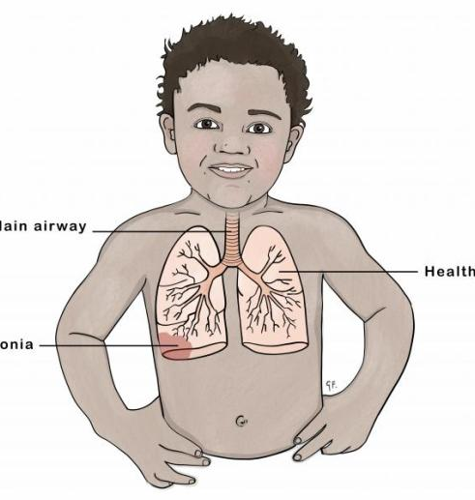
Classification of Pneumonia
Location : CAP, HAP, >/= 48 hous after admission VAP >\=48 hr after intbation and mechanical ventilation.
Causative agent: Bacterial, viral, fungal and aspiration pneumonia
Clinical presentation: typical and atypical

Slide 53
List the organisms that cause atypical pneumonia;
Mycoplasma pneumoniae (B)
Chlamydia pneumoniae (B)
Legionella pneumophila (B)
Coxiella burnetii B
Francisella tularensis (B)
Influenza A and B (V)
RSV
SARS-CoV-2
Parainfluenza virus
PJP (F)
Histoplasma capsulatum (F)
Cryptococcus neoformans (F)

Slide 54
How do you make a diagnosis of pneumonia?
Clinical diagnosis
WHO classification
Pnumonia: Cough+tachypnea
Severe pneumonia: Couh + Chest indrawing
Very severe pneumonia: Cough+Danger signs-cyanosis, inability to drink, convulsions
Investigations
CXR: Lobar consolidation (bacterial pneumonia), Interstitial infiltrates ( Viral pneumonia)
Blood tests: CRP, procalcitonin-bact vs viral
Microbial tests: nasopharyngeal swabs-viral PCR, blood culture if severe.
Guidelines and standards
WHO Integrated Management of Childhood Illness
South African Thoracic Society Guidelines
British Society Guidelines

Slide 55
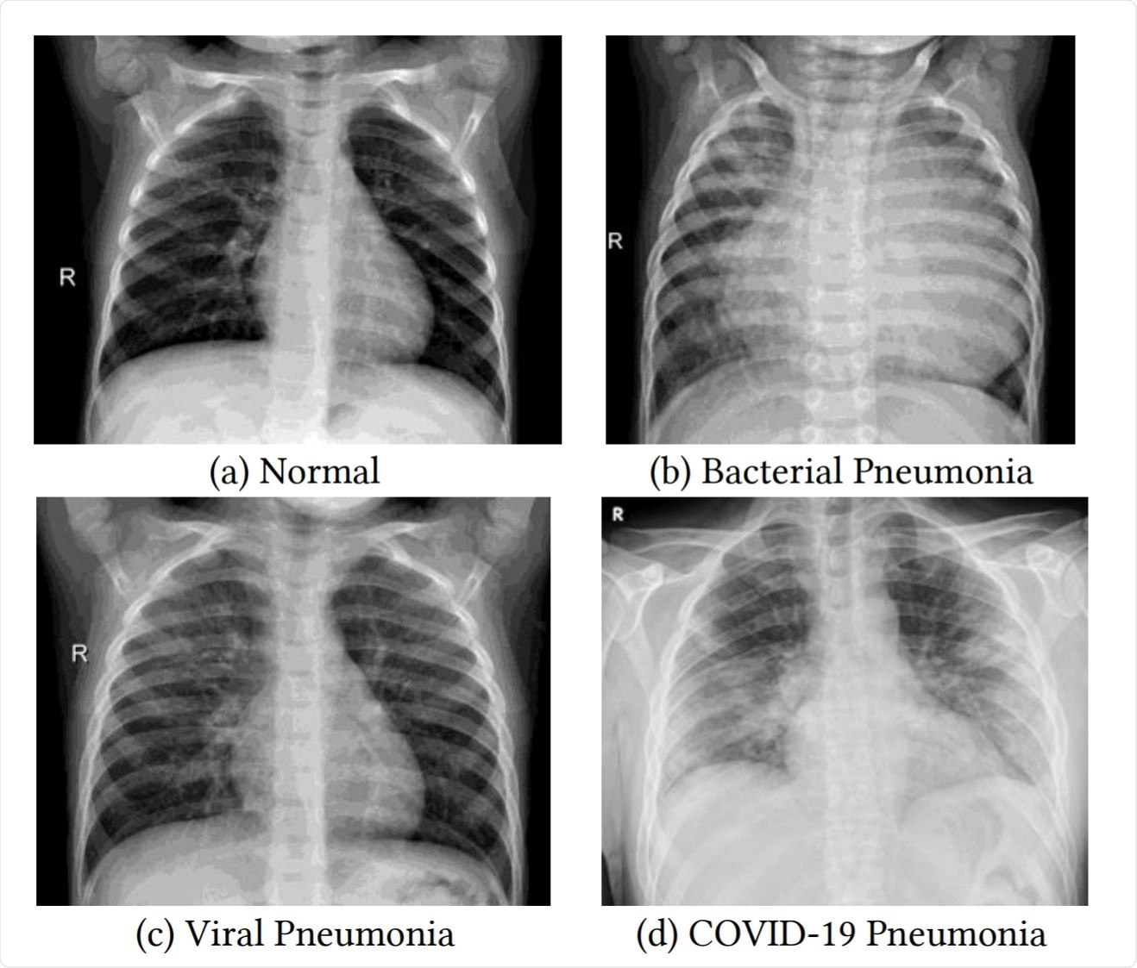

Slide 56
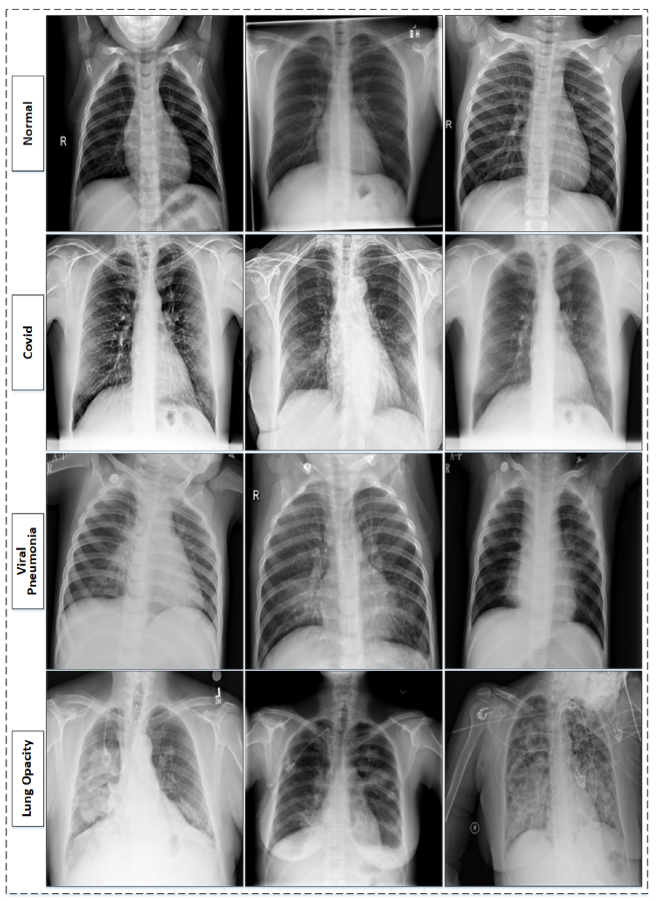

Slide 57
What do you look for on clinical diagnosis?
Key symptoms
Cough
Difficult breathing
Fever (>/=38°C)
Signs of Pneumonia
Tachypnea: <1 yr>/=50 bpm. 1-5yr >/=40 bpm
Chest indrawing-Severe pneumonia
Grunting, nasal flaring (in infants)
Cyanosis or hypoxia ( SpO2 <92%)

Slide 58
What are the major CXR findings of pneumonia?
Lobar pneumonia
Homogeneous consolidation in a single lobe.
Air bronchograms
Sharp lobar boundaries
Bronchopneumonia
Patchy, bilaeral infiltrates -often in lower zones.
Ill-defined opacities around bronchi
No clear lobar consolidation
Interstitial pneumonia
Diffuse, reticular opacities- viral or atypical
Perihilar prominence- Common in viral infections
Ground-glass opacities seen in PJP
Cavitary pneumonia
Cavitations or necrosis
Thick walled cavities
Pleural effusion
Blunting of costophrenic angles
Meniscus sign
Possible empyema

Slide 59
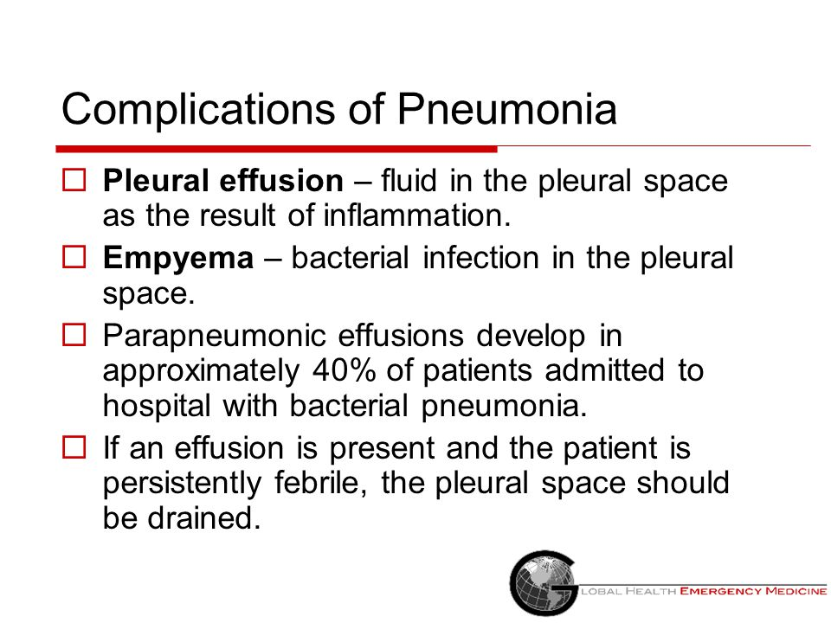

Slide 60
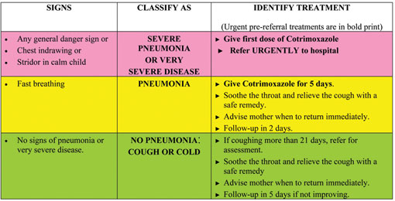

Slide 61
Station 7: Dehydration
What is dehydration?
It is defined as significant depletion of body water and electrolytes
2° fluid loss, decreased intake, or both
Common in cases of diarrhea, vomiting, fever or excessive sweating.
How do you classify dehydration?
Mild: less than 5%, increased thirst, slightly reduced skin turgor
Moderate:5-9%; letargic, irritable, tachycardia, dry mucus membranes, sunken eyes, decreased skin turgor.
Severe: greater than 10%. Shock Sx; reduced consciousness, hypotension, weak pulses, cold extremities, acidosis

Slide 62
Classification of Dehydration according to Weight Loss
Less than 1 year
Mild: less than 5% weight loss
Moderate: 5 to 10% weight loss
Severe: Greater than 10% weight loss
Greater than 1 year
Mild: less than 3% wl
Moderate: 3 to 6% wl
Severe: greater than 6% wl

Slide 63
Paediatrics classification of Dehydration
No dehydration (<3% loss)
Some dehydration (3-9%)
Severe dehydration (>9%loss)

Slide 64
No dehydration (<3% loss)
Child is alert and active
Normal skin turgor
Moist mucus membranes
Normal urine output
No sunken eyes
Normal heart rate
Normal capillary refill time

Slide 65
Some Dehydration
Restlessness or irritability
Sunken eyes
Thirsty and drinks eagerly
Reduced skin turgor (slow skin pinch retraction)
Dry mucus membranes
Reduced urine output
Slightly increased heart rate 💕

Slide 66
Severe dehydration
Lethargy or unconscious
Very sunken eyes
Drinking poorly or unable to drink
Very slow skin pinch retraction (>2s)
Very dry mucus membranes
Minimal or absent urine output
Weak, rapid pulse
Hypotension and signs of circulatory collapse
Rapid breathing
Sunken anterior fontanelle ( in infants)

Slide 67
What are the key diagnostic features of dehydration?
Weight loss
Sunken fontanelle
Delayed capillary refill
Reduced tears and urine output
Altered mental status

Slide 68
How do you manage dehydration?
Oral rehydration therapy
ORS is used in plan A and B
Intravenous fluids
Required for severe Dehydration or shock
Treatment of service dehydration is called plan c
Electrolyte correction
Tailored to the underlying cause.
For example metabolic acidosis in diarrhea and metabolic alkalosis in vomiting.

Slide 69
What are the causes of dehydration?
Increased fluid loss
Commonly due to gastroenteritis, vomiting, diarrhea, excessive sweating, burns or polyuria ( e.g diabetes mellitus or DKA)
Decreased fluid intake
Poor oral intake such as pharyngitis, respiratory distress or neglect.

Slide 70
Plan A management of Dehydration
What is plan A?
It is a home based management
Of children who show no signs of dehydration
It focuses on what?
Preventing dehydration
And maintaining nutrition during diarrheal illness.

Slide 71
What are the key components of plan A?
Increased fluid intake
Supplemental Zinc therapy
10-20mg of Zinc sulphate daily for 10-14 days to reduce severity and duration of diarrhea
Continue feeding
Frequent small feedings are better tolerated than large meals
Don't dilute the food

Slide 72
How is ORS given plan A??
50 to 100 ml for children under the age of 2 years
100 to 200 ml for children aged 2 to 10 years
Above the age of 10;
They can take as much as desired
What are the preferred fluids?
ORS
Salted rice water
Weak tea and fruit

Slide 73
What is plan B?
Used to treat moderate dehydration (some dehydration)
Moderate dehydration is;
Where the child has signs of dehydration but is not in shock
Administrator 75ml/kg of ORS over 4 hours
If still dehydrated, repeat the process.
Give small frequent sips using a spoon 🥄 🥣 or syringe 💉
Older children can drink 🍷 directly from a cup 🍶
If vomiting occurs, wait 5-10 min and resume at lower rate

Slide 74
Assess the hydration status every hour
Look for signs of improvement;
Reduced thirst
Improved skin turgor
Normal urine output
If dehydration worsens or if the child is unable to drink 🍷, switch to Plan C(IV fluids)

Slide 75
Plan C
Introduction
Initial fluid resuscitation
Monitoring and reassessment
Transition to oral rehydration
Additional consideration

Slide 76
Plan C: Introduction
Used for severe Dehydration
Or in Shock
Requires IV fluids
To rapidly restore intravascular volume
And correct fluid deficit

Slide 77
Plan C: Initial fluid Resuscitation
Start fluids immediately using Ringers lactate (preferred)or Normal saline
For infants less 12 months
30ml/kg over 1 hour then
70ml/kg over 5 hours
For children over 1 year
30ml/kg over 30min then
70ml/kg over 2 hr 30 min

Slide 78
Plan C: Monitoring and Reassessment
Reassess every 15 to 30 min for signs of improvement
Signs of improvement:
Heart rate stabilization
Capillary refill time <2s
Improved skin turgor
Urine output normalization
If no improvement, increase IV fluid rate and reassess

Slide 79
Plan C: Transition to Oral
Once the child is stable and can drink
Start ORS at 5ml/Kg/hr
Continue ORS alongside IV fluids until full transition

Slide 80
Plan C: Additional consideration
Hypoglycemia: monitor blood glucose and correct if needed
Electrolyte Imbalance: Consider potassium supplementation
Zinc supplementation:
Less than 6 months: 10mg/day for 10 days
Greater than 6 months: 20mg/day for 10 days

Slide 81
Station 8: Splenomegaly in SCA
Splenomegaly occurs due to?
Repeated vascular occlusion and
Red cell entrapment
What is the mechanism of splenomegaly?
Microvascular occlusion
Splenic sequestration crisis
Hypersplenism
Progressive fibrosis and autosplenectomy

Slide 82
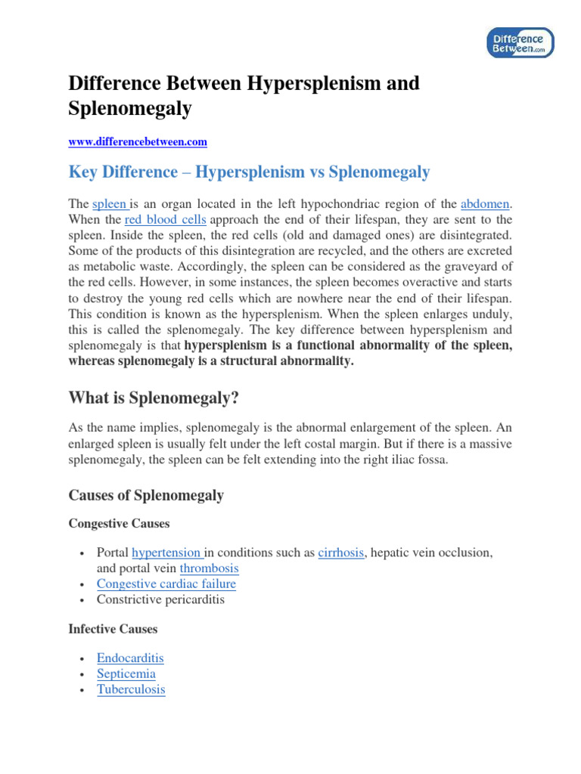

Slide 83
What are the details of the Mechanism?
Microvascular occlusion
Ischemia, infarction, and progressive fibrosis
Splenic sequestration crisis
Entrapment of sickled cells-Rapid enlargement and acute anemia
This can lead to Hypovoemic shock.
Hypersplenism
Chronic congestion leads to excessive destruction of RBCs, PLTs and WBCs
This results into anemia, Thrombocytopenia and leukopenia
Progressive fibrosis and Autosplenectomy
Repeted infarction cause the spleen to shrink and become non functional ( auto splenectomy)
This increases the risk of encapsulated bacterial infection like pneumococcus and meningococcus.

Slide 84
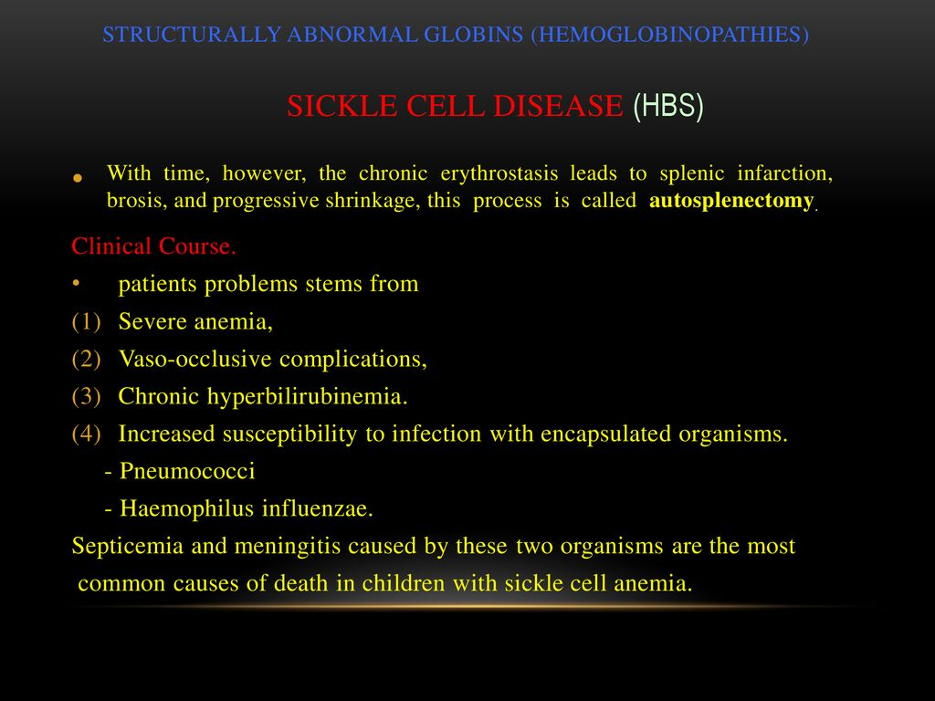

Slide 85
How is the I.S involved in Splenomegaly in SCA?
The primary driver enlargement is;
Vascular occlusion and red cell entrapment
How does immune mechanism contribute?
Chronic inflammation and immune activation
Immune mediated hemolysis and hypersplenism
Impaired immune clearance and infection susceptibility
Role of macrophages and immune surveillance
Ischemia alters macrophage fxn- immune dysregulatíon

Slide 86
Station 9: Examination of a Newborn
What is it?
It is a systematic assessment performed shortly after birth
To evaluate the infant's health,
Detect abnormalities and identify any immediate medical concerns.

Slide 87
List the components involved in the Ex:
General observation
Vital signs
Skin examination
Head and face
Chest and heart
Abdomen
Genitalia
Extremities and spine
Neurological assessment

Slide 88
Introduction
It is a structured assessment
Performed within the first 72 hours of life
It's goal is to identify congenital abnormalities and overall health of a child
And provide reassurance to the parents
This requires systematic approach

Slide 89
Preparation
Wash your hands 👊
Ensure that they are warm
The environment must be well lit
Introduce yourself to the parents
Confirm the baby's identity
Explain the procedure
Obtain consent
Encourage parental involvement
Ensure the baby is calm
Ideally examined between feeds

Slide 90
History taking
Pregnant history (gestational age, antenatal scans, maternal infections, medications)
Mode of delivery
Vaginal
Cs
Assisted delivery
Birth History
Apgar score, resuscitation, meconium stained liquor
Feeding history
Breast feeding or
Formula
Latch issues
Family Hx
Congenital conditions
Metabolic disorders
Neonatal Concerns
Jaundice
Poor feeding
Abnormal movements

Slide 91
General Inspection
Posture and tone: should be flexed with spontaneous movements
Color: Look for cyanosis, pallor, jaundice
Respiratory effort: Observe chest movements, nasal flaring, grunting
Dysmorphic features: Assss for syndromic facies e.g down syndrome
Skin: birthmarks, bruising, petechiae, Mongolian spots: aka congenital dermal melanocytosis. They are benign, flat, blue-grey birthmarks. That typically appear on the lower back and buttocks of newborns. They result from melanocytes, trapped in deeper layers of the dermis during embryonic development.

Slide 92
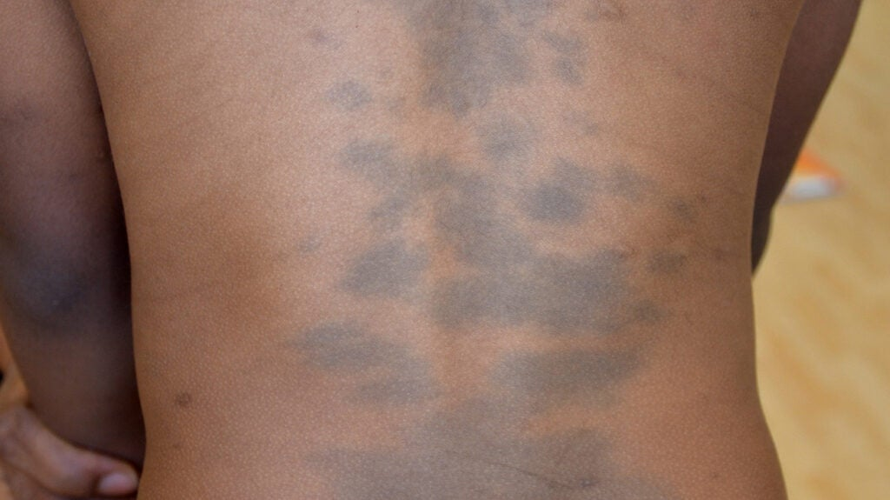

Slide 93
Head to toe: Head and Face
Fontanelles: Should be soft and flat. Bulging=raised ICP, Sunken=Dehydration
Sutures: Assss for craniosynostosis: a condition where one or more cranial sutures close prematurely. Affecting skull shape and potentially increasing ICP
Facial symmetry: Look for asymmetry e.g facial nerve palsy
Eyes: Check for red reflex, absent=Congenital cataracts/Retinoblastoma
Ears: position, shape and preauricular pits and tags
Mouth: Inspect the palate for cleft, tongue for ankyloglossia (AKA tongue tie, congenital condition where lingual frenulum - band of tissue under the tongue -is short or tight restricting tongue movements+ this can affect breastfeeding speech and oral hygiene and Epstein pearls (small benign white or yellow cysts on the roof of the mouth _palate or along the gums of newborns. They are filled with keratin during fetal development)

Slide 94
Neck and Clavicles
Palpate for fractures (Common in shoulder dystocia)
Check for sternocleidomastoid masses (Suggestive of torticollis)

Slide 95
Chest and respiration
Breath sounds
Symmetrical
No wheezing or Stridor
Heart sounds:
Auscultate for murmurs
This would indicate congenital heart diseases
Femoral pulses
Weak pulse 🫀 suggest coarctation of aorta

Slide 96
Abdomen
Shape: Should be
symmetrical,
soft,
not distended
Umbilical cord .
Inspect for hernia
Infection
Or discharge
Palpation
Check for organomegaly
Tenderness
Hepatosplenomegaly in infections

Slide 97
Genitalia
Male
Testicular descent
Hydrocele (Accumulation of serous fluid between the parietal and visceral layers of tunica vaginalis which surrounds the testicle. This fluid can occur due to congenital defects, trauma, infection or impaired lymphatic drainage
Hypospadias: urethral opening located underside of penis instead of at the tip
Female
Assess for labia fusion
Vaginal discharge-maternal hormone effect

Slide 98
Limbs and Hips
Digits
Count fingers and toes
To check for polydactyly and syndactyly
Hip examination
Perform Barlow and ortolani tests: They are clinical maneuvers used to assess hip instaBility in newborn examination to detect hip dislocation or subluxation.
For Developmental dysplasia

Slide 99
Neurological Assessment
Reflexes
Moro
Grasp
Suck
Rooting
Stepping reflexes
Tone
Hypotonia
May indicate neuromuscular disorders

Slide 100
Documentation
Summarize your findings and reassure the parents
Arrange follow up for abnormal findings
Provide guidance on feeding, jaundice monitoring and danger signs

Slide 101
Station 10: RBC Processes
What is meant by RBC Metabolism?
These are processes that support the fxn and survival of RBCs (Anabolism)
Also the processes that are involved in the depredation of RBCs (Catabolism)
How do RBCs generate their energy?
They rely exclusively on anaerobic glycolysis
To maintain their structure and fxn

Slide 102
List all the important processes in RBCs:
Glycolysis: Energy production
Pentose phosphate pathway (Hexose monophosphate shunt): Production of NADPH
Methemoglobin reductase: Converts Fe3+ (Methemoglobin) back to Functional Fe2+ (Hemoglobin)
2,3-BPG ( Bisphosphoglycerate): Regulation of oxygen delivery. Produced in RBC via Rapoport-Luebering shunt, a glycolytic pathway detour. Reduces oxygen affinity for Hemoglobin, making it easier for oxygen to be released into peripheral tissue
Calcium ATPase: : Prevent excessive calcium accumulation

Slide 103
Minor details on Glycolysis
RBCs lack mitochondria
Cannot undergo oxidative phosphorylation
Glucose enters RBCs via GLUT1 transporters
What is produced during glycolysis?
ATP: for membrane ion transport
NADH: used to reduce methemoglobin back to Functional Hb
Pyruvate which is converted to lactate

Slide 104
Minor details on PPP
Produces NADPH
NADPH maintains glutathione in it's reduced state
Reduced glutathione neutralizes ROS
There by preventing oxidative damage to the RBC and Hb

Slide 105
Reflections on Methemoglobin
RBCs need to prevent the oxidation of iron in hemoglobin
They do this by using the enzyme called Methemoglobin reductase
This enzyme acts on Methemoglobin and covert it to Hemoglobin
Methemoglobin ( Fe3+)
Hemoglobin (Fe2+)
Methemoglobinemia impairs oxygen transport

Slide 106
Reflections on ion homeostasis and Membrane integrity
RBCs use ATP to power Na+/K+ ATPase
To maintain ionic gradient
Calcium ATPase Prevent excessive calcium accumulation
Excessive calcium accumulation will reduce RBC flexibility
Cytoskeletal proteins like spectrin and ankyrin depend on ATP for maintaining RBC shape and deformability

Slide 107
RBC lifespan and Clearance
Lifespan is 120 days
As RBC age
ATP levels drop
Membrane integrity decline
Senescent RBCs are removed by microphages in the spleen
Where RBCs are removed by macrophages in the spleen

Slide 108
How is hemoglobin broken down?
Heme: Bilirubin
Globin: Amino acids
Iron: Recycled for new hemoglobin synthesis

Slide 109
What's the clinical significance?
Defects in RBC metabolism leads to disorders like:
G6PD deficiency: PPP failure will lead to oxidative stress
Pyruvate kinase deficiency: impaired glycolysis will lead to Hemolytic Anemia
Methemoglobinemia: Failure to reduce Fe3+ to impair oxygen transport

Slide 110
RBC Clearance in much detail
Senescence and recognition of aged RBCs
Phagocytosis by macrophages
Hemoglobin breakdown
Transport and excretion of bilirubin
Intestinal processing and fecal elimination
Clinical relevance

Slide 111
Introduction /o RBC Clearance
Highly regulated process
Involving aging RBCs
Occurs primarily in the;
Spleen
Liver
And bone marrow
The process sees to it that;
Iron is recycled
Removal of senescent RBCs

Slide 112
Senescence and recognition of aged RBCs
As RBCs age their membrane integrity decline
ATP production decreases
Oxidation damages structural proteins
Several signals mark senescent RBCs for clearance
Loss of phospholipid asymmetry- Exposure of phosphatidylserine
Clustered band 3 protein: aggregates 2° oxidative stress
Reduced CD 47 expressions: CD47 acts as don't eat me signal
Macrophages in the spleen (Major site), Liver (Kupffer cells) and bone marrow recognize these signals and initiate phagocytosis

Slide 113
Phagocytosis by macrophages
Macrophages engulf senescent RBCs
Via receptor- mediated endocytosis
This is aided by:
CR1 (Complement Receptor 1)- Binds opsonized RBCs
Fc receptors: Recognize IgG-Tagged RBCs in Hemolytic process
Phosphatidylserine receptors- Detect apoptotic RBCs
Once engulfed the RBCs enter the phagosome
Where lysosomal enzymes break it down.

Slide 114
Hb break down
Heme degradation
Broken down by heme oxygenase (HO-1,2,3)
Yielding biliverdin (green pigment), carbon monoxide (vasoregulator)
Fe3+ recycled
Biliverdin is converted to bilirubin by biliverdin reductase(Beliverdin-IX Alpha -Reductase)
Turning it into a yellow pigment
Globin break down:
Degraded into proteasome into amino acids
Which are recycled for protein synthesis
Iron recycling
Released iron binds to ferroportin,
Transported out of macrophages and attaches to transferrin in the plasma
For delivery to the bone marrow
Where it is used in new hemoglobin synthesis

Slide 115
Carbon monoxide
Carbon monoxide (CO) plays a role in vasoregulation by promoting vasodilation through multiple mechanisms. It is produced endogenously via the breakdown of heme by heme oxygenase enzymes (HO-1, HO-2, and HO-3) and influences vascular tone in several ways:

Slide 116
Transport and excretion of bilirubin
Bilirubin transport ( unconjugated): Unconjugated bilirubin exits macrophages through passive diffusion across the cell membrane into the blood stream.
Unconjugated bilirubin is insoluble in plasma
Bound to albumin for transport to the liver
Hepatic conjugation
In hepatoytes UDP-glucuronosyltrabsferase (ugt1a1) converts bilirubin into conjugated bilirubin making it water soluble
Excretion via bile
Conjugated bilirubin is actively secreted into bile canaliculi via MRP2 ( multidrug resistant protein 2) and reaches the intestine.

Slide 117
Intestinal processing and elimination
In the gut conjugated bilirubin is converted into urobilinogen
This is done by intestinal bacteria
Urobilinogen undergoes;
Reabsorption into circulation
Some enter urine as urobilin
Oxidation into stercobilin: excreted in faeces, giving stool it's brown color.

Slide 118
Clinical relevance of RBC metabolism
Hemolytic Anemia: Excessive RBC destruction lead to increased bilirubin and jaundice
G6PD deficiency: impaired glutathione recycling, increasing oxidative damage and premature RBC clearance
Sickle cell Disease
Abormal RBCs
Leading to splenic clearance and anemia
Hereditary spherocytosis:
Defect in ankrin and spectrin
RBCs become fragile
This also increases splenic sequestration
Gilbert syndrome
Reduced UGT-glucuronosyltransferase
This impairs bilirubin conjugation causing mild Jaundice

Slide 119
Station 11: Severe acute malnutrition (SAM)
It is life threatening
Results from insufficient intake of;
Energy ( calories)
Fat
Proteins
Mostly affects children under 5 years of age.

Slide 120
What characterizes SAM?
Severe wasting
WFH < -3 SD or
MUAC < 11.5 cm
Bilateral pitting oedema ( kwashiorkor)
Metabolic disturbances leading to complications like
Hypoglycemia
Hypothermia
Dehydration
Infections
Electrolyte imbalance

Slide 121
What are the interventions in brief?
Therapeutic feeding
Antibiotics
Fluid management
The special fluid used in SAM is ReSomal
Early identication and treatment significantly improve survival rates.

Slide 122
What are the long term side effects of SAM?
Impaired cognitive function
Reduced academic performance
Delayed educational attainment: Lower grades and low educational attainment
Reduced self esteem: Psychological effects including
Lower self esteem
Social difficulties ( Seen mostly in people with a Hx SAM in childhood)
Persistent health issues
Growth stunting

Slide 123
10 steps of SAM management
Treat or prevent Hypoglycemia
Treat or prevent Hypothermia
Treat or prevent Dehydration
Treat or prevent Electrolyte Imbalance
Treat Infections
Initiate Cautious feeling: Start with F-75 Therapeutic milk, providing small frequent feeds to avoid refeeding syndrome
Achieve catch up growth: Transition to F-100 or ready to use therapeutic food(RUTF) to promote weight gain
Provide sensory stimulation and emotional support
Prepare for discharge and follow up
Treat associated conditions

Slide 124
Refeeding Syndrome in SAM
Definition: It's life threatening. Occurs when nutrition is rapidly introduced after prolonged starvation. Characterized by severe electrolyte shift particularly Hypophosphatemia, hypokalemia and hypomagnesemia leading to metabolic and organ dysfunction
Pathophysiology: In starvation the body relies on fat metabolism for energy. When feeding resume, insulin secretion increases. Driving glucose into cells. This rapidly triggers intracellular uptake of phosphate, potassium and magnesium. Leading to Dangerous deficiencies. Thiamine deficiency can occur worsening metabolic dysfunction.
Clinical manifestation
Neurological
Cardiovascular
Respiratory
Hematological
Prevention and Management
Start feeding cautiously
Monitor electrolytes
Gradually increase caloric intake

Slide 125
ReSoMal vs ORS
ReSoMal
ORS
Designed for SAM
Lower sodium and higher Potassium (to prevent conditions like heart failure)
Has addiional magnesium, zinc and copper which are crucial for malnourished children.
General dehydration
High Sodium and lower potassium
Nacl 2.6g
Glucose anhydrous 13.5g (anhydrous=containing no water/ crystalline)
Kcl 1.5g
TriNa Citrate dihydrate 2.9g
Water make 1 liter of solution.

Slide 126
Contents of ReSoMal
Glucose 125 mmol/L
Sodium 45 mmol/L
Potassium 40 mmol/L
Chloride 70 mmol/L
Magnesium 3 mmol/L
Zinc 0.3 mmol/L
Copper 0.045 mmol/L
Citrate 7 mmol/L
This formulation helps prevent fluid overload, heart failure and electrolyte imbalances in malnourished children. Unlike standard ORS, ReSoMal is not suitable for cholera treatment due to low Na.

Slide 127
Contents of F-75
Energy 75 kcal
Protein 0.9g
Fat 4g
Carbohydrates 9.3g
Sodium 0.6 mmol
Magnesium 0.15 mmol
Calcium 0.28 mmol
Zinc 2 mg
Copper 0.25mg
Iron None to prevent oxidative stress
Vitamin A 0.3 mg
Vitamin C 12mg

Slide 128
F 75 is a therapeutic milk formula
It is used in the initial stabilization phase of SAM
It provides low protein energy to prevent metabolic overload
It is not designed for weight gain but rather stabilization

Slide 129
How is F 75 given according to weight and frequency?
Dosage: 130 ml/kg/day for children without severe edema ( +++oedema requires 100 ml/kg/day)
Every 2 hours is 12 feeds in a day for critically ill children
Every 3 hours is 8 feeds in a day once vomiting and diarrhea improve
Every 4 hours is 6 feeds in a day when stable
Example: A 5kg child would receive 650 ml/day (130 ml × 5kg) Divided into- 55ml per feed if given every 2 hours

Slide 130
Contents of F-100
Energy 100 kcal
Protein 2.9g
Fat 5.4g
Carbohydrates 10.5g
Sodium 0.6 mmol
Potassium 2.0mmol
Magnesium 0.15mmol
Zinc 2mg
Copper 0.25mg
Iron: none (to prevent oxidative stress)
Vitamin A: 0.3mg
Vitamin C: 12mg

Slide 131
Grading of Edema
WHO classification for nutritional edema particularly in Severe Acute Malnutrition
Mild: Grade 1: Sweling limited to the feet and ankles.
Moderate: Grade 2: Swelling extends to the lower legs, hands Or face
Severe : Grade 3: Severe edema or anasarca. Generalized Oedema of the entire body often with ascites.

Slide 132
Pitting oedema grading
For pitting oedema grading is based on depth and duration
+1: Slight indentation which disappears rapidly
+2: Deeper indentation, disappears within 15s.
+3: Notable indentation. Disappears within 30s
+4: Very deep indentation. Disappears after 2 min

Slide 133
Notice the following;
In clinical practice grading oedema assesses:
Nutritional status
Renal function
Cardiac health
and Systemic disease 🪰

Slide 134
F 100 is a therapeutic milk formula
Used in rehabilitation phase of SAM
Provides higher energy and protein than F 75
It's goal is to promote rapid weight gain
It's composition is per 100ml
Not used in initial stabilization
Due to its high protein and energy content it can overwhelm a malnourished child's metabolism.

Slide 135
How is F 100 given, dosage and frequency in a day?
Dosage: 150-220ml/kg/day, depending on the child's condition
Feeding frequency
Every 4 hours (6 feeds/day) for structural feeding
Free feeding is encouraged once the child is stable and showing appetite recovery
For example a 5 kg child would receive 750-100ml/kg/day divided into -125 to 185ml/feed if given every 4 hours

Slide 136
Station 12: Hydrocephalus
Introduction
Definition
Pathophysiology
Classification
Etiology
Clinical features
Diagnosis
Management
Prognosis and Complications

Slide 137
Introduction
Abnormal accumulation of CSF fluid within the brain ventricles.
This will lead to an increase
an intracranial pressure
and potential neurological impairment

Slide 138
Definition and Pathophysiology
Hydrocephalus occurs when:
CSF production and absorption are not in a proper balance
Leading to unwanted accumulation
CSF is produced by the choroid plexus In the ventricles
Then it is circulated through the ventricular system
It is absorbed into the blood stream via arachnoid granulations
Disruptions in this process results into Hydrocephalus

Slide 139
Classification
Communicating Hydrocephalus
CSF flows freely
But is inadequately absorbed
Non communicating Hydrocephalus
CSF flow is blocked within the ventricular system
Normal pressure Hydrocephalus
Occurs in older adults
With normal CSF pressure but enlarged ventricles
Hydrocephalus Ex Vacuo
Ventricular enlargement 2° brain atrophy
Rather than CSF accumulation

Slide 140
Etiology
Congenital causes:
Aquiductal stenosis
Chiari malformation
Dandy-walker syndrome
Neurotube defects
Crack pot sound
Acquired causes:
Infections (Meningitis)
Intracranial hemorrhage
Tumors
Traumatic brain injury
Post surgical complications

Slide 141
Clinical Features
Infants
Rapid head enlargement
Bulging fontanelles
Sun-Set eyes (Sun-setting eyes)
Irritability
Poor feeding
Children and adults
Headache
Nausea
Vomiting
Gait disturbances
Cognitive decline
Papilledema

Slide 142
Diagnosis
Imaging
Ultrasound: for neonates
CT scan: quick assessment of ventricular dilation.
MRI: Detailed anatomical evaluation
Lumbar puncture
Helps differentate NPH from other causes
Icp monitoring
Used in severe cases

Slide 143
Management
Medical
Acetazolamide and furosemide (Reduce CSF production)
Corticosteroids (For inflammatory causes)
Surgical
Ventriculo-peritoneal shunt: diverts CSF to the peritoneal cavity
Endoscopic third ventriculostomy (ETV): creates alternative CSF drainage pathway.
Tumor resection: if hydrocephalus is 2° mass

Slide 144
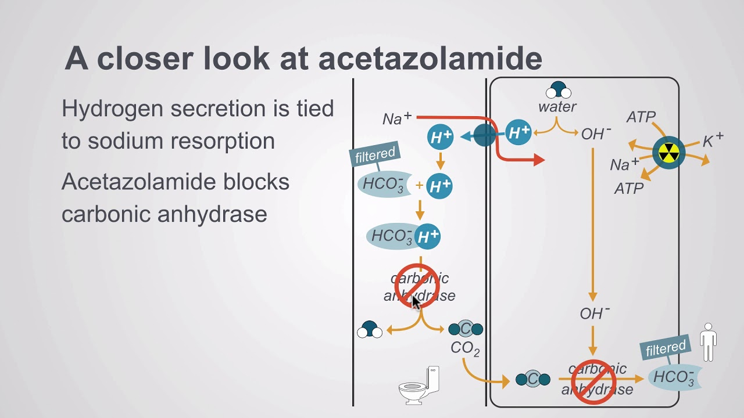

Slide 145
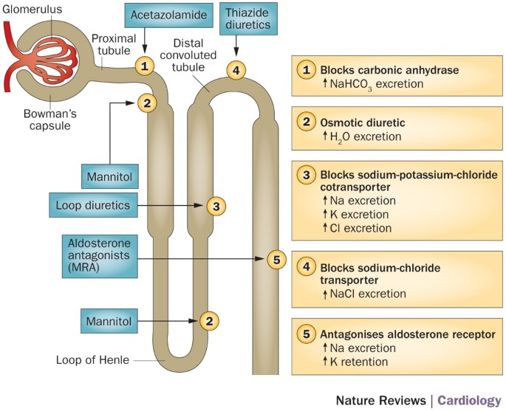

Slide 146
Endoscopic Third Ventriculostomy (ETV)
Used in the treatment of Non-Communicating Hydrocephalus
Instead of implanting a shunt, EVT created an opening on the floor of the Third Ventricle
Allowing CSF to by-pass the obstruction
Allowing CSF to Flow into the basal cysterns

Slide 147
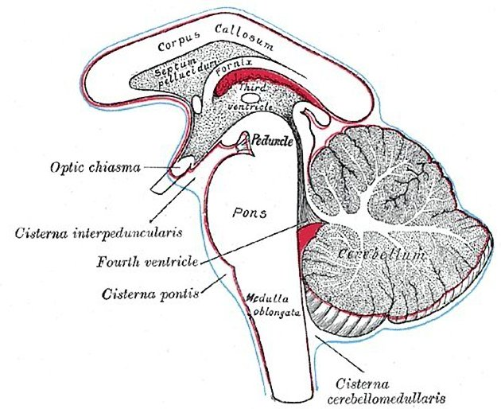

Slide 148
Prognosis and Complications
Shunt malfunction
Blockage
Infection:
Over-drainage
Cognitive impairment:
If untreted, hydrocephalus can lead to developmental delays or dementia
Seizures
Increased risk due to cortical damage

Slide 149
Mnemonic Chiari vs Dandy-walker
Chiari malformation (Type II)-Chiari compresses Cerebellum
C: Cerebellar tonsils herniation 2°Small posterior fossa, malformation
C: Compression of brainstem
C: can be associated with myelomeningocele
General: Downward displacement
Dandy-walker syndrome -Dandy dilates the 4th ventricle
D: Dilated 4th ventricle
D: Developmental failure of cerebellar vermis
D: hyDrocephalus
General: Enlargement of the 4th ventricle - posterior fossa

Slide 150
Chiari malformation vs Dandy-walker syndrome
Chiari malformation
Congenital brain abnormality
Affects the posterior fossa ($mall)
Definition: Herniation of cerebellar structures through the foramen Magnum Due to small posterior fossa (Malformation)
Pathophysiology: small posterior fossa leads to down ward displacement of cerebellar tonsils
Types: Chiari I-IV(Chiari I is most common)
Dandy Walker syndrome
Congenital brain abnormality
Affects the posterior fossa(Large 2° Enlargement of 4th ventricle)
Malormation of cerebellum with cystic dilation of the 4th ventricle
Pathophysiology: enlargement of the posterior fossa with hypoplasia of the cerebellar vermis
Types: dandy Walker malformation, variant and mega cisterna magna.

Slide 151
Chiari vs Dandy-walker
Chiari
Sx: Headache, neck pain, dizziness, syringomyelia, hydrocephalus (Because of the compression and herniation)
Imaging findings: Cerebellar tonsils extended below the foramen Magnum
Treatment: surgical decompression (posterior fossa decompression)
Dandy-walker
Sx: hydrocephalus, developmental delays, ataxia, increased head circumference
Imaging findings: Enlarged 4th ventricle, hypoplastic cerebellar vermis, enlarged posterior fossa.
Treatment: Ventriculo-peritoneal shunt, supportive therapy

Slide 152
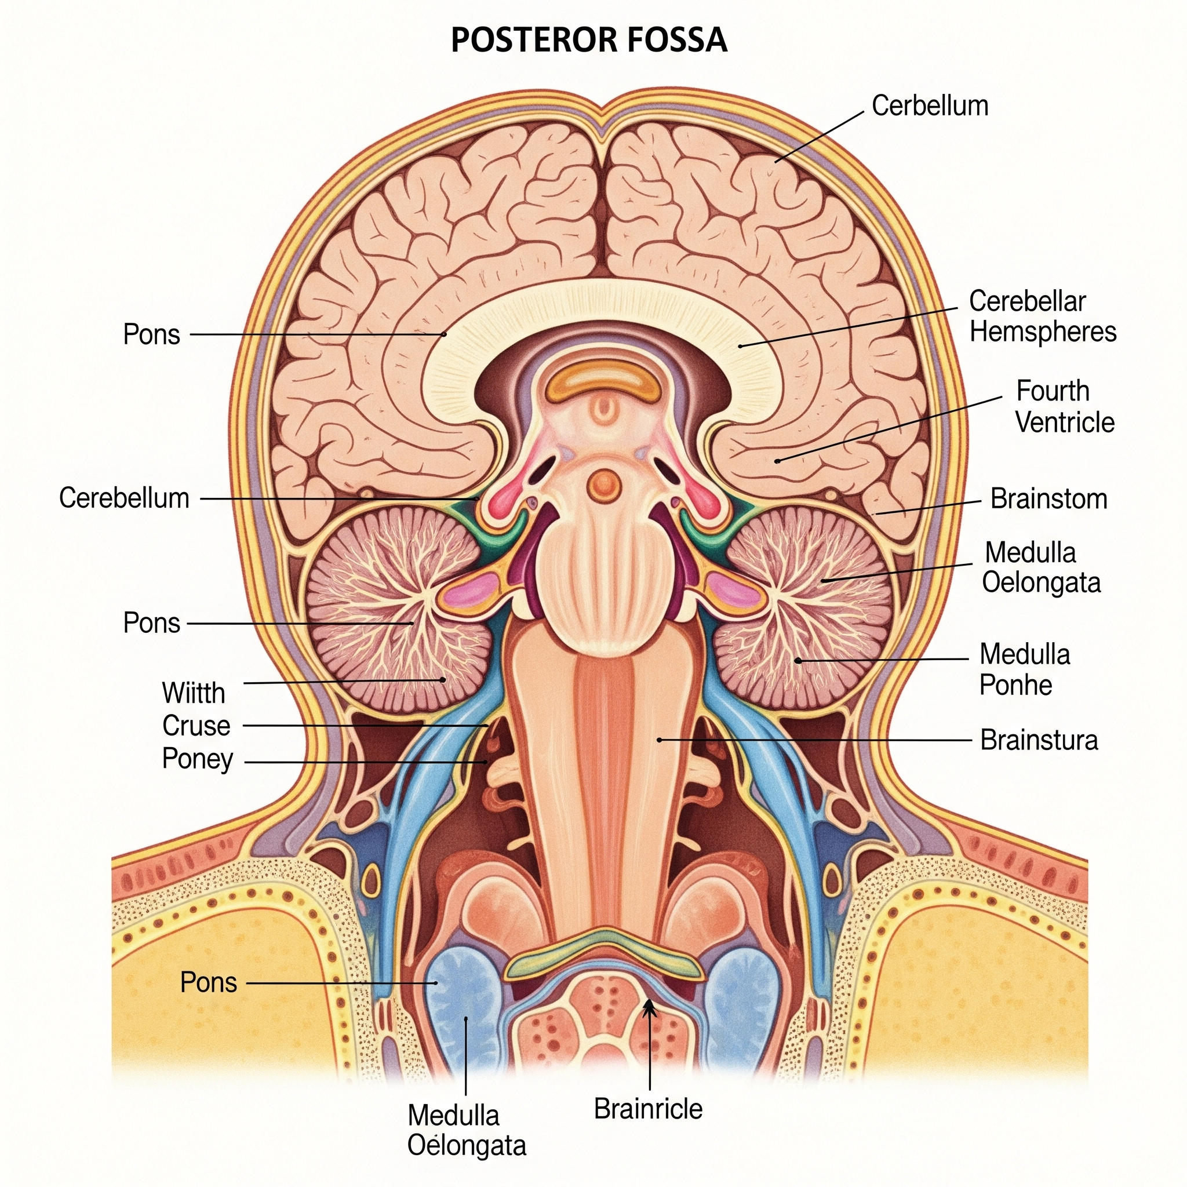
Posterior fossa
Chiari malformation is primarily a disorder of cerebellar herniation
Where as Dandy Walker syndrome involves cerebellar hypoplasia and ventricular enlargement
Both conditions can lead to hydrocephalus
But require different management approaches

Slide 153
Flow of CSF fluid
Introduction
CSF production
CSF circulation pathway
CSF absorption and clearance
Clinical relevance

Slide 154
Introduction
Protects the brain and the spinal cord
Maintenance of ICP
Facilitate metabolic exchange 💱😂
Now lets break down the flow of CSF fluid in great details 👍

Slide 155
CSF production
Site of production👉 CSF is primarily primarily produced by the choroid plexus located in the lateral, third and fourth ventricles.
Mechanism:
The choroid plexus epithelium: Actively secrete CSF via Na+/K+ ATPase pumps, creating an osmotic gradient that derives water movement.
The blood-Csf barrier: ensures selective transport of ions and nutrients while preventing harmful substances from entering the CSF .

Slide 156
CSF Circulation pathway
Lateral ventricles: CSF is produced in the choroid plexus of lateral ventricles
Foramen Monroe: CSF flows into the third ventricle via the interventricular foramen ( foramen of Monroe)
Third ventricle: more CSF is produced by the choroid plexus here
Cerebral acquiduct (aquiduct of sylvius): CSF move into the fourth ventricle via the narrow cerebral acquiduct
Fourth ventricle: additional CSF is produced by the choroid plexus
Foramen luschka and Magendie: CSF exit ventricles
Foramen Magendie (midline): CSF enters cisterna magna
Foramen luschka (Lateral): CSF enters pontine cistern
Subarachnoid space
Absorption via arachnoid granulations

Slide 157
CSF absorption and clearance
Arachnoid granulations:
Specializd structures in the dural venous sinuses that facilitate CSF absorption
Glymphatic system:
Recently discovered pathway where CSF interact with interstitial fluid to clear metabolic waste
Pressure gradient:
CSF absorption is driven by a pressure difference between the subarachnoid space and Venous sinuses

Slide 158
Clinical relevance
Hydrocephalus: blockage at any point in CSF lead to ventricular dilation and increased ICP
Normal Pressure Hydrocephalus:
Impaired CSF absorption without increased pressure
Leading gait disturbances
Dementia and urinary incontinence
Lumbar puncture:
Used to assess CSF composition and
Diagnose infections like meningitis

Slide 159
Station 13: Management of Shock
Introduction
Recognition of Shock
Types of Shock
Initial Management
Specific management consideration
Monitoring and support

Slide 160
Introduction
Shock Management requires systematic approach
To restore perfusion
And prevent multi-organ failure
Let's dive through the study☝️

Slide 161
How can you recognize shock?
Shock is a state of inadequate tissue perfusion
Leading to cellular dysfunction.
Paediatrics patients may compensate well initially, making early recognition crucial.
Signs of shock include the following:
Tachycardia -Early compensatory mechanism
Altered Mental Status (Irritability)
Delayed capillary refill (>2s)
Hypotension (Late sign)
Cold Extremities ( suggesting poor perfusion)

Slide 162
Oliguria ( urine output<1ml/kg/h)

Slide 163
Types of Shock
Hypovolemic shock
Dehydration
Hemorrhage
Distributive shock
Septic shock
Anaphylactic
Cardiogenic Shock
Congnital heart diseases
Myocarditis
Obstructive shock
Cardiac tamponade
Tension pneumothorax

Slide 164
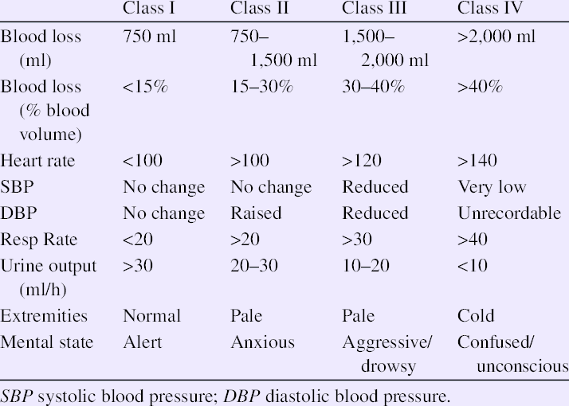

Slide 165
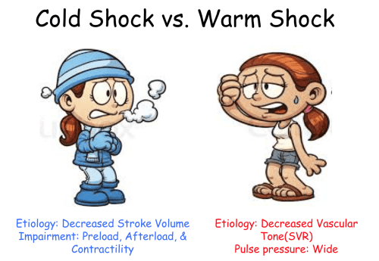

Slide 166
Initial Management
Initial Management (ABCDE Approach)
A_Airway
Ensure that the airway is patent
Consider intubation if necessary
Provide High flow oxygen via face mask or nasal cannula
B_Breathing
C_Circulation
D_Disability
E_Exposure

Slide 167
B_Breathing
Assess respiratory effort and oxygen saturation
Support ventilation if necessary
Bag-Mask ventilation or mechanical ventilation
C_Circulation

Slide 168
C_Circulation
Establish I.V or intraosseous(IO) access
Fluid resuscitation:
Hypovolemic: Bolus 20ml/kg isotonic crystalloid (e.g normal saline or Ringer's lactate)
Septic shock: Aggressive fluid resuscitation with multiple boluses if needed.
Cardiogenic Shock: smaller fluid boluses (5-10ml/kg) to avoid overload

Slide 169
Vasopressors:
Cold shock: Epinephrine or Dopamine
Warm shock: Norepinephrine
Blood products: if hemorrhagic shock is suspected
D_Disability
Assess neurological status (AVPU or Glasgow Coma Scale)
Correct hypoglycemia (give Dextrose if needed)

Slide 170
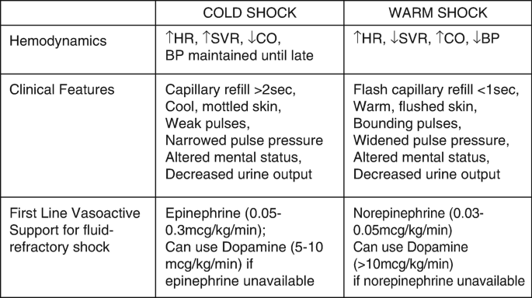

Slide 171
E_Exposure
Identify underlying causes (infection, trauma, congenital heart disease)
Maintain normothermia ( avoid hypoglycemia

Slide 172
Why NE in Warm shock?
Warm shock; NE🌡️
There is vasodilation and
Low systemic vascular resistance (SVR)
Cardiac output is often Normal or High
Perfusion is poor. Why? Due to vasoplegia (Vaso-paralysis)
NE is preferred because;
It's a potent alpha-adrenergic agonist
It increases SVR, through vasoconstriction: This helps to restore perfusion pressure and organ perfusion

Slide 173
Cold Shock🥶 EN❤️
The child is vasoconstricted
With high SVR
Low cardiac out
Here the problem is poor forward flow, not vasodilation
Epinephrine is favored because it has Beta 1 effects
Beta 1 effects: increasing HR and contractility
Please take note EN has also some alpha effects (vasoconstriction)
It improves CO without worsening vasoconstriction

Slide 174
Epinephrine vs NE
Epinephrine heart ❤️
Norepinephrine 🌡️
Act on a1,a2,b1 and b2 receptors
B1 increases HR and contractility (Positive Chronotropy and Inotropy)
B2 causes vasodilation in skeletal muscles and bronchodilation in the lungs 🫁
A1 at higher doses causes vasoconstriction to raise blood pressure
Net effect: a balanced increase in CO with variable effects on systemic vascular resistance depending on dose and receptor dominance
Strongly stimulates a1,a2 and b1 (minimal b2 activity)
A1: potent vasoconstriction increasing SVR and BP
B1: increases HR and contractility, though reflex bradycardia may blunt this
Net effect: marked vasoconstriction with modest cardiac stimulation
Ideal for distributive shock with vasodilation

Slide 175
Specific management considerations
Septic shock: early antibiotics, fluid resuscitation and vasopressors
Anaphylactic shock: IM epinephrine, antihistamine and steroids
Cardiogenic Shock: Inotropes and cautious fluid administration
Obstructive shock: needle decompression (tension pneumothorax), pericardiocentesis (cardiac tamponade)

Slide 176
Monitoring and Support
Continuous vital signs monitoring
Urine output (>1ml/kg/h indicates adequate perfusion)
Lactate level to assess tissue hypoxia
Central venous oxygen saturation (ScvO2)(>70%is a target in septic shock)

Slide 177
Station 14: Tetralogy Of Fallot
Introduction
Key features
Pathophysiology
Clinical presentation
Investigations
Management
Prognosis

Slide 178
Introduction
It is the most common cyanotic heart disease
It is characterized by 4 anatomical defects.
Pulmonary Stenosis
Overriding aorta
Ventricular septal defects
Right ventricular hypertrophy

Slide 179
Key features
Ventricular septal defects
A large defect
Allowing mixing of oxygenated and deoxygenated blood
Pulmonary stenosis
Narowing of the right ventricular outflow tract
Increasing resistance to pulmonary blood flow
Overriding aorta
The aorta is displaced over the VSD receiving blood from both ventricles.
Right ventricular hypertrophy (RVH)
Due to increased workload against pulmonary stenosis
This implies that right ventricular hypertrophy occurs as a result of Pulmonary stenosis.

Slide 180
Pathophysiology
The severity of pulmonary stenosis determines the degree of cyanosis
The worse the stenosis, the worse the cyanosis
Right to left shunting through the VSD leads to systemic circulation of deoxygenated blood.
Normally the Left ventricle has higher pressure than the right.
Meaning that blood should flow from left to right through a VSD

Slide 181
Pathophysiology
However, in TOF, the right to left shunt occurs due to 2 Mechanisms:
Severe pulmonary stenosis increasing right ventricular pressure
Overrding aorta changing flow dynamics: In TOF, aorta is displaced over the VSD. Meaning it is directly receiving blood from both ventriculars. This setup reduces left ventricle's normal dominance over systemic circulation.

Slide 182
Pathophysiology: why does this matter?
The right to left shunt bypasses the 🫁 lungs, as a result causes cyanosis due to systemic circulation of deoxygenated blood.
Tet spells ( hyper cyanotic episodes): occurs when pulmonary resistance increases further for example during exertion or crying, worsening the right to left shunting.
This unique physiology is why TOF leads cyanosis from birth 👍 and requires correction

Slide 183
Clinical presentation
Cyanosis: severity depends on pulmonary stenosis
Ejection systolic murmur: Best heard at the left upper sternal border⭐
Clubbing: chronic hypoxia
Tet spells: Intermittent cyanotic episodes relieved by squatting
Failure to thrive: Poor feeding and weight gain.

Slide 184
Investigations
Echocardiogram: Confirms the diagnosis and assesses severity
CXR: Shows a boot shaped heart due to RVH
ECG: RVH and right axis deviation
Pulse oximetry: To assess oxygen saturation

Slide 185
Management
Medical
IV fluids
Beta blockers: Propranolol to reduce Right ventricular outflow obstruction
Morphine: To reduce respiratory derive and Systemic oxygen demand (reduces the respiratory rate and increases tidal volume=this improves gas exchange)
Surgical
Blalock-Taussig shunt: Temporary palliation in neonates
Definitive repair: Total surgical correction via VSD closure and relief of pulmonary stenosis
Usually performed at 6 to 12 months

Slide 186
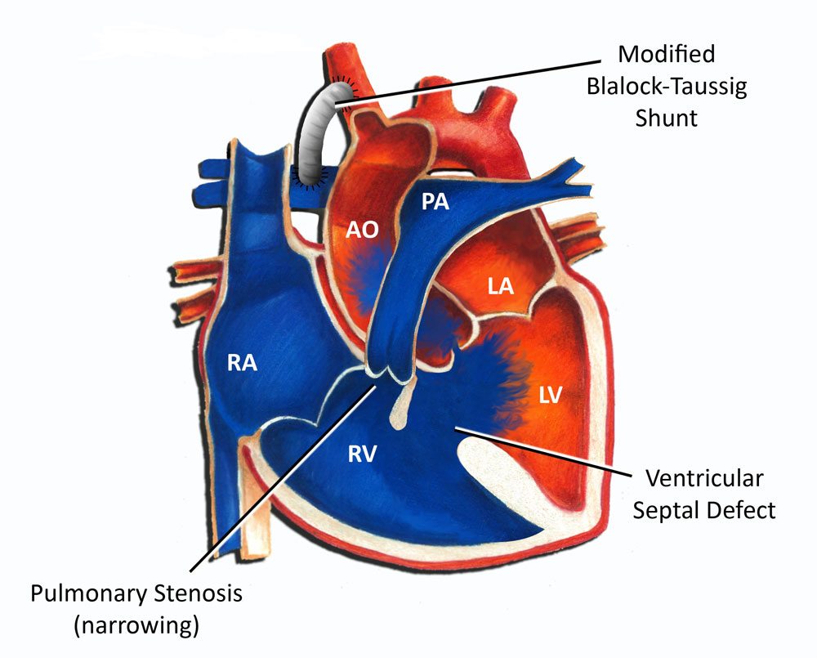

Slide 187
Prognosis
Without surgery survival is poor beyond childhood
Post-surgical outcomes are generally good, though some patients may develop residual pulmonary stenosis or arrhythmias

Slide 188
⭐Station 15: Lumbar Puncture
Introduction
Definition and Purpose
Indications
Contraindications
Anatomy and Needle pathway
Procedure steps
Complications
CSF Analysis
Exam tips

Slide 189
LP: Introduction
LP is also called spinal tap
It is an important procedure in medicine
Used for diagnosing neurological conditions

Slide 190
Definition and Purpose
Involves insertion a needle into the subarachnoid space of the Lumbar spine
To collect cerebral spinal fluid
Or administer medication
It is used for:
Diagnosis: meningitis, subarachnoid hemorrhage, multiple sclerosis, Guillain-Barre syndrome, neurosyphilis, CNS malignancies
Therapeutic purposes: administration of chemotherapy, antibiotics, or anesthetics.
Measurement: CSF pressure in conditions like idiopathic intracranial hypertension

Slide 191
Indications
Suspected meningitis: bacterial, viral or fungal
Subarachnoid hemorrhage: if CT is inclusive
CNS malignancies to detect malignant cells
Multiple sclerosis: oligoclonal bands in CSF
Guillain-Barre syndrome: elevated proteins without pleocytosis
Pseudo tumor cerebri: to measure CSF pressure

Slide 192
Contraindications
Raised ICP: risk of brain herniation
Coagulopathy: Risk of spinal hematoma
Local infection at puncture site
Spinal deformities: scoliosis and kyphosis
Acute spinal trauma

Slide 193
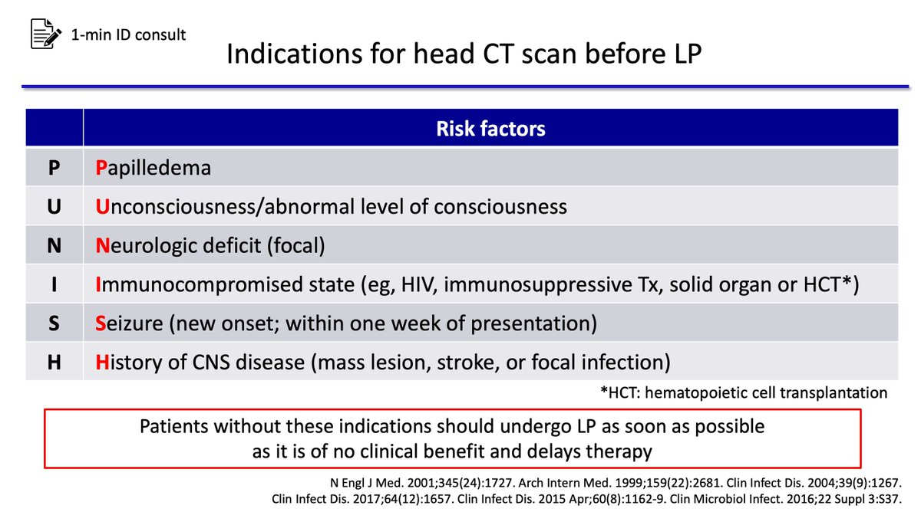

Slide 194
Anatomy and Needle pathway
The needle passes through:
Skin
Subcutaneous tissue
Supraspinous ligament
Interspinous ligament
Ligamentum flavum
Epidural space
Dura mater
Arachnoid mater
Subarachnoid space (CSF collection site)

Slide 195
Procedure steps
Patient positioning: lateral decubitus or sitting position
Landmark identification: L4-L5 or L3-L4 intervertebral space
Aseptic technique: sterile gloves, draping, antiseptic preparation
Local anesthesia: Lidocaine infiltration
Needle insertion: advance slowly until CSF flows
CSF collection: measure opening pressure, collect, removal and dressing. Apply pressure and sterile dressing.
3 test tubes
Hematology: Cell count
Microbiology: MCS
Biochemistry: Glucose and Protein

Slide 196
Brain herniation LP and Raised ICP
Results from sudden pressure gradient created by LP
Normally CSF is distributed evenly across the intracranial and spinal compartments.
However, in conditions like space-occupying lesions, meningitis or cerebral edema, ICP is already elevated.
This puts the brain at risk of downward displacement.

Slide 197
When LP is performed
CSF is is removed from the spinal canal leading to transient drop in pressure in the Lumbar region
This creates pressure difference between the intracranial and spinal compartments
Which can force brain structures downward
The most dangerous form of herniation is trans tentorial herniation
Where the brainstem is compressed leading to respiratory failure and and death
Even normal CT scan does not rule out the risk of herniation.
To mitigate this risk, guidelines recommend performing a head CT scan before LP.

Slide 198
In patients with suspected raised ICP especially if they have Signs of raised ICP like
Altered Mental Status
Papilledema
Focal neurological deficit
If herniation is suspected LP should be avoided
And an alternative diagnostic approach should be considered

Slide 199
Papilledema
Is optic disc swelling due to increased intracranial pressure. Some key features include;
Venous engorgement: often the first sign
Loss of venous pulsation
Hemorrhages near the optic disc
Blurring of optic disc margins
Elevation of the optic disc
Parton's lines: retinal lines extending from the optic disc
Clinically, patients may experience headaches, transient visual obscuration, double vision and nausea/vomiting.
If not treated, it may lead to progressive vision loss

Slide 200
Complications
Post-Lp headache: due to CSF leak
Infection: aseptic technique reduce risk
Bleeding: especially in coagulopathic patients
Brain herniation: if performed in raised ICP
Nerve root irritation: transient pain or paresthesia

Slide 201
CSF Analysis
Bacteria meningitis: increased WBCs, reduced glucose, increased proteins
Viral meningitis: increased WBCs (lymphocytes), normal glucose
Subarachnoid hemorrhage: xanthochromia (yellow CSF), RBCs
Multiple Sclerosis: Oligoclonal bands

Slide 202
Exam tips
Know the layers pierced by the needle
Understand CSF findings in different diseases
Be familiar with contraindications and complications
Practice landmark identification on models

Slide 203
⭐Station 16: NGT Insertion
Introduction
Indications
Contraindications
Preparations
Insertion technique
Confirmation of placement
Complications

Slide 204
NGT: Introduction
Is a very important skill for medical students and health care personnel

Slide 205
Indications
For therapeutic and diagnostic purpose
Gastric decompression: bowel obstruction, paralytic ileus, post operative care
Enteral feeding: when intake is unsafe or impossible
Medication administration directly into the stomach
Aspiration of gastric content: For diagnostic purpose like uppers GI bleeding or poisoning (Removing only)
Gastric lavage in cases of overdose or poisoning (instilling and removing)

Slide 206
Contraindications
Suspected basal skull fracture - Risk of intracranial placement
Severe coagulopathy - risk of bleeding
Esophageal stricture or varices - risk of perforation
Recent nasal or facial trauma - risk of misplacement
Unstable cervical spine injury - risk of exacerbating injury

Slide 207
Preparation
Equipment required
Nasogastric tube appropriate size for example 12-16 Fr for adults
Syringe 💉 50 ml
Lubricant: water soluble
pH strips
Tape or fixation dressing
Glass of water with a straw if a patient can swallow
Stethoscope
Gloves and PPE

Slide 208
Patient preparation
Explain the procedure to the patient and obtain verbal consent
Position the patient in a high Fowler's position that's sitting upright at 60-90°
Assess nasal patency by asking the patient to breathe through each nostril separately
Measure the tube length
From the bridge of the nose to earlobe to 5cm below the xiphisternum
Mark the insertion length on the tube

Slide 209
Insertion technique
Lubricant the tip of the tube with water soluble lubricant
Insert the tube gently through the nostril, directing it along the nasal floor
Advance the tube while asking the patient to swallow if it's safe. Provide water with a straw 🧃
Check for coiling in the mouth 👄 using a pen 🖊️ touch
Advance to marked length without forcing
Secure the tube with tape on the nose and cheek

Slide 210
Confirmation of placement
To ensure correct placement in the stomach:
Aspirate gastric content and check pH , it should be less than 4. This confirms gastric placement
Auscultate air entry by inflatting 10-20 ml and listening 🎧 over the epigastrium
CXR: Gold standard if placement is uncertain
Use a bowl 🥣 of water and dip the tube in water during expiration. If it forms bubbles the it's not in the stomach

Slide 211
Complications
Misplacement
Aspiration pneumonia
Epistaxis
Mucosal injury
Sinusitis: long term use

Slide 212
Station 17: Epilepsy
Introduction
Definition and epidemiology
Etiology and risk factors
Classification of paediatric epilepsy
Diagnosis and investigations
Management of paediatric epilepsy
Prognosis and Complications

Slide 213
Introduction
Epilepsy is a chronic neurological disorder
Characterized by recurrent unprovoked seizures
Due to abnormal electrical activity in the brain.
In paediatrics, there are challenges in diagnosis, classification and management
Hence this requires a structured approach
Epilepsy is also defined as having 2 or more seizures 24 hours apart without any precipitating factors

Slide 214
Definition and Epidemiology
Epilepsy is defined as two or more unprovoked seizures occuring more than 24 hours apart
It affects - 1% of children world wide with peak incidence in infancy and early childhood
Paediatric epilepsy accounts for-25% of neurological disorders in children

Slide 215
Etiology and Risk factors
Genetic causes
Idiopathic epilepsy syndrome e.g childhood epilepsy, juvenile myoclonic epilepsy
Channelopathies affecting neuronal excitability like SCN1A mutations in drovet syndrome
Structural causes:
Congenital brain 🧠 malformations like lissencephaly, polymicrogyria
Perinatal insults like HIE, intraventricular hemorrhage
Neurocutaneous syndrome like tuberous sclerosis, sturge-weber syndrome

Slide 216
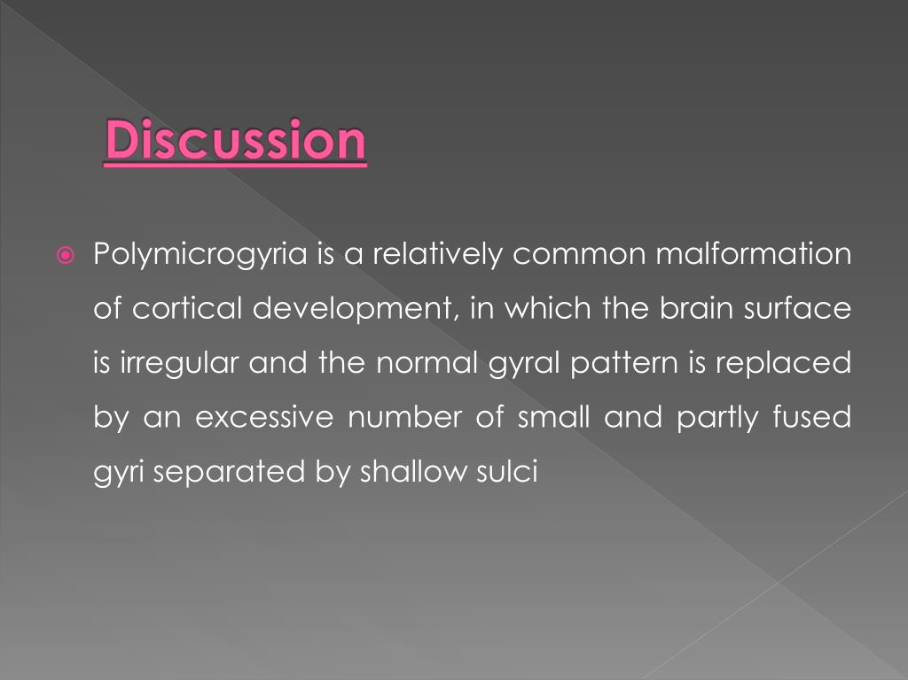

Slide 217
Metabolic causes:
Inborn errors of metabolism like mitochondrial disorders, phenylketonuria
Electrolyte Imbalance like hypocalcemia, hypoglycemia
Infectious causes:
Neurocysticercosis common in endemic areas
Meningitis and encephalitis like HSV encephalitis, TB meningitis
Immune mediated causes
Autoimmune encephalitis like anti-NMDA receptor encephalitis
Febrile seizures can evolve into epilepsy in predisposed children

Slide 218
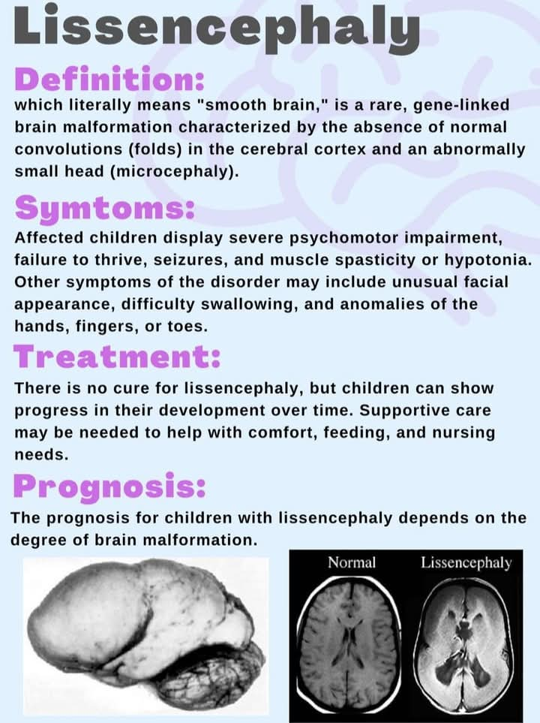

Slide 219
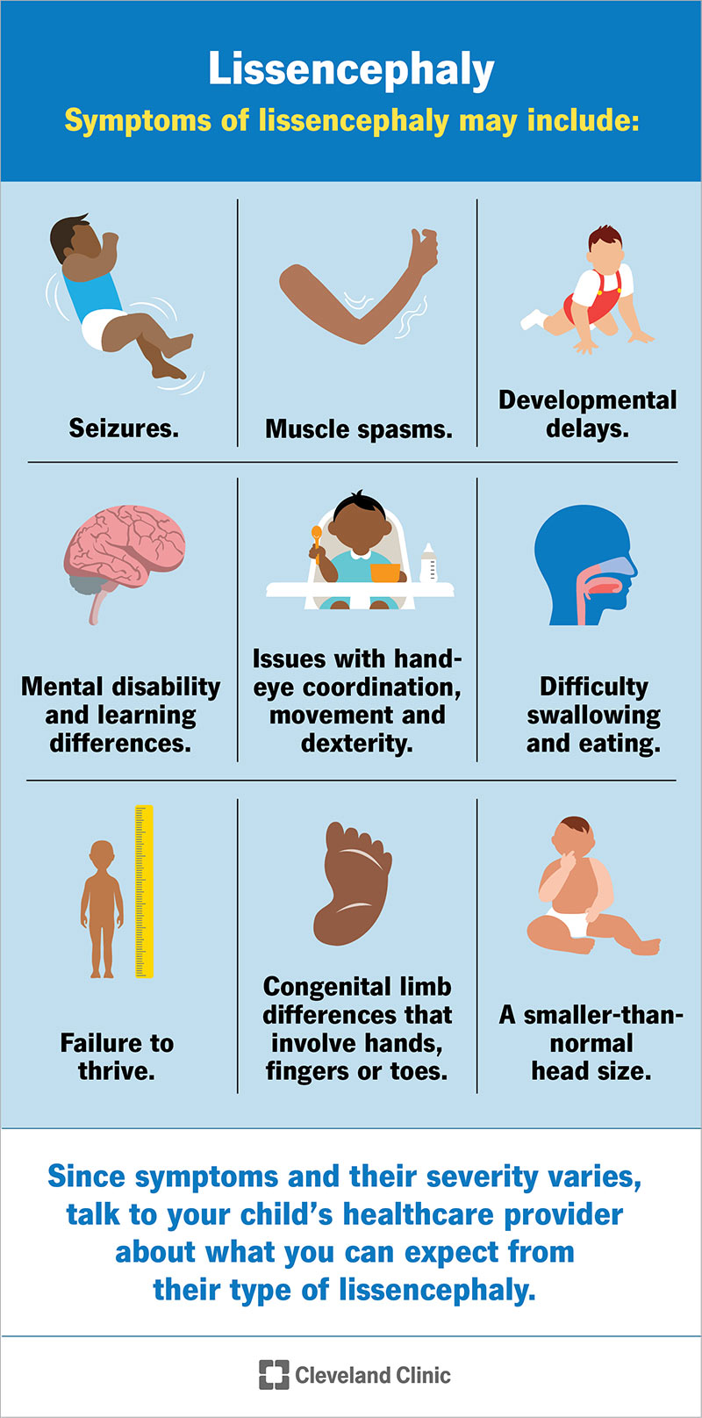

Slide 220
Classification of paediatric Epilepsy
Focal seizures also known as partial seizures
Simple focal seizures: No loss of consciousness, localized motor/Sensory symptoms.
Complex focal seizures: Impaired awareness, automatism like lip-smacking, hand movements
Generalized seizures:
Absence seizures: Brief staring episodes, often unknoticed
Tonic-clonic seizures: loss of consciousness, stiffness (Tonic phase), rhythmic jerking (clonic phase)
Myoclonic seizures: Sudden muscle jerks, often in the morning
Atonic seizures: Sudden loss of muscle 💪 tone leading to falls

Slide 221
Epileptic syndrome (Infantile spasms): Triad of spasms, hypsarrhymia(EEG) and developmental regression
Lennox-Gastaut Syndrome: Multiple seizures types, cognitive impairment, slow spike waves EEG
Dravet syndrome: Severe epilepsy with prolonged febrile seizures, SCN1A mutation.

Slide 222
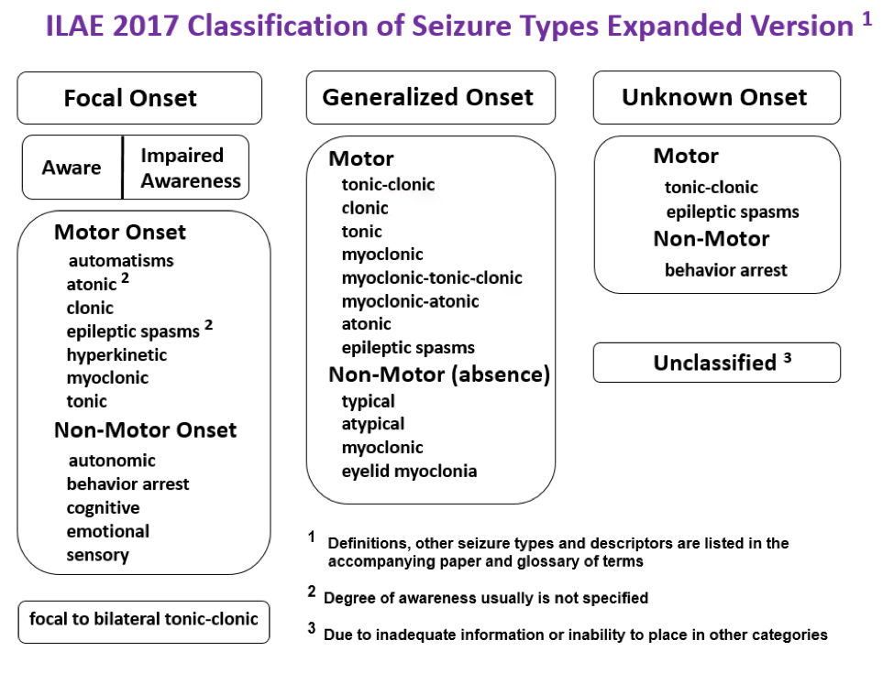

Slide 223
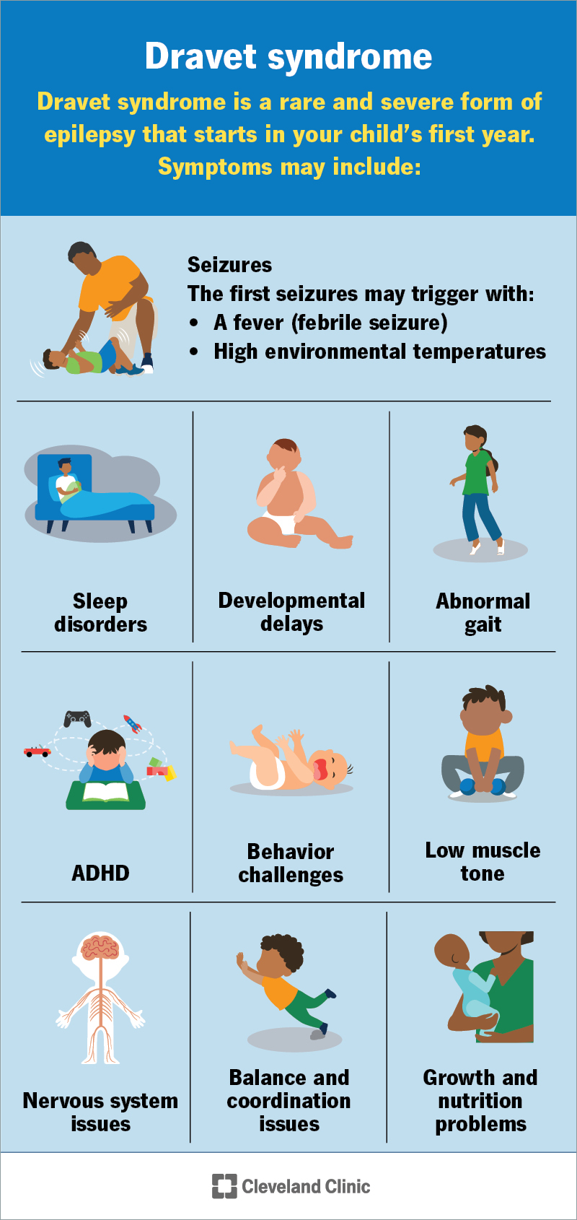

Slide 224
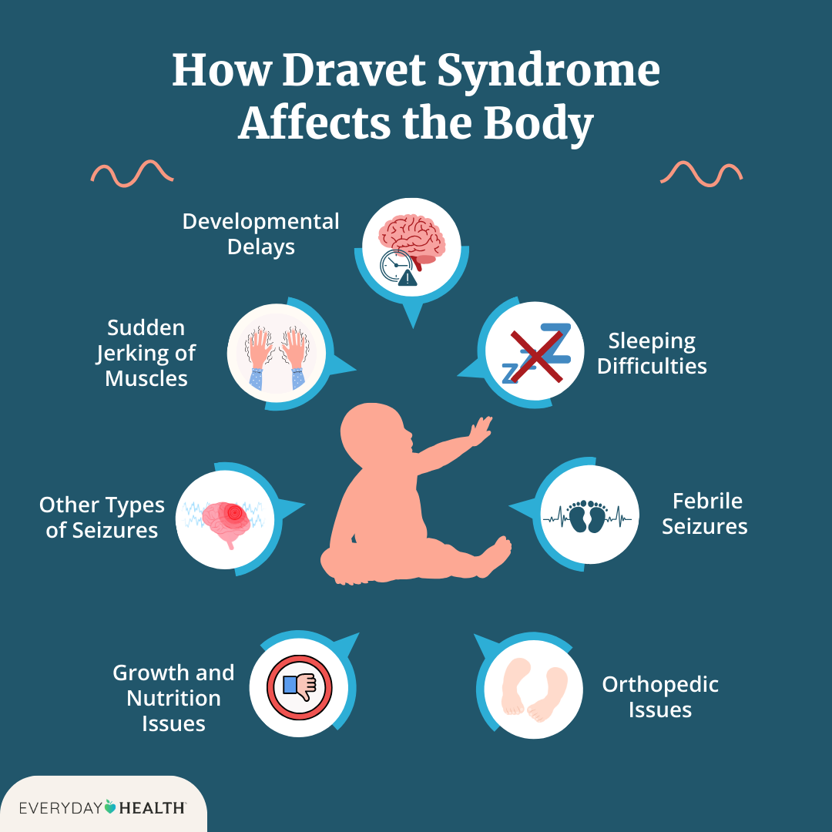

Slide 225
Diagnosis and Investigations
Clinical Hx
Detailed seizure description: onset, duration, triggers, postictal state
Developmental Hx: Delays, regression
Family Hx: Genetic predisposition
Perinatal Hx: birth complications, infections
Investigations
EEG: essential for classification e.g 3Hz spike wave in absence epilepsy
MRI brain 🧠: structural abnormalities e.g cortical dysplasia, tumors
Metabolic screening: hypoglycemia, aminoacidopathies
Genetic testing: SCN1A. Mutations in Dravet syndrome

Slide 226
Management of Paediatric Epilepsy
Acute seizure management
ABC approach: airways, breathing 🫁 and circulation
Benzodiazepines e.g lorazepam, diazepam for status epilepticus
Second line agents like phenytoin, levetiracetam
Long term management
Anti epileptic drugs
Valproate: generalized epilepsy
Carbamazepine: focal epilepsy
Ethosuximide: absence epilepsy
Ketogenic diet: useful in drug resistant epilepsy
Surgical option: Hemispherectomy, vagus nerve stimulation

Slide 227
Prognosis and Complications
Good prognosis in idiopathic epilepsy e.g childhood absence epilepsy
Poor prognosis in syndromic epilepsy like Lennox - Gastaut syndrome
Neurodevelopmental impact: Cognitive impairment, behavioral issues
Sudden unexpected death in epilepsy (SUDEP): Rare but serious risk

Slide 228
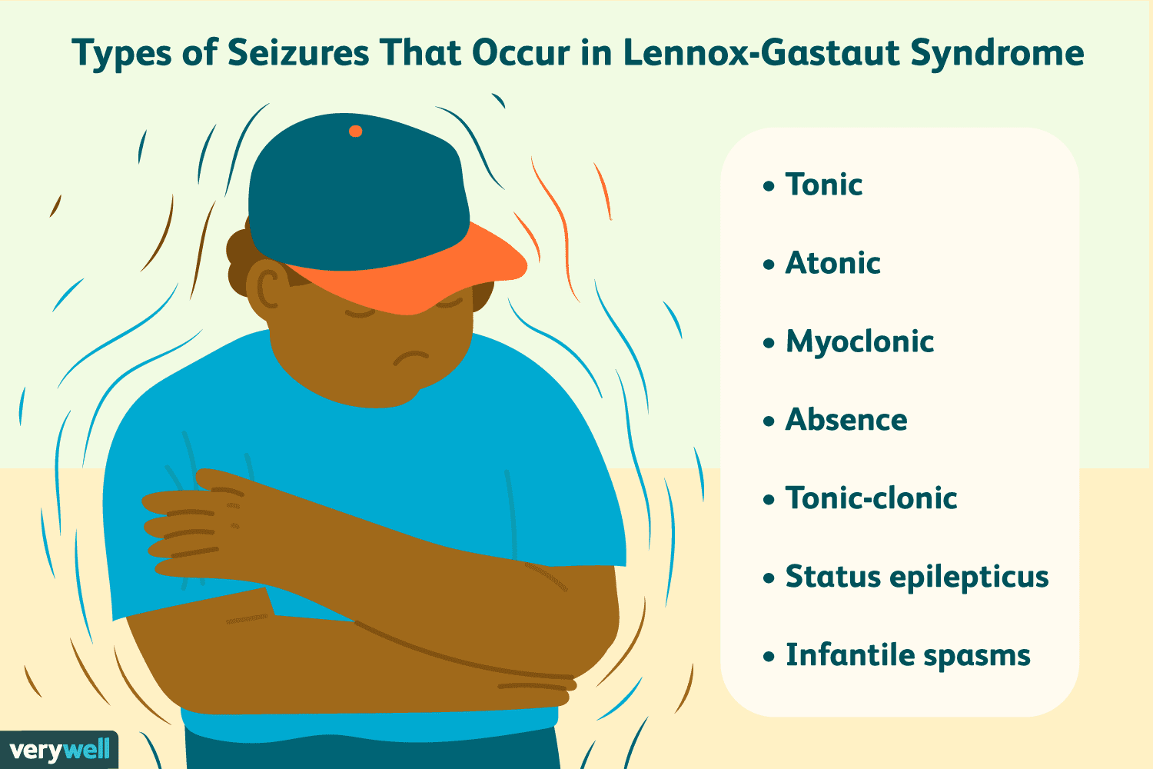

Slide 229
Station 18: Developmental Milestones
Introduction
Gross motor
Fine motor
Language
Social/ Cognitive

Slide 230
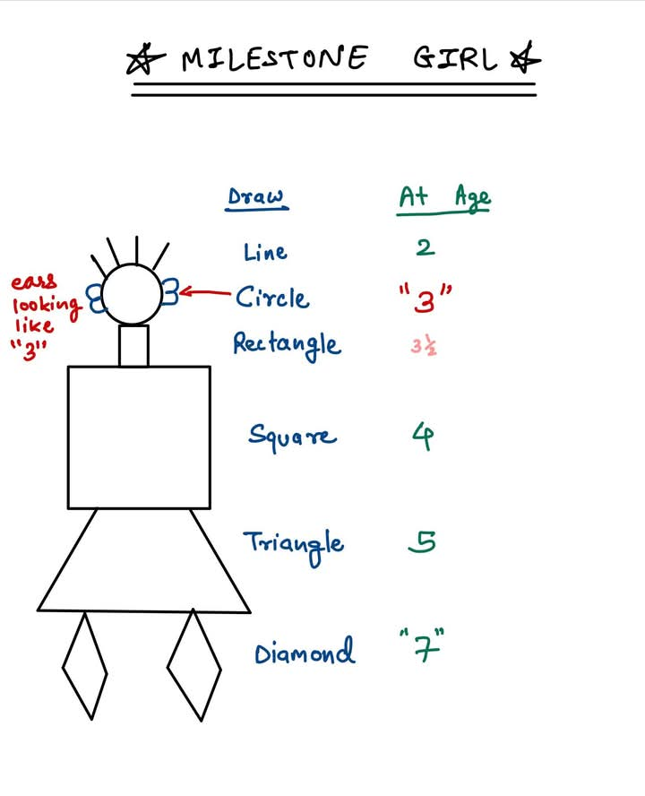

Slide 231
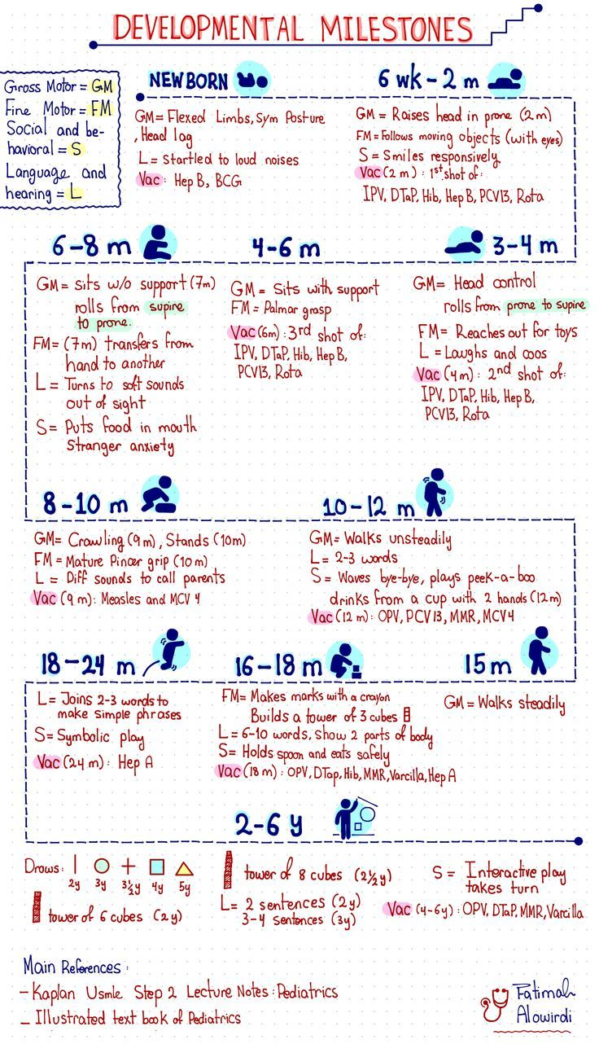

Slide 232
Introduction
They are age specific functional skills
That children typically achieve as they grow 🪴
The milestones are categorized into 4 domains:
Gross motor
Fine motor
Language
Social/Cognitive

Slide 233
Gross motor milestones
New born: primitive reflexes (Moro, grasp, rooting)
One month: LIFTs head momentarily when prone
Two months: HOLDs head up briefly, turns head side to side
4 months: ROLLs from front to back, supports weight on forearms
6 months: Rolls both ways, SITs with support
9 months CRAWLs, pulls to stand
12 months: WALKs with support, stands alone
18 months: Walks without support, Climbs stairs with support
2 years: RUNs,kicks a ball 🏀, Jumps 🦘
3 years: CLIMBs upstairs with alternating feet, rides a TRICYCLE

Slide 234
Gross motor milestones
4 years: HOPS on one foot, catches a ball
At 5 years: SKIPs, balances one one foot for 10s

Slide 235
Fine motor milestones
Newborn: Grasp reflex
2 months: hold objects briefly
4 months: reaches for objects, brings hands to midline
6 months: Transfers objects from one hand to another
9 months: begin thumb and index finger 👌
12 months: refined pincer grasp, stacks 2 blocks
18 months: Scribles, stacks 3 blocks
2 years: turns pages, stacks 6 blocks
3 years: copies a cycle, uses utensils
4 years: copies a square ⬛ ⬜, cuts with scissors
5 years: Copes a triangle 📐 ▶️, ties shoelaces

Slide 236
Language milestones
Newborn: Startles to sound
2 months: Coos
4 months: Laughs, vocalizes responsively
6 months: Babbles consonants
9 months: Says mama/dada nonspecifically
12 months: Says 1-2 words with meaning
18 months: says 10-20 words
2 years: Two word phrases, 50+ words
3 years: 3 word sentences, knows name and age
4 years: Tells stories, understands complex commands
5 years: Fluent speech, understands the concepts

Slide 237
Social/ Cognitive Milestones
New born: Fixates on faces
2 months: Social smile
4 months: Laughs, enjoys play
6 Months: Stranger anxiety begins
9 Months: Waves "Bye-bye" plays peek-a-boo
12 Months: Imitates gestures, shows preferences
18 Months: Parallel play, points 👉 to objects
2 years: Engages in pretend play, follows simple rules
3 years: Cooperative play, understands GENDER
4 years: Has IMAGINARY friends, follows group rules
5 years: understands FAIRNESS, follows complex instructions

Slide 238
Red Flags🌡️
Early identification of delays is critical for intervention:
No social smile by 2 months: Possible visual impairment or Autism
No babbling by 6 months; Consider hearing impairment
No sitting by 9 months: Possible neuromuscular disorder
No walking by 18 months: Consider cerebral palsy
No meaningful words by 2 years: Possible speech delay or autism
Persistent primitive reflexes beyond 6 months: Consider neurological disorder

Slide 239
Assessment Tools
Denver Developmental Screening Test (DDST)
Ages and Stages Questionnaire (ASQ)
Barley Scales of Infant Development
N-CHAT ( Modified checklist for autism in toddlers)

Slide 240
Station 19: Primitive Reflexes
Introduction
Classification of primitive reflexes
Key primitive reflexes

Slide 241
Introduction
They are involuntary motor responses
Originating from the CNS
They are present in newborns
But typically integrate as brain matures
They serve as survival functions
They provide insight into neurological development
Their persistent beyond a expected ages may indicate neurological impairment.

Slide 242
Classification of Primitive Reflexes
Primitive reflexes can be categorized based on their origin within the CNS
Spinal reflexes: Flexor withdrawal, extensor Thrust, Crossed Extension
Brainstem reflexes: Tonic neck reflexes, positive supportive reaction
Midbrain reflexes: Labyrinthine righting reflex, optical righting reflex
Cortical reflexes: equilibrium reaction

Slide 243
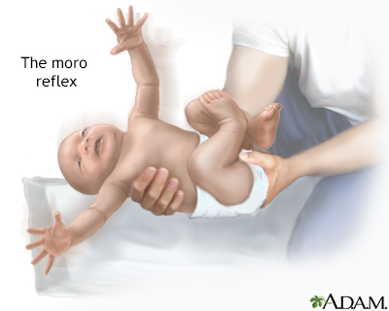

Slide 244
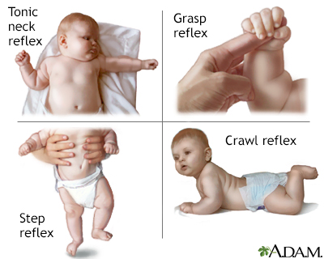

Slide 245
Moro reflex (startle or parachute reflex)
Stimulus: Sudden loss of support or loud noise
Response: symmetric abduction and extension of arms, followed by adduction
Integration age: 4-6 months
Clinical significance: Persistence may indicate cerebral palsy or brain injury

Slide 247
Palmar grasp reflex
Stimulus: Pressure on the palm
Response: Flexion of fingers, grasping the object.
Integration age: 5 to 6 months
Clinical significance: Persistent beyond infancy may indicate pyramidal tract dysfunction

Slide 248
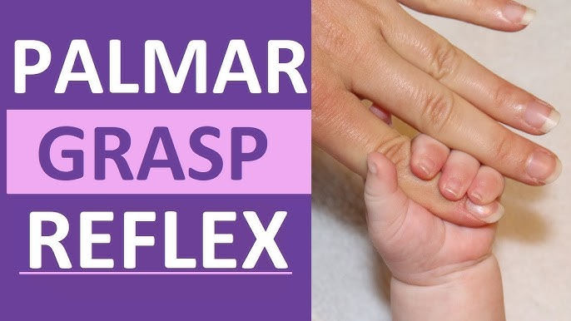

Slide 249
Plantar grasp reflex
Stimulus: Pressure on the sore of the foot
Response: Toe Flexion
Integration: 9-12 months
Clinical significance: Persistence may indicate corticospinal tract dysfunction

Slide 250
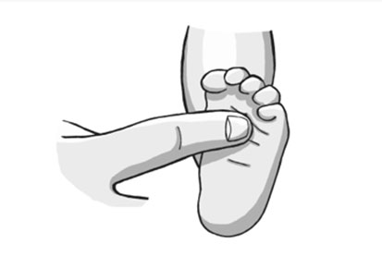

Slide 251
Rooting reflex
Stimulus: stroking the cheek
Response: Turning head towards the stimulus and opening mouth
Integration age: 3-4 months
Clinical significance: absence may indicate CNS depression

Slide 253
Sucking reflex
Stimulus: Object placed in the mouth 👄
Response: rhythmic suckling
Integration age: 2-4 months
Clinical significance: weak or absent reflex may indicate prematurity or neurological dysfunction

Slide 254
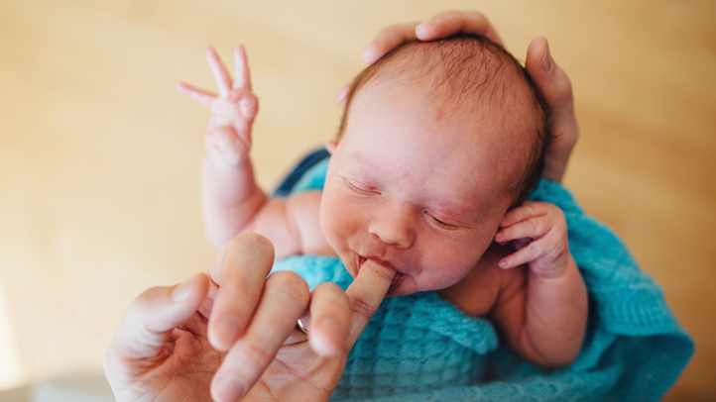

Slide 255
Asymmetric Tonic Neck Reflex (Fencer's Reflex)
Stimulus: Turning the head to one side
Response: Extension of the limbs on the face side, Flexion on the opposite side
Integration age: 4-6 months
Clinical significance: Persistence may interfere with motor development and indicate cerebral Palsy

Slide 256
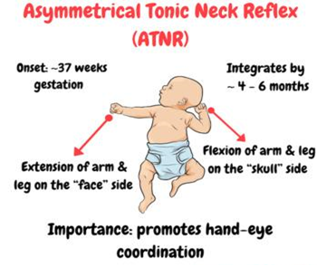

Slide 257
Symmetric Tonic Neck Reflex(Crawling reflex, Bauer crawling reflex)
Stimulus: Neck flexion or extension
Neck flexion=arm flexion and leg extension; Neck extension= arm extension and leg Flexion
Integration age: 8 to 12 months
Clinical significance: Persistence may affect crawling and postural control

Slide 258
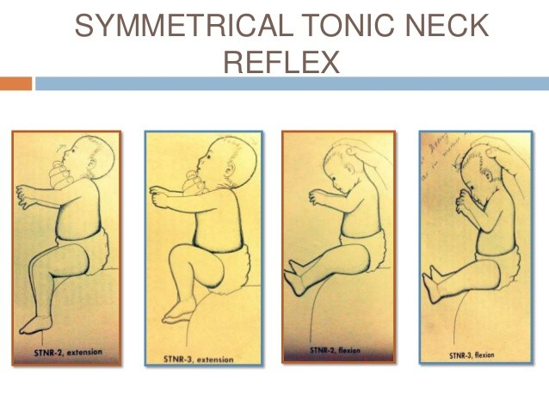

Slide 259
Babinski reflex
Stimulus: stroking the lateral sore of the foot 🦶
Response: Dorsiflexion of the big toe and fanning of the other toes
Integration age: 12-24 months
Clinical significance: Persistence beyond 2 years suggests corticospinal tract dysfunction

Slide 260
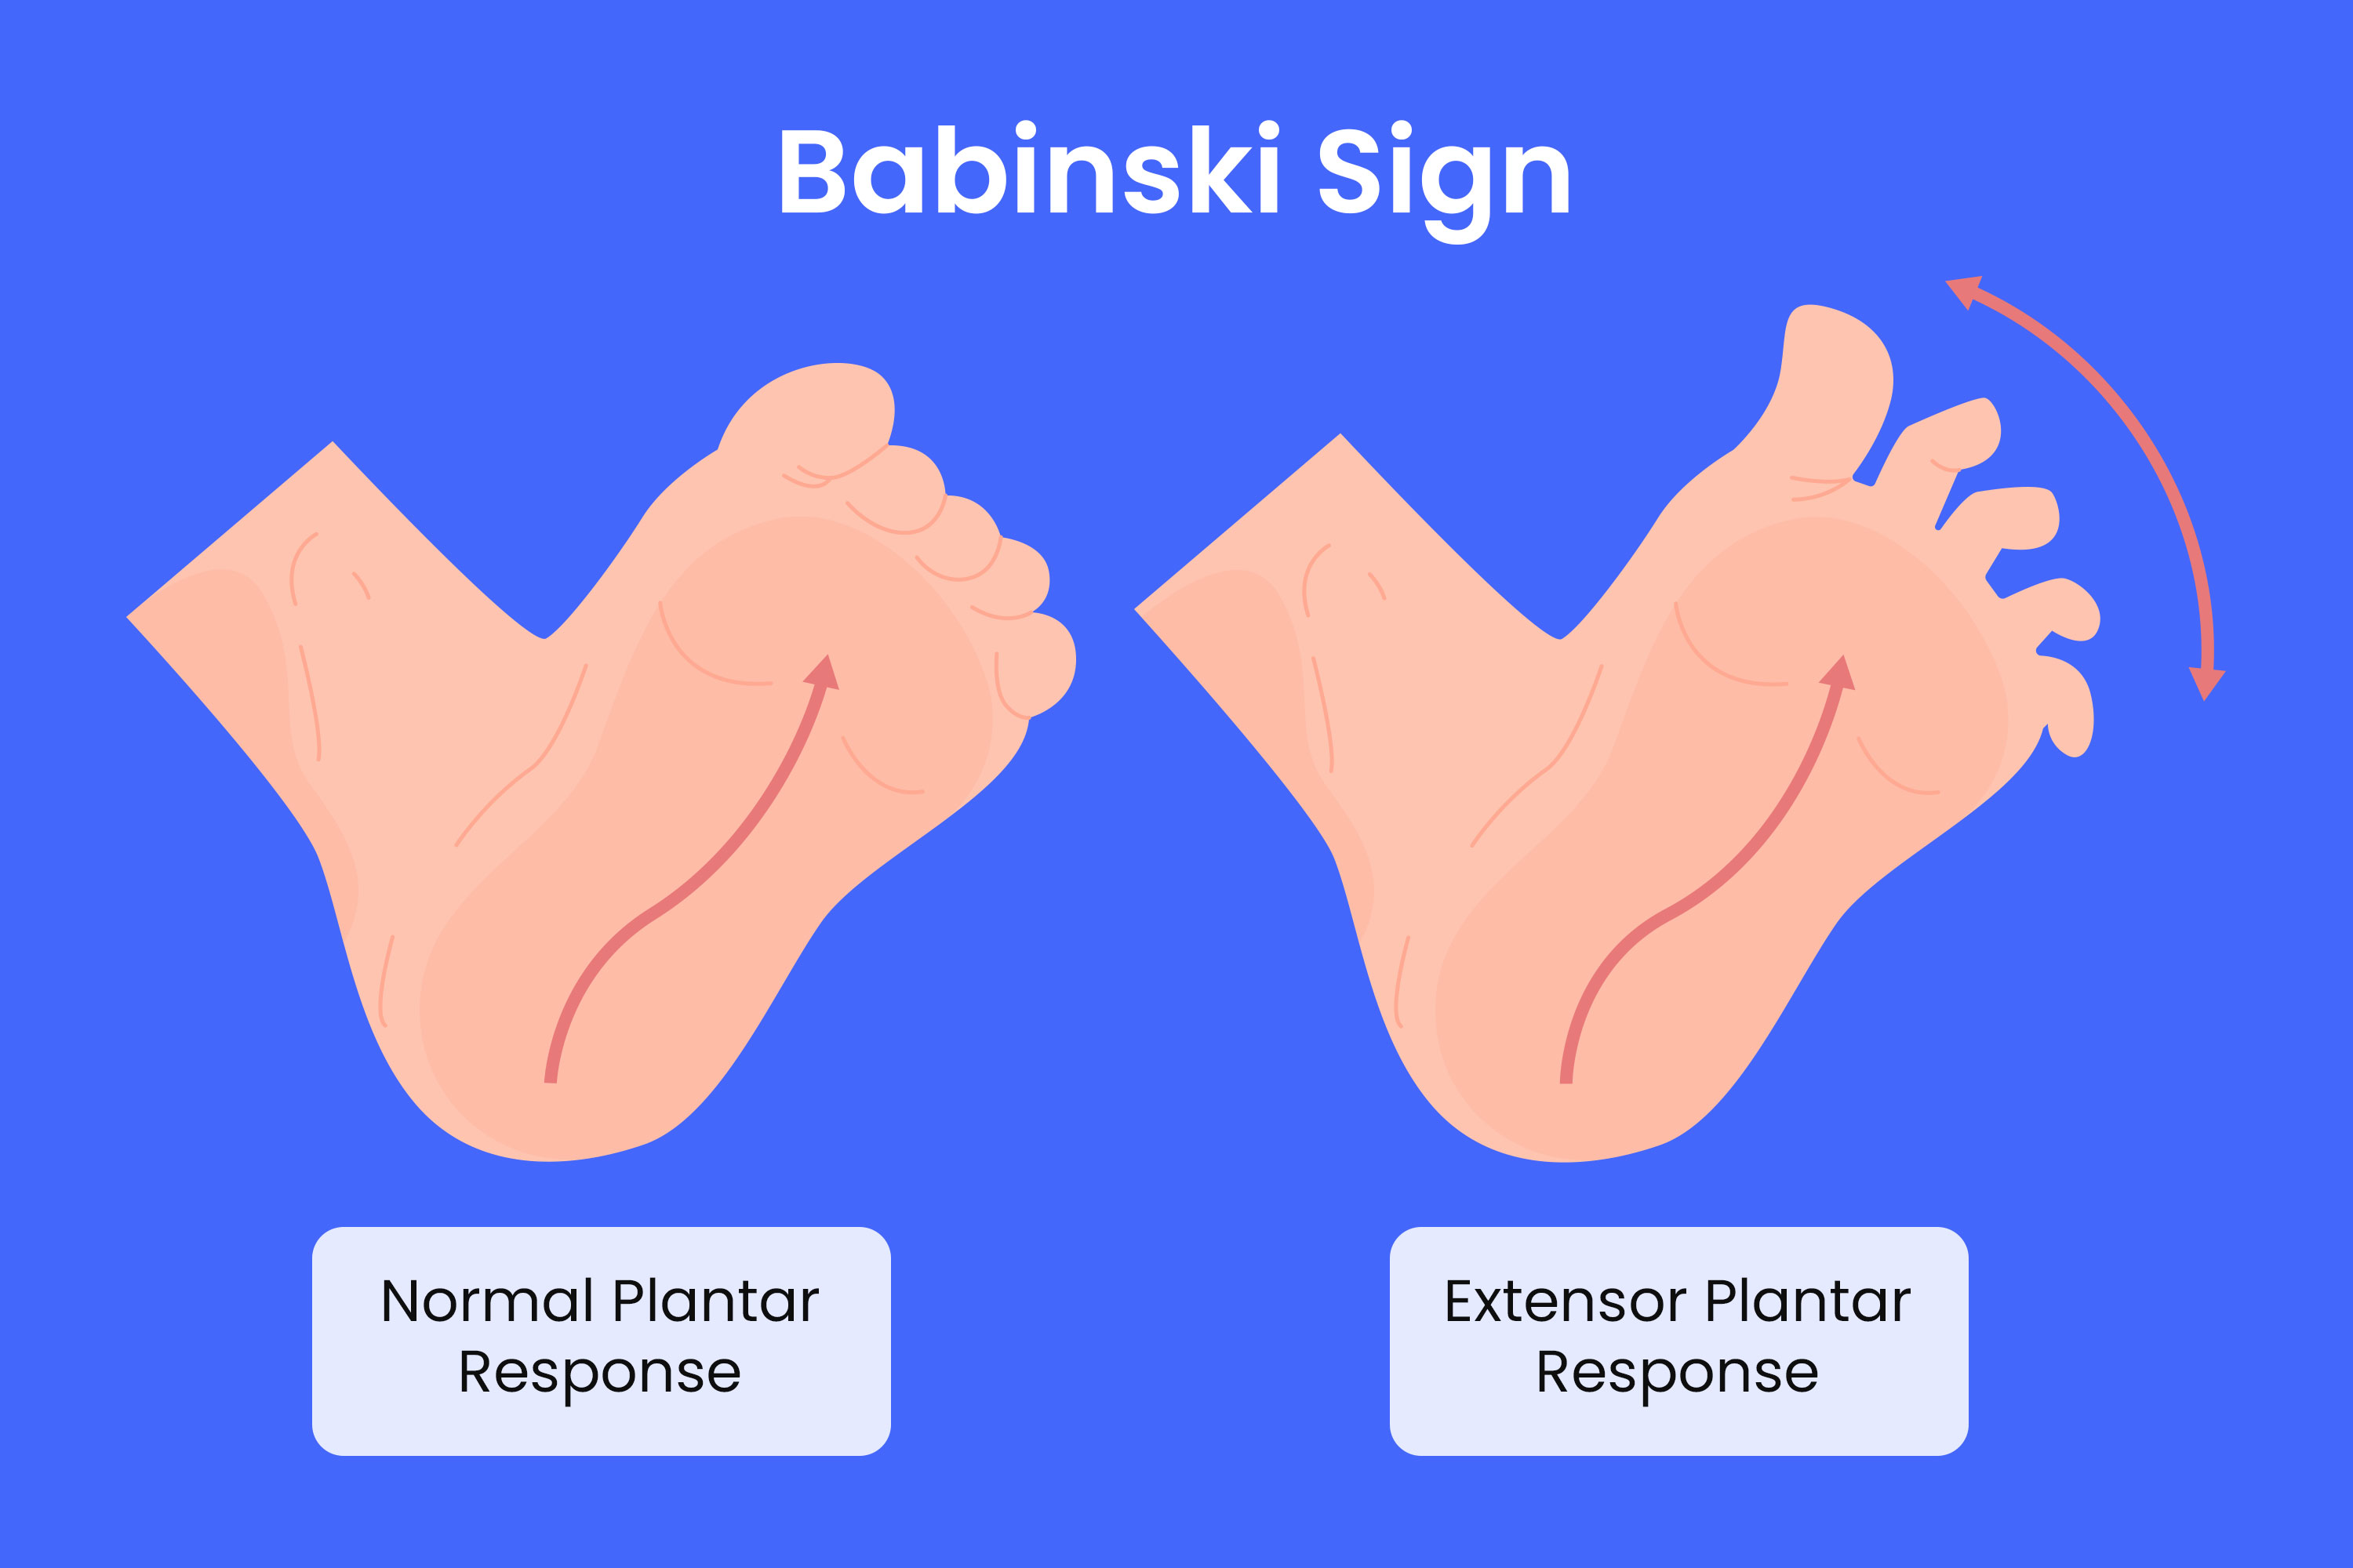

Slide 261
Spinal Galant reflex
Stimulus: Stroking the paravertebral area
Response: Lateral flexion of the trunk towards the stimulus
Integration age: 4-6 months
Clinical significance: Persistence may indicate spinal cord pathology

Slide 262
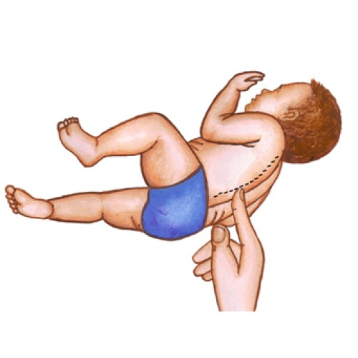

Slide 263
Stepping Reflex
Stimulus: holding the infant upright with their feet touching a surface
Response: alternating stepping movements
Integration age: 2 months
Clinical significance: Absence may indicate neuromuscular dysfunction

Slide 264
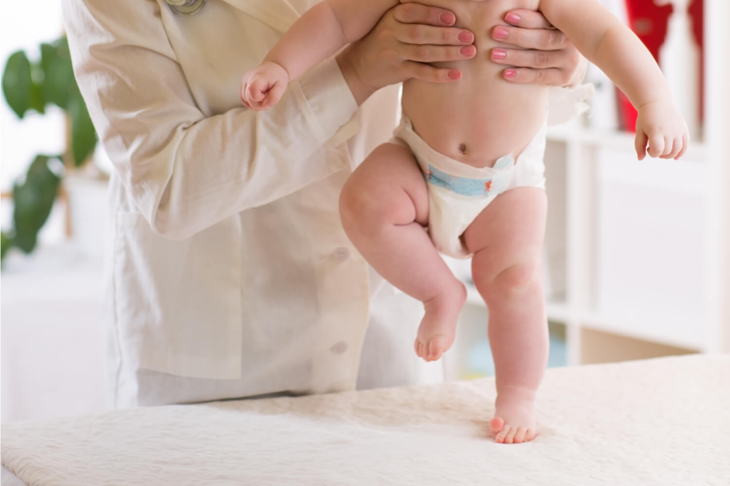

Slide 265
Clinical relevance
Neurological assessment: Primitive Reflexes are crucial in paediatric neurological evaluations
Developmental milestones: Their integration is necessary for voluntary motor control
Pathological Persistence: Reflex retention beyond expected ages may indicate cerebral Palsy, brain 🧠 injury 🤕 or developmental delay

Slide 266
Station 20: Neonatal Sepsis
Introduction
Classification of Neonatal Sepsis
Pathophysiology
Clinical features
Investigations
Management
Prevention strategies
Complications

Slide 267
Introduction
It is life threatening
Systemic condition
Occurs in newborns within the first 28 days of life 🧬
Results from an overwhelming immune response to bacterial, viral or fungal pathogens
Leading to multi-organ dysfunction
Early recognition and prompt management are crucial to improving outcomes

Slide 268
SIRS, Sepsis, Bacteremia and Septicemia
Positive SIRS criteria plus a confirmed infection with Multiple Organ Dysfunction is equal to sepsis
Bacteria is the presence of microbes in the bloodstream without causing symptoms
Septicemia is the presence of microbes in the bloodstream including their toxins leading to systemic inflammation, with signs of organ dysfunction

Slide 269
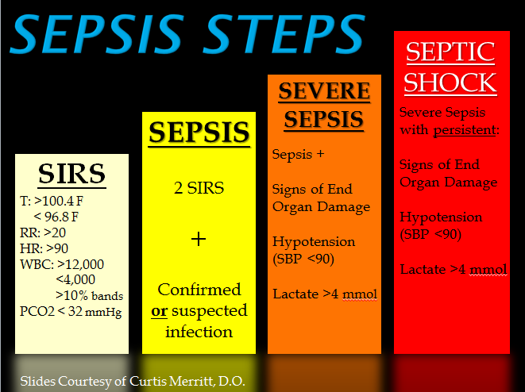

Slide 270
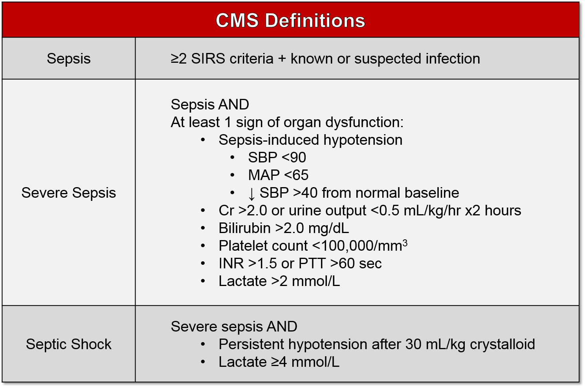

Slide 271
SOFA Score
It's purpose is to check if there is organ dysfunction
It's purpose is to grade if it's severe sepsis or just sepsis
It checks for pathological chenges in vital organs like the Liver, Brain, Lungs, Heart
It assesses for Multiple Organ Damage

Slide 272
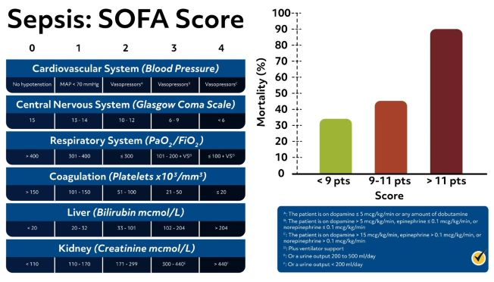

Slide 273
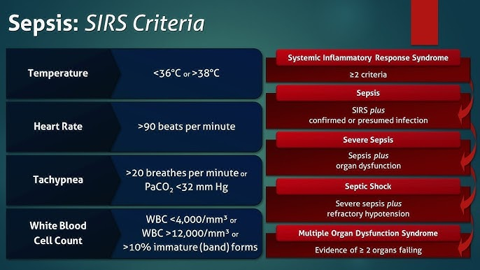

Slide 274
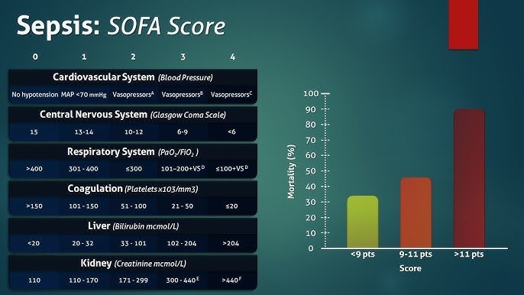

Slide 275
Sepsis Vs Septicemia
Sepsis
Septicemia
Systematic inflammatory response
Triggered by an Infection
Anywhere in the body
The immune system over reacts
Leading to wide spread inflammation, blood clotting and potential organ failure.
Sepsis can result from infection in the lungs 🫁, urinary tract, skin or abdomen
Also called blood poisoning
It is a blood stream infection
Caused by bacteria or other pathogens
It is a subset of sepsis
Meaning that septicemia can lead to sepsis
If the infection spreads and triggers an extreme immune response

Slide 276
Septicemia vs Bacteremia
Septicemia
Bacteremia
Septicemia is a more serious condition
Where bacteria multiply in the blood stream
Triggering a systematic inflammatory response
It can lead to sepsis,organ dysfunction and potentially Life threatening complications
Bacteremia is the presence of bacteria in the blood
Without necessarily causing symptoms
It can occur transiently after a dental procedure
The immune system often clears without intervention

Slide 277
Immune Response vs Extreme Immune Response
I.R
Extreme I.R
Mild fever
Localized inflammation
Fatigue
Increased white blood cell activity
Helps eliminate infections without causing significant harm
Manifest as hypersensitivity reaction
Like anaphylaxis
Autoimmune attacks
Cytokine storm
Leading to wide spread inflammation
Multi-organ failure
Severe hypotension and respiratory distress

Slide 278
Sepsis vs Septic shock
Sepsis
Septic shock
Life threatening condition where the body's immune system overreacts to an Infection
Which can lead to organ dysfunction
Sx: Fever, Rapid heart rate, Confusion And dificulty breathing
It is the most severe stage of sepsis
Characterized by dangerously low blood pressure
That does not respond to IV fluids
This prevents vital organs from receiving oxygen
Increasing the risk of multi-organ failure and death ☠️

Slide 279
Classification of Neonatal Sepsis
Classified based on timing of onset.
Early onset sepsis (EOS): Less or equal to 72 hours of life. The source is vertical transmission from the mother ( Intrauterine or peripartum). Common pathogens are group B streptococcus (GBS), Escherichia coli, Listeria monocytogenes. Risk factors include prematurity, prolonged rupture of membranes that is greater than 18 hours, maternal chorioamnionitis, maternal GBS colonization
Late onset sepsis (LOS)>72 hours of life. Postnatal environmental exposure. Hospital acquired or community acquired. Common pathogens include coagulase negative streptococci, staphylococcus aureus, klebsiella spp, candida spp. The risk factors include prolonged hospitalization, invasive procedures -central line, mechanical ventilation, poor infection control

Slide 280
Pathophysiology
Neonatal immune systems are immature, leading to;
Reduced neutrophil function- impaired chemotaxis and phagocytosis
Deficient compliment system -Poor opsonization
Immature cytokines response, increasing susceptibility to overwhelming infection

Slide 281
Pathophysiology
Pathogens invade via :
Hematogenous spread: transplacental transmission
Aspiration of infected amniotic fluid (EOS)
Direct inoculation - umbilical catheters, mechanical ventilation in LOS

Slide 282
Clinical Features
Neonatal Sepsis presents with nonspecific symptoms, requiring a high index of suspicion
General: lethargy, poor feeding, temperature instability - hypothermia or fever
Respiratory: Tachypnea, grunting, apnea, respiratory distress
Cardiovascular: tachycardia, hypotension, poor perfusion, mottled skin
GIT: abdominal distension, vomiting, diarrhea,
Neurological: irritability, seizures, bulging fontanelle
Hematological: jaundice, petechiae - suggestive of disseminated intravascular coagulation.

Slide 283
Investigations - Laboratory tests
Full blood Count:
Leukocytosis or leukopenia
Increased immature to total neutrophil ratio greater than 0.2
Thrombocytopenia: less than 100,000/mm3
C- Reactive protein:CRP
Elevated greater than 10mg/L suggests inflammation but lacks specificity

Slide 284
Blood culture
Gold standard for diagnosis
Requires greater than or equal to 1 ml of blood for optimal yield
Lumbar Puncture-LP
Indicated if meningitis is suspected
CSF analysis: Elevated WBCs, low glucose, high protein

Slide 285
Urine culture 🧫
Essential in late onset sepsis
Suprapubic aspiration or catheterized specimen preferred
CXR
If respiratory distress is present rule out pneumonia

Slide 286
Management
Empirical Antibiotic Therapy
EOS: Ampicillin+Gentamicin covers GBS, Ecoli, listeria
LOS: Vancomycin+gentamicin covers CoNS, Staphylococcus aureus
Suspected meningitis: Cefotaxime+Ampicillin
Fungal sepsis: Amphotericin B or Fluconazole

Slide 287
Supportive care
Fluid resuscitation - 10-20 ml/kg IV bolus for hypotension
Oxygen therapy for respiratory distress
Inotropes: dopamine or dobutamine for septic shock
Glucose control prevent Hypoglycemia
Parenteral nutrition if enteral feeding is contraindicated

Slide 288
Prevention strategies
Maternal GBS screening and intrapartum abx prophylaxis
Strict hand hygiene in neonatal units
Early removal of invasive devices
Exclusive breast feeding to enhance immunity

Slide 289
Complications
Meningitis - hydrocephalus, cerebral Palsy
Septic shock - multi-organ failure
Disseminated intravascular coagulation - bleeding complication
Bronchopulmonary dysplasia in neonates

Slide 290
Conclusion
Neonatal Sepsis remains a major morbidity and mortality
Particularly in preterm infants
Early recognition, timely antibiotic therapy and supportive care are essential for improving survival rates

Slide 291
Station 21: Vaccinations
Introduction
Principals of Paediatric Vaccinations
Types of Vaccines
Routine paediatrics Immunization
Special considerations
Adverse effects and contraindications
Global and regional guidelines

Slide 292
Introduction
They are a cornerstone of preventive medicine

Slide 293
Principals of Paediatric Vaccinations
Active and passive immunization:
Active uses vaccines to stimulate immunity
Passive involves preformed antibodies
Herd immunity:
Protects vulnerable populations
By reducing disease transmission
Cold chain management:
Ensures vaccine potency
By maintaining proper storage temperatures

Slide 294
Types of Vaccines
Live attenuated
Mumps, Measles and Rubella
BCG
Rotavirus
Inactivated
Hepatitis A
IPV
Subunit, Recombinant, Conjugated
Hib
HPV
Pneumococcal
Toxoid: Diphtheria, Tetanus
mRNA Vaccines: COVID-19

Slide 295
Let's get it Right:
Live attenuated
Inactivated
Contain weakened form of the pathogen
That can replicate but can not cause disease 🪰 🦟
In healthy individuals
Induce a strong and long lasting immune response
Often requiring fewer doses
Not recommended for immunocompromised individuals
Requires strict cold chain ⛓️ storage
Contain killed or inactivated pathogen that cannot replicate
Produce a weaker immune response
That is why they require booster shots
More stble and easier to transport

Slide 296
Let's get it Right; Examples
Live atteVaccines Vaccine
Inactivated Vaccines
Measles, Mumps and Rubella
Rota virus
Small pox
Chicken pox
Yellow fever
Hepatitis A
Influenza (shot only)
Polio (shot only)
Rabies

Slide 297
Routine paediatrics Immunization schedule
Birth: BCG, hepatitis B, OPV 0
6 weeks: DPT-Hib-HepB, OPV, PCV, Rotavirus
10 weeks: DPT-HIB-HEPB, OPV, PCV
6 months: Influenza- Annual
9 months: Measles
12 months: MMR, Hep A
15 months: Varicella, PCV booster
18 months: DTP booster
4-6 years: DTP, IPV, MMR booster
Adolescence: HPV meningococcal, Tdap booster

Slide 298
Special considerations
Catch up vaccines for children who missed doses
High risk groups: immuncompromised children may need modified schedules
Travel vaccines: Yellow fever, typhoid, depending on destination

Slide 299
Adverse effects and contraindications
Common reactions: Fever, redness, swelling at injection site
Severe reaction: anaphylactic-Rare
Contraindications: Severe allergy to vaccine component, immunosuppression -For live vaccines

Slide 300
Global and regional guidelines
WHO and CDC provide standardized schedules
But national programs may vary

Slide 301
Station 22: Bronchiolitis
Introduction
Epidemiology and risk factors
Pathophysiology
Clinical features
Diagnosis
Management
Prevention
Complications
Introduction
It is a common lower respiratory tract infection
In infants and children
Primarily caused by RSV

Slide 302
Epidemiology and risk factors
Peak Age: Most common in infants under 2 years, 6 months
Seasonality: Occurs predominantly in winter and early spring 🌼
Risk factors:
Prematurity
Congenital heart disease
Chronic lung disease e.g bronchopulmonary dysplasia
Immunodeficiency
Exposure to tobacco smoke
Lack of breast feeding

Slide 303
Why 6 months to 2 years?
Airway anatomy
Immature immune system
High exposure risk
Limited respiratory reserve
RSV tropism

Slide 304
Airway Anatomy
At this age children have narrower bronchioles
Becuse of this, even mild inflammation will cause airway obstruction
The smaller the airwys, the greater the resistance to airflow when swollen

Slide 305
Immature Immune System
By 6 months, maternal Antibodies like IgG begin to wane
But the child's own adaptive immune system is still developing
Ths leaves a window 🪟 of vulnerability
Where they canot fight respiratory viruses 🦠 effectively

Slide 306
High Exposure risk
This age group is often starting day care
Interacting more with the siblings
This will increase the exposure to respiratory viruses 🦠 🦠
Plus they are more likely to put things in their mouth 👄
Faciitating viral transmission

Slide 307
Limited respiratory reserve
Young children have higher metabolic rate and oxygen demand
But their lungs 🫁 are still developing
So when bronchiolitis hits, they can decompasate faster than adults

Slide 308
RSV tropism
RSV is the most common cause of bronchiolitis
Has high affinity for lower respiratory tract epithelium of infants
It causes necrosis and sloughing of epithelial cells
Leading to mucus plugging and air trapping
Problematic in small collapsible airways

Slide 309
Pathophysiology
Viral invasion leads to inflammation, edema and increased mucus production in the bronchioles
Airway obstruction causes hyperinflation, atelectasis and ventilation perfusion mismatch
Cytokine-mediated immune response contributes to airways narrowing and respiratory distress

Slide 310
Clinical features
Early symptoms: Rhinorrhea, cough, low-grade fever
Progressive symptoms:
Tachypnea, dyspnea, nasal flaring
Wheezing, crackles on auscultation
Poor feeding, lethargy,
Apneic episode especially in premature infants
Severe disease:
Cyanosis, grunting, severe respiratory distress
Hypoxia requiring oxygen therapy

Slide 311
Diagnosis
Clinical Diagnosis: Based on Hx and examination
Investigations: only in severe cases
Pulse oximetry: assess oxygen saturation
Nasopharyngeal swab: RSV rapid test not routinely needed
CXR: only if atypical presentation e.g lobar consolidation
Blood gas analysis: If respiratory failure is is suspected

Slide 312
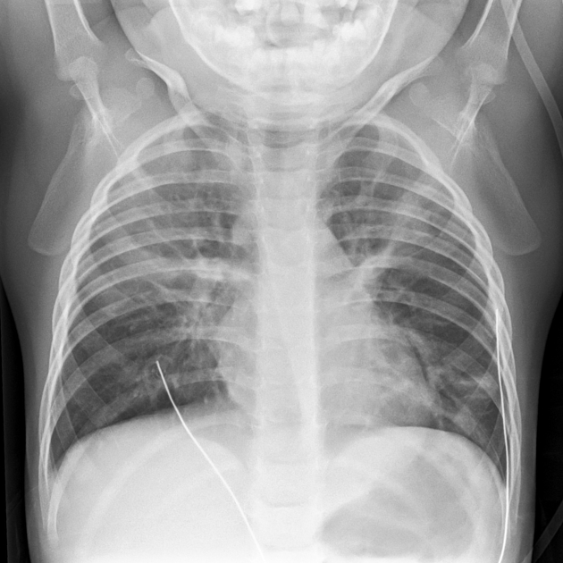

Slide 313
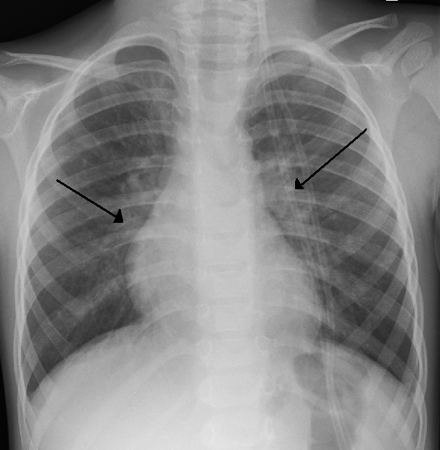

Slide 314
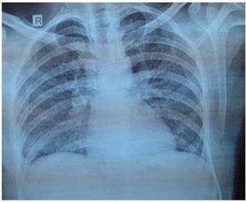

Slide 315
Management
Supportive care: Mainstay of treatment
oxygen therapy: if SpO2 < 92%
Hydration: IV fluids or nasal gastric feeds if poor oral intake
Suction: helps clear nasal secretions
Minimal handling: reduces distress and oxygen demand

Slide 316
Medication - Limited role
Nebulized hypertonic saline: may improve improve mucus clearance
Bronchodilators-Salbutamol: not routinely recommended
Corticosteroids: no proven benefits
Antibiotics: only if secondary to bacterial infections suspected

Slide 317
Prevention
Hand hygiene: reduce viral transmission
Palivizumab(RSV prophylaxis): for high risk infants e.g preterm, congenital heart disease)
Breast feeding: provides passive immunity

Slide 318
Complications
Respiratory failure
Secondary bacterial pneumonia
Recurrent wheezing/asthma later in life 🧬

Slide 319
Station 23: Croup
Introduction
Epidemiology and risk factors
Etiology and pathophysiology
Clinical features
Diagnosis
Management
Differentials
Prevention

Slide 320
Introduction
Also called laryngotracheobronchitis
It's a common viral uRTI
Affects children
Primarily affects the; larynx, trachea and bronchi

Slide 321
Epidemiology and risk factors
Age group: Most common in children aged 6 months to 3 years
Seasonality: peak in autumn 🍁 and winter ❄️🥶
Risk factors:
Previous episodes of severe croup
Prematurity
Congenital airway abnormalities
Exposure to tobacco smoke

Slide 322
Etiology and pathophysiology
Causative viruses 🦠🦠
Parainfluenza virus - most common
Influenza A and B
RSV
Adenovirus
Rhinovirus
Pathophysiology
Viral infection leads to inflammation and edema of upper airway
Narrowing of subglottic region causes stridor and respiratory distress
Mucus production contributes to airway obstruction

Slide 323
Clinical features
Classic symptoms
Barking cough (seal-like)
Stridor (high pitched inspiratory noise)
Hoarse voice
Low grade fever
Symptoms worsen at night 🌉 🌉
Severe disease 🪰
Respiratory distress
Cyanosis
Lethargy or agitation

Slide 324
Diagnosis
Clinical diagnosis: Based on history and examination
Westley Croup Score (assess severity):
Mild (0-2): Barking cough, no stridor at rest
Moderate (3-5): Stridor at rest, mild respiratory distress
Severe (6-11): Marked respiratory distress, hypoxia
Impending respiratory failure (12-17): Cyanosis, poor air entry

Slide 325


Slide 326


Slide 327


Slide 328

Croup Mnemonic

Slide 329
Management
Mild Croup
Supportive care: Hydration, parental reassurance
Single dose of oral dexamethasone (0.15mg/kg)
Moderate -severe Croup
Dexamethasone (0.6mg/kg) or nebulized budesonide
Nebulized epinephrine for severe cases
Oxygen therapy If hypoxic
Minimal handling to reduce distress

Slide 330
Impending respiratory failure
Urgent airway management
Intubation if severe obstruction
ICU admission for monitoring

Slide 331
DDx
Epiglottitis
High fever
Drooping
Toxic appearance
Bacterial tracheitis
High fever 🥵
Purulent secretions
Foreign body aspiration
Sudden onset
Asymmetric breath sounds
Anaphylactixis
Rapid onset
Urticaria
Hypotension

Slide 332
Prevention
Hand hygiene to reduce viral transmission
Influenza Vaccination to lower the risk
Avoid exposure to tobacco smoke

Slide 333
Station 24: Foreign Body Aspiration
Introduction
Epidemiology and risk factors
Pathophysiology
Clinical features
Dx
Mx
Complications
Prevention
FBA it is a potentially Life threatening emergency 🦺
That occurs when a foreign body is inhaled into the airway
Leading to obstruction, RD and complications

Slide 334
Epidemiology and risk factors
Peak Age: most common in children aged 1-3 years
High risk groups:
Infants and toddlers - exploratory behavior.
Neurological impaired individuals: poor swallowing coordination
Elderly patients: dysphagia, altered consciousness
Common aspirated objects
Organic: Nuts, seeds, food particles
Inorganic: Coins, beads, small toys

Slide 335
Pathophysiology
Obstruction mechanism
Complete obstruction: acute respiratory failure, cyanosis, sudden collapse
Partial obstruction: Persistent cough, wheezing, recurrent pneumonia
Location of foreign body:
Larynx: Stridor, hoarseness, aphonia
Trachea: biphasic stridor, respiratory distress
Bronchi: Unilateral wheezing, decreased Breath sounds 🫁

Slide 336
Clinical features
Acute presentation
Delayed presentation
Sudden choking episode
Coughing, gagging, stridor
Respiratory distress, Cyanosis
Recurrent pneumonia
Chronic cough 🥶, wheezing
Hemoptysis due to erosion

Slide 337
Diagnosis
History: Witnessed choking event, sudden onset symptoms
Physical Examination:
Asymmetric breath sounds
Wheezing localized to one lung
Stridor if upper airway involvement
Investigations
CXR: may show radio-opaque object, air trapping, atelectasis
CT Scan: if diagnosis is unclear
Bronchoscopy: Gold standard for diagnosis and removal

Slide 338


Slide 339


Slide 340
Management
Emergency management ( complete obstruction)
Conscious patient: encourage coughing
Infants less than 1 year : Back blows and and chest thrust 5 each
Children greater than 1 year and adults: Heimlich maneuver - abdominal thrusts
Unconscious patients: Basic life 🧬 support, CRP if needed

Slide 341


Slide 342
Definitive Treatment
Complications
Rigid Bronchoscopy (children)
Flexible bronchoscopy for smaller objects or diagnostic purposes
Surgical intervention if bronchoscopy fails.
Airway obstruction
Aspiration pneumonia
Bronchiectasis
Tracheal stenosis
Pulmonary abscess

Slide 343
Prevention
Parental education: avoid small objects near infants
Supervised feeding: Avoid aspiration of food 🥝
Proper swallowing technique: for high risk individuals

Slide 344
Station 25: Neonatal Jaundice
Introduction
Pathophysiology
Types of neonatal jaundice
Clinical features
Diagnosis
Management
Complications
Prevention
Common condition in newborn
Charcterized by yellow discoloration of the skin and sclera
Due to elevated bilirubin levels

Slide 345
Pathophysiology
Increased bilirubin production: Due to high fetal turn over
Immature liver conjugation: Neonatal liver has UDP-glucuronosyltrabsferase activity
Enterohepatic circulation: Delayed stooling increases bilirubin reabsorption

Slide 346
Types of Neonatal Jaundice
Physiological Jaundice: Benign, peaks at day 3 to 5
Pathological Jaundice: appears within 24h or lasts greater than 2 weeks
Breast feeding jaundice: Due to inadequate intake
Breast milk 🍼 jaundice: Due to inhibitory substances in breast milk 🥛
Hemolytic jaundice: Due to ABO /Rh incompatibility, G6PD deficiency
Obstructive jaundice: biliary atresia choledochal cyst
Cholidoch - Refers to the common bile duct

Slide 347


Slide 348


Slide 349


Slide 350


Slide 351


Slide 352


Slide 353
Let's get it Right 👍▶️
Breastfeeding Jaundice
Breast milk Jaundice
3 to 5 days of life 🧬
Inadequate milk intake
Reduced enteral intake - Delayed meconium passage
Increased enterohepatic circulation
Dehydration may exacerbate the condition
Early onset jaundice
Signs of suboptimal feeding: weight loss greater than 10%, few wet diapers
Encourage frequent feeding ( 8 to 12 times a day)
Begin after 5 to 7 days
Peaks at 2-3 weeks
Substances in the milk 🥛 that inhibits bilirubin conjugation
Beta glucuronidase, pregnane-3a20B-diol
Inhibits UDP glucuronisyl transferase
Increased deconjugation of bilirubin in the gut
Persistent jaundice with no signs of illness

Slide 354
Clinical Features
Yellow skin and sclera
Poor feeding, lethargy
High pitched cry
Hypotonia or hypertonia
Signs of Kernicterus: Severe cases: opisthotonos, seizures, hearing loss

Slide 355


Slide 356
Diagnosis
Serum Bilirubin levels: Total and direct
Blood group and coumbs test for hemolysis
G6PD assay: if suspected deficiency
Liver function test; for cholestasis
Abdominal ultrasound: Biliary obstruction

Slide 359
Management
Supportive and Phototherapy
Exchange Transfusion
Adequate feeding
Hydration
Phototherapy is the first line for unconjugated hyperbilirubinemia
Converts bilirubin to water soluble isomers
Indications are based on nomograms
Indicated in Severe cases bilirubin greater 20mg/dLor signs of Kernicterus
Remove excess bilirubin and antibodies

Slide 360
Complications
Prevention
Kernicterus (bilirubin encephalopathy)
Neurodevelopmental delay
Sensorineural hearing loss
Early feeding initiations
Screening high risk neonates
Monitoring bilirubin levels in preterm infants

Slide 361
Station 26: CXR Signs
Introduction
Cardiac Signs
Pulmonary Signs
Miscellaneous signs
CXR findings in paediatrics are critical for diagnosing congenital and acquired conditions
Here is a structured breakdown of important radiological signs

Slide 362
Cardiac Signs
Boot shaped heart:
Seen in tetralogy of Fallot
Due to right ventricular hypertrophy
Egg-on-a-string:
Classic for transposition of great arteries (TGA)
Reflecting narrow mediastinum
Snowman sign: Also called figure of 8
Total anomalous pulmonary venous return (TAPVR)
Showing enlarged supra-cardiac veins
Figure of 3 sign:
Coarctation of aorta
Due to pre-and post-stenotic dilation

Slide 363


Slide 364


Slide 365


Slide 366


Slide 367
Pulmonary Signs
Stipple sign:
Neonatal lung calcification
Seen in congenital infections (TORCH)
Steeple sign:
Croup, showing subglottic narrowing
Thumbprint sign:
Epiglottitis
Due to swollen epiglottitis
Ground glass opacity:
Neonatal respiratory distress syndrome (NRDS)
Due to surfactant deficiency
Hyperinflated lungs:
Bronchiolitis
Asthma
Meconium aspiration syndrome

Slide 368


Slide 369


Slide 370


Slide 371


Slide 372
Miscellaneous
Double bubble sign:
Duodenal atresia
Showing gas in stomach and duodenum
Sail sign:
Thymic shadow
Normal in infants
Spinnaker sign:
Pneumomediastinum
Showing bilateral thymic elevation
String of pearls:
Necrotizing Enterocolitis
Due to pneumatosis intestinalis

Slide 373


Slide 374


Slide 375


Slide 376


Slide 377
Station 27: Down syndrome
Contents
Introduction
Introduction
Genetics and pathophysiology
Clinical features
Diagnosis
Management
Supportive care
Prognosis and life expectancy
Down syndrome is also called trisomy 21
It is the most common chromosomal disorder
Characterized by intellectual disability, dysmorphic features, and multi system involvement

Slide 378
Genetics and pathophysiology
Chromosomal basis: Trisomy 21 results from nondisjunction (95%), Translocation (4%), or Mosaicism (1%)
Risk factors:
Advaned maternal age (>35 years)
Previously affected child
Robertsonian translocation carriers
Pathophysiology
Extra chromosome 21 leads to over expression of genes, affecting neurological, cardiac and immune function.
Amyloid precursor proteins (APP) over expression leading to onset Alzheimer's disease 🪰 🦟

Slide 379
Clinical features
Dysmorphic features:
Facial: Flat nasal bridge, epicathal folds, up slanting palpebral fissures
Cranial: Brachycephalic, small ears, single transverse palmar crease
Musculoskeletal: Hypotonia, short stature, sandal gap toes.
Neurological and cognitive:
Intellectual disability: IQ 30-70
Delayed milestones: Speech and motor skills
Early onset Alzheimer's Disease 🪰🦟 by the age of 40

Slide 380
Clinical features
CVS:
Congnital heart defects (50%)
Atrioventricular septal defects (AVSD): most common
Ventricular septal defect (VSD)
Patent ductus arteriosus (PDA)
GIT:
Duodenal atresia: double bubble sign
Hirschprungs disease 🪰🦟: aganglionic colon
Gastroesoohageal reflux disease: GERD

Slide 381
Clinical features
Hematological:
Leukemia risk (ALL, AML)
Transient myeloproliferative disorder (Neonatal leukemia-like condition)
Endocrine and metabolic:
Hypothyroidism (common)
Obesity risk
Diabetes mellitus (Higher prevalence)

Slide 382
Clinical Features
Immunological
Recurrent infections: otitis media, pneumonia
Autoimmune diseases: celiac disease, hypothyroidism

Slide 383
Diagnosis
Prenatal screening:
First trmester screening: Nuchal translucency (increased in down syndrome), Serum markers (reduced PAPP-A, increased Beta HCG)
Second trimester screening: Quad screen (reduced AFP, Reduced estradiol, increased beta HCG, increased Inhibin A)
Definitive diagnosis: 1. Amino centesis (Karyotyping), 2. Chorionic villus sampling (CVS)
Postnatal diagnosis:
Clinical features
Karyotyping (Confirmatory)

Slide 384


Slide 385


Slide 386
Management
Multidisciplinary Approach:
Cardiology: Early echocardiography for congenital defects
Endocrinology: Thyroid function tests
Neurology: Developmental assessment
Gastroenterology: Screening for celiac disease 🪰 🦟
Hematology: Monitor for leukemia.
Immunology: vaccination and infection prevention.

Slide 387
Management
Supportive care
Early Intervention programs: Speech, occupational therapy.
Special education:
Family counseling:

Slide 388
Prognosis and Life Expectancy
Life expectancy: approximately 60 years (improved with medical care)
Major causes of mortality:
Congenital heart diseases
Leukemia
Respiratory infections
Alzheimer's disease

Slide 389
Station 28: Approximate Weight
Content
Introduction
Introduction
Formula
Examples
Clinical application
Infants under 1 year
Examples
Alternative estimations
Baby Nelson's Formula is a quick method for estimating a child's weight based on age
Commonly used in paediatric emergencies
And drug dosing

Slide 390
Formula
For infants (<1 year)
Weight=(Age in months+9)/2
Examples:
A 3 months old infant:
Weight=(3+9)/2=6 Kg
A 6months old infant:
(6+9)/2=7.5kg

Slide 391
Formula
For children aged 1-6 years:
Weight (Kg)=( Age in years x 2)+8
For children aged 7 to 12 years:
Weight (kg)=( Age in years x3)+7

Slide 392
Examples
A 3 years old child:
Weight={3x2}+8=14kg
A 9 year old child:
Weight=(9×3)+7=34kg

Slide 393
Clinical application
Drug dosing: Used for weight based medication calculations
Fluid resuscitation: Guidelines IV fluid therapy in emergencies
Nutritional assessment: Helps estimate caloric needs

Slide 394
Station 29: Sickle Cell Disease
Contents
Introduction
Introduction
Genetics and pathophysiology
Clinical features
Diagnosis
Management
Complications
SCA is a genetic hemoglobinopathy resulting from a mutation in the beta globin gene
Leading to the production of hemoglobin S(HbS)
This condition is characterized by chronic hemolysis, vaso-Occlusive crisis and multi organ complications

Slide 395
Genetics and pathophysiology
Mutation: GAG is mutated to GTG, in beta globin gene on chromosome 11, because of this, Glutamic acid is replaced with valine at position 6.
HbS polymerization: Under hypoxic conditions, HbS undergoes polymerization, causing erythrocyte Sickling.
Membrane damage: Repeated Sickling damages the RBC membranes, leading to hemolysis and reduced RBC lifespan, 10 to 20 days vs 120 days for normal RBCs
VOC:
Sickled cells adhere to the endothelium
Triggering inflammation and microvascular occlusion
Resulting in Ischemia and infarction

Slide 396
Clinical features
Chronic manifestations
Acute complications

Slide 397
Chronic manifestations
Hemolytic anemia: Pallor, Jaundice, gallstones
Growth retardation: Delaed puberty due to chronic anemia
Functional asplenia:
Increased susceptibility to encapsulated organisms
Like streptococcus pneumoniae

Slide 398
Acute complications(Shav)
VOC
Acute chest syndrome
Splenic sequestration crisis
Aplastic crisis
Stroke risk
Infections

Slide 399
VOC
Severe pain in the bone, chest or abdomen
Dactylitis: Painful swelling of hands and feet in children
Priapism: Prolonged painful erection due to venous stasis
Acute chest syndrome:
Fever, hypoxia, pulmonary infiltrates
It is the leading cause of mortality in adults

Slide 400
Splenic sequestration crisis (in children):
Acute anemia, hypovolemia
Rapid splenic enlargement
Aplastic crisis:
Parvvirus B19: Infection halts erythropoiesis
Sudden drop in hemoglobin with low reticulocyte count

Slide 401
Stroke risk:
Ischemic stroke in children
Hemorrhagic stroke in adults
Infections:
Encapsulated bacteria: S. pneumoniae, H. influenza, N. meningitidis
Osteomyelitis: Often due to salmonella.

Slide 402
Diagnosis
Peripheral smear: sickled RBCs, Howell jolly bodies-asplenia
Hemoglobin electrophoresis: Confirms HbS
Sickling test: Sodium metabisulfite induces Sickling
FBC: normocytic anemia, reticulocytosis
LDH, indirect bilirubin: Markers of hemolysis
Transcranial Doppler (TCD): Assess stroke risk in children

Slide 403
Management
Chronic management
Acute crisis management

Slide 404
Acute cisis management
Pain crisis: Hydration, analgesia (NSAIDs, opioids)
Acute chest syndrome: Oxygen, antibiotics, exchange Transfusion
Splenic sequestration: Transfusion, splenectomy if recurrent
Aplastic crisis: Transfusion, monitor reticulocyte recovery

Slide 405
Chronic management
Hydroxyurea: increases HbF there by reducing Sickling.
Pain control: NSAIDs, opioids, for severe crisis
Blood transfusion: for severe anemia, stroke prevention
Infection prophylaxis: pneumococcal vaccine, penicillin prophylaxis
Bone marrow transplant: potential cure in select cases

Slide 406
Complications
Chronic pain: Repeated VOC
Cardiac failure: High output heart failure
Pulmonary hypertension: Chronic hypoxia - induced vascular remodeling
Gallstones: Chronic hemolysis leads to bilirubin stones
Retinopathy: Proliferative sickle cell retinopathy
Avascular necrosis: avascular necrosis of the head of femur 2° microvascular infarction
Chronic kidney disease: Sickling in renal medulla leads to nephropathy.

Slide 407
Station 30: Cyanotic&A cyanotic Heart Diseases
Contents
Introduction
Introduction
Key differences
Cyanotic heart diseases (Right to left shunt)
Acyanotic Heart diseases (Left to Right Shunt)
Congenital heart diseases are structural abnormalities
That are present at birth
Affects heart function and circulation
Classified as cyanotic and acyanotic Heart diseases
Based on their impact on oxygenation

Slide 408
Key Differences
Cyanotic HD
Acyanotic HD
Right to left shunting: By pass the 🫁
Causes hypoxia and cyanosis
Pulmonary blood flow is decreased in TOF
Pulmonary blood flow is increased in Transposition of great arteries.
Left to Right Shunting: Oxygenated blood circulates through the lungs 🫁
No significant hypoxia: patients remain pink
Pulmonary blood flow is increased leading to pulmonary congestion

Slide 409
Cyanotic
Acyanotic
Cyanosis, clubbing, polycythemia, dyspnea
Examples: TOF, TOGA, Tricuspid atresia
Heart failure symptoms: dyspnea, fatigue, pulmonary edema
Examples: VSD, ASD, PDA

Slide 410
CHD: TOF
TOF has four defects: Pulmonary Stenosis, Right ventricular hypertrophy, overriding aorta, Ventricular Septal Defects
Clinical features: Cyanosis, Tet spells ( Hypoxic episodes relieved by squatting), boot-shaped heart on XR.
Management: surgical repair - Blalock taussig shunt, complete repair

Slide 411
Cyanotic HD: TOGAs
Aorta rises from the right ventricle, pulmonary artery from the left ventricle-Parallel circulation.
Clinical features: Severe cyanosis at birth, egg on a string appearance on XR
Management: Prostaglandin E1 to maintain ductal patency, arterial switch surgery

Slide 412
Cyanotic HDs: Tricuspid atresia
Absence of Tricuspid valve: Hypoplastic right ventricle
Clinical features: Cyanosis, single S2 heart sound
Management: Fontan procedure

Slide 413
ACHD: VSD
Abnormal communication between ventricles, left to right shunting
Clinical features: Harsh Holo systolic murmur at lower sternal border, pulmonary hypertension if untreated
Management: Small defects may close spontaneous, large defects require surgical closure.

Slide 414


Slide 415


Slide 416


Slide 417


Slide 418


Slide 419
ACHDs: ASD
Left to Right Shunting at atrial level
Clinical features: Fixed, widely split S2, ejection systolic murmur at upper left sternal border
Management: Percutaneous or surgical border

Slide 420


Slide 421


Slide 422
ACHDs: PDA
Left to right shunting
Continuous machinery murmur, bouning pulses
Management: Indomethacin (closure in preterm infants), surgical ligation.

Slide 423
Station 31: Urinalysis
Contents
Introduction
Introduction
Urine collection and preparation
Physical Examination
Chemical Examination
Microscopic Examination
Interpretation and Clinical Correlation
Urinalysis is a fundamental diagnostic tool that provides insight into renal function, metabolic status and Systemic 🪰🦟
Let's look into that;

Slide 424
Urine Collection and Preparation
Types of samples:
Random
First morning
Midstream catch
Catheterized
Suprapubic aspiration
Collection guidelines:
Ensure proper hygiene
Use sterile containers
Avoid contamination
Preservation: If delayed, refrigerate at 2 to 8°C or use preservatives like bolic acid

Slide 425
Physical Examination
Color: Normal is pale yellow, red may indicate hematuria, brown suggests bilirubin
Clarity: Clear to slightly cloudy, turbidity may indicate infection or crystalluria
Ordo: Fruity( diabetes), ammonia-like(UTI), foul (bacterial infection)
Volume: Normal is 1200-1500 ml/day: Polyuria is greater than 2500 ml, oliguria is less than 500ml

Slide 426
Chemical Examination(Dipstick Analysis)
pH: Normal is 4.5 to 8. Alkaline suggests UTI, renal tubular acidosis
Protein: Normal is less than 150mg/day, elevated in nephrotic syndrome, Glomerulonephritis
Glucose: Should be absent, presence suggests DM
Ketones: Positive in DKA, starvation
Bilirubin/Urobilinogen: Elvated in liver disease, hemolysis
Blood: Hematuria (Glomerulonephritis, Traum) , hemoglobinuria ( Intravascular hemolysis)
Leukocytes/Nitrates: Suggests UTI
Specific gravity: Normal is 1.003-1.035, low in diabetes insipidus, high in dehydration.

Slide 427
Microscopic Examination
Cells: RBCs ( Glomerular disease, trauma), WBCs (infection, inflammation)
Casts: Hyaline (normal), RBC casts (Glomerulonephritis), WBC casts (pyelonephritis), Granular casts (renal disease 🪰 🦟)
Crystals: Calcium oxalate (normal or ethylene glycol poisoning), uric acid (gout), cystine (cystinuria)
Bacteria/Yeast: Suggests infection.

Slide 428
Interpretation and Clinical Correlation
Proteinuria+Hematuria: suggests glomerular disease
Leukocytes+Nitrates: Strongly indicates UTI
Glucose+Ketones: Suggests uncontrolled diabetes
Bilirubin+Urobilinogen: points to liver dysfunction or hemolysis

Slide 429
Station 32: Botulism
Contents
Introduction
Introduction
Etiology and pathophysiology
Epidemiology and risk factors
Clinical presentation
Diagnosis
Management
Prognosis and recovery
It's rare
It's a very serious condition
It affects the nervous system
Caused by botulinum toxin
The toxins are produced by clostridium botulinum.
Affects mostly infants
Botulism presents unique challenges in diagnosis and management

Slide 430
Etiology and Pathophysiology
Caused by Clostridium botulinum
An aerobic spore forming bacteria
The toxin inhibits acetylcholine release at the neuromuscular junction
This will lead to flaccid paralysis.
There are mostly 3 types in paediatrics:
Infant Botulism: Most common form, occuring in infants less than 1 year due to ingestion of spores that colonize the gut and produce toxin
Foodborne Botulism: Ingestion of preformed toxin in contaminated food.
Wound Botulism:Rare in children. Results from toxin production in infected wounds

Slide 431
Epidemiology and risk factors
Mostly occurs in infants between 2 weeks and 6 months
Honey is a well documented source and should be avoided in infants less than 1 year
Soil and dust can harbor spores

Slide 432
Clinical Presentation
Early Symptoms
Progressive Symptoms
Constipation: Often the first sign
Poor feeding and weak suck
Hypotonia ( floppy baby syndrome)
Weak cry and facial expression
Descending paralysis affecting cranial nerves first
Ptosis, ophthalmoplegia
Respiratory insufficiency due to diaphragmatic paralysis

Slide 433
Key differentiating features
No fever
Intact sensorium (unlike encephalopathies)

Slide 434
Diagnosis
Based on presentation
Confirmatory tests:
Stool culture: Detects C. botulinum spores
Toxin detection: mouse bioassay or PCR-based assays
Electromyography (EMG) : shows characteristic incremental response to repeatitive stimulation

Slide 435
Management
Supportive care:
Respratory support: mechanical ventilation if necessary
Nutritional support: NG feeding for dysphagia
Specific therapy:
Botulism immune globulin (BIG-IV): Reduce disease severity and recovery time
Antibiotics: Generally not recommended unless secondary infection is present.
Avoidance of Amino-glycosides: These can exacerbate neuromuscular blockade

Slide 436
Prognosis and recovery
Gradual recovery over weeks or months
Most infants recover fully with appropriate care
Morality is Low with timely intervention

Slide 437
Prevention strategies
Avoid honey in infants less than 1 year
Environmental precautions: minimize exposure to sol and dust in endemic areas.
Proper food handling to prevent food borne botulism

Slide 438
Station 33: Tetanus
Content
Introduction
Introduction
Etiology and pathophysiology
Epidemiology and risk factors
Clinical presentation
Diagnosis
Management
Prognosis and recovery
Prevention strategies
Life threatening neurological disorder
Caused by Clostridium tetani
An aerobic spore forming bacterium

Slide 439
Etiology and Pathophysiology
Causative agent: Clostridium tetani, found in soil, dust and animal feces
Tetanospasmin blocks the inhibitory neurotransmitter (GABA and Glycine) at neuromuscular junction leading to uncontrolled muscle contractions.
Entry point 👉: wounds, burns, umbilical stump ( neonatal Tetanus), contaminated surgical instruments

Slide 440
Epidemiology and risk factors
The affected group is neonates and unvaccinated children are at risk
The sources of neonatal Tetanus
Neonatal Tetanus: Poor umbilical cord care, use of contaminated instruments
Pediatrics Tetanus: Puncture wounds, burns or animal bites
Geographical distribution: More common in regions with low vaccination coverage

Slide 441
Clinical Presentation
Clinical Presentation
Neonatal Tetanus: First 2 weeks of life,poor sucking and feeding, irritability and excessive crying, trismus (lock jaw). Opisthotonos (arched back due to muscle 💪 spasms of respiration)
Paediatric Tetanus: Greater than 1 month old. Generalized muscle regidity. Begins in the jaw and spreads. The patient experiences painful muscle 💪 spasms. Triggered by light, sound or touch, Resus Sardonicus: Facial muscle contraction causing a grinning appearance, autonomic dysfunction: tachycardia hypertension, sweating

Slide 442
Diagnosis
Clinical diagnosis is based on characteristic symptoms
Laboratory tests:
C.tetani culture (rarely positive)
Serum toxin detection (Not widely available)
DDx:
Meningitis,
strychnine poisoning,
dystonic reaction

Slide 443
Management
Supportive care
Airway protection: Mechanical ventilation if necessary
Muscle relaxation: Diazepam or baclofen for spasm control
Specific therapy:
Tetanus Immunoglobulin (TIG); neutralizes circulating toxin
Antibiotics: Metronidazole or penicillin to eradicate C. tetani
Autonomic Dysfunction Management: Magnesium sulfate for autonomic instability

Slide 444
Prognosis and recovery
Mortality: High in neonates without intervention
Recovery: Gradual over weeks to months
Long term effects: Possible residual muscles weakness

Slide 445
Prevention strategies
Vaccinations: DTP (Diphtheria-Tetanus-Pertussi) schedule
Neonatal care: Clean umbilical cord practices
Wound Management: Proper cleaning and prophylactic vaccination

Slide 446
Station 34: Diphtheria
Contents
Definition and etiology
Definition and etiology
Epidemiology
Clinical manifestations
Management
Prevention
It is an acute infectious disease
Caused by Corynebacterium Diphtheriae
Or Corynebacterium ulcerans
The bacteria produce Diphtheria toxin,
Leading to systemic complications

Slide 447
Epidemiology
It's rare in countries with high vaccine coverage
But still prevalent in resource limited settings
Outbreaks occur when immunization rates decline
As seen in displaced populations

Slide 448
Clinical manifestations
Respiratory Diphtheria
Cutaneous diphtheria
Systemic complications

Slide 449
Respiratory Diphtheria
Pharyngeal diphtheria:
Insidious onset of membranous pharyngitis
Fever
Bull neck appearance due to cervical lymphadenopathy
Laryngeal diphtheria:
Passve hoarseness
Stridor
And airway obstruction
Nasal diphtheria:
Chronic blood nasal discharge
Often unilateral

Slide 450


Slide 451
Cutaneous diphtheria
Ulcerative skin lessions
With bluish-grey eschar
Common in tropical regions
Often misdiagnosed as IMPETIGO

Slide 452


Slide 453
Systemic Complications
Myocarditis:
Neurological effects: Cranial nerve palsies, post-diptheriae paralysis
Adrenal involvement: Can lead to adrenal insufficiency
Clinical suspicion: Presence of pseudo membranes and Systemic toxicity.
Laboratory confirmation:
Culture: On Loeffler serum slopes or potassium tellurite
PCR: For tox gene detection
Elek test: for toxin production.

Slide 454


Slide 455
Management
Supportive care
Airway management: intubation for severe cases
IV fluids and cardiac monitoring for myocarditis
Antitoxin therapy:
Diphtheria antitoxin neutralizes circulating toxin
Must be given early to prevent systemic complications
Antibiotic therapy
Erythromycin or penicillin to eradicate C. Diphtheriae
Contact prophylaxis for close contacts

Slide 456
Prevention
DPT vaccine ( Diphtheria-Tetanus-Pertussis)
Given at 6, 10 and 14 weeks with boosters
Surveillance and outbreak control in endemic areas.

Slide 457
Station 35: Kaposi sarcoma ☝️
Contents
Introduction
Introduction
Etiology and pathogenesis
Clinical presentation
Diagnosis
Management
Prognosis
It's rare in paediatrics
It is common in areas where human herpes virus 8 is common
And also in areas where HIV is common
Adult KS often presents with cutaneous lessions
Paediatric KS manifest as lymphadenopathic KS
Characterized by bulging lymphadenopathy
With minimal skin involvement

Slide 458
Etiology and Pathogenesis
Caused by HHV-8 (Kaposi sarcoma herpes virus)
HHV-8 is transmitted via saliva
Leading to early childhood infection
HHV-8 induces angioproliferative spindle cell tumors
Affecting endothelial and immune cells
Immunocompromised patients (CD4 <200)are highly affected

Slide 459
HIV staging
WHO
CDC
Designed for resource limited settings
Emphasize on clinical signs to guide treatment decisions
1 to 4 stages
Stage 1: Asymptomatic or persistent generalized lymphadenopathy
Stage 2: mild symptoms: weight loss less than 10%, Minar mucocutaneous issues
Stage 3: advanced Sx; wl greater than 10%, chronic diarrhea, pulmonary TB
Severe Sx, e.g HIV wasting, PCP, KS, cryptococcal meningitis
Primarily for surveillance
Uses laboratory based criteria
Especially CD4 count and AIDS defining conditions
Stage 1: , CD 4 greater or equal to 500cells/uL
Stage 2: 200 to 499
Stage 3: less than 200

Slide 460


Slide 461
Clinical Presentation
Lymphadenopathic KS:
Bulging lymphadenopathy: often cervical or inguinal
Minmal hyperpigmented cutaneous lessions
Severe cytopenia despite normal CD4 count
Fulminant progression if untreated
Other forms:
Cutneous KS: Hyperpigmented nodules, Woody edema
Visceral KS: Involves lungs 🫁, GIT and other organs
Oral KS: Violaceous lessions on the palate

Slide 462
Diagnosis
Clinical suspicion in endemic areas, especially in HIV positive children
Histopathology
Spindle cell proliferation
Slit like vascular spaces
Hemosiderin deposition
Immunohistochemistry:
HHV-8 latent nuclear antigen (LNA-1) positivity

Slide 463
Imaging: CT/MRI for Visceral involvement
IV testing: Important for management planning.

Slide 464


Slide 465
Hemosiderin deposition
Refers to iron containing deposits in the tumors of Kaposi sarcoma
This occurs due to repeated vascular damage and hemorrhage
Leading to breakdown of red blood cells
And subsequent Iron storge in macrophages

Slide 466
Management
ART for KS associated with HIV
Chemtherapy: Paclitaxel, liposomal,Doxorubicin, for aggressive cases,
Radiotherapy: used for localized lessions
Supportive care: Management of cytopenia
What is cytopenia?
It is a reduction in the number of future blood cells
It can occur when one oR more of your blood cells is lower
Blood consistsof 3 main types (RBCs, WBCs and Platelets)

Slide 467
Cytopenia can either be anemia, neutropenia or thrombocytopenia

Slide 468
Prognosis
Favourable response to chemotherapy in lymphadenopathic KS
Poor prognosis in untreated cases or those with visceral involvement
Early ART initiation improves survival

Slide 469
Station 36: HIV
Contents
Introduction
Introduction
HIV diagnosis in infants and children
PMTCT
ART in children
Special considerations
Zambia follows Zambia Consolidated Guidelines for Treatment and Prevention
The guidelines emphasize early diagnosis, prevention of mother to child transmission of HIV And optimized ART

Slide 470
HIV Dx In Infants and Exposed children
All infants born to HIV positive mothers should undergo Early Infant Dx (EID) using HIV DNA PCR at Birth, 6 weeks and 6 months
Serological Tests: Used for children greater or equal to 18 months. Confirmatory PCR is required for younger infants
Repeat testing: If initial PCR is neg, repeat testing is done at 9 months and 18 months or 6 weeks post breastfeeding cessation

Slide 471
PMTCT
Maternal ART: All pregnant and breastfeeding women who are HIV positive receive life long ART. This is called Option B+
Infant prophylaxis:
Low risk infants: Nevirapine (NVP) for 6 weeks
High risk infants: NVP(Nevirapine)+AZT (Zidovudine) for 12 weeks followed by NVP Until breast feeding cessation

Slide 472
Let's get it Right 👍
Low risk
High risk
Diagnosed early in pregnancy
Received consistent ART
Undetectable viral load
Good adherence
Exclusively breastfeed with consistent ART coverage
Receive Single dose prophylaxis
Nevirapine for 6 weeks
Mother diagnosed in late pregnancy or during labor
Had high viral load at delivery
Did not receive adequate ART during pregnancy
Had advanced HIV disease 🪰 🦟
Had poor adherence to ART or treatment failure
Had breastfeeding interruptions or mixed feeding in early month
Receive duol prophylaxis
Nevirapine NVP and Zidovudine AZT for 6 weeks or longer

Slide 473
ART in Children
First Line
Second Line
Infants less than 3 years
Abacavir(ABC)+Lavudine (3TC)+Lopinavir/ritonavir (LPV/r)
Children greater or equal to 3 years: Dolutegravir (DGT)+ABC+3TC
Second line is used for treatment failure
Typically AZT+3TC+Lopinavir/ritonavir Or DTG-Based regimens

Slide 474
Dolutegravir in Children
It is not included in children less than 3 years because of the following reasons:
Limited safety data: Clinical trials are still ongoing.
Metabolism differences: Below 3 years the liver is still immature. Greatingly increasing the chances of toxicity
Alternative preferred regimen: For children under 3 years of age Lopinavir/ritonavir is preferred because of its safety an efficiency that is
Risk of neural tube defects: This risk is for pregnant women. Becase of this, there are concerns about early neurodevelopmental issues in infants

Slide 475
Monitoring and follow up
Viral load testing:
Performed at 6 months, 12 months and annually thereafter
Adherence support:
Peer counseling
Caregiver education
And nutritional support
Opportunistic Infection Management:
Co-Trimoxazole prophylaxis
TB Sscreening

Slide 476
Special Considerations
Malnutrition: HIV-positive children with SAM require nutritional rehabilitation before ART initiation
TB Co-infection: Isoniazid Preventive Therapy (IPT). Recommended for HIV positive children without active TB
Immunization: HIV positive children should receive all routine vaccines except BCG in severely immunocompromised cases

Slide 477
Station 37: Tuberculosis
Contents
Introduction
Introduction
Diagnosis of TB in Children
Classification of TB
Treatment regimen for Non severe TB
Management of Drug resistant TB
HIV Co-infection
Monitoring and follow up
TB Preventive Treatment
Nutritional and Psychosocial support
Management of TB in Zambia is based according to Zambia's National Tuberculosis and Leprosy Control Program (NTLP) Guidelines
With WHO recommendations and adopted for the Zambian context

Slide 478
Diagnosis of TB in Children
History and clinical assessment: Chronic cough, weight loss, failure to thrive, fever, night sweats, TB Contact History.
Scoring system: Zambia uses a clinical scoring chat to aid diagnosis in children under 5 years
Investigations:
CXR: Look for Hilar lymphadenopathy, miliary patterns or cavitations
Gastric aspirate or sputum (if possible) For geneXpert MTB/RIF testing
Urine LAM: Especially in HIV positive children with advanced disease 🪰🦟
Tuberculin skin test: where available
HIV testing: Mandatory in all presumptive TB cases

Slide 479
Classification of TB
Pulmonary TB: most common form. Localized to the lungs
Extrapulmonary TB: Include
TB meningitis,
pleural TB,
abdominal TB
TB adentis
Severe vs Non Severe TB: Guides treatment duration

Slide 480
Treatment Regimens
Drug susceptible TB (DS-TB)
Shorter regimen for Non severe TB
Management of drug resistant TB

Slide 481
Drug susceptible TB
DS-TB
Intensive phase
(HRZE)
Isoniazid
Rifampin
Pyrazinamide
Ethambutol
Continuation phase:HR-Isonizide and rifampin
Dosing:
Weight Band based
Fixed dose combinations (FDCs) Are used

Slide 482
Shorter regimen for Non severe TB
For children with non severe TB
For example isolated Hilar lymphadenopathy
Minimal symptoms
A 4 months regimen (2HRZ/2HR) may be used under close monitoring

Slide 483
Management of drug resistant TB
Diagnosis:
Treatment:
Zambia has adopted the shorter 9-11 months MDR-TB regimen where appropriate
Include drugs like bedaquiline, leazimine, and linezolid
Requires close monitoring for side effects and adherence
Community based care: Is encouraged for stable patients.

Slide 484
HIV Co-infection
ART initiation:
All HIV positive children with TB should start ART within 2 weeks of TB treatment initiation
Co-Trimoxazole prophylaxis: Given to all HIV positive children
Drug Interactions:
Monitor for interactions between rifampin and ART
For example adjust doses for Efavirenz or Dolutegravir

Slide 485
Monitoring and follow up
Monthly clinical reviews: Weight, symptom resolution, adherence
Repeat CXR: At 2 months and 6 months if indicated
Treatment outcomes:
Cured
Completed
Failed
Died
Lost to follow up

Slide 486
TB Preventive Treatment (TPT)
Eligibility:
All children less than 5 years
And HIV positive of any age exposed to TB
Regimens
6 months of Isoniazid (6H)
3 months of Isoniazid and rifampin (3HR)
1 month of daily rifampin+Isoniazid (1HP)- If available

Slide 487
Nutritional and Psychosocial support
Nutritional supplementation: For under nourished children
Counseling and adherence support:
Involves care givers
And community health workers

Slide 488
Station 38: Sickling test vs HB Ectrophoresis
Contents
Introduction
Introduction
Principle
Purpose of use
Procedure
Accuracy and diagnostic value
Interpetation
Limitations
When to use
Advanced techniques
Summary table
By the end of this component you will have no doubt, the difference between Sickling test and Hb Electrophoresis
So get ready you are in for a Great awakening

Slide 489
Principle
Sickling test
Hb Electrophoresis
It is based the ability of HbS to polymerize
Under low oxygen tension
Causing red blood cells to assume a sickle shape
A reducing agent like Sodium metabisulfite is used to deoxygenate the sample
Seperates different types of hemoglobin
Based on their charge
And mobility in an electric field
It is able to identify hemoglobin variants
As well as quantify them
Hemoglobin variants include: HbA, HbS, HbF, HbC

Slide 490
Purpose and clinical use
Sickling test
Hb Electrophoresis
Screening for sickle cell Disease or trait
Cannot distinguish between sickle cell trait or disease
It's a diagnostic and Confirmatory test for hemoglobinopathies
It is able differentiate HbA, HbS, HbF, HbC etc

Slide 491
Procedure
Sickling test
Hb Electrophoresis
Mix blood with 2% SODIUM METABISULFITE
Place under cover ship
Seal to prevent oxygen entry
Incubate at 37°C for 1-2Hours
Examine under microscope 🔬 for sickled cells
Hemolysate is prepared from blood
Sample is run on gel or capillary system
Hemoglobin migrate based on charge
Results interpreted by comparing migration patterns to known standards

Slide 492
Accuracy and diagnostic value
Sickling test
Hb Electrophoresis
It's sensitivity is MODERATE -Misses some traits
It's specificity is LOW- false positives are possible
It is used for screening only
Not able to qualify
High sensitivity
Very high specificity
Gold standard for diagnosis
It is able to quantify

Slide 493
Interpretation
Sickling test
Hb Electrophoresis
Positive: sickled cells seen. Suggests presence of HbS
Negative: No Sickling. Does not rule out trait. Especially in neonates or recent transfusion
HbSS: Mostly HbS, no HbA, increased HbF
HbAS: HbA>HbS
HbSC: HbS and HbC present
Thalassemias: Altered HbA2 or HbF levels

Slide 494
Limitations
Sickling Test
Hb Electrophoresis
Cannot detect HbC, HbE or Thalassemias
False negatives in neonates due to High HbF
False positives in dehydration and hypoxia
Cannot quantify hemoglobin fractions
Require lab infrastructure and trained personal
May be affected by recent transfusion ( consider DNA 🧬 based testing if needed)

Slide 495
When to use each:
Sickling test
Hb Electrophoresis
Used for screening
Confirming diagnosis of SCD or trait
Neonatal screening
Differentiating Hb variants
Consider DNA 🧬 based testing or delay testing: post transfusion evaluation

Slide 496
Advanced techniques
High performance liquid chromatography (HPLC) and Capillary Electrophoresis are modern alternatives to gel electrophoresis with higher resolution and automation

Slide 497
Summary Table
Sickling Test
Hb Electrophoresis
Qualitative
Low cost
Rapid turnaround
Screening only
Accuracy is moderate
Cannot detect Hb variants
Cannot differentiate between trait vs disease 🪰🦟
Quantify the results
Moderate to high interms of Cost
Slower turn around
Gold standard for diagnosis
High accuracy
Able to detect Hb variants
Able to differentiate trait from disease 🪰 🦟

Slide 498
Station 39: CXR Reading
Contents
Systematic approach to reading the CXR in Paediatrics
Systematic approach to reading a paediatrics CXR
Normal paediatrics CXR features
Common pathological findings and interpretation
Special considerations
5 tips for interpretation
RIPE: Assessing Imagine quality
Rotation: clavicles should be equidistant from the spinous process
Inspiration: Count greater or equal to 6 anterior ribs above the diagram
Projection: PA preferred, AP may magnify he heart
Exposure: Should see vertebrae behind the heart ❤️

Slide 499


Slide 500


Slide 501


Slide 502


Slide 503
ABCD Approach
A: Airway: Is the tracea central?, Is the Carina visible?, Is the bronchi patent?
B: Breathing 🫁: Lung fields, Symmetry, Opacities, Consolidation, B-lines,
Circulation, heart size, Cardio thoracic ratio is greater than 60% in infants
D: Diaghragm: Position, sharp costophrenic angles, free air?
E: Eveything Else: Bones, soft tissue, lines/tubes, gastric bubble 💭

Slide 504
Normal Paediatrics CXR Features
Thymic shadow: Prominent in infants: Sail sign appearance
Horizontal ribs: Due to compliant chest wall
Large heart silhouette ❤️: Normal in neonates
Visible growth 📈 plates: at clavicles, ribs, and vertebrae

Slide 505
Common pathophysiological findings and interpretation
Pneumonia
Kerley B lines
Atelectasis
Pleural effusion
Pneumothorax
Congenital heart disease 🪰🦟
Foreign aspiration
Tuberculosis

Slide 506
Pneumonia
Lobar consolidation: Homgeneous opacity with air bronchograms
Bronchopneumonia: Patchy infiltrates, often bilateral
Viral pneumonia:
Perihilar infiltrates
Hyperinflation
Interstitial markings

Slide 507


Slide 508


Slide 509


Slide 510
KerleyB Lines
Definition: Vertical, thin, well-defined lines from pleura to lung parenchyma
Indicates: Interstitial edema for example pulmonary edema, viral Pneumonitis
Interpretation: Multiple B lines in both lungs 🫁 suggests fluid overload or ARDS

Slide 511


Slide 512


Slide 513


Slide 514


Slide 516
Atelectasis
Signs:
Volume loss
Mediastinal shift toward lession
Elevated hemi-diaphragm
Common in:
Post op patients
Mucus plugging

Slide 517


Slide 518


Slide 519


Slide 520


Slide 521
Pleural Effusion
Blunting of costophrenic angles: meniscus sign
Large effusions: may cause contralateral mediastinal shift.

Slide 522


Slide 523


Slide 524


Slide 525


Slide 526


Slide 527


Slide 528
Congenital heart disease
Cardiomegaly: pulmonary plethora or oligemia.
Boot shaped heart: Tetralogy of Fallot
Egg on a string: Transposition of great arteries

Slide 529


Slide 530


Slide 531
Foreign body aspiration
Unilateral hyperinflation: mediastinal shift on expiration
Collapse: if obstruction is complete

Slide 532


Slide 533


Slide 534


Slide 535


Slide 537
Tuberculosis
Hilar lymphadenopathy
Miliary nodules
Cavitations ( rare in children)

Slide 538


Slide 539


Slide 540


Slide 541


Slide 542
Special considerations in neonates
Respiratory distress syndrome: Ground glass appearance, air bronchograms
Transient tachypnea of newborn: prominent vascular markings, fluid in fissures.
Meconium aspiration: patchy infiltrates, hyperinflation, air leaks

Slide 543
Ground glass appearance
Appears like smoke
Smokey patches

Slide 544


Slide 545


Slide 546


Slide 547


Slide 548
Air bronchograms: RDS
Smokeless within the smoke

Slide 549


Slide 550


Slide 551


Slide 552


Slide 553
Prominent vascular markings: Transient tachypnea of the newborn
They are very visible and longer

Slide 554


Slide 556
Tips for interpretation
Always correlate with clinical findings
Compare with previous films if available
Beware of normal variants e.g thymus, prominent pulmonary markings in infants
Use lateral views to localize lesions

Slide 557
Station 40: Respiratory Examination
Contents
Preparation and Introduction
Preparation and introduction
General Inspection
Hands and peripheries
Face and neck
Chest Examination
Back and Posterior Chest
To complete the examination
Wash your hands, don PPE if needed
Introduce yourself to the caregiver and child
Confirm identity 🆔; name, age and dob
Explain the procedure in child-Friendly terms. I'm going to listen to your breathing and check how your chest is working.
Gain consent from caregiver and assent from the child
Ensure comfort: warm hands, warm stethoscope 🩺 and a calm environment

Slide 558
General Inspection
Observe from the foot end of the bed;
Position of the baby: sitting, tripod, lying flat?
Level of distress: Nasal flaring, grunting, head bobbing, accessory muscle use
Respiratory rate: Count for 30 to 60s
Signs of hypoxia: Cyanosis (Lips, tongue), agitation, drowsiness.
Chest wall movements: Symmetrical, retractions( subcostal, intercostal, suprasternal)
Noisy breathing: Stridor, wheezing, grunting
Oxygen delivery: Nasal cannula, face mask. Saturation probe

Slide 559
Hand and peripheries
Clubbing: suggests chronic hypoxia e.g cystic fibrosis
Cyanosis: Peripheral or central
Capillary refill: should be less than 2 s
Tremor: fine tremor from Beta 2 agonists
Temperature: Cold peripheries may suggest shock

Slide 560
Face and Neck
Nasal flaring: Sign of respiratory youth breathing 🫁 or pursed lips 👄
Central cyanosis: Tongue and mucosa
Tracheal position: Deviation may suggest tension pneumothorax or collapse
Lymphadenopathy: Especially cervical nodes
Neck veins: Rarely visible in children but assess if distended

Slide 561
Chest Examination
Inspection
Palpation
Percussion
Auscultation

Slide 562
Inspection
Shape: Barrel chest ( asthma, CF) pectus escavatum
Scars: Thoraotomy, chest drains
Asymmetry: Reduced movements on one side
Respiratory effort: Use of accessory muscles, indrawing

Slide 563
Palpation
Chest expansion: symmetrical?
Tactile vocal fremitus: Increased in consolidation, decreased in effusion or pneumothorax
Apex beat: Displaced in Hyperinflation or effusion

Slide 564
Percussion
Hyperresonant: Pneumothorax
Dull; Consolidation, collapse, effusion
Stony dull: Pleural effusion

Slide 565
Auscultation
Use a warm stethoscope and distract the child if needed.
Vascular breath sounds: normal
Bronchial breathing 🫁: Consolidation
Wheeze: Asthma, bronchiolitis
Crackles: fine, pulmonary edema, coarse: pneumonia, bronchiectasis
Reduced breath 🫁 sounds: Effusion, pneumothorax, collapse
Stridor: Upper airway obstruction
Pleural rub: Pleuritis
Ask the child to cough or cry if they can't follow command- This will help clear secretions and may reveal hidden findings

Slide 566
Back and Posterior Chest
Repeat inspection, palpation, percussion and auscultation on the back
Pay attention to lower lobes, often missed anteriorly
Look for spinal deformities e.g scoliosis that may affect lung function

Slide 567
To Complete the Examination
Examine the ears, nose, and throat for infection
Check ✅ temperature and oxygen saturation
Consider growth parameters and nutritional status
Review medications e.g inhalers, nebulizers
Always thank the child and caregivers

Slide 568
Station 41: TAPVR
Contents
Introduction
Definition
Embryology
Classification by drainage site
Pathophysiology
Clinical presentation
Physical Examination
Investigations
Management
Prognosis
TAPVR is a rare cyanotic congenital heart defect
In which all four 🍀 pulmonary veins fail to connect to the left atrium
Instead they drain anomalously into the systemic venous circulation, resulting in mixing of oxygenated and deoxygenated blood and Systemic desaturation

Slide 569
Embryology
Normally, a common pulmonary vein develops as an out pouching of the left atrium and connects with pulmonary venous plexus
In TAPVR, this connection failes to form or regresses and pulmonary veins remain connected to the systemic venous channels e.g Cardinal veins
This results in right sided volume overload and left sided underfilling

Slide 570
Classification by Drainage
Supra-cardiac:
Pulmonary veins drain via a vertical vein into the SVC or innominate vein: it is usually non obstructed; 50% frequency
Cardiac: Dran into coronary sinus or directly into right atrium: frequency is 20%; rarely obstructed
Intracardiac: Drain below the diaphragm into the portal vein, ductus venous or IVC; frequency is 20%; Obstruction risk is variable

Slide 571
Pathophysiology
Oxygenated blood from the lungs 🫁 by pass the left atrium, mixing with systemic venous blood
The right heart 💖 volume overload -Pulmonary over circulation
Systemic output: depends on the right to left shunt which is via ASD or PFO (patent foramen ovale)
Obstruction: especially in intracardiac TAPVR leads to pulmonary venous congestion, pulmonary edema and severe cyanosis

Slide 572
Clinical Presentation
Obstructed TAPVR (Usually intracardiac)
Unobstructed TAPVR (Supra-cardiac/Cardiac)

Slide 573
Obstructed TAPVR
Usually intracardiac
Presents in neonatal period with;
Severe cyanosis
Tachypnea, respiratory distress
Pulmonary edema
Poor response to oxygen
Shock or cardiovascular collapse

Slide 574
Obstructed TAPVR
Supra-cardiac/Cardiac
Presents later with
Mild cyanosis
Failure to thrive
Tachypnea, recurrent chest infections
Signs of right heart 💖❤️ failure

Slide 575
Physical Examination
Cyanosis
Tachypnea, nasal flaring, subcostal retractions
Single loud S2, due to pulmonary hypertension
No murmur or soft systolic murmur
Hepatomegaly: right heart 💞 failure

Slide 576
Investigations
CXR: Cardiomegaly; Pulmonary plethora (an abnormal increase in blood flow to the lungs); Snowman or figure of 8 in supra-cardiac TAPVR (Vertical vein+ dilated SVC)
ECG: Right axis deviation; Right ventricular hypertrophy
Echocardiography: Diagnostic modality of choice; shows anomalous venous connections and interatrial communication
Cardiac MRI/CT angiography: For detaied anatomical mapping pre-Surgery

Slide 577
Management
Initial management
Definitive management

Slide 578
Initial Management
Oxygen ( though may not improve saturations)
Mechanical ventilation if needed
Prostaglandin E1 not helpful - ductus not involved
Inotropes for shock

Slide 579
Definitive management
Surgical correction: Reconnect the pulmonary venous confluence to left atrium; Close ASD; Ligate anomalous connections
Timing: Urgent in obstructed TAPVR; Elective in stable cases

Slide 580
Prognosis
Excellent with early surgical repair
Mortality High in obstructed TAPVR without timely intervention
Long term; Monitor for pulmonary vein stenosis, arrhythmias or residual shunts

Slide 581
Station 42: Transposition Of Great Vessels
Contents
Overview
Overview
Embryological basis
Type of TGA
Pathophysiology of d-TGV
Clinical presentation
Investigations
Management
Prognosis
Key Mnemonic
Transposition of great vessels or arteries refers to a group of congenital cardiac anomalies
Where the aorta and pulmonary artery arise from the wrong ventricles,
Resulting in parallel rather than sequential circulation
The most common and clinical significant type is Dextro-Transposition of Great arteries (d-TGA)

Slide 582
Embryological Basis
Normally, the conotruncal( outflow tract) septum spirals during fetal development
Allowing the aorta to connect to the left ventricle
In d-TGV, this septum fails to spiral properly
It runs straight in instead. So the aorta arises from the right ventricle and the pulmonary artery from the left ventricle, creating non communicating circulations.

Slide 583
Types of TGV
Extro-TGA (d-TGA)
Aorta anterior and to the right of the pulmonary artery
Ventriculoarterial discordance
Requires mixing of blood through ASD, VSD or PDA to sustain life
Levo-TGA (l-TGA) or congenitally corrected TGA
Both arterioventricular and ventriculoarterial discordance
Functionally corrected as blood still reaches systemic and pulmonary circuits appropriately
Often associated with conduction abnormalities and Systemic right ventricle failure later in life 🧬

Slide 584
Pathophysiology of d-TGV
Two separate circuits form:
Pulmonary Circulation: Oxygenated blood loops between the lungs 🫁 and left heart 💘 and back to the lungs 🫁
Systemic Circulation: Deoxygenated blood circled between the body and right heart and back to the body
Life is only possible If there is;
Atrial septal defect (ASD)
Ventricular septal defect (VSD)
Aortopulmonary Collateral (Rare)

Slide 585
Clinical presentation
Often presents within the first days of life, once the ductus arteriosus begins to close
Cyanosis: Profound and central; unresponsive to oxygen therapy
Tachypnea: Without significant respiratory distress
Single loud S2: Due to anteior Aorta and absent pulmonary valve sound
Murmurs may be absent unless there is a a VSD or PDA
Without early Intervention, profound hypoxia and acidosis ensue, leading to deah ☠️ 💀 in infancy

Slide 586
Investigations
Pulse oximetry: Marked hypoxia less than 85% that do not improve with oxygen
CXR:
"Egg on a string" appearance : narrow mediastinum and enlarged globular heart ❤️
Echocardiogram: Gold standard for diagnosis; Visualizes origins of great vessels and associated defects.
ECG: May show right ventricular hypertrophy

Slide 587
Management
Immediate (Neonatal Period)
Definitive: Arterial switch operation (Jatene procedure)

Slide 588
Immediate (Neonatal Period)
Prostaglandin E1 infusion: Keeps ductus arteriosus open, facilitating oxygenated and deoxygenated blood mixing.
Balloon Arterial Septostomy (Rashkind procedure):
Performed via catheter to enlarge an existing ASD or Create one
Mechanical ventilation and correction of acidosis if necessary

Slide 589
Definitive: Arterial Switch Operation (Jatene procedure)
Ideally within first 2 to 3 weeks of life
Involves intersecting and anatomically correcting the great vessels
Coronary arteries must be reimplanted into the neoaorta

Slide 590
Prognosis
With timely surgical correction:
Excellent survival greater than 90%long term survival
Need for life long cardiology follow up to monitor coronary perfusion and neo-aortic valve function
Without intervention:
Fetal in the majority of cases by the first month of life 🧬

Slide 591
Key Mnemonic
TGA = Two Seperate Tracts
This helps students remember the essence: the system and pulmonary circuits are completely parallel not in series - unless there is a mixing lession, survival is compromised

Slide 592
Station 43: Coarctation of Aorta
Contents
Definition
Definition
Embryological basis
Types of coarctation
Associated Conditions
Pathophysiology
Clinical presentation
Investigations
Management
Complications
Mnemonic
Prognosis
Congenital narrowing of the aortic lumen
Typically near the aortic isthmus
Just distal to the origin of the left subclavian artery
Adjacent to the ductus arteriosus ( ligamentum arteriosus)

Slide 593
Embryological Basis
The exact mechanism is not fully understood but is likely related to abnormal development of the fourth aortic arch or migration of ductal tissue into the aorta,
Which constricts as the ductus closes after birth
This narrowing causes increased pressure pressure proximal to the coarctation ( Head and upper limbs)
And decreased 🫁 pressure distally ( Lower limbs and abdominal organs)

Slide 594
Types of Coarctation
Preductal (Infantile types)
Narrowing proximal to the ductus arteriosus
More severe (serious) often associated with a patent ductus arteriosus (PDA)
Presents in neonates with heart failure and Systemic hypoperfusion once PDA closes
Post-ductal (Adult Type)
Narrowing occurs distal to the closed ductus (now ligamentum arteriosum)
May present later in childhood or adulthood, often asymptomatic early
Collateral circulation develops through intercostal and internal thoracic arteries

Slide 595


Slide 596


Slide 597


Slide 598


Slide 599


Slide 600
Associated Conditions
Bicuspid aortic valve (50-75%)
Turner's syndrome (XO)
VSD
Berry 🍓 aneurysm ( increased risk of subarachnoid hemorrhage)
Other left-sided obstructive lessions e.g hypoplastic left heart 💖

Slide 601
Pathophysiology
Left ventricular afterload increases, leading to left ventricular hypertrophy and heart failure if untreated
The body attempts to compasate via collateral circulation especially via intercostal arteries
In neonates with severe coarctation and ductal closure, systemic circulation may collapse
Resulting in shock and metabolic acidosis

Slide 602
Clinical Presentation
Neonates (Critical CoA)
Older children/ adults ( milder/Post-ductal CoA)

Slide 603
Neonates (Critical CoA)
Poor feeding, tachypnea, lethargy
Weak/absent femoral pulses
Differential cyanosis: pink upper limbs, if PDA right to left shunt
Signs of heart failure or cardiogenic Shock (often within 48 hours of ductal closure)

Slide 604
Older children/Adults (Milder/post-ductal CoA)
Hypertension in upper limbs with radio-femoral delay
Diminished or delayed femoral pulses
Systolic murmur best heard over the back/scapular area
Headache, epistaxis, claudication in lower limbs with exertion
Rib notching or CXR from dilated collateral vessels

Slide 605
Investigations
Clinical: 4 limb BP measurements; upper limbs BP >20 mmHb higher than lower limb ; Palpation of radialand femoral pulses: assess volume and timing.
Imaging
CXR: figure of 3, indentation of aortic wall+pre and post-stenotic dilation; rib notching. Typically 3rd and 8th ribs
Echocardiography: First line diagnostic tool: assesses gradient and associated lessions
CT/MR angiography: For detailed anatomical 🫀 mapping pre-surgery
ECG: Left Ventricular hypertrophy

Slide 606
Management
Neonatal critical CoA
Older children/Adults

Slide 607
Neonatal Critical CoA
Prostaglandin E1, Infusion: Reopens ductus arteriosus to restore systemic perfusion
Stabilize circulation: Fluids, Inotropes, correction of acidosis
Definitive surgery once stabilized:
Resection with end to end anastomosis (most)
Subclavian flap or patch aortoplasty in some centers

Slide 608
Older children -Adults
Surgical repair or percutaneous balloon angioplasty with or without stenting
Anti-Hypertensives often needed pre- and post-operatively e.g beta-blockers

Slide 609
Complications
Re-Coarctation, especially in young repairs
Persistent hypertension, despite successful repair
Aortic aneurysm or dissection
Endocarditis risk
Cerebral hemorrhage ( especially with associated berry 🍓 aneurysms)

Slide 610
Final lessons!
Mnemonic; Coarctation=Cool lower limbs, overloaded upper limbs, Anomalies ( bicuspid valve, Turner), Radio-femoral delay, Collaterals (rib notching), Tachycardia in neonates
Prognosis:
Excellent with timely repair
Long term follow up is crucial to monitor for Hypertension, restenosis or aneurysm formation

Slide 611
Station 44: DKA
Contents
Definition
Definition
Pathophysiology
Common triggers in children
Clinical features
Severity classification
Investigations
Management
Monitoring
Complications
Key paediatric nuances
DKA is a life threatening complication
Of absolute or relative insulin deficiency
Characterized by;
Hyperglycemia (blood glucose>11mmol/L or known diabetes)
Ketosis (presence of ketones in blood or urine)
Metabolic acidosis ( venous pH<7.3 and/or bicarbonate<15mmol/L

Slide 612
Pathophysiology
At its core, DKA results from;
The combination of ;
Insulin deficiency
Which leads to reduced glucose uptake
Which leads to hyperglycemia
Counter-regulatory hormone excess(glucagon, cortisol, growth hormone, catecholamines)
Which will lead to gluconeogenesis, lipolysis and ketogenesis
Osmotic diuresis from glycosuria will lead to dehydration and electrolyte losses
Ketone accumulation will lead to acidosis
Electrolyte shift especially potassium leads to multi-organ stress particularly affecting the brain 🧠 and cardiac conduction
The brain 🧠 - cerebral oedema
Cardiac conduction 2° K shift

Slide 613
Common triggers in Paediatrics
New-onset Type 1 Diabetes Mellitus often undiagnosed
Infection especially UTIs, respiratory illnesses
Missed insulin doses or pump failure
Emotional or physical stress (Trauma, surgery)

Slide 614
Clinical Features
Symptoms
Polyuria, Polydipsia, Weight loss
Nausea, vomiting, abdominal pain can mimic appendicitis
Lethargy, Altered mental status from dehydration or cerebral oedema
Deep rapid breathing called kussmaul respiration
Fruity breath 🫁

Slide 615
Signs
Dehydration ( dry mucosa, sunken eyes, delayed capillary refill)
Tachycardia
Hypotension (late)
Reduced consciousness (GCS<14 suggests cerebral involvement)

Slide 616
Severity classification (per ISPAD guidelines)
Mild: pH < 7.3 or Bicarbonate<15mmol/L
Moderate: pH < 7.2 or Bicabonate < 10 mmol/L
Sevre : pH<7.1 or Bicarbonate<5 mmol/L

Slide 617
Investigations
Baseline labs
Blood glucose, venous blood gas ( for pH, bicarbonate, anion gap)
Serum/ urine ketones
Electrolytes especially potassium
Urea and creatinine
FBC, CRP if infection is suspected
Blood cultures, urinalysis, CXR based on context

Slide 618
Management
Fluid resuscitation
Insulin therapy
Electrolyte management
Monitor for cerebral oedema
Transition to subcutaneous insulin

Slide 619
Fluid resuscitation
Correct dehydration gradually over 48 hours to reduce cerebral oedema risk
Initial bolus only if in shock: 10 to 20 mL/kg 0.9% saline over 1 hour
Maintenance + deficit over 48 hours using 0.45% NaCl with K+ (KCl or Khos depending on electrolyte profile)

Slide 620
Insulin therapy
Start after initial 1 to 2 hours of rehydration
IV insulin infusion at 0.05 to 0.1 units/kg/ hour
Don't give Bolus insulin
Goal;
Reduce glucose by more than 5 mmol/L/ hour

Slide 621
Electrolyte Management
K should be monitored closely
Initial K should be normal or high
Despite total deficit
Add k once urine output is confirmed and k < 5.5 mmol/L
Avoid bicarbonate unless in life 🧬 threatening acidosis<6.9 with compromise

Slide 622
Monitor for cerebral oedema
The most feared complication-can be subtle or sudden
Warning signs;
Headache, irritability, bradycardia, reduced consciousness, cranial nerve palsies
Management
Immediate mannitol 0.5 to 1 g/kg or hypertonic saline 3%(5-10 ml/kg)
Elavate the head, reduce fluids, involve ICU

Slide 623
Transition to subcutaneous insulin
Once pH normalizes, child is alert, eating well and anion gap has closed
Overlap SC insulin short acting or rapid acting with IV infusion by at least 30 min

Slide 624
Monitoring
Hourly; vitals, capillary glucose, neurological Signs
2-4 hourly; electrolytes, VBGs, fluid balance
Continuous ECG for potassium disturbances
Input/output charting

Slide 625
Complications
Cerebral oedema 1% incidence but High mortality
Hypokalemia
Hypoglycemia
Thromboembolism
ARDS, acute kidney injury

Slide 626
Key paediatric nuances
Children have greater brain 🧠 to body water ratio and therefore have a greater risk of Cerebral oedema
Avoid over hydration or rapid glucose correction
Nasogastric suction may be needed in Severe vomiting

Slide 627
Station 45: Abdominal Examination
Contents
Preparation
Preparation
General Inspection
Abdominal inspection
Auscultation (before palpation)
Palpation
Percussion
Special tests
Final steps
Environment: quiet, well lit. Ensure privacy and comfort
Equipment: Stethoscope, measuring tape, gloves, pen torch
Patient position: Supine, arms at sides( not above the head to relax the abdominal wall), draped from chest to pubic symphysis
Exposure: From just below the breasts to the pubic symphysis

Slide 628
General Inspection
From the foot end of the bed: Look for jaundice, pallor, cachexia, edema, abdominal distension or agitation e.g peritonitis, Medical adjuvants, Respiratory Distress,
Hands: Clubbing, koilonychia, palmar erythema, asterixis, leukonychia (liver disease or malnutrition)
Arms and axilla: spider naevi( especially above diaphragm), bruising, scratch marks
Face: Conjunctival pallor, scleral icterus, xanthelasma, parotid swelling, fetor hepaticus
Chest: gynecomastia, spider 🕷️ naevi, hair distribution

Slide 629

Xanthelasma
High cholesterol levels
Diabetes
Thyroid disorders
Cardiovascular disease

Slide 630

Spider naevi
AKA spider 🕷️ angiomas
Indicates liver disease
Esp alcoholic liver cirrhosis
Other causes
Hormonal changes like pregnancy, puberty, menopause etc

Slide 631
Fetor hepaticus
Also called breath 🫁 of the dead
A distinctive musty odor, and sweet odor on the breath associated with Severe liver disease and hepatic encephalopathy
It arises when the liver's ability to filter toxins is impaired particularly volatile sulphur compounds
Causng these compounds to reach the lungs and exhaled.

Slide 632

Palmar Erythema
Liver disease
Thyrotoxicosis
Diabetes Mellitus
Obesity

Slide 633

Finger clubbing
Cystic fibrosis
TOF
Infective endocarditis
Inflammatory bowel syndrome
Lung abscess

Slide 634

Koilonychia
Iron deficiency
Vitamin B12 deficiency
Folate deficiency
Hypothyroidism
Diabetes Mellitus
Lupus erythematosus

Slide 635

Leukonychia
Liver disease like liver cirrhosis
Chonic illnesses like heart failure, diabetes and HIV
Hypoalbuminemia
Chemotherapy, and sulphonamide containing meds

Slide 636
Abdominal Inspection
Contour: Flat, scaphoid, distended, look for surgical scars, hernias, visible masses or peristalsis, striae, caput Medusa
Umbilicus: inverted Vs everted , displaced
Pulsations: visible aortic pulsations may suggest aneurysms

Slide 637
Auscultation (Before palpation)
Bowel sounds: Present, absent, tinkling (Obstruction) or rushes
Bruits: Over arteries, aorta,liver( hepatic bruit)

Slide 638
Palpation
Start with light palpation, then move to deep palpation in all 9 regions
Tenderness: Rebound tenderness (peritonitis), guarding
Masses: note size, shape, surface, consistency, mobility, pulsatility
Liver: start in the RIF, move upward to costal margin, percuss liver span
Spleen: start from the RIF diagonally towards the LUQ
Kidneys: Bimanual ballotment
Bladder: suprapubic mass- smooth, midline, dull to percussion
Aortic pulsation: Expansile suggests aneurysms

Slide 639
Percussion
Liver span: normally 6 to 12 cm in the mid clavicular line
Spleen: percuss Traube's space or percuss from mid-axillary line medially
Shifting dullness: ascites
Fluid thrill : Large volume ascites

Slide 640
Special tests
Murphy's sign: Cholecystitis
Rovsing'sign: Appendicitis
Psoas sign: retrocecal appendicitis
Obturator sign: Pelvic appendicitis
Cullen's and Grey Turner's sign: retroperitoneal bleed/ pancreatitis

Slide 641


Slide 642


Slide 643


Slide 645


Slide 646


Slide 647


Slide 648


Slide 649


Slide 650


Slide 651


Slide 652
Final steps
Examine the hernial orifices
Digital Rectal Exam: if relevant
Pelvic Exam: If indicated
Urinalysis: as part of systemic review

Slide 653
Station 46: CVS Examination
Contents
Preparation
Preparation
General observation
Hands and arms
Face and neck
Chest inspection
Palpation
Auscultation
Abdomen
Peripheral Examination
Final steps
Environment:
Warm, calm and well lit
Minimize anxiety: Examine in a caregiver 's lap if needed
Position:
Supine or semi-recumbent.
Undress from neck to umbilicus
Explain in child-Friendly terms: or through play especially in toddlers.

Slide 654
General Observation
From the foot end of the bed: Look for signs of distress, cyanosis, irritability, failure to thrive, feeding difficulties
Activity: Lethargy, decreased interaction (especially in infants)
Syndromic facies:
Don syndrome (AVSD)
Turner's syndrome (coarctation)
Marfan syndrome (aortic root disease)
Respiratory Distress:
Subcostal/intercostal recessions
Nasal flaring, grunting

Slide 655
Hand and Arms
Clubbing: Cyanotic Congenital Heart Disease e.g TOF
Peripheral perfusion: Capillary refill time (normal less than 2s)
Pulse volume and Character:
Radial and Brachial: Compare bilaterally
Radio-femoral delay: Suggests coarctation of aorta
Tachycardia and bradycardia

Slide 656
Face and Neck
Conjunctiva: Pallor
Lips and tongue: Central cyanosis
Eyes: Hypertelorism, ptosis (syndromes)
Neck:
Jugular venous pressure (difficult in small children but valuable in older children)
Carotid pulse: Character and volume

Slide 657
Chest Inspection
Precordial activity: visible Apex beat, heave, or thrill
A Heave: also called a lift. A sustined, forceful outward movement of the chest wall. You detect it by using the heel of your hand placed along the left parasternal area. It indicates ventricular hypertrophy.LVH seen in aortic stenosis or systemic HTN. RVH seen in pulmonary HTN or pulmonary Stenosis
Thrill: a vibration. Pads of your fingers over the valve area. Suggests a palpable murmur due to Turbulent blood blood flow. Aortic or mitral stenosis, VSD
Scars: previous surgery eg sternotomy
Pectus deformities: chest asymmetry

Slide 658
Palpation
Apex beat
Normal location: 4th ICS, Mid clavicular line in infants, 5th ICS in older children
Displaced in cardiomegaly
Heaves: Suggestive of ventricular hypertrophy
Thrills: Palpable murmurs eg VSD, aortic stenosis

Slide 659
Auscultation
Use bell and diaphragm. Instruct the child to be quiet or distract with a toy if needed
Heart sounds:
S1 and S2: Fixed splitting of S2 suggests ASD; Loud S2 in pulmonary Hypertension
Extra sounds: S3 gallop (dilated cardiomyopathy), S4 (restrictive pathology)

Slide 660
Murmurs:
Location, timing (Systolic/diastolic), intensity (I-IV), radiation
Innocent murmurs: common in children: soft, systolic and not associated with symptoms
Pathological murmurs:
Pan systolic: VSD
Ejection Systolic: AS, PS
Continuous: PDA
Radiation eg to carotids (aortic stenosis),to axilla (mitral regurgitation)

Slide 661
Abdomen
Hepatomegaly: Sign of right heart failure in infants
Splenomegaly: consider endocarditis, chronic Hemolytic states
Ascites: in advanced failure

Slide 662
Peripheral
Femoral pulses: weak/delayed in coactation
Lower limb edema, cyanosis, capillary refill

Slide 663
Final steps
Oxygen saturation: pre- and post-ductal ( right hand vs foot) in neonates-detects duct-dependent lessions
BP in all four limbs: Vital in coarctation assessment
Growth parameters: Plot weight, height, head circumference
Developmental status: Delays may point to syndromic or chronic disease 🪰🪰

Slide 664
Station 47: Whooping Cough
Contents
Etiology and pathogenesis
Etiology and pathogenesis
Epidemiology
Clinical phases
Complications
Diagnosis
DDx
Management
Prevention
Prognosis
Caused by Bordetella pertussis
A gram negative coccobacillus
Transmitted through droplets 💦
It is highly contagious
Attack rate is greater than 90% in susceptible contacts

Slide 665
It produces several EXOTOXINS
These toxins include;
Pertussis toxin
Tracheal cytotoxin
Adenylate cyclase toxin
These toxins impair ciliary function, leading to
Paroxysmal coughing ( impaired clearance)
Lymphocytosis Via perussis toxin
Brachial epithelial damage: leading to secondary infection

Slide 666
Epidemiology
High burden in infants less than 6 months especially in unvaccinated ones
Cyclic outbreaks every 3 to 5 years even in vaccinated populations
Seasonality: Tends to peak in late summer 🏝️/ early autumn 🍁
In LMICs: Delayed vaccination and undiagnosis contribute to morbidity

Slide 667
Clinical Phases
Catarrhal Phase (1 to 2 weeks): Mild uRTI.Sx; Rhinorrhea, low grade fever, mild cough, highly infectious, often mistaken for viral illness
Paroxysmal phase (2 to 6 weeks):Classic whooping cough appears; paroxysms:Repeatitive bursts of violent coughing.Inspiratory whoop: due to forced inspiration against closed glottis. Post-tussive vomiting: Common in children. Apnea: Particularly in neonates-may present without cough. Cyanosis, exhaustion, bradycardia may occur
Convalescent phase (weeks to months): Gradual reduction in frequency and severity of cough. Cough may persists for weeks (100 day cough 😷)

Slide 668
Complications
Pulmonary: pneumonia often secondary to bacterial eg S. Pneumoniae, H influenzae, atelectasis, bronchiectasis
Neurogenic: Seizures, encephalopathy due to hypoxia or pertussis toxin
Others:
Apnea life threatening in infants
Malnutrition due to feeding difficulties
Rib fractures, hernia, subconjunctival hemorrhage

Slide 669
Diagnosis
Clinical diagnosis is key in resource limited settings
Classic triad: Prolonged cough, post-tussive vomiting, inspiratory whoop
Laboratory confirmation if available;
NP swab for PCR: Rapid and sensitive
Culture ( Bordet-Gengou or Regan-Lowe medium): Gold standard but slow
Lymphocytosis: Characteristically high WBC count with absolute lymphocytosis

Slide 670
DDx
Viral bronchiolitis or pertussis like illness (adenovirus, parainfluenza)
Cough variant asthma
Foreign body aspiration
TB
Cystic fibrosis (recurrent bronchitis+failure to thrive)

Slide 671
Management
Supportive care: Hydration, nutrition, oxygen if hypoxic. Monitor for apnea in infants
Antibiotics:
Macrolides: Azithromycin is mostly preferred, clarithromycin, erythromycin. Most effective if started in catarrhal Phase. Prevent transmission but doesn't alter course in paroxysmal stage
Chemoprophylaxis: Household contacts especially if < 6 months or unimnunized
Hospitalization criteria:
Age < 6 months
Apnea, cyanosis, feeding difficulty
Severe paroxysms (Paroxysm: A sudden, intense burst or recurrence of symptoms like a spasm, seizure or fit. Comes abruptly and may repeat overtime.

Slide 672
Prevention
Immunization:
Whole-cell DPT or acellular DTaP vaccines
Given at 6, 10, and 14 weeks in EPI schedule in Zambia
Maternal immunization in 2nd or 3rd trimester improves neonatal protection
Outbreak control:
Ealy case detection
Prophylaxis to close contacts
Vaccination coverage greater or equal to 90%

Slide 673
Prognosis
Good in older children
High mortality in young infants, often due to apnea and pneumonia
Window 🪟 of vulnerability before first vaccine dose is critical

Slide 674
Station 48: Enteric Fever
Contents
Etiology and pathogenesis
Epidemiology
Clinical features
DDx
Investigations
Management
Prevention
Prognosis

Slide 675
Etiology and Pathogenesis
Causative agent: Salmonella enterica serovar Typhoid ( most common), Salmonella paratyphi A, B, and C ( typically less severe)
Transmission: Fecal oral route from contaminated food or water
Infectious dose: As low as 100 to 1000 organisms
Pathogenesis: Ingested bacteria Survve in gastric acid. Reach the small intestine. Invade Peyers patches via M cells. Enter lymphatics and blood stream (bacteremia). Multiply in reticuloendothelial organs (liver, spleen, bone marrow). Secondary bacteremia will lead to systemic symptoms

Slide 676
Salmonella enterica serovar Typhi and Stomach acid
The stomach pH is around 1 to 2, which is lethal to most pathogens. Yet the bacteia is able to survive the acid. It does this using the following mechanisms:
Resistant acid mechanisms:
Acid tolerance response (ATR): when exposed to mild acid, it activates genes that prepare it to survive harsher acid shock. These genes helps maintain intracellular pH and protect vital proteins and DNA 🧬

Slide 677
Stationary phase Advantage: Bacteria in the stationary growth phase (nutrient-limited,slow-growing) are more acid-resistant than actively dividing ones.
Protective food matrix: If ingested with food. The bacteria 🦠 can be shielded from gastric acid by the food. Allowing most of them to reach the intestines.
Low infectious dose adaptation: Compared to other enteric pathogens, S. Typhi requires high infectious dose but it's acid resistance helps it bridge that gap.

Slide 678
Epidemiology
High burden in sub Saharan Africa and south Asia
Children aged 5 to 15 years mostly affected, but younger children are increasingly recognized
Risk factors: Poor sanitation, contaminated water, food vendors, unimnunized individuals
Incubation: 7 to 14 days range 3 to 60 days

Slide 679
Clinical features
Stage wise presentation ( classic but often overlaps)
Week 1: Bacteremic phase
Week 2: Systemic toxicity
Week 3: Complications
Week 4: Recovery or death ☠️💀

Slide 680
Week 1
Bacteremic phase
Gradual onset Fever ( step-ladder pattern uncommon in children)
Malaise, anorexia, headache, abdominal discomfort.
Constipation is more common than diarrhea

Slide 681
Week 2
Systemic Toxicity
Continued fever, often high grade and sustained
Abdominal pain, hepatosplenomegaly
Rose spots: faint salmon-colored macules on trunk-rare but pathognomonic
Diarrhea may now occur ( green pea soup stool)
Relative bradycardia (Faget sign ☢️) less pronounced in young 🌱 children

Slide 682

Rose spots
Seen in Typhoid fever

Slide 683
Week 3
Complications
Severe toxicity, delirium ( Typhoid state)
Intestinal perfusion or hemorrhage ( terminal ileum, 2-3 weeks in)
Encephalopathy, shock, myocarditis
Complications occur more frequently in malnourished or untreated children

Slide 684
Week 4
Recovery or death ☠️💀
If untreated, mortality may approach 10 to 30%
With appropriate therapy, recovery usually begins in this stage

Slide 685
DDx in children
Malaria esp cerebral or severe
TB
Septicemia from other causes
Dangue
Non-typhoidal salmonellosis
Inflammatory bowel disease 🪰🦟 in adolescence with relapsing symptoms

Slide 686
Investigations
Laboratory:
FBC: Leukopenia is classic but variable, anemia in chronic or malnourished cases
Blood culture: Gold standard-positive in first 1 to 2 weeks. Sensitivity is approx 40 to 70%
Stool/Urine culture: Positive in later stages
Bone marrow culture: Highest yield (app 90%), rarely done in resource limited settings
Widal test: Low specificity; may be used where cultures are unavailable. Rising titers over time are more useful than a single value
Others:
LFTs: Elevated transaminases, mild hepatic dysfunction
Abdominal U/S: If complications are suspected eg perforaction, abscess

Slide 687
What's a Widal test?
A serological agglutination test used to detect antibodies (agglutinins) against Salmonella enterica serovars Typhi and Paratyphi in a patients serum
Primarily for diagnosing enterica (typhoid and Paratyphoid) fever

Slide 688
Principal
Based on antigen - antibody agglutination
Patient serum is mixed with known salmonella antigens
O antigen (somatic): indicates acute infection
H antigen (flagellar): indicates past or on going infection
Agglutination= presence of corresponding antibodies

Slide 689
Antigens Used
O (somatic): s. Typhi - appears early (6-8 days): more specific
H (flagellar): S. Typhi and paratyphi A/B - appears later ( 10-12 day); less specific
AH, BH: S. Paratyphi A/B - for paratyphoid fever
When to perform?
After 1 week of fever onset to allow antibodies to develop
Ideally, test paired sera 7-10 days apart to detect rising titers

Slide 690
Interpretation of titers
O: >\= 1:160 or >\= 1: 180 in endemic areas
H: >\= 1:160
A fourfold rise in titers between acute and convalescent samples is more diagnostic than a single High titre
Limitations
Cross-reactivity with other enterobacteriaceae
False positives in vaccinated individuals or prior exposure

Slide 691
False negatives: in early infection or immunocompromised patients
Blood culture remains the gold standard
Mnemonic
O for ongoing (acute)
H for History (past or chronic)

Slide 692
Management
Supportive care
Antimicrobial therapy
Management of complications

Slide 693
Supportive Care
Adequate hydration and nutrition
Monitor vitals and level of consciousness
Antipyretics for fever and discomfort

Slide 694
Antimicrobial Therapy
Empirical treatment often guided by local resistance patterns:
First line ( if susceptible): Ceftriaxone IV esp for moderate to severe illness. Azithromycin po ( used increasingly)
Multidrug resistant ( MDR) typhoid: Resistant to Ampicillin, Chloramphenicol and TMP-SMX
Extensively Drug resistant (XDR) Typhoid: Resistant to first line, flouroquinolones, and 3rd gen Cephalosporins-reported in some parts of Africa 🌍 and Asia 🌏. Meropenem or tigecycline may be used in extreme cases eg sepsis

Slide 695
Management of Complications
Bowel perforation: Emergency 🦺 laparotomy
Sepsis/ shock: Resuscitation, critical care
Neurological features: Rule out CNS infection; Consider cerebral malaria

Slide 696
Prevention
Public health measures: safe water 💦🌊, improved sanitation, hand hygiene
Vaccination:
WHO recommends Typhoid conjugate vaccine (TCV) as a single dose from 6 months of age.
Included in many EPI schedules
Food safety education esp in schools and markets

Slide 697
Prognosis
Excellent with early diagnosis and treatment
Mortality<1% with antibiotics
Poor prognosis in;
Delayed presentation
Infants, malnourished children
Those with complications

Slide 698
Station 49: Dubin johnson syndrome
Definition
Pathophysiology
Epidemiology
Clinical Features
Laboratory findings
DDx
Dx
Management
Prognosis

Slide 699
Definition
Dubin-Johnson syndrome is a rare, benign, autosomal recessive disorder
Characterized by;
Chronic or intermittent conjugated hyperbilirubinemia
Due to impaired hepatic excretion of conjugated bilirubin into bile
It typically presents in adolescence or early adulthood
But neonatal cases have been reported

Slide 700
Pathophysiology
Gene involved: ABCC2 gene mutation on chromosome 10q24
Protein Affected: Multidrug Resistant Protein 2 (MRP2)also known as canalicular multi specific organ anion transporter (cMOAT)
Mechanism:
MRP2 is responsible for transporting conjugated bilirubin and other organic anion from hepatocytes into bile

Slide 701
Mutation leads to defective canalicular transport, causing accumulation of conjugated bilirubin in hepatocytes and back-leak into plasma
Pigment granules (melanin-like) accumulate in hepatocytes, giving the liver a black 🖤 appearance on gross pathology
MRP2: Excretes conjugated bilirubin and other metabolites. Impaired excretion will cause accumulation of these compounds esp epinephrine metabolites. They accumulate in lysosomes of hepatocytes.

Slide 702
Over time these metabolites polymerize into a dark, melanin-like pigment
Despite it's appearance, the pigment is not true melanin.
It is a lipofuscin-like, polymerized epinephrine metabolite-a stable free radical compound that stains dark brown to black on histology
Clinical pearl: This pigment gives the liver it's characteristic black appearance on gross pathology
A Hallmark of DJS-but liver function remains otherwise normal

Slide 703
Epidemiology
Rare globally; higher prevalence in Iranian Jews, Moroccan, and Japanese populations
Autosomal recessive inheritence: Often seen in consanguineous families
Onset: Usually adolescence or early adulthood but neonatal onset has been described

Slide 704
Clinical features
Jaundice; intermittent or persistent, non-pruritic and often the only symptom
No hepatosplenomegaly or signs of liver failure
Normal growth and development
May be triggered or worsened by;
Pregnancy
Oral contraceptives
Intercurrent illness
Certain medications eg estrogens

Slide 705
Laboratory findings
Conjugated (direct) hyperbilirubinemia: Total bilirubin typically 2 to 5 mg/dL but can be higher
Normal liver enzymes: ALT, AST, ALP and GGT are usually normal
Normal synthetic function: INR, albumin, glucose
Urinary coproporph: Total coproporphyrin normal or slightly elevated. Coproporphyrin I > 80% normal is app 25% - Diagnostic clue
Liver biopsy: Dark brown 🟤 🤎/ black 🖤 due to pigment in lysosomes

Slide 706
Coproporphyrin I
Coproporphyrins III is a dominant isomer in urine (~75%) in healthy individuals
Coproporphyrins I is excreted in bile.
If coproporphyrins I can't be excreted in bile it backs up into blood and is excreted in urine instead
This leads to a reversal of the normal urinary ratio to; ~80% coproporphyrins I and ~20% coproporphyrins III

Slide 707
Coproporphyrins I is a product of heme synthesis, but it's not part of the main physiological pathway

Slide 708
DDx
Rota syndrome
Also causes conjugated hyperbilirubinemia
No liver pigmentation
Neonatal cholestasis
Hepatitis: viral, autoimmune, metabolic
Drug-induced cholestasis

Slide 709
Diagnosis
Clinical suspicion: persistent jaundice with normal LFTs
Urinary coproporphyrin analysis: Elevated type I fraction
Genetic testing: Normal hepatobiliary ultrasound
Liver biopsy: Reserved for unclear cases, shows pigment laden hepatocytes

Slide 710
Management
No specific treatment required
Reassurance: it's a benign Condition with normal life 🧬 expectancy
Avoid triggers: Estrogen, Hepatotoxic drugs
Monitor during pregnancy or illness if jaundice worsens

Slide 711
Prognosis
Excellent
No progression to cirrhosis or liver failure
Life long mild Jaundice may persist but is harmless

Slide 712
Key OSCE pearls
Child with isolated conjugated jaundice, normal LFTS and no hepatomegaly
Black liver on biopsy=Dubin - Johnson syndrome
Urinary coproporphyrin I > 80% is diagnostic
No treatment needed just reassurance.

Slide 713
Station 50: Rota syndrome
Definition
Pathophysiology
Epidemiology
Clinical features
Laboratory findings
Differential diagnosis
Diagnosis
Management
Prognosis
OSCE pearls

Slide 714
Definition
It is rare, benign, autosomal recessive disorder
Characterized by;
Chronic, predominantly conjugated (Direct) hyperbilirubinemia without evidence of hemolysis or Liver dysfunction
It is a hepatic storage and transport defect not hepatocellular or obstructive pathology

Slide 715
Pathophysiology
Caused by mutations in both SLCO1B1 and SLCO1B3 genes, which encode organic anion transporting polypeptides (OATP1B1 and OATP1B3)
These transporters are responsible for hepatic uptake of conjugated bilirubin and other organic anion from the blood
In rota syndrome:
Hepatic reuptake of conjugated bilirubin is impaired, leading to leakage into blood stream
No pigment accumulation in hepatocytes unlike Dubin Johnson syndrome
Mixed hyperbilirubinemia: Both conjugated and unconjugated fractions elevated but conjugated predominates

Slide 716
Epidemiology
Extremely rare, fewer than 100 cases reported globally
Onset: often childhood or adolescence but may be noted in neonates
Inheritance: Autosomal recessive
Consanguinity may increase risk

Slide 717
Clinical Features
Mild, non-pruritic jaundice: Intermittent or persistent
No hepatosplenomegaly, no signs of liver failure
Normal growth and development
No systemic symptoms: No fever abdominal pain or fatigue unless coincidental illness
May be discovered incidentally during routine labs or neonatal jaundice workup

Slide 718
Laboratory findings
Total bilirubin: Mildly elevated ( typically 2 to 5 mg/dL), predominantly conjugated
Liver enzymes (ALT, AST, ALP, GGT): Normal
No hemolysis: Normal hemoglobin, reticulocyte count, heptoglobin
Urinary coproporphyrins:
Total increased (2-5× normal)
Coproporphyrin I > 65% of total (vs < 30% in normal individuals)
Liver histology: Normal ( No pigmentation)

Slide 719
DDx
Dubin-Johnson syndrome - conjugated hyperbilirubinemia, black liver, normal LFTs, normal total urinary coproporphyrins, but > 80% is coproporphyrin I
Neonatal cholestasis: conjugated jaundice, abnormal LFTs, hepatomegaly, poor feeding
Biliary atresia: pale stool, dark urine, hepatomegaly, elevated GGT
Gilbert syndrome: unconjugated hyperbilirubinemia, triggered by stress/ fasting
Crigler-Najjar syndrome: Severe unconjugated hyperbilirubinemia, risk of Kernicterus

Slide 720
Diagnosis
Clinical suspicion: Isolated conjugated jaundice with normal LFTs and no hepatomegaly
Urinary coproporphyrin analysis: elevated total with predominance of isomer I
Genetic testing: confirms SLCO1B1 and SLCO1B3 mutations if available
Imaging: Normal hepatobiliary ultrasound
Liver biopsy: Not routinely needed; shows no pigmentation ( vs Dubin Johnson)

Slide 721
Management
No treatment needed
Reassurance: Life long benign course
Avoid Hepatotoxic drugs and unnecessary interventions
Monitor during stressors eg pregnancy if Jaundice worsens

Slide 722
Prognosis
Excellent
No progression to cirrhosis or liver failure
Normal life expectancy
Important to differentiate from serious causes to avoid over treatment

Slide 723
OSCE pearls
Child with isolated conjugated jaundice, normal LFTS, no hepatomegaly
Urinary coproporphyrin I > 65% = Rota
No treatment needed - just reassurance

Slide 724
Station 51: Congenital Syphilis
Definition
Epidemiology
Pathophysiology
Classification
Clinical features
Diagnosis
Management
Prevention
Key teaching pearl's

Slide 725
Definition
CS is a multi system infection
Caused by Treponema pallidum
Transmitted via the placenta
From an infected mother to the fetus
Less commonly, transmission can occur during delivery via contact with infectious genital lesions

Slide 726
Epidemiology
WHO estimates over 900,000 maternal infections annually
Leading to 350,000 adverse outcomes
Including stillbirths and neonatal deaths
Risk of transmission;
Primary/Secondary Syphilis: 90 to 100%
Early latent: app 40%
Late latent: app 10%

Slide 727
Pathophysiology
T. pallidum crosses the placenta, esp after 14 weeks gestation
Why? Why 14 weeks? Why not before🤔
This due to the following;
The pathogens biology 🧫 and
The development of the placenta
By week 14, the placenta has matured enough to support enough maternal-fetal exchange
Before this, the syncytial trophoblast layer is relatively impermeable

Slide 728
The spirochete causes vasculitis, leading to tissue Ischemia, inflammation and fibrosis
Severity depends on
Stage of maternal disease 🪰🦟
Gestational age at transmission
Maternal treatment adequacy

Slide 729
Classification
Early Congenital Syphilis (Birth to 2 years)
Reflects active infection
Most infants are asymptomatic at birth
Symptoms emerge within 4 to 8 weeks
Late Congenital Syphilis (>2 years)
Represents chronic Inflammation and scarring from earlier infection

Slide 730
Clinical Features
Early Congenital Syphilis
Late Congenital Syphilis

Slide 731
Early Congenital Syphilis
Systemic: Fever, failure to thrive, irritability
Skin: Desquamating rash ( especially palms/soles), vesiculobulous lesions)
ENT: snuffles-bloody nasal discharge, highly infectious
Hepatosplenomegaly, lymphadenopathy
Skeletal: periostitis, osteochondritis, pseudoparalysis (Parrots)
CNS: Meningitis, hydrocephalus, seizures
Hematologic: Anemia, thrombocytopenia
Others: Jaundice, non-immune hydrops

Slide 732
Late Congenital Syphilis
Skeletal: Sabar shins, frontal bossing, saddle nose
Dental: Hutchinson's incisors, mulberry molars
Ocular: Interstitial keratitis
Auditory: Sensorineural deafness (8th CN)
Neurological: Tabes dorsalis, intellectual disability
Hutchinson's Triad: Interstitial keratitis, Notched incisors, Deafness

Slide 733
Diagnosis
Maternal History: Positive Treponemal and non Treponemal serology. Inadequate or absent Tx during pregnancy
Neonatal Evaluation
Serology: 1.NonTreponemal: RPR/vdrl (quantitative), 2.Treponemal: TPHA, FTA-ABS (qualitative), 3.Neonatal RPR>4×material titre suggests active infection
IgM: Specific For congenital (doesn't cross the placenta)
CSF analysis: VDRL,cell count, protein
Radiographs: Long bones for periostitis
Other:LFTs, CBC, Ophthalmologic and audiologic assessment

Slide 734
Management
Empirical treatment
First line therapy:
Aqueous Crystalline Penicillin G: 50,000 units/kg IV every 12 hours (first 7 days),then every 8 hours for 10 days
Alternative: Procaine penicillin G IM daily for 10 days ( if not feasible)
Follow up: Monitor RPR/VDRL titre every 2 to 3 months until non reactive. If titres persists, repeat CSF and consider retreatment

Slide 735
Prevention
Antenatal screening: at booking, 32 weeks and delivery if high risk
Partner notification and treatment
Early maternal treatment (>30 days before delivery) prevents Congenital Syphilis
Gloves when handling neonates with snuffles or skin lesions (infectious)

Slide 736
Key teaching pearl's
Always compare infant and maternal RPR titre
IgM positivity in neonate is diagnostic
CSF VDRL is highly specific but not sensitive
Late Congenital Syphilis is preventable with early detection and Tx
Hutchinson's Triad is pathognomonic for late Congenital Syphilis

Slide 737
Station 52: Poisoning
Organophosphate vs Hydrocarbon Poisoning
Ferrous sulfate vs Paracetamol Poisoning
Salicylate vs Carbon monoxide Poisoning
Toxic alcohols vs Other Poisons

Slide 738
Organophosphate Poisoning
Irreversible inhibition of acetylcholinesterase, which will lead to CHOLINERGIC excess
Common sources are pesticides and insecticides
Toddlers are mostly affected by accidental ingestion

Slide 739
Key symptoms
MUSCARINIC:
salivation, lacrimation, urination, diarrhea, bronchorrhea, bradycardia.
NICOTINIC:
fasculations,
weakness,
weakness,
CNS: seizures, coma

Slide 740
Complications
Respiratory failure
Seizures
Intermediate syndrome
Delayed neuropathy
Investigations
RBC/plasma cholinesterase levels
ABG
ECG

Slide 741
Management
Atropine for muscarinic symptoms
Pralidoxine to reactivate cholinesterase
benzodiazepines for seizures

Slide 742
Hydrocarbon Poisoning
Aspiration risk 👉 Chemical pneumonitis; Systemic toxicity from volatile/aromatic hydrocarbons
The main sources are kerosene, petrol, turpentine, lighter fluid
Toddlers are mostly affected through accidental ingestion
Key symptoms are; cough, wheezing, tachypnea, hypoxia, CNS depression ( if systemic absorption), vomiting

Slide 743
Complications include chemical pneumonitis, ARDS, CNS depression, arrhythmias (rare)
Investigations include; CXR within 2 to 8 hours, ABG, ECG if symptomatic
Management: Supportive: Oxygen, bronchodilators, avoid gastric lavage, no role for steroids or antibiotics unless secondary Infection

Slide 744
Ferrous Sulfate Poisoning
It has a direct GI mucosal injury , systemic mitochondrial toxicity
The toxic dose is > 40 mg/kg elemental iron
It has 5 phases: GI from 0 to 6 hours, Latent phase from 6 hours to 24 hours, Systemic from 12 to 72 hours, Hepatic failure from 2 days to 5 days, GI strictures
Symptoms include; vomiting, diarrhea, hematemesis, Shock, metabolic acidosis, Hepatotoxicity

Slide 745
Investigations: serum iron peak at 4 to 6 hours, AXR (radiopaque tablets), LFTs, ABGs
The antidote is Deferoxamine ( chelates iron)
Decontamination is done by whole bowel irrigation if tablets are visible on AXR

Slide 746
Paracetamol Poisoning
Hepatotoxic metabolites (NAPQI) accumulation when glutathione is depleted
NAPQI is N-acetyl-p-Benzoquinone Imine
A toxic dose of Paracetamol is anything greater that 150mg/kg in a single ingestion
Paracetamol Poisoning has 4 phases: Asymptomatic (0 to 24), Hepatic injury (24 to 72hr), Hepatic failure (72 to 96h), Recovery
Sx: Include the following: Nausea, Vomiting,RUQ pain, Jaundice, Coagulopathy, Encephalopathy

Slide 747
Investigations that are done include the following 👉 Serum paracetamol at 4 hours, LFTs, INR, Creatinine
The antidote used is N-acetylcysteine: Restores Glutathione
Decontamination is done using activated charcoal. If it's done within 1 to 2 hours of ingestion

Slide 748
Salicylate Poisoning
Uncouples oxidative phosphorylation leading to metabolic acidosis, respiratory alkalosis
Sources are; Aspirin, oil of wintergreen
Symptoms include: Tinnitus, vomiting, hyperventilating, fever, Confusion, seizures
Acid-Base: Mixed respiratory alkalosis+High anion gap metabolic acidosis
Investigations include: salicylate level, ABGs, glucose, electrolytes
Management: Alkalinization (IV bicarbonate), glucose, dialysis if Severe

Slide 749
Carbon monoxide
MOA: Binds Hb with high affinity leading to 👉 tissue hypoxia
Source is incomplete combustion; Charcoal braziers, car exhaust, faulty hearters
Smptoms include: Headache, dizziness, cherry-skin(rare), confusion, coma
Acid-Base: Metabolic acidosis (late), normal pulse oximetry, ABG, ECG
Management: 100% oxygen (non-rebreather), hyperbaric oxygen if severe neurological symptoms

Slide 750
Toxic Alcohols
Toxic alcohols include: Methanol, Ethelene glycol.
Mechanism of action: metabolized to toxic acids which will lead to acidosis and organ 🫁 damage
Symptoms include; Methanol 👉 vision loss snowfield vision; Ethelene Glycol 👉 Renal failure
Investigations: osmolar gap, anion gap, serum Methanol, EG, ABGs
The antidote is Fomepizole or Ethanol (ADH inhibitors), dialysis
Supportive care: Correct acidosis, monitor end organ damage

Slide 751
Other Poisons;
These include;
Methemoglobinemia inducers and
Calcium channel blockers CCBs
The mechanism of action varies; MetHb inducers oxidize Fe2+ to Fe3+, CCBs block L-type Ca2+ channels
Symptoms; MetHb👉 Cyanosis unresponsive to oxygen, CCBs👉 Bradycardia, hypotension, Shock
Investigations: MetHb level (co-oximetry), ECG, glucose, calcium
Antidote: MetHb👉 Methylene blue; CCBs: Calcium gluconate, high dose insulin therapy
Supportive care: Fluids, vasopressors, airway support as needed

Slide 752
⭐ Station 53: Malaria
Etiology and transmission
Lifecycle and pathophysiology
Clinical features in children
Diagnosis
Management
Complications
Prevention

Slide 753
Etiology and Transmission
Malaria is caused by protozoa of the plasmodium genus.
The 4 main species infecting humans are👉
P. falciparum👉most severe, predominant in Africa 🌍
P. vivax; relapses due to hypnozoites
P. ovale; relapses but less common
P. malariae: chronic low grade infection
P. knowlesi: zoonotic, southeast Asia 🌏
Transmission: via bite of an infected female Anopheles mosquito. Less commonly: Congenital, blood transfusion or organ transplant

Slide 754
Life Cycle & Pathophysiology
Sporozoites enter the bloodstream 👉Invade hepatocytes 👉 mature into schizonts
Schizonts rupture 👉 release merozoites 👉infect RBCs
In RBCs: Trophozoites👉 Schizonts 👉 rupture 👉more merozoites
Some merozoites form 👉taken up by the mosquito 🦟 and go through sexual cycle

Slide 755
Pathophysiology
P. falciparum causes cytoadherence and sequestration of infected RBCs in microvasculature leading to cerebral malaria 🦟, acidosis, organ dysfunction
Hemolysis and splenic clearance will lead to anemia
Inflammatory cytokine will lead to fever 🤒🥵 and endothelial damage

Slide 756
Clinical Features in Children
Uncomplicated Malaria
Severe Malaria

Slide 757
Uncomplicated Malaria
Non specific: Fever 🤒🥵, chills, vomiting, headache, malaise
May mimic viral illness or gastroenteritis
Splenomegaly, hepatomegaly common

Slide 758
Severe Malaria (WHO criteria)
Cerebral malaria: coma, seizures
Severe malaria: Hb < 5g/dL
Hypoglycemia: < 2.2 mmol/L
Metabolic acidosis: Kussmaul breathing 🫁
Shock
Renal failure
Pulmonary edema/ARDS
Hyperparasitemia: > 10% parasitized RBCs
Hemoglobinuria (blackwater fever)

Slide 759
Diagnosis
Thick and thin blood smears: Gold standard
Thick: sensitive for parasite 🪱 detection
Thin: species identification
Rapid Diagnostic Test (RDTs): Detect antigens eg HRP2 for falciparum
FBC: anemia, thrombocytopenia
Glucose, ABG, LFTs, renal function, lactate
G6PD screen: If primaquine is considered

Slide 760
Management
Uncomplicated Malaria
Severe Malaria

Slide 761
Uncomplicated Malaria
First line: Artemisin-based combination therapy (ACT)
Artemether-lumefantrine
Dihydroartemisinin-piperaquin
P. vivax/ovale: Add primaquine to eradicate hypnozoites (after G6PD testing)

Slide 762
Severe Malaria
IV artesunate is preferred over quinine
2.4 mg/kg at 0, 12, 24 hours then daily
Supportive care:
Correct hypoglycemia
Transfuse if Hb < 5 g/dL
Manage seizures
Fluid balance: avoid overload
Monitor for secondary bacterial infections
Switch to oral ACT once the child can tolerate oral meds and complete full course

Slide 763
Complications
Neurogenic sequelae (post-cerebral malaria)
Severe anemia requiring transfusion
RD from acidosis or pulmonary edema
Hypoglycemia esp in infants or on quinine
Renal impairment
Death ☠️💀 if untreated or delayed treatment

Slide 764
Prevention
Vector control: insecticides treated nets (ITNs), indoor residual spraying
Chemoprophylaxis: For travelers (eg atovaquone-proguanil, mefloquine)
Vaccination: RTS, S/AS01 (Mosquirix) for P. falciparum in endemic areas
Intermittent Preventive Treatment: In Infants (IPTi) seasonal chemoprevention

Slide 765
Station 54: SSSS
Definition
Epidemiology
Clinical Features
Differential diagnosis
Diagnosis
Management
Prognosis
Complications
Prevention

Slide 766
Definition
It is a toxin-mediated dermatological emergency caused by exfoliative toxins (ET-A and ET-V)
Produced by Staphylococcus aureus
It leads to wide spread superficial blistering and desquamation of the skin
Resembling a scald or burn

Slide 767
Epidemiology
Primarily affects neonates and children under 5 years
Rare in adults due to acquired immunity and efficient renal clearance of toxins
Higher incidence in warm climates and during summer 🌞 months

Slide 768
Pathophysiology
Caused by toxigenic strains of S. aureus usually phage group II
Exfoliative toxins are serine proteases that target desmoglein-1, a cadherin in desmosomes of superficial epidermis
Desmoglein-1 is absent in mucosal epithelium, this implies that mucosal membranes are spared
Toxins spread hematogenously from localized infection eg Conjunctivitis, otitis media, impetigo to distant skin sites

Slide 769
Clinical Features
Prodrome (within 24 to 48h)
Fever, irritability, malaise
Skin tenderness and erythema, often starting around the mouth, neck, axillae or groin

Slide 770
Skin manifestations
Defuse erythema with sandpaper-like texture
Formation of large, flaccid bullae that rupture easly
Nikolsky sign positive: gentle pressure causes epidermal separation
Desquamation leaves raw, moist, tender skin resembling a scald
Mucosal surfaces are not involved ( key differentiator from Steven-Johnson Syndrome

Slide 771
Why are mucosal surfaces not affected?
The key 🗝️🔐 lies in the molecular target 🎯 of Exfoliative toxin (A and B)
The taget of the two toxins is Desmoglein-1
Desmoglein-1 is found between stratum corneum and stratum granulosum
Mucosal surfaces predominantly express Desmoglein-3
Hence the reason why the mucosal surfaces are not affected

Slide 772
DDx
Toxic Epidermal Neurolysis - mucosal involvement, full-thickness epidermal necrosis
Bullous impetigo - Localized form of SSSS
Kawasaki disease, scarlet fever, congenital syphilis, drug eruptions

Slide 773
Diagnosis
Primarily clinical
Swabs from suspected primary infection sites eg nasopharyngeal, conjunctiva
Blood cultures often negative
Skin biopsy if needed: intraepidermal cleavage at the granular layer without inflammation
Labs: Leukocytosis, elevated CRP, possible electrolyte, imbalances due to fluid loss

Slide 774
Management
Hospitalization: Required in all moderate to severe cases, ideally in a burn or high-dependency unit
Antibodies: Empirical IV anti-staphylococcal antibiotics: Flucloxacillin first line, Add Clindamycin to inhibit toxin production, Vancomycin if MRSA is suspected
Supportive: IV fluids to correct dehydration and electrolyte imbalance, Pain control (Paracetamol+-Opioids), Wound care; gentle cleaning, emollients, non-adhesive dressings, Nutritional support if oral intake is compromised.

Slide 775
Prognosis
Excellent in children with early treatment
Skin re-epithelialization within 5 to 7 days
Scaring is rare
Mortality in children: <5%; higher in immunocompromised or Delayed treatment

Slide 776
Complications
Secondary bacterial infection eg sepsis, cellulitis
Fluid and Electolyte balance
Hypothermia
Rarely, scarring or pigmentary changes

Slide 777
Prevention
Hand hygiene in neonatal units and childcare settings
Screening and decolonization of healthcare workers during outbreaks
Prompt treatment of localized S. aureus infections

Slide 778
Station 55: GCS and AVPU
Purpose of consciousness scales
AVPU scale
GCS
Paediatrics GCS modifications
Clinical use and interpretation
Comparison of GCS and AVPU
Clinical pearls

Slide 779
Purpose of Consciousness Scales
Both GCS and AVPU are tools to assess the patient's level of consciousness
Particularly in emergency, trauma, and neurological settings
This helps to;
Monitor neurological status over time
Guide decisions on airway protection and imaging
Communicate findings across health care teams

Slide 780
AVPU scale
Acronym
A: Alert
V: Responds to verbal stimuli
P: Responds to pain
U: Unresponsive
Key features
Rapid, simple and easy to use
Commonly used in pre hospital and triage settings
Does not require detailed scoring
Particularly useful in infants and young children where GCS may be challenging

Slide 781
Clinical Interpretation
Alert: GCS 15 app; fully consciousness
Verbal: GCS 12-14 app; Reduced consciousness
Pain: GCS 8-11 app; Significant depression
Unresponsive: GCS 3 to 7; coma
Note: AVPU is not developmentally dependent - ideal for preverbal children

Slide 782
GCS
Originally developed for adults with head injury
GCS is now adapted for paediatrics
It assesses 3 domains
Eye opening (E): score range is 1 to 4; spontneous to none
Verbal response (V): 1-5; Oriented to none (age adopted)
Motor Response (M): 1 to 6; obeys command to none
Total score 3 deep coma and 15 fully allert

Slide 783
Paediatrics GCS Modifications
Verbal Response (age<=2 years)
5 coos, Babbles
4 irritable cry
3 cries to pain
2 Moans to pain
1 No response

Slide 784
Verbal response (> 2 years)
5 oriented
4 Confused
3 Inappropriate words
2 incomprehensible sounds
1 no response

Slide 785
Motor Response
6 obeys command
5 localizes pain
4 withdraws from pain
3 abnormal flexion
2 abnormal extension
1 No response

Slide 786
Clinical Use and interpretation
GCS 13 to 15; mild head injury 🩸; Observe and may not need imaging
GCS 9 to 12; Moderate injury 🩸🩸; consider imaging and monitor closely
Less or equal to 8: Severe Injury 🩸🩸🩸🤕; intubation, ICU, urgent imaging
GCS less or equal to 8=Coma👉 Consider airway protection

Slide 787
AVPU clinical use
A Alert ~ GCS 15
V Responds to Voice ~GCS 13
P Responds to pain ~ GCS 8
U Unresponsive ~ GCS 3
15, 13, 8, 3

Slide 788
GCS vs AVPU
GCS
AVPU
Granular (3-15)
In hospital, Serial monitoring
Requires modification
Requires familiarity
Broad 4 levels
Pre hospital, triage
Universally applicable
Minimal training needed

Slide 789
Clinical pearls
Always reassess regularly; consciousness can change rapidly
AVPU is a screening tool; abnormal AVPU should prompt a full GCS
In infants AVPU may be more reliable due to developmental limitations
Use GCS trends over time rather than isolated values

Slide 790
Station 55: NEC
Definition
Epidemiology
Pathogenesis
Risk factors
Clinical features
Investigations
Staging - Modified Bell's criteria
Management
Complications
Prevention

Slide 791
Definition
NEC: is a life-threatening gastrointestinal emergency in neonates
Characterized by inflammatory and transmural necrosis of intestinal wall
It predominantly affects preterm infants
Especially those with Very low birthweight ( vlbw)

Slide 792
Epidemiology
Incidence is app 1 to 3 per 1000 live births; up to VLBW infants (<1500g)
90% of cases occur in preterm neonates
Mortality: 20-30%, higher in surgical NEC

Slide 793
Etiopathogenesis
NEC is Multifactorial
Immature intestinal mucosa will lead to Increased Permeability
Abnormal bacterial colonization (Dysbiosis)
Enteral feeding,epp formula
Ischemia-Reperfusion
Inflammatory cascade: Exaggerated TLR4-mediated immune response leads to mucosal injury 🩸 and necrosis

Slide 794
Risk factors
Prematurity
Formula feeling (vs protective effect of breast milk)
Perinatal asphyxia
Sepsis
Polycythemia
Congenital Heart Disease epp duct dependent lessions
Umbilical catheterization

Slide 795
Clinical Features
Gastrointestinal symptoms
Systemic symptoms

Slide 796
Gastrointestinal symptoms
Feeding intolerance
Abdominal distension
Vomiting (may be bilious)
Bloody stools (hematochezia)
Abdominal tenderness, erythema, or palpable loops

Slide 797
Systemic symptoms
Apnea
Lethargy
Temperature instability
Bradycardia
Hypotension
Signs of sepsis or Shock 🥶

Slide 798
Investigations
Laboratory findings
Imaging

Slide 799
Laboratory findings
FBC: Thrombocytopenia, neutropenia or leukocytosis
CRP: elevated
Blood gas: Metabolic acidosis
Electrolytes: Hyponatremia
Blood cultures

Slide 800
Imaging
Abdominal X-ray (mainstay)
Pneumatosis intestinalis (pathognomonic)
Portal venous gas
Dilated bowel loops
Pneumoperitoneum if perforation
Abdominal Ultrasound: useful adjunct for early detection and assessing perfusion

Slide 801
Staging - Modified Bell's Criteria
I (Suspected)
Mild systemic Signs, mild GI symptoms
Normal or mild ileus
II (Definite)
Moderate systemic illness, GI bleeding, abdominal tenderness
Pneumatosis intestinalis, portal venous gas
III (Advanced)
Severe illness, shock, DIC, Peritonitis
Pneumoperitoneum, fixed dilated loops

Slide 802
Management
Medical (Stage I and II)
Surgical (Stage III or failed medical)

Slide 803
Medical (Stage I and II)
NPO (bowel rest) for 7 to 14 days
Nasogastric decompression
IV fluids and parenteral nutrition
Broad-spectrum IV antibiotics eg ampicillin+gentamicin+metronidazole
Supportive care: Respiratory, circulatory, correction of coagulopathy

Slide 804
Surgical (Stage III or Failed medical)
Indications: perforation, clinical deterioration, fixed bowel loops
Procedures: Laparotomy with resection+-stoma formation
Peritoneal drainage may be used in unstable neonates

Slide 805
Complications
Acute
Intestinal perforation
Sepsis
DIC
Death ☠️ 💀
Chronic
Short bowel syndrome
Intestinal strictures
Neurodevelopmental delay
Recurrent NEC

Slide 806
Prevention
Exclusive breast milk feeding
Probiotics (evidence-based in preterm infants)
Judicious use of antibiotics
Slow advancement of enteral feeds
Antenatal corticosteroids in preterm labor

Slide 807
Station 56: Asthma
Definition
Epidemiology
Pathophysiology
Risk factors
Clinical features
Diagnosis
DDx
Classification
Management
Asthma action plan
Complications
Prognosis

Slide 808
Definition
It is a Chronic Inflammatory disorder of the airways
Characterized by
Reversible airway obstruction
Airway hyper responsiveness (AHR)
Airway inflammation
These features lead to episodic symptoms of wheeze, cough, chest tightness and breathlessness

Slide 809
Epidemiology
Most common chronic respiratory disease in children
Affects app 14% of children globally
Peak onset: Before age 5, but diagnosis may be delayed
Boys are more commonly affected in early childhood

Slide 810
Pathophysiology
Type 2 helper T-cell (Th2)-mediated inflammation
Inflammatory cells: Eosinophils, mast cells, Th2 lymphocytes
Leads to:
Mucosal edema
Goblet cells hyperplasia - mucous hypersecretion
Smooth muscle hypertrophy
Airway remodeling in chronic cases

Slide 811
Risk Factors
Genetic predisposition (family Hx of asthma or atopy)
Atopic Conditions: Eczema, allergic rhinitis
Environmental Exposures: Tobacco smoke, air pollution, allergens (dust mites, pets, 🐶 pollen)
Low birth weight, prematurity
Viral respiratory infections (especially RSV, rhinovirus)

Slide 812
Clinical Features
Typical symptoms
Wheeze (especially expiratory)
Cough (worse at night or early morning)
Shortness of breath
Chest tightness
Symptom patterns
Episodic
Triggered by exercise, cold, allergens, viral infections
May be worse at night or early morning

Slide 813
Diagnosis
There is no single gold standard test. Diagnosis is clinical, supported by Investigations
Key diagnostic clues
Objective tests (age>5 years)

Slide 814
Key diagnostic clues
Recurrent wheezing or cough
Symptom variability
Response to bronchodilators
Personal/ family history of atopy

Slide 815
Objective tests (age > 5 years)
Spirometry: Reduced FEV1, reduced FEV1/FVC ratio; reversibility with bronchodilators
Peak Expiratory Flow (PEF): diurnal variability> 20%
Fractional exhaled nitric oxide (FeNO): elevated in eosinophilic asthma
Allergy testing: Skin prick or specific IgE

Slide 816
Differential Diagnosis
Viral induced wheeze esp in less than 5 years
Bronchiolitis
Foreign body aspiration
Cystic fibrosis
Primary ciliary dyskinesia
GERD
Vocal cord dysfunction

Slide 817
Classification (GINA 2024)
By control
Well controlled
Partly controlled
Uncontrolled
By severity
Intermittent
Mild persistent
Moderate persistent
Severe persistent

Slide 818
Management
Acute Exacerbation
Chronic management: step 🪜 approach
Inhaler technique and adherence are critical

Slide 819
Acute Exacerbation
Oxygen to maintain SpO2>94%
Short acting Beta 2 agonist (SABA): Salbutamol via spacer or nebulizer
Systemic corticosteroids: oral Prednisolone
Ipratropium bromide (in moderate to severe cases)
Magnesium sulfate IV in Life threatening cases
Theophylline

Slide 820
Chronic Management (stepwise approach)
SABA as needed
Add low dose inhaled corticosteroids (ICS)
Add long acting Beta 2 agonist (LABA) or increase ICS dose
Consider leukotriene receptor antagonist (LTRA) or Theophylline
Refer to the specialist: Consider biologics eg Omalixumab

Slide 821
Non pharmacological measures
Allergen avoidance
Smoking cessation in household
Weight management
Vaccination: Influenza, pneumococcal

Slide 822
Asthma Action Plan
Personalized, written plan
Includes;
Daily meditations
How to recognize worsening symptoms
When to seek emergency care

Slide 823
Complications
Poor growth from chronic steroid use or poor control
Frequent hospitalization
School absenteeism
Airway remodeling - fixed obstruction
Death ☠️💀 rare but preventable

Slide 824
Prognosis
Many children outgrow symptoms by adolescence
Persistent asthma more likely with:
Atopy
Severe early symptoms
Parental asthma

Slide 825
Station 57: Nephroblastoma
Definition
Epidemiology
Pathogenesis
Associated syndromes
Clinical features
DDx
Investigations
Staging (SIOP/COG)
Management
Prognosis
Complications

Slide 826
Definition
Nephroblastoma is also called Wims tumor
It is the most common malignant renal tumor in children
Arises from Embryonic renal tissue
It typically presents in children under 5 years and is associated with several congenital syndrome

Slide 827
Epidemiology
Accounts for app 6% of all paediatric cancers
Peak incidence: 3-4 years of age
Unilateral in app 95% of cases; Bilateral in app 5%
Slight Female predominance
Higher incidence in children of African descent

Slide 828
Pathogenesis
Originates from metanephric blastema (primitive kidney tissue)
Often associated with nephrogenic rest-foci of embryonic renal tissue that persist abnormally
Genetic mutations:
WT 1 gene (11p13): associated with WAGR and Denys-Drash syndromes
WT 2 gene (11p15): associated with Beckwith-Wiedeman Syndrome
Other genes: WTX (X chromosome), beta-catenin, TP53

Slide 829
Associated Syndromes
WAGR: Wilms tumor, Aniridia, Genitourinary anomalies, Mental retardation
Denys-Drash: Wims tumor, nephropathy, ambiguous genitalia
Beckwith-Wiedeman: Macroglossia, Organomegaly, Hemihypertrophy, Omphalocele

Slide 830
Clinical Features
Painless abdominal mass (most common presentation)
Abdominal pain or distension
Hematuria
Hypertension (due to renin secretion)
Fever, anorexia, weight loss
Rarely: varicocele (if left renal vein involved, signs of metastasis eg cough, dyspnea

Slide 831
DDx
Neuroblastoma (crosses midline, calcifies, may cause periorbital ecchymosis)
Multi cystic dysplastic Kidney
Hydronephrosis
Renal cell carcinoma (rare in children)
Mesoblastic nephroma ( in neonates)

Slide 832
Investigations
Laboratory
Imaging
Histology

Slide 833
Laboratory
FBC: anemia
U&Es: assessment of renal function
Urinalysis: Hematuria
Coagulation profile ( risk of von Willebrand disease)

Slide 834
Imaging
Abdominal Ultrasound: Initial modality to localize renal mass
CT abdomen/pelvis: staging, contralateral kidney assessment
Chest CT: evaluate for pulmonary metastasis
MRI: useful for IVC involvement or bilateral disease

Slide 835
Histology
Triphasic pattern: Blastemal, epithelial, and stromal components
Anaplasia (unfavorable histology) leads to worse prognosis

Slide 836
Staging (SIOP/COG)
I: Confined to the Kidney, completely resected
II: Extends beyond the kidney
III: Residual tumor post surgery eg Lymph nodes, peritoneal spills
IV : Hematogenous metastasis (Liver, lungs, bone)
V: Bilateral renal involvement

Slide 837
Management
Pre-operation (SIOP protocol)
Neoadjuvant chemotherapy (eg Vincristine+actinomycin D+-doxorubicin)
Reduces tumor size and risk of rupture
Surgery
Radical nephrectomy (unilateral)
Nephron-sparing surgery (bilateral or solitary kidney)

Slide 838
Post-operative:
Chemotherapy: based on stage and histology
Radiotherapy: For stage III/IV or unfavorable histology
Supportive care:
Manage Hypertension
Monitor renal function
Long term follow up for late effects eg cardiotoxicity, second malignancies

Slide 839
Prognosis
Excellent overall survival: > 90% in early stage disease
Worse prognosis with:
Anaplastic histology
Advanced stage
Age greater than 4 years
Tumor rupture

Slide 840
Complications
Tumour rupture 👉 peritoneal seeding
Renal insufficiency esp in bilateral disease
Chemotherapy - related toxicity
Secondary malignancies
Psychosocial impact

Slide 841
Station 58: Leukemias
Overview
Classification
Atiology and risk factors
Pathophysiology
Clinical features
Red flag signs
Investigations
Staging
Subtypes
Management
Complications
Prognosis

Slide 842
Overview
Leukemia is a malignant proliferation of white blood cell precursors in the bone marrow
Leading to bone marrow failure and infiltration of other organs
It is the most common childhood cancer,
Accounting for about 30% of all paediatric malignancies

Slide 843
Classification
Leukemias are classified by:
Cell lineage:
Lymphoid: Acute Lymphoblastic Leukemia (ALL), Chronic Lymphocytic Leukemia (CLL)
Myeloid: Acute Myeloid Leukemia (AML), Chronic Myeloid Leukemia (CML)
Disease course:
Acute: Rapid progression, immature blast cells
Chronic: Slower progression, more mature cells
In children, acute leukemias predominate, especially ALL 75% and AML 20-25%

Slide 844
Aetiology and Risk factors
Genetic Syndrome:
Down syndrome (Increased risk of ALL and AML, especially M7 subtype)
Fanconi anemia, Li-Fraumeni, Atexia telengiectasia
Environmental Exposures: Ionizing radiation, pesticides
Infections: EBV, HIV
Previous chemotherapy or radiotherapy

Slide 845
Fanconi Anemia
A rare inherited disorder that primarily affects the bone marrow
Leading to decreased production of all types of cells
This is called Pancytopenia
But it's reach goes beyond hematology
Congenital abnormalities:
Short stature
Microcephaly
Hearing loss
Developmental delay
Absent or hypoplastic thumbs
Heart defects, Renal anomalies, skin pigmentation changes

Slide 846
Pathophysiology
Malignant transformation of hematopoietic stem cells
Acute leukemias: failure of differentiation leads to accumulation of blast cells in the bone marrow leading to suppression of normal hematopoiesis
Organ infiltration: liver, lymph nodes, CNS, testes

Slide 847
Clinical Features
Symptoms results from:
Bone marrow failure:
Anemia - fatigue, pallor
Thrombocytopenia - bruising, petechiae, bleeding
Organ infiltration
Hepatosplenomegaly
Lymphadenopathy
Bone pain (marrow expansion)
CNS involvement - headache, vomiting, cranial nerve palsies
Testicular enlargement esp in ALL

Slide 848
Red Flag Signs (NICE Guidelines)
Unexplained petechiae or bruising
Persistent fatigue or pallor
Hepatosplenomegaly
Generalized lymphadenopathy
Bone pain
Recurrent infections or fever

Slide 849
Investigations
Laboratory:
FBC: anemia, thrombocytopenia, leukocytosis or leukopenia, blast cells
Peripheral smear: Confirms presence of blasts
Coagulation profile: DIC in some AML subtypes
LDH, uric acid: Increased due to high cell turnover
Renal and Liver Function: Baseline before chemotherapy

Slide 850
High cell turnover and LDH, Uric acid
High cell turnover - like what you see in certain cancers, hemolytic anemias, or even during rapid bone marrow regeneration
Leads to elevated levels of both Lactate dehydrogenase and uric acid through two two distinct but related mechanism
Elevated LDH: Marker of cell disruption
LDH is an intracellular enzymes found in various tissues especially the liver, heart, muscles and RBCs

Slide 851
When cells die or rapidly broken down - as in tumor lysis, hemolysis or inflammation, cell membrane rupture, releasing LDH into the bloodstream
It doesn't matter whether the death is programmed - apoptosis - or chaotic - necrosis - LDH leaks out in both scenarios
So high LDH reflects cellular damage or lysis and is especially elevated in high turn over states like acute leukemia, lymphoma or large infarcts

Slide 852
Elevated Uric acid: By product of nucleic acid catabolism
High turn over also means high nucleic acid metabolism. Dying cells release large amounts of DNA and RNA
Purines - adenine and guanine are broken down into Xanthine and then into uric acid by Xanthine oxidase
This surge overwhelms renal excretion leading to hyperuricemia, which can cause urate nephropathy

Slide 853
Definitive
Bone marrow aspirate and biopsy: : >20% blasts confirms diagnosis
Immunophenotyping: Distinguishes ALL vs AML
Cytogenetics: Prognostic (eg t(12;21) in ALL= good prognosis)
Staging:
Lumbar Puncture: assess CNS involvement
CXR: Mediastinal mass esp T-cell ALL
Testicular ultrasound: if enlargement

Slide 854
Subtypes
Acute Lymphoblastic Leukemia (ALL)
Acute Myeloid Leukemia (AML)
Chronic Myeloid Leukemia (CML)

Slide 855
Acute Lymphoblastic Leukemia (ALL)
Most common childhood leukemia
Peak Age: 2-5 years
Subtypes: B-cell (majority), T-cell (older boys, mediastinal mass)
Prognosis: Excellent ( > 85% cure rate)

Slide 856
Leukemia+Mass
A mas can form due to Extra medullary Infiltration of leukemic blast cells
Mechanism of Mass formation
Thymic Infiltration ( Mediastinal Mass): T cell precursors originate in the Thymus. In T-ALL, malignant transformation of these cells often leads to proliferation within the Thymus, thus forming a mediastinal mass. The mass can compress nearby structures, causing dyspnea, cough, or superior vena cava syndrome

Slide 857
Lymph node Involvement: Leukemia blast cells can infiltrate lymph nodes, leading to generalized or localized lymphadenopathy. These can sometimes be large enough to be mistaken for Lymphoma
Testicular involvement: in boys leukemic cells may infiltrate the Testes, presenting as painless testicular enlargement
CNS and Orbital Infiltration: Rarely, leukemia blasts can form mass like lesion in the CNS or Orbit leading to cranial nerve palsies
Leukemia Cutis:Can infiltrate the skin. Causing Nodular or plaque-like lesions

Slide 858
Superior Vena cava syndrome
It is a condition where the superior vena cava, the large vein that drains blood from the upper body into the heart becomes partially or completely blocked
Sx:
Facial swelling
Neck vein distention
Upper limb edema
SOB, cough, hoarseness
Headache, dizziness, confusion
Pemberton sign: facial congestion and Cyanosis when raising the arms

Slide 859
Acute Myeloid Leukemia (AML)
Less common,
More aggressive
Subtypes: M0-M7 (FAB classification)
M3 (APL): associated with DIC, responds to ATRA
Prognosis: app 60 to 70% survival

Slide 860
Chronic Myeloid Leukemia (CML)
Rare in children
Associated with Philadelphia Chromosome (t(9:22))
May progress to blast crisis

Slide 861
Management
Supportive care
Chemotherapy
Targeted therapy
Stem cell transplant

Slide 862
Supportive care
Blood product transfusion
Infection prophylaxis and treatment
Tumour lysis syndrome prevention: Hydration, allopurinol/ rasburicase

Slide 863
Chemotherapy
ALL: multi-phase protocol
Induction: achieve remission
Consolidation: Eradicate residual disease
Maintenance: Prevent relapse
CNS prophylaxis: Intrathecal methotrexate+\- cranial irradiation
AML: Intensive chemotherapy+/- stem cell transplant

Slide 864
Targeted Therapy:
Imatinib for Ph+ALL or CML
ATRA for APL (M3 Subtype)
Stem cell transplant:
High risk or relapse cases

Slide 865
Complications
Early
Tumour lysis syndrome
Neutropenic sepsis
DIC esp APL
Late
Growth retardation
Infertility
Secondary malignancies
Neurocognitive effects

Slide 866
Prognosis
ALL: 5 years survival> 85%
AML: 5 years survival app 60 to 70%
Better prognosis with
Age 1 to 10 years
WCC < 50×10^9/L
Good cytogenetics (eg t(12;21))
Rapid response to induction therapy

Slide 867
Station 59: COPD
Is COPD a Paediatric Diagnosis?
Paediatric Conditions that mimic or lead to COPD
Pathophysiology
Clinical features
Investigations
Management
Prognosis
Key takeaways

Slide 868
Is COPD a Paediatric Diagnosis?
Strictly speaking, COPD is not a common diagnosis in children
It is classically a disease of adults
Esp Smokers
Characterized by Irreversible airflow limitation due to Chronic bronchitis and/or Emphysema
However, Paediatric conditions can predispose to early onset COPD in adolescence or adulthood

Slide 869
Conditions that can lead to COPD
Bronchopulmonary Dysplasia:
Seen in preterm infants requiring prolonged ventilation and oxygen therapy
Leads to Chronic lung disease with airflow limitation and alveolar simplification
Cystic Fibrosis:
Autosomal recessive disorder causing thick mucus, recurrent infection and progressive bronchiectasis
Can lead to chronic obstructive physiology
Primary Ciliary Dyskinesia (PCD)
Impaired mucociliary clearance - recurrent infections - bronchiectasis

Slide 870
How to make a Dx/I Chronic Bronchitis 💥
A productive cough lasting at least 3 months per year for 2 consecutive years
This is a clinical diagnosis often made in the context of chronic obstructive pulmonary disease (COPD)

Slide 871
Severe Childhood Asthma:
Poorly controlled asthma with airway remodeling may evolve into fixed airflow obstruction
Alpha-1 Antitrypsin Deficiency:
Rare in chldren but may present with early onset emphysema, especially if exposed to smoke
Post-infectious Bronchiolitis Obliterans:
Following severe lower respiratory tract infection eg adenovirus
Leads to fixed Smll airway obstruction

Slide 872
Pathophysiology
Chronic inflammation of airways leads to goblet cells hyperplasia, mucus hypersecretion
Airway remodeling and loss of alveolar attachments
Air trapping and Hyperinflation
In children this may result from recurrent infections, mechanical ventilation, or genetic disorders

Slide 873
Clinical Features
Chronic cough +/- productive
Wheezing
Exertional dyspnea
Recurrent lower respiratory tract infections
Failure to thrive esp in CF of BPD
Clubbing in CF, bronchiectasis
Hyperinflated chest, use accessory muscles

Slide 874
Investigations
Baseline
Imaging
Pulmonary Function Tests

Slide 875
Baseline
FBC: anemia, polycythemia (chronic hypoxia)
CRP/ESR: if infection is suspected
Sweat chloride Test: For CF
Alpha - 1 Antitrypsin levels
Immunoglobulin levels: to rule out immunodeficiency

Slide 876
Imaging:
CXR: Hyperinflated lungs, flattened diaphragm, bronchial wall thickening
High-resolution CT (HRCT): Bronchiectasis, emphysema
Pulmonary Function Tests:
Reduced FEV1, reduced FEV1/FVC ratio
Poor reversibility with bronchodilators

Slide 877
Management
There is no cure, management is supportive and preventive
General measures
Pharmacological
Physiotherapy
Advanced therapies

Slide 878
General Measures
Avoid smoke exposure
Nutritional support
Vaccinations:
Influenza
Pneumococcal
RSV prophylaxis in high risk infants

Slide 879
Pharmacological
Bronchodilators: SABA, LAMA
Inhaled corticosteroids: if asthma overlap
Mucolytic: in CF
Antibiotics: For exacerbation or prophylaxis in bronchiectasis
Supplemental oxygen: in chronic hypoxemia

Slide 880
COPD, Hypoxia and O2
It's not that we avoid treating Hypoxia in COPD
But rather we treat it carefully
In patients with Chronic COPD
Especially those with CO2 Retention ( type 2 respiratory failure)
Excessive therapy can worsen hypercapnia.
This happens due to several mechanisms

Slide 881
Ventilation-Perfusion (V/P) Mismatch: High oxygen levels can blunt hypoxic pulmonary vasoconstriction, increasing blood flow to poorly ventilated alveoli, which worsens gas exchange
The Haldane effect: Oxygenated hemoglobin carries less CO2, so giving too much oxygen can displace CO2 into plasma, raising PaC02
Blunted respiratory derive: Less significant than once first thought, in some patients, high oxygen may reduce the respiratory drive, though it's now considered as a minor contributor

Slide 882
Physiotherapy: chest physiotherapy to aid mucus clearance esp in CF, PCD
Advanced Therapies:
Lung transplant: in end stage disease eg CF
Alpha-1 Antitrypsin augmentation therapy ( Experimental in children)

Slide 883
Alpha 1 Antitrypsin
AAT is a serine protease inhibitor
Produced mainly in the liver
It's primary role is to protect lung tissue
From Neutrophil Elastase
If left unchecked can degrade elastin and damage alveolar walls
Leading to Emphysema

Slide 884
Prognosis
Depends on the underlying cause
CF and BPD may lead to progressive lung damage and early onset COPD
Early diagnosis and multidisciplinary care improves outcomes

Slide 885
Key Takeaways for Exam
COPD is rarely diagnosed in children but paediatric lung diseases can lead to COPD like physiology
Always Consider underlying cause like CF, BPD, PCD and severe Asthma
Management is multidisciplinary, focusing on prevention, symptom control and preserving lung function

Slide 886
Station 60: Hexagon-W7
Signs of overhydration
Kramer's rule
Status Epilepticus
Torch infections
Eisenmenger syndrome
Bilharziasis

Slide 887
Signs of overhydration
Overhydration is also known as fluid overload
It can lead hyponatremia via hemodilution
Clinical features
General appearance
Puffy face, periorbital oedema
Weight gain: acute, greater than 10% in neonates
Lethargy or irritability especially in infants

Slide 888
Cardiorespiratory
Tachypnea, nasal flaring, subcostal recession
Crackles on auscultation - pulmonary Edema
Gallop rhythm - S3, bounding pulses
Raised JVP in older children
Gastrointestinal
Hepatomegaly due to hepatic congestion
Feeling intolerance, vomiting

Slide 889
Renal
Polyuria - early, oliguria - late, due to dilutional ADH effect
Low serum sodium - dilutional hyponatremia
Neurological
Bulging fontanelle in infants
Seizures due to hyponatremia
Altered mental status

Slide 890
Kramer's rule
It's a clinical tool for estimating the severity of neonatal jaundice based on the cephalocaudal progression of skin discoloration
The approximate Serum Bilirubin is in mg/dL
Zone 1: head and neck, 4-8
Zone 2, upper trunk, chest and upper back, 5-12
Zone 3: Lower trunk and thighs; 8-16
Zone 4: Arms and lower legs; 11-18

Slide 891
Zone 5: Palms and soles; > 15-20
Note: it is a screening tool, not a substitute for serum Bilirubin measurements. Accuracy is limited in dark-skinned infants

Slide 892
Status Epilepticus
A seizure lasting more than or equal to 5 min or
Have having 2 or more seizures without return to baseline consciousness between them
Types
Convulsive SE: Generalized tonic-clonic most common
Non convulsive SE: Subtle motor signs, Altered consciousness
Refractory SE: Persists despite 2 appropriate antiseizure medications
Super refractory SE: Persists > 24 hours despite anesthetic therapy
Refractory means unmanageable

Slide 893
Causes
Febrile seizures - prolonged
CNS infections - meningitis, encephalitis
Metabolic derangements - hypoglycemia, hyponatremia
Epilepsy
Toxin ingestion
Structural brain lessions

Slide 894
Management algorithm
0-5 min: ABCs, oxygen, iv access, glucose check
5-10 min: Benzodiazepine - IV lorazepam 0.1 mg/kg or buccal midazolam
10-20 min: Second dose of Benzodiazepine if no response
20-40 min: Second line agent - phenytoin, levetiracetam, phenobarbital
> 40 min: Refractory SE - ICU, Intubation, continuous infusion - midazolam, thiopentone

Slide 895
Torch Infections
A group of congenital infections with similar clinical presentations
Toxoplasmosis: chorioretinitis, hydrocephalus, intracranial calcifications-diffuse
Other: syphilis: snuffles, rash, Hutchinson teeth, Varicella, Parvovirus B19
Rubella: cataracts, PDA, sensorineural deafness - classic triad
CMV: Periventriculat calcification, microcephaly, petechiae, SNHL

Slide 896
HSV: Vesicular lessions, encephalitis, seizures, disseminated disease
Diagnosis: Torch screen - IgM, PCR, Neuroimaging
Prevention: Maternal screening, vaccination - rubella, avoiding undercooked meat - toxoplasmosis

Slide 897
Eisenmenger Syndrome
A late complication of uncorrected large left to right shunts eg VSD, PDA, AVSD leading to pulmonary hypertension and reversal shunt - right to left
Pathophysiology
Large L-R shunt will lead to increased pulmonary blood flow
Pulmonary vascular remodeling - increased PVR
PVR > SVR will lead to R-L shunt - cyanosis

Slide 898
Clinical features
Central cyanosis, clubbing
Polycythemia - compasatory
Exertional dyspnea, fatigue
Hemoptysis
Loud P2, RV heave
Complications
Stroke, brain abscess - paradoxical emboli

Slide 899
Heart failure
Sudden death
Pregnancy: High maternal mortality
Management
Avoid high altitude, dehydration
Pulmonary vasodilators sildenafil, bosentan
Phlebotomy if symptomatic polycythemia
Heart lung transplant - definitive

Slide 900
Bilharziasis
Also known as Schistosomiasis
A parasitic infection caused by Schistosoma species common in endemic areas eg Zambia
Species and clinical Syndromes
S. haenatobium: urinary Schistosomiasis; hematuria, dysuria, bladder wall fibrosis, increased risk of bladder cancer
S. mansoni, japinicum: intestinal/hepatic: hepatosplenomegaly, portal hypertension, periportal fibrosis

Slide 901
Paediatric presentations
Growth retardation
Anemia
Cognitive impairment
Hematuria eg school aged children
Abdominal pain, diarrhea
Diagnosis
Urine/stool microscopy for ova
Serology, antigen detection
Ultrasound

Slide 902
Treatment
Praziquantel 40 mg/kg dose - repeat in 2-4 weeks if needed
Mass drug administration in endemic areas

Slide 903
Station 61: Heptagon
Acute Epiglottis
Common cold vs coryza
Dysentery
Hemolytic disease of newborn
Meconium Aspiration Syndrome
Nephrotic vs nephrotic
Pulmonary edema

Slide 904
Acute Epiglottis
Introduction
A rapidly progressive, life threatening bacterial infection causing inflammation and swelling of the epiglottis and surrounding supraglottic structures
Etiology:
Haemophilus influenza type B (Hib) - historically the most common cause - now rare due to vaccination
Others: Streptococcus pneumoniae, Streptococcus pyogenes, staphylococcus aureus

Slide 905
Epidemiology
Peak age is 2-7 years
Incidence has dropped significantly in countries with Hib vaccination
Pathophysiology
Inflammation - edema of epiglottis and aryepiglottic folds - airway obstruction
Can progress to complete airway occlusion within hours

Slide 906
Clinical features
Sudden onset high fever
Severe sorethroat with minimal oropharyngeal findings
Tripod position - sitting forward, neck extended, jaw thrust
Drooling, dysphagia, dysphonia, Distress - the 4 Ds
Stridor late sign
Muffled "hot potato" voice

Slide 907
Diagnosis
Clinical diagnosis is paramount: do not delay airway management for imaging
Lateral neck XR: " Thumb Print" Enlarged epiglottis
Direct laryngoscopy under controlled conditions OR confirms diagnosis
Management
Airway first: Prepare for intubation in OR with ENT/anesthesia
Iv antibiotics: ceftriaxone or cefotaxine

Slide 908
Iv corticosteroids eg dexamethasone may reduce edema
ICU monitoring

Slide 909
Common Cold
A viral upper RTI
Caused by rhinovirus, coronavirus, RSV etc
Refers to the full syndrome - nasal congestion, sorethroat, cough etc
Duration is 7-10 days
Fever, malaise, sorethroat, cough are the associated symptoms
Mx: Supportive: fluids, antipyretics

Slide 910
Coryza
Inflammation of nasal mucosa
Often viral, but can be allergic or irritant-induced
Refers specifically to the nasal symptoms - runny nose, sneezing
The duration is variable depending on cause
Associated symptoms are sneezing, nasal discharge, nasal congestion
Mx: Tx the underlying cause eg antihistamine for allergic coryza
Coryza is a symptom and common cold is a syndrome

Slide 911
Dysentery
Introduction
Dysentery is diarrhea with visible blood and mucus, often accompanied by fever and abdominal pain
Etiology
Bacterial: Shigella most common, E coli - EHEC, Campylobacter
Parasitic: Entamoeba histolytica - less common in children

Slide 912
Pathophysiology
Invasive organisms damage colonic mucosa - ulceration - leading to bleeding and mucus production
Toxin - mediated inflammation eg Shiga toxin
Clinical features
Sudden onset blood diarrhea
Tenesmas - painful straining
Fever, abdominal cramping

Slide 913
Dehydration, lethargy
Seizures especially with Shigella
Diagnosis
Stool microscopy: RBCs, WBCs
Stool culture: Identify pathogen
FBC: Leukocytosis
Electrolytes: Assess dehydration

Slide 914
Management
Rehydration: ors or iv fluids
Antibiotics: ciprofloxacin or azithromycin based on local resistance
Zinc supplementation: 10-20 mg/kg for 10 to 14 days
Avoid antimotility agents like Loperamide

Slide 915
HDN
Hemorrhagic Disease of Newborn
A bleeding disorder in neonates due to vitamin k deficiency, leading to impaired synthesis of clotting factors
II, VII, IX and X {2,7,9 and 10}
Types
Early onset: Within 24 hours, maternal medications like anticonvulsants
Classic: Day 2-7 most common
Late onset: 2-12 weeks, often in exclusively breastfed infants

Slide 916
Clinical features
Bleeding from umbilical stump, GI tract, circumcision site
Intracranial hemorrhage late onset
Pallor, anemia, shock
Diagnosis
Prolonged PT, aPTT
Normal platelet count and Fibrinogen
Rapid correction with Vitamin K confirms diagnosis

Slide 917
Prevention
Vitamin K prophylaxis: 1mg IM at birth
Treatment
Vitamin K 1-2 mg iv/IM
FFP or PCC if severe bleeding

Slide 918
Meconium Aspiration Syndrome
Respiratory distress In a new born due to aspiration of meconium - stained amniotic fluid
Risk factors
Post term infants
Fetal distress
Thick meconium
Non reassuring fetal heart rate
Pathophysiology
Mechanical airway obstruction

Slide 919
Chemical pneumonitis
Surfactant inactivation
Risk of persistent pulmonary hypertension - PPHN
Clinical features
RD at birth
Cyanosis, grunting, nasal flaring
Barrel shaped chest
Meconium stained skin

Slide 920
Investigations
CXR: Patchy infiltrates, hyperinflation, air leaks
ABG: Hypoxia, acidosis
Management
Supportive: Oxygen, CPAP or mechanical ventilation
Surfactant therapy
Inhaled nitric oxide For PPHN
Antibiotics if infection is suspected

Slide 921
Nephrotic Syndrome
Podocyte injury - protein leakage
Massive proteinuria > 3.5 g/day
Hematuria is absent or microscopic
Edema is severe and Generalized - anasarca
BP is normal or slightly elevated
Markedly low serum albumin
Hyperlipidemia
The urine appearance is frothy, fatty casts
Examples are MCD, FSGS

Slide 922
Nephritic Syndrome
Inflammatory damage to glomeruli
Mild to moderate proteinuria < 3.5 g/day
Hematuria is present with RBC casts
Edema is mild to moderate
BP is elevated
Normal to mildly low serum albumin
Lipid profile is normal
Urine is cola-colored, RBC casts
Examples are post strep GN, Lupus nephritis

Slide 923
Pulmonary Edema
Accumulation of fluid in the alveolar spaces and interstitium of the lungs, impairing gas exchange
Types
Cardiogenic: Due to increased hydrostatic pressure eg LHF, CHD
Non cardiogenic: Due to increased capillary permeability eg ARDS, sepsis, neurogenic causes

Slide 924
Etiologies In Children
Acute glomerulonephritis - fluid overload
Congenital heart defects, VSD, PDA
ARDS, infection, trauma
High altitude pulmonary edema
Iatrogenic - fluid overload, transfusion
Clinical features
Tachycardia, dyspnea
Hypoxia, cyanosis

Slide 925
Crackles on auscultation
Pink frothy sputum - severe
Signs of heart failure - cardiogenic
Investigations
CXR: Bilateral perihilar infiltrates, Kerley B lines, cardiomegaly if cardiogenic
ABGs: hypoxia
BNP: Elevated in cardiogenic
Echocardiography

Slide 926
Management
Oxygen therapy
Diuretics eg furosemide
Inotropes if cardiac dysfunction
Mechanical ventilation if severe
Treat underlying cause

Slide 927
Station 62: Duality
Duke's criteria
Jones criteria

Slide 928
Duke's Criteria
It's purpose is to diagnose infective endocarditis
Especially in children with congenital heart diseases or indwelling lines
Pathological criteria - definitive if either is present
Microorganisms demonstrated by culture or histology of vegetation
Embolized vegetation
Intracardiac abscess

Slide 929
Histological evidence of active endocarditis
Vegetation or abscess with inflammation and microorganisms
Clinical criteria
Major criteria
Two required for definitive diagnosis
Positive blood for typical IE organisms
Viridians streptococci, step bovis, HACEK group, staphylococcus aureus, enterococcus without primary focus
Persistently positive cultures,

Slide 930
2 cultures > 12 hours apart
3/4 culture positive with first and last drawn > 1 hour apart
Single positive culture for Coxiella burnetii or antiphase I IgG > 1:800
Evidence of Endocardial Involvement
Positive echocardiogram
Oscillating intracardiac mass - vegetation
Abscess

Slide 931
New partial dehiscence of prosthetic valve
New valvular regurgitation not just worsening murmur
Minar criteria - 5 required if no major criteria
Predisposing heart condition or iv drug use
Fever>\=38°C
Vascular phenomena: Janeway lesions, Roth spots, glomerulonephritis, rheumatoid factor,
Immunological phenomena: oslars nodes,
Microscopic evidence not meeting major criteria
Echocardiographic findings consistent with IE but not fulfilling major criteria

Slide 932
Diagnostic thresholds
2 major or 1 major + 3 minor or 5 minor (Definitive IE)
Possible IE: 1 major+ 1 minor or 3 minars
Rejected: Alternative diagnosis, resolution < 4 days or no evidence of surgery/autopsy
Pearl: In paediatrics, IE is rare but serious. Always suspect in children with CHD and unexplained fever

Slide 933
Jones Criteria
To diagnose acute rheumatic fever, Post-streptococcal autoimmune condition affecting the heart, joints, skin and CNS
Prerequisite: Evidence of recent Group A streptococcal infection
Positive throat culture or rapid antigen test
Elevated or rising ASO or anti-DNase B titres
Recent scarlet fever

Slide 934
Major Criteria:
Mnemonic JONES
J: Joints: migratory polyarthritis - large joints, knees, ankles, elbows, wrists
O: ❤️ : Carditis: Pericarditis: murmur, pericardial rub, cardiomegaly, CHF, prolonged PT
N: Nodules: Subcutaneous, firm, painless, extensor surfaces
E: Erythema narginatum, non pruritic, serpiginous rash on trunk/ extremities not face

Slide 935
S: Sydenham chorea: involuntary, purposeless movements, emotional lability, handwriting changes
Minor criteria
Fever>\=38.5°C low risk or >\= 38°C high risk
Elevated ESR >\=60mm/hr or CRP>\= 3.0 mg/dL
Prolonged PR interval on ECG age adjusted
Arthralgia - polyarthralgia in low risk; mono arthralgia in high risk

Slide 936
Risk stratification (2015 AHA Revision)
Low risk
Major joint criterion - polyarthritis
Minor joint criterion - polyarthralgia
High risk
Major joint criterion - monoarthritis/polyarthritis/polyarthralgia
Minor joint criterion - monoarthralgia

Slide 937
Diagnosis requires
Initial ARF: 2 major or 1 major + evidence of step infection
Recurrent ARF: 2 major or 1 major+2 minor or 3 minars+ evidence of strep infection
Note: chorea or indolent carditis may be surficient for diagnosis without evidence of recent strep infection

Slide 938
Station 63: Scarlet Fever
Also known as scarlatina
An exotoxin-mediated illness caused by Group A beta-hemolyticcus pyogenes (GAS)
Typically following streptococcal pharyngitis
It is characterized by a sandpaper like rash, strawberry tongue and fever
And is most common in children aged 5 to 12 years

Slide 939
Etiology and Pathogenesis
Caused by streptococcus pyogenes
Erythrogenic exotoxins- speA, speB, speC act as super antigens, triggering wide spread T-cell activation and cytokine release
Transmitted via respiratory droplets
Incubation period is 2-5 days

Slide 940
Epidemiology
Peak incidence is 5 to 12 years
Rare in infants less than 3 years due to maternal antibodies
Seasonal peak is late winter to early spring
Outbreaks common in schools, daycare centers and crowded settings

Slide 941
Clinical features
Prodromal phase: First 24-48 hours
Sudden onset high grade fever > 38.5°C
Sore throat, odynophagia
Headache, malaise
Abdominal pain, vomiting especially in younger children
Palatal petechiae, tonsillar exudates
Tender anterior cervical lymphadenopathy

Slide 942
Exanthem phase - 24 to 48 hours after fever onset
Scarlatiniform rash: begins in the neck, chest, axillae, then spread to trunk and extremities. Fine, erythematous, blanching papules and sandpaper texture. Accentuated skin folds: pastia's lines ( linear petechiae in antecubital, axillary, inguinal creases). Spares palms and soles. Rash fades in 3-7 days, followed by desquamation especially on hands and feet

Slide 943
Enathem
Strawberry tongue:
Initially: white coating with prominent red papillae - white strawberry
Later: sisquamation reveals beefy red tongue-red strawberry
Circumoral pallor: flushed cheeks with pale area around the mouth

Slide 944
Diagnosis
Clinical diagnosis
Classic triad: fever, sore throat, sandpaper rash
Consider in any child with pharyngitis and rash
Laboratory confirmation
Rapid antigen detection test - RADT for GAS
Throat culture: gold standard
FBC: leukocytosis with neutrophilia
ASO titre may rise later not useful actually

Slide 945
Management
Antibiotics
First line
Penicillin V, 250 mg bid/TDS × 10 days
Amoxicillin, 50 mg/kg/day × 10 days
Penicillin allergy
Azithromycin, 12 mg/kg/day × 5 days
Clindamycin or cephalexin if non anaphylactic allergy

Slide 946
Antibiotics reduce symptom duration, prevent complications and limit transmission
Supportive care
Antipyretics: paracetamol, ibuprofen
Fluids, soft diet
Calamine, lotion or antihistamine for pruritus

Slide 947
Complications
Suppurative
Otitis media
Peritonsillar/retro pharyngeal abscess
Sinusitis
Cervical lymphadenitis
Non suppurative: Immune mediated
Acute rheumatic fever 2-3 weeks later
Post-streptococcal glomerulonephritis
Reactive arthritis
Pandas - Controversial

Slide 948
Prevention
No vaccine currently available
Hand hygiene, respiratory etiquette
Exclude from school until 24 hours after starting antibiotics
Treat close contacts if symptomatic

Slide 949
Mnemonic
"FACES" of scarlet fever
Fever
Angina - sore throat
Circumoral pallor
Exanthem - sandpaper rash
Strawberry tongue

Slide 950
Station 63: Congenital Malformations
Neurological Malformations
Respiratory Malformations
Cardiovascular Malformations
Git Malformations
Renal and GU Malformations
Cranial and skeletal Malformations
Genomic syndromes with Malformations

Slide 951
Neurological Malformations
Neural Tube Defects (NTDs)
Spina bifida occulta: Skin dimple/hair tuft; no Neuro deficits
Meningocele: CSF-filled sac, no neural tissue; good prognosis post-repair
Myelomeningocele: Exposed spinal; neural deficits plus hydrocephalus
Anencephaly: Absence of forebrain; incompatible with life
Chiari II Malformations: Small posterior fossa - herniation of cerebellar tonsils plus medulla; always associated with myelomeningocele
Dandy-walker Malformations: Cystic dilation of the 4th ventricle, hypoplasia of cerebellar vermis - microcephaly, hydrocephalus
Antenatal clue: elevated AFP, Polyhydromnios
Prevention: Preconceptional folic acid

Slide 952


Slide 953


Slide 954
Respiratory Malformations
Congenital Diaphragmatic Hernia (CHD)
Pathophysiology: Defect in the posterolateral diaphragm (Bochdalek): abdominal viscera herniates into the thorax- pulmonary hypoplasia
Signs: Scaphoid abdomen, severe respiratory distress at birth, mediastinal shift
Management: Intubation at birth, gentle (avoid barotrauma), delayed surgical repair after stabilization

Slide 955


Slide 956
Congenital pulmonary airway Malformations (CPAM)
Hamartomatous Cystic lung lesion; respiratory distress if large
Diagnostic via ultrasound+/- postnatal CT
Pulmonary Sequestration
Non functional lung tissue with systemic arterial supply
Look for recurrent infections, atypical consolidation

Slide 957


Slide 958


Slide 959
CV Malformations
Remember the 5 Ts of cyanotic HD
TOF, TGA, Tricuspid atresia, TAPVR, Truncus arteriosus
TOF: VSD, pulmonary stenosis, overriding aorta, RVH - bootshaped heart
TGA: Aorta from the RV, Pulmonary artery from LV - parallel circuits; Egg on a string
Tricuspid atresia: No Tricuspid valve - hypoplastic RV; Needs ASD plus VSD
TAPVR: Pulmonary vein drains into SVC, RV: snowman sign on XR

Slide 960
Truncus arteriosus: one vessel supplies systemic, pulmonary and coronary circulation
A cyanotic lesions: VSD, ASD, PDA,AVSD (common in down syndrome)

Slide 961


Slide 962


Slide 963
GIT Malformations
Esophageal atresia+/- TEF: Excess drooling, can pass NGT, coiling on XR
Duodenal atresia: Bilious vomiting, double bubble sign; often in down syndrome
Malrotation with volvulus: Bilious vomiting, surgical emergency - cockscrew sign
Hirschsprung disease: Delayed meconium>48hr, tight anal sphincter, blast sign
Annular pancreas: Non Bilious vomiting, may mimic duodenal atresia

Slide 964
Renal and GU Malformations
Posterior urethral valves: male infants, bladder outlet obstruction, keyhole sign on prenatal US
Horseshoe kidney: Fusion of lower poles, often asymptomatic but increased risk of obstruction/stones/VUR
Multicystic dysplastic kidney: Non functioning kidney with multiple cysts, contralateral kidney may hypertrophy
Vesicouteral reflux (VUR): Recurrent UTIs; grade on VCUG; prophylactic antibiotics if needed
Hypospadias/epispadias: urethral opening on ventral(Hypo) or dorsal (epi)side; don't circumcise before urology consult

Slide 965
Craniofacial and skeletal Malformations
Cleft lip/palate: Feeding difficulties, risk of aspiration, associated with 22q11 syndromes
Pierre Robin sequence: Micrognathia - glossoptosis - airway obstruction +/- Cleft palate
Achondroplasia: FGFR3 mutation, rhizomelic limb shortening, microcephaly
Thanatophoric dysplasia: Lethal skeletal dysplasia with narrow thorax

Slide 966
Clubfoot (Talipes equinovaeus): Inversion, plantar flexion; managed, with poseti casting
Developmental dysplasia of the hip (DDH): Positive Ortolani/Barlow, asymmetrical gluteal folds, confirm with US in infants

Slide 967
Genomic Syndromes with Malformations
Down Syndrome (T21): AVSD, duodenal atresia, hypotonia, Hirschsprung disease
Turner's syndrome (45, XO): Coarctation, horseshoe kidney, webbed neck
DiGeorge (22q11): TOF, cleft palate, hypocalcemia, absent thymic shadow (CATCH-22)
Edwards (T18): Micrognathia, rocker-bottom feet, VSD, Clenched fists
Patau (T13): Holoprosencephaly, polydactyly, cleft lip/palate, cutis aplasia

Slide 968
Station 63: GIT abnormalities
Abdominal wall defects
Foregut anomalies
Midgut and Hindgut Anomalies
Anorectal Malformations
Diagnostic Pearls

Slide 969
Abdominal wall defects
Gastroschisis
The defect is located to the right of umbilicus
The covering sac is absent. The bowel is exposed to amniotic fluid
The contents are usually small bowel +/- stomach, colon
It is rarely syndromic, may have intestinal atresia
Antenatal clues are elevated AFP, free floating bowel on U/S

Slide 970
Postnatal care is sterile wrap, fluid resuscitation, staged closure
The prognosis is good if isolated, risk of short if atresia
Omphalocele
Located midline, at base of umbilical cord
Has a covering sac - peritoneal and amniotic membrane

Slide 971
May include liver, bowel and stomach
Highly associated with trisomies ( 13, 18, 21)
Antenatal clue is membrane covered mass at umbilicus on U/S
Postnatal care: assess for anomalies, staged or primary closure
Depends on associated anomalies

Slide 972
Foregut anomalies
Esophageal atresia +/- Tracheal esophageal Fistula (EA/TEF)
Presentation: Frothing, choking, cyanosis on feeds
Diagnosis: Inability to pass NGT, coiling on XR
Management: surgical repair, screen for VACTERL anomalies
Duodenal atresia
Classic sign: Double bubble on XR

Slide 973
Association: Trisomy 21
Management: Duodenoduodenostomy

Slide 974
Midgut and Hindgut Anomalies
Malrotation with Midgut Volvulus:
Presentation: Bilious vomiting, abdominal distension
Diagnosis: upper GI contrast study ( Corkscrew duodenum)
Management: Emergency Ladd's procedure
Jejunoileal Atresia
Cause: intrauterine insult
X-ray: Dilated loops, air fluid levels
Management: Resection and anastomosis

Slide 975
Meconium ileus
Often the first sign of Cystic fibrosis
X-ray soap bubble appearance
Management: Gastrografin enet+/- surgery
Hirschsprung Disease
Absence of ganglion cells
Presentation: Delayed meconium, abdominal distension
Rectal biopsy

Slide 976
Management: Pull through surgery

Slide 977
Anorectal Malformations
Spectrum: Imperforate anus, rectourethral/rectovaginal fistulas
Diagnosis: Cross-table lateral X-ray , invertogram
Management: Depends on level; may need colostomy then PSARP

Slide 978
Diagnostic Pearls
Antenatal clues: Polyhydromios (EA, duodenal Atresia), elevated AFP (gastroschisis)
Postnatal red flags: Bilious vomiting= surgical emergency until proven other Wise
Imaging: Start with plain XR, escalate to contrast or ultrasound as needed

