Slide 1
Surgery Revision
☝️
By
Nawa Mutonga
(5th MBChB student/EHT)

Slide 2
Contents
Station 1: Intestinal Obstruction
Station 2: Pneumothorax
Station 3: Features of an ulcer
Station 4: Grading of Diabetic foot 🦶 ulcer
Station 5: Staging of melanoma
Station 6: Head Injury
Station 7: Types of Amputations
Station 8: Breast pathologies
Station 9: Mondo's disease 🪰🦟
Station 10: Prostate cancer
Station 11: Septagone 1
Station 12: Deca
Station 13: Deca
Station 14: Deca
Station 15: Deca

Slide 3
station 16: Deca

Slide 4
Magnetic Waves 🌊
Wave 1: 1-9
Wave 2: 10-19
Wave 3:20-29
Wave 4: 30-39
Wave 5: 40-49
Wave 6: 50-59
Wave 7: 60-69

Slide 5
Station 1: Intestinal Obstruction
Definition
Classification
Key causes
Clinical features
Investigations
Red flags for surgery
Management principles
Surgical
Bonus high yield pearls

Slide 6
Definition
Intestinal Obstruction is the partial or complete blockage of the intestinal lumen, impairing forward flow of intestinal contents

Slide 7
Classification
Mechanical: Physical blockage eg Adhesions, tumors, volvulus
Functional (Paralytic ileus): Impaired peristalsis without blockage eg post-op ileus, electrolyte imbalance
Based on location: Small vs Large bowel eg SBO: Adhesions; LBO: malignancy, sigmoid volvulus

Slide 8
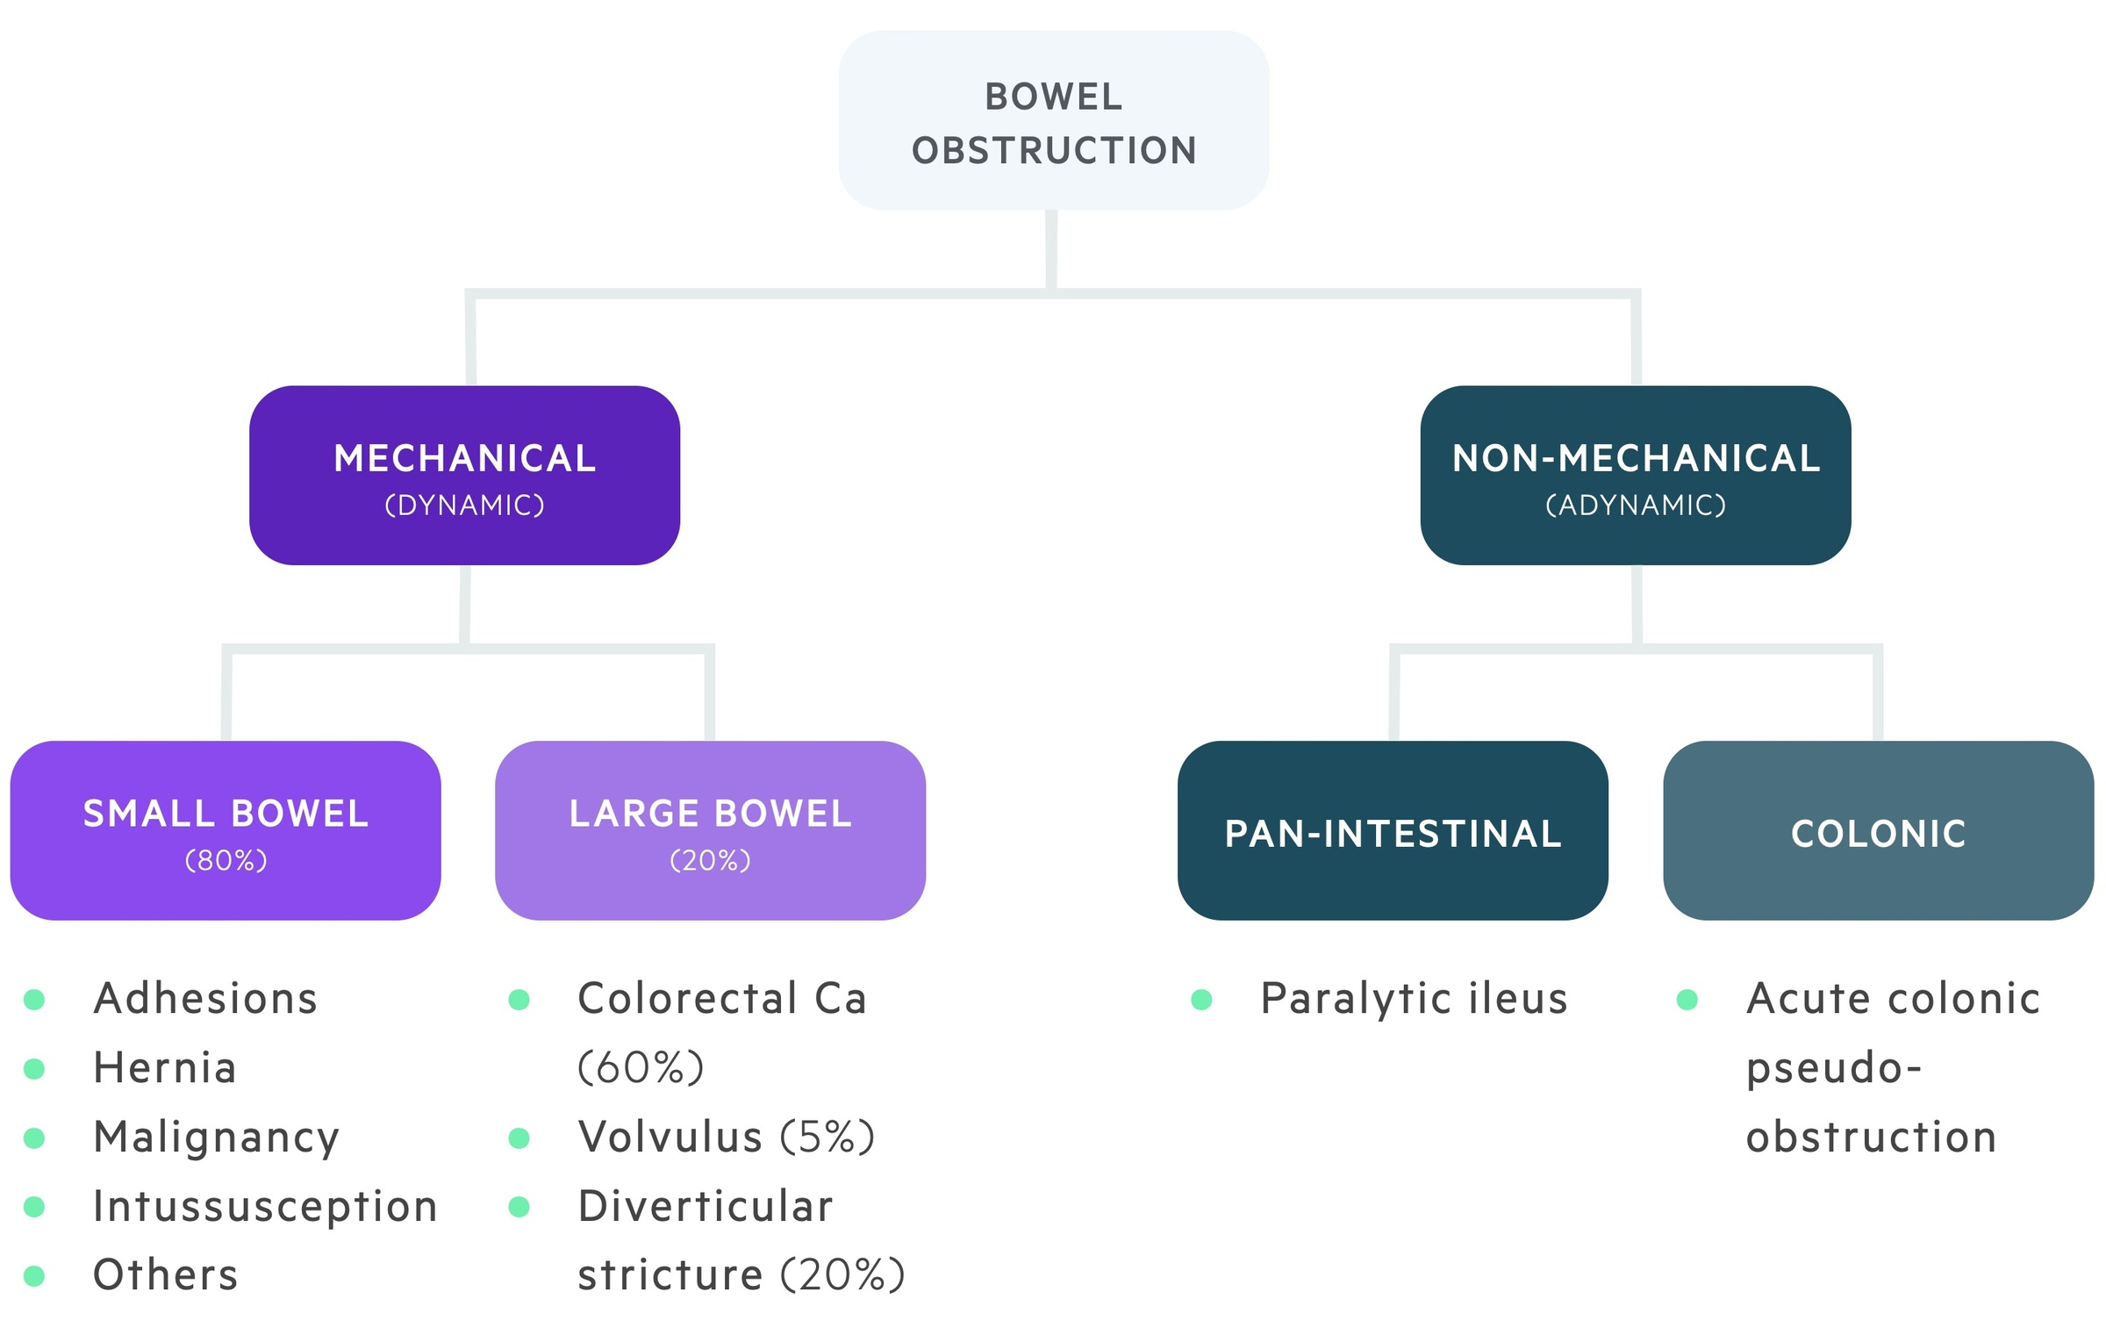

Slide 9
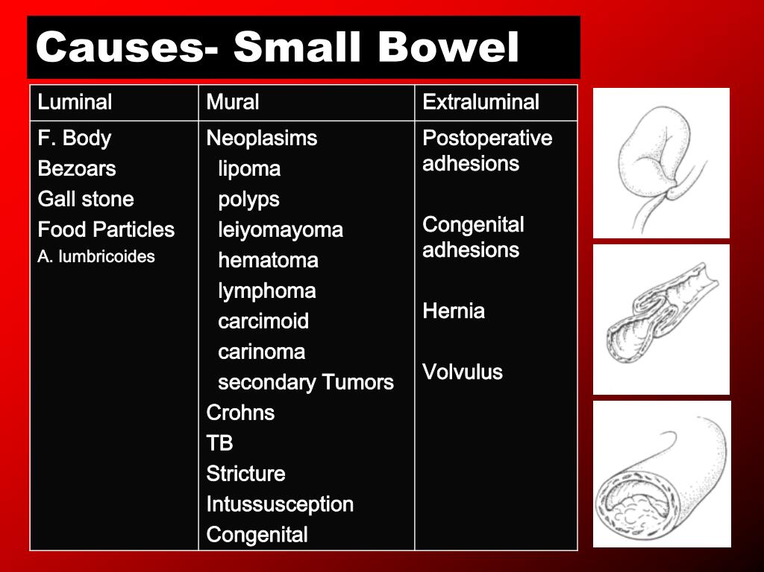

Slide 10
Key causes
Small Bowel:
Post-op Adhesions most common
Hernia esp inguinal or incisional
Intussusception - paediatrics
Volvulus - midgut in children
Volvulus is a condition where the intestines twist and turn around itself
Large Bowel
Colonic carcinoma
Sigmoid volvulus - elderly
Diverticular structures

Slide 11
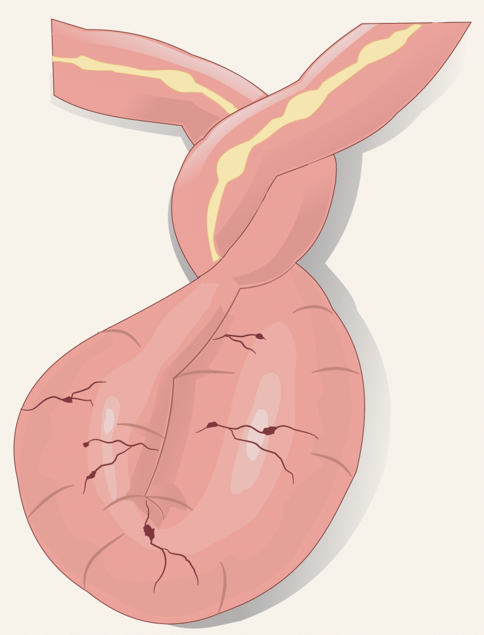

Slide 12
Clinical features-4 cardinal signs
Colicky abdominal pain: Crescendo - decrescendo pattern
Abdominal distension: More prominent in distal obstruction
Vomiting: Early in SBO and late in LBO
Obstipation - no flatus or stool; late finding in complete obstruction
Bonus tip: Bowel sounds may be high pitched and tinkling early on, then become absent in strangulation or ileus

Slide 13
Investigations
AXR: Multiple air-fluid levels, dilated loops, "coffee bean" sign in sigmoid volvulus
CT abdomen with contrast: Most sensitive, identifies level, cause, complications eg ischemia
CBC/U&E/Lactate: Leukocytosis, dehydration, elevated latate = ischemia risk

Slide 14
Reg Flags for Surgery
Fever, tachycardia, peritonism
Elevated Lactate or WCC
Closed - loop obstruction: volvulus, internal hernia
Strangulation or bowel compromise on imaging
Never miss a strangulated hernia - it's a surgical emergency

Slide 15
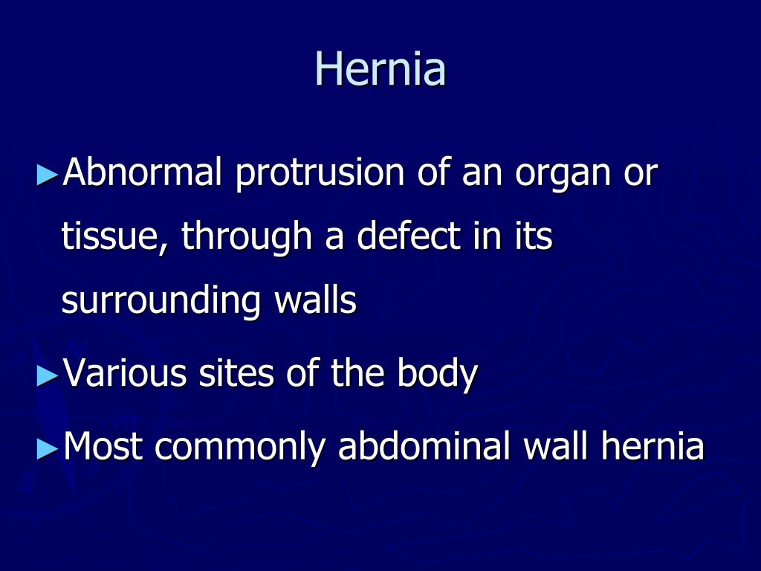

Slide 16
Management Principles
Initial (Conservative "drop and suck"): NPO, IV fluids, NGT decompression, correct electrolytes, serial exams and monitoring
Surgical: Indicated for complete obstruction, failure of conservative management (usually after 24-48hours), Evidence of ischemia, perforation
Srgical options: Laparotomy vs laparoscopy; resection, stoma or primary anastomosis depending on viability and contamination

Slide 17
Bonus High Yield Pearls
In sigmoid volvulus: attempt rectal decompression first unless signs of peritonitis
In paediatric Intussusception: air or contrast enema both diagnostic and therapeutic
Watch for "transition point" on imaging - it localizes the obstruction

Slide 18
Station 2: Pneumothorax
Definition
Classification
Clinical features
Investigations
Management
Needle vs Chest tube
Complications
Recurrence Prevention
High Yield Nuggets for Exams and Wards

Slide 19
Definition
Pneumothorax is the presence of air in the pleural space, leading to partial or complete collapse of the lung on the affected side
It disrupts the negative intrapleural pressure that normally keeps the lung inflated

Slide 20
Classification
Spontaneous Pneumothorax: Spontaneous Pneumothorax can either be primary or secondary. Primary occurs without underlying lung disease, Typically in tall, thin males aged 10 to 30 often due to rupture subpleural apical blebs. Secondary occurs with pre-existing lung pathophysiology eg COPD, TB, Cystic fibrosis, PCP pneumonia in HIV
Traumatic Pneumothorax: Can either be iatrogenic or non iatrogenic. Iatrogenic is from procedures like central line placement, thoracentesis, mechanical ventilation. Non iatrogenic is from blunt or penetrating trauma eg fractured ribs, stab wounds
Tension Pneumothorax: Life threatening emergency where air enters pleural space with each breath but cannot escape, causing massive shift of mediastinal structures, reduced venous return and cardiogenic shock

Slide 21
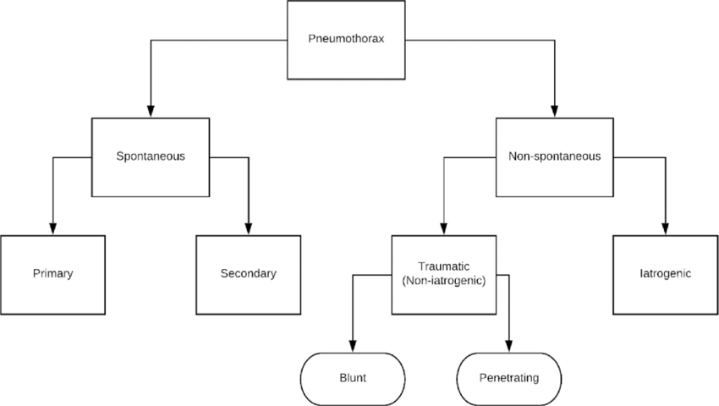

Slide 22
Clinical Features
Sudden pleuritic chest pain; especially in spontaneous types
Dyspnea; mild in PSP, severe in SSP or tension
Reduced chest expansion; on affected side
Hyperresonance; on affected side
Diminished breath sounds; unilateral
Tracheal deviation; away from affected side ( in tension Pneumothorax)
Jugular venous distension and hypotension; in tension Pneumothorax due to SVC compression

Slide 23
Investigations
CXR: Key signs are; Visible pleural line, absent lung markings peripheral to the line, deep sulcus sign (supine PT), mediastinal shift in tension Pneumothorax. Note that small pneumothoraces might be missed in supine films - consider CT if unsure
ABGs: May show hypoxia, especially in SSP and tension
CT Scan: Gold standard for detecting small or occult pneumothorax. Especially useful in trauma or complex lung disease

Slide 24
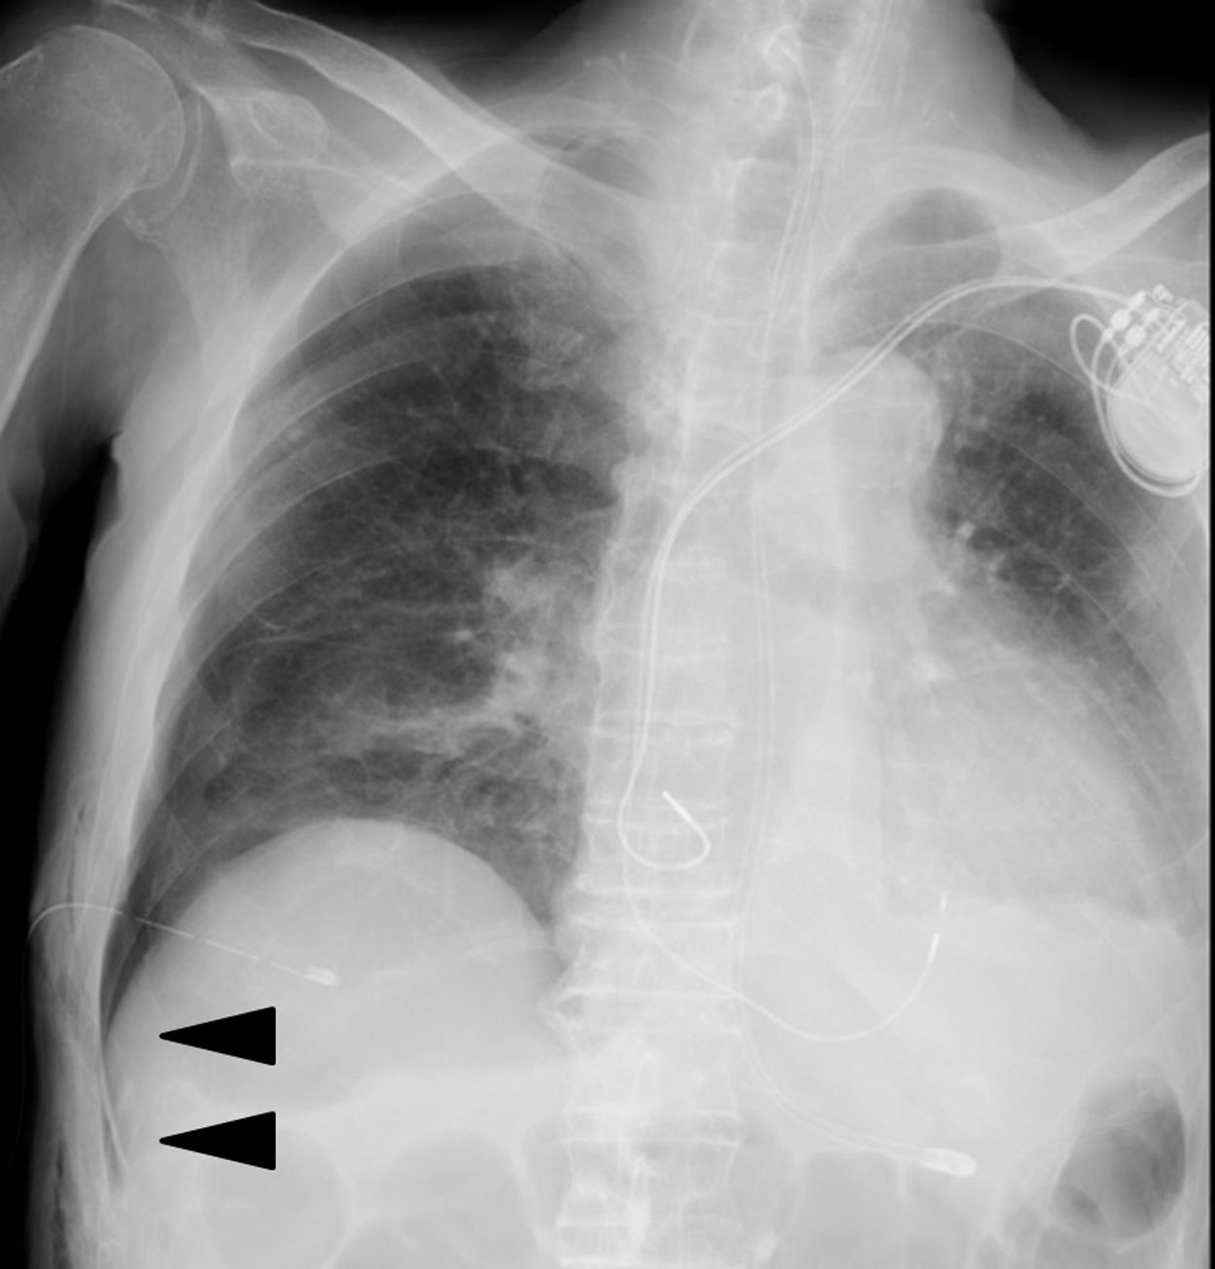

Slide 25
Management
General Principles: Depends on size, symptoms and underlying disease
Primary Spontaneous Pneumothorax:
Small and asymptomatic: observation plus O2 - high flow oxygen helps reabsorb pleural air
Large/symptomatic: needle aspiration first line
Failed aspiration or recurrent: Chest drain ( intercostal drain, ICD)
Secondary Spontaneous Pneumothorax: More cautious due to poor lung reserve, admit all, often start with ICD even for moderate cases

Slide 26
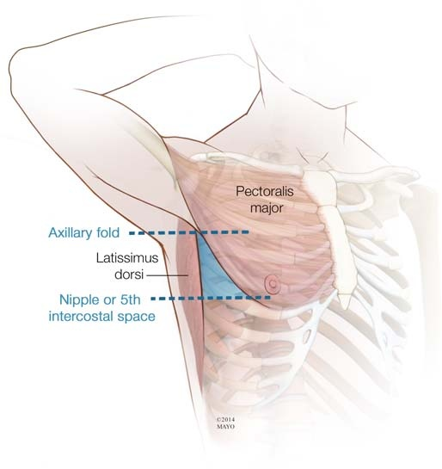

Slide 27
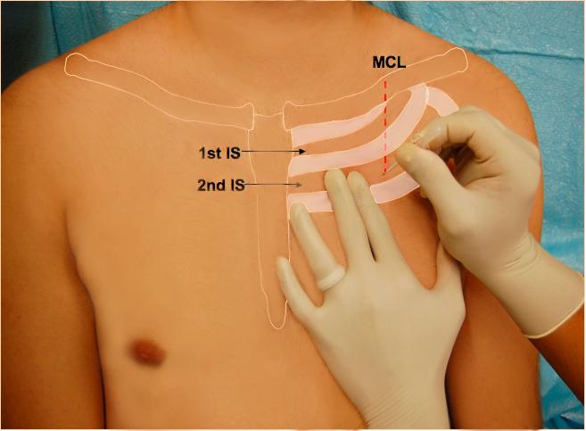

Slide 28
Tension Pneumothorax;
Immediate needle decompression ( 2nd ICS, MCL)
Followed by chest tube
Clinical diagnosis - do not wait for imaging

Slide 29
Needle vs Chest tube: QR
Needle Thoracotomy
Chest Tube
Emergent tension relief
2nd ICS MCL - 18G to 14G
Temporarily only
Definitive Air evacuation
4th to 5th ICS
AAL- 24 to 28 Fr
Connect to underwater seal drain or Heimlich valve

Slide 30
Complications
Re-expansion pulmonary edema
Persistent air leaks: > 5-7 days suspect bronchopleural fistula
Infection: Empyema
Recurrence app 30% after PSP
Subcutaneous emphysema
Hypotension and shock

Slide 31
Recurrence Prevention
Smoking cessation: Reduced recurrence from 50 to 60% to app 20%
Pleurodesis: Chemical (talc) or surgical ( VATS abrasion, pleurectomy). If
>\= 2 episodes
Bilateral pneumothorax
Occupational risk - pilot, divers

Slide 32
High Yield Nuggets for Exams
Needle decompression before imaging in tension Pneumothorax
Air reabsorbs at app 1.25% of hemithorax volume/day with oxygen O2
Deep sulcus sign suggestions pneumothorax in supine trauma patient
PSP most common in young males with apical blebs despite being healthy
Always assess for underlying conditions in recurrent pneumothorax

Slide 33
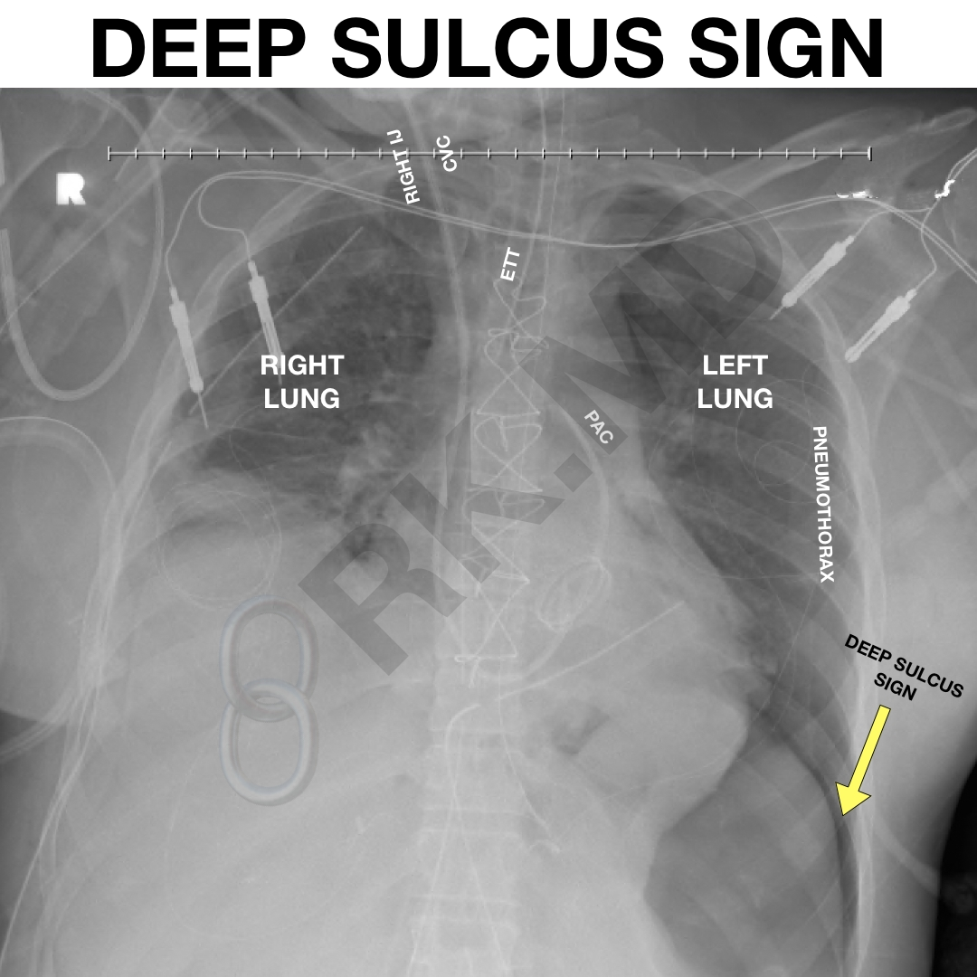

Slide 34
Station 3: Features of an Ulcer
Clinical features
Pathological features
Gross physiological examination
Mnemonic for characterizing Ulcers

Slide 35
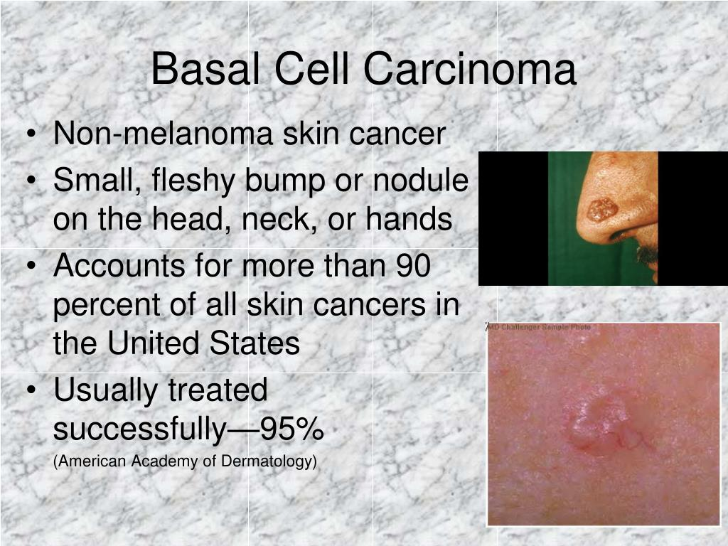

Slide 36
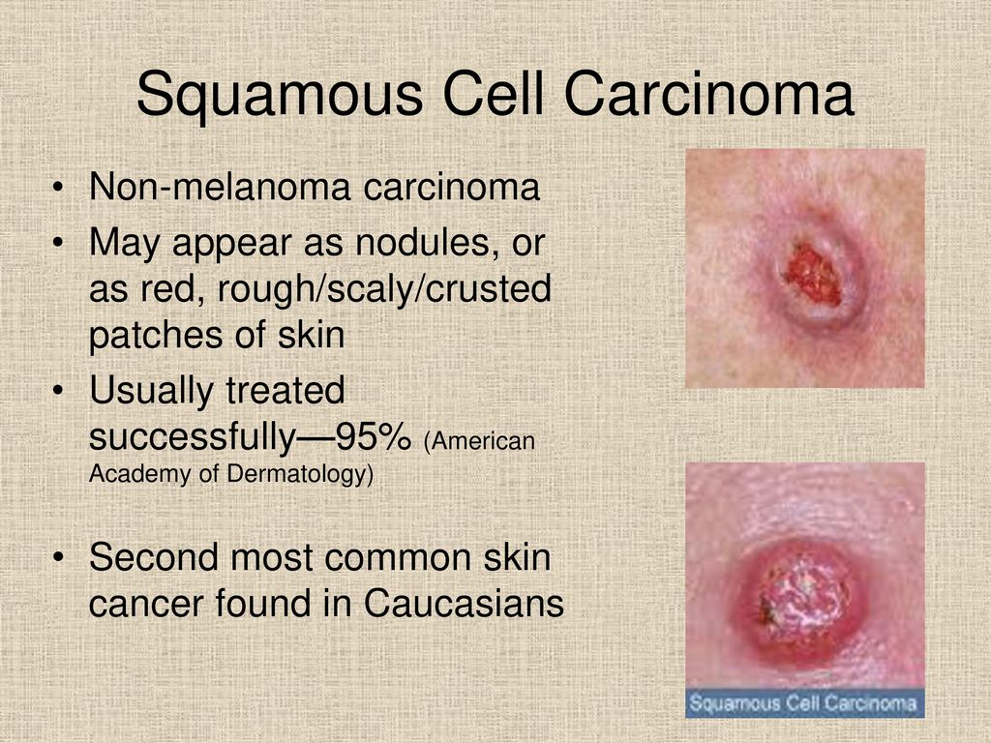

Slide 37
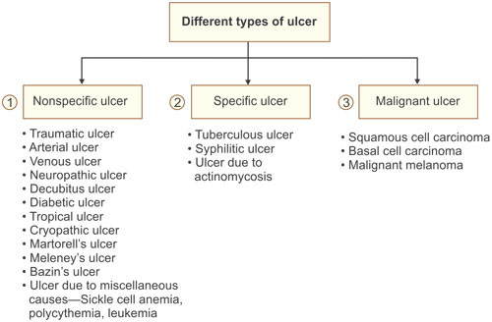

Slide 38
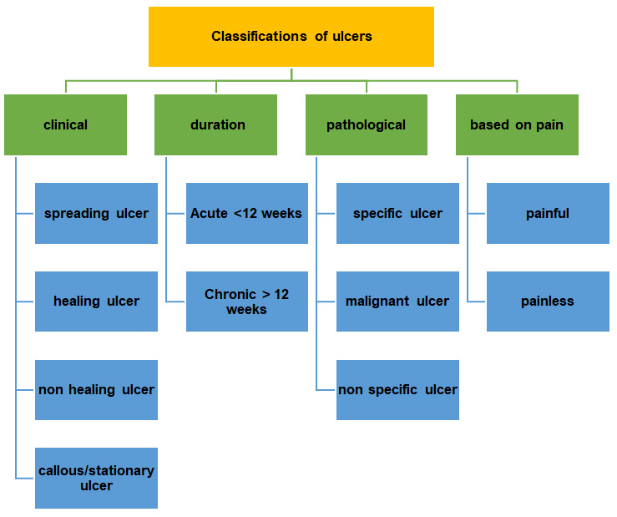

Slide 39
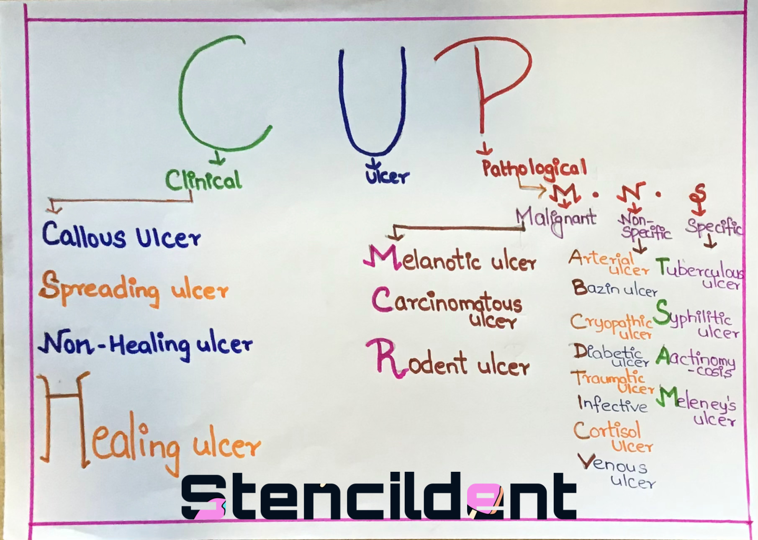

Slide 40
Let's get it Right 👍👍👍
Specific ulcer
Non specific ulcer
Ulcers caused by specific identifiable disease process with characteristic pathology and microbiology
These are ulcers that arise from non specific causes
Such as trauma, vascular insufficiency, pressure or metabolic disorders

Slide 41
Clinical features
Pain: Often described as burning, gnawing or aching. Peptic ulcers, for example may present with epigastric pain that worsens on an empty stomach.
Bleeding: May present as hematemesis or melena in gastrointestinal Ulcers
Perforation signs: Sudden severe pain with signs of peritonitis (rigid abdomen, absent bowel sounds)
Weight loss and nausea: Especially in chronic ulcers affecting the GIT

Slide 42
Pathological features
Loss of epithelial continuity: Ulcers penetrate past, unlike erosions which remain superficial
Necrotic base: Typically covered with slough or fibrin (slough is non viable [dead] tissue that is found in a wound. Usually yellow or green in color. It's is required to be removed)
Inflammatory rim: Surrounded by granulation tissue and infiltrates of neutrophils and macrophages ( granulation is the new connective tissue that grows back during healing process, it's beefy in color, and bumpy in texture)
Healing features: Presence of fibroblast, angiogenesis and epithelial regeneration at the periphery

Slide 43
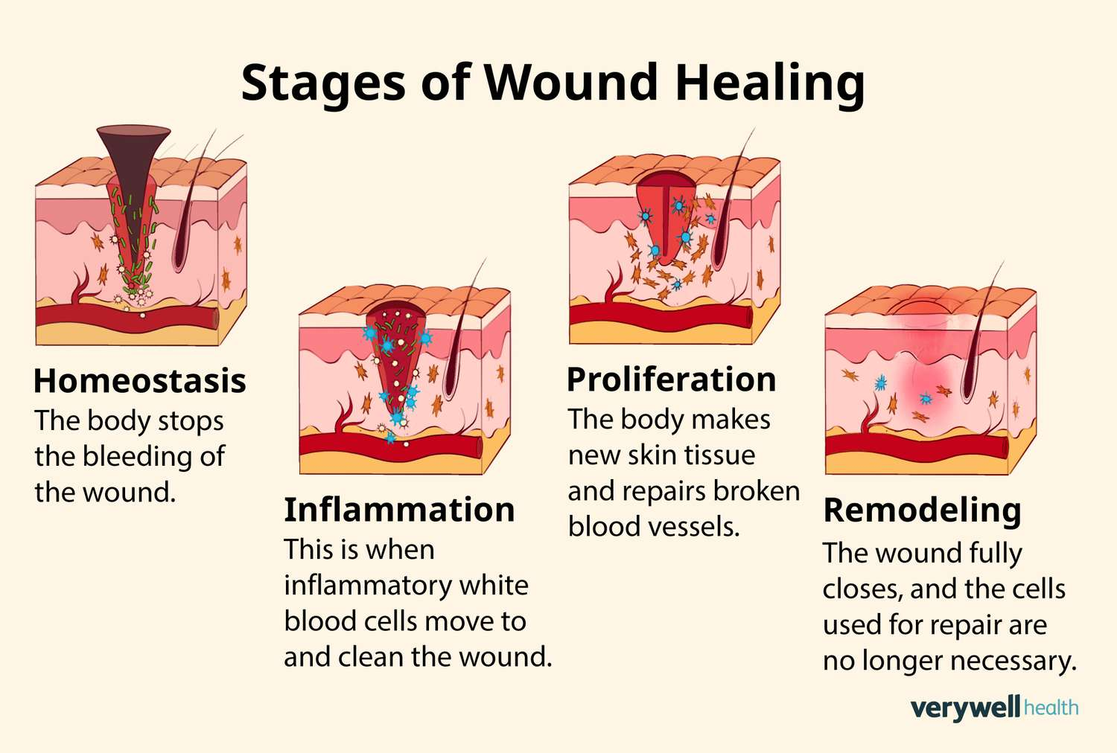

Slide 44
Gross Physiological Examination
Shape: Round, oval, punched out (eg trophic uler) or serpiginous (eg tuberculous ulcer)
Margins: Can be undermined (Eg Venous ulcer), raised (eg carcinomatous Ulcer), or sloping (healing ulcer)
Base: Covered with slough, granulation tissue or necrotic debris
Surrounding skin: May show pigmentation, induration, or eczema depending on chronicity
Discharge: Serious, purulent, bloody - may guide etiology (infectious vs vascular)

Slide 45
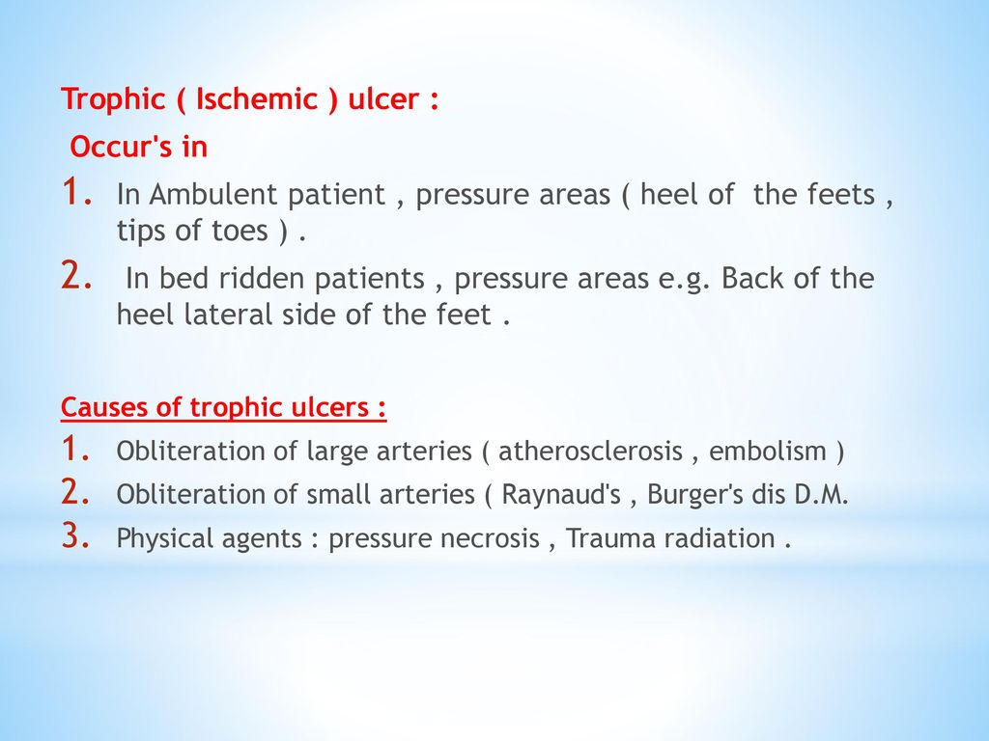

Slide 46
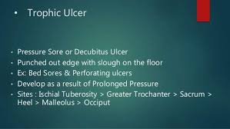

Slide 47
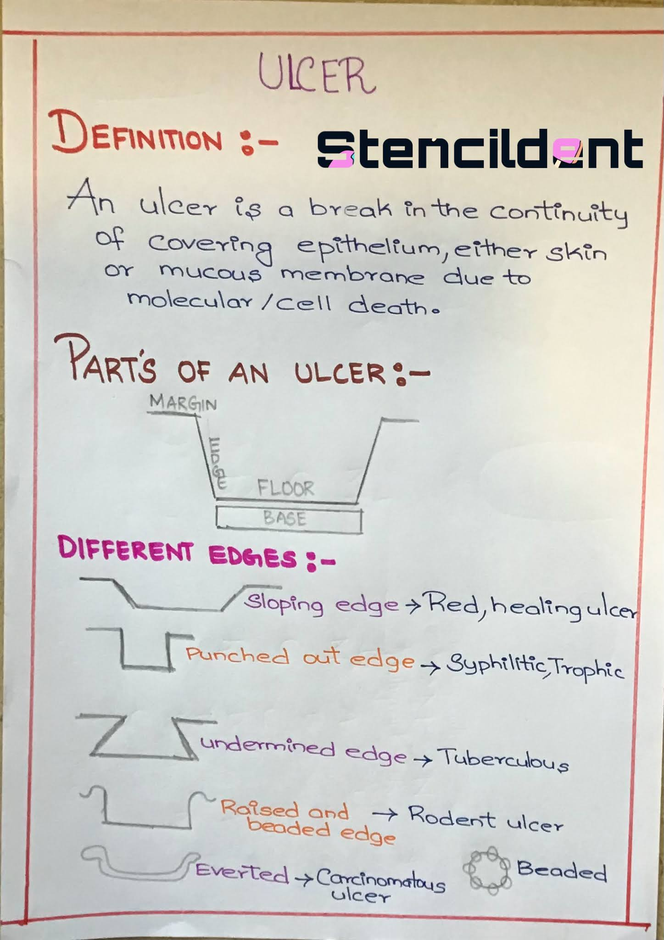

Slide 49
Mnemonic
Mnemonic for characterizing Ulcers is LIMBS
L: Location - anatomical and vascular relevance
I: Involvement of surrounding tissues
M: Margins - sloping, punched out, undermined
B: Base - granulation, slough, necrosis
S: Size and shape

Slide 50
Station 4: Grading of DFU
Wagner - Meggitt Classification
University of Texas classification
SUNBAD System
WIfI Classification

Slide 51
Wagner - Meggitt Classification
Focus on depth and presence of Osteomyelitis/gangrene
0: intact skin - pre- ulcerative lessions
1: Superficial ulcer (skin/subcutaneous tissue)
2: Ulcer penetrates tendons, bones or capsule
3: Deep ulcer with abscess or Osteomyelitis
4: Partial foot gangrene
5: Whole foot gangrene
Strengths: Simple and widely used
Limitations: Doesn't account for infection or ischemia

Slide 52
UT Classification
Combines depth with infection/ischemia
0: Pre-/post ulcerative site
1: Superficial ulcer
2: Penetrates tendon or capsule
3: Penetrates bone or joint
A: Clean ulcer
B: Infected Ulcer
C: Ischemic ulcer
D: Infected plus Ischemic ulcer
Strength: More descriptive, predicts healing/amputation
Mnemonic: "GASP" + A/B/C/D stage plus pathophysiology

Slide 53
SINBAD System
Used for communication and audit: Scores 0-6 based on;
Site - forefoot, mid or hind
Ischemia
Nephropathy
Bacterial infection
Area: >2cm2
Depth-Superficial vs deep

Slide 54
WIFI Classification
Used to guide revascularization decisions
Wound: 0-3; None to extensive/gangrenous
Ischemia: ABI or toe pressure
Foot Infection: 0-3;non to systemic
Strength: Predicts amputation risk and benefit of vascular Intervention

Slide 55
Station 5: Staging of Melanoma
TNM - Based staging overview
Melanoma stages - 0-IV
Breslow Thickness Categories
Mnemonic

Slide 56
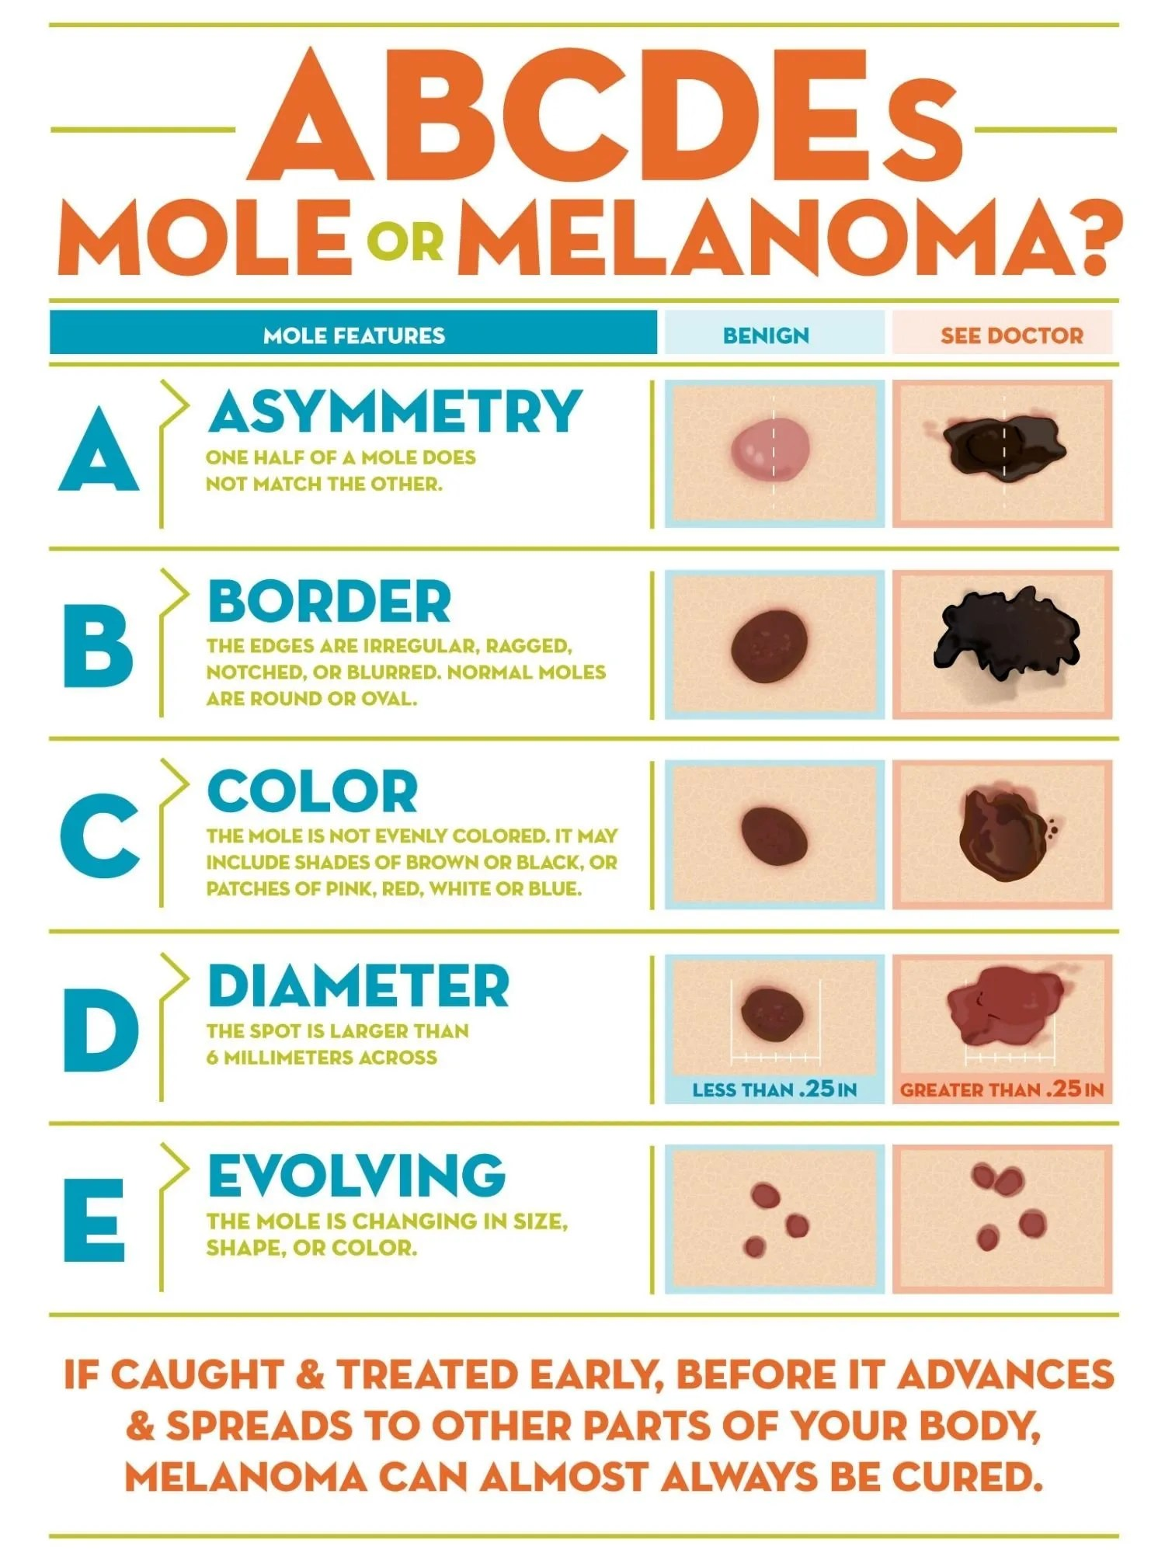

Slide 57
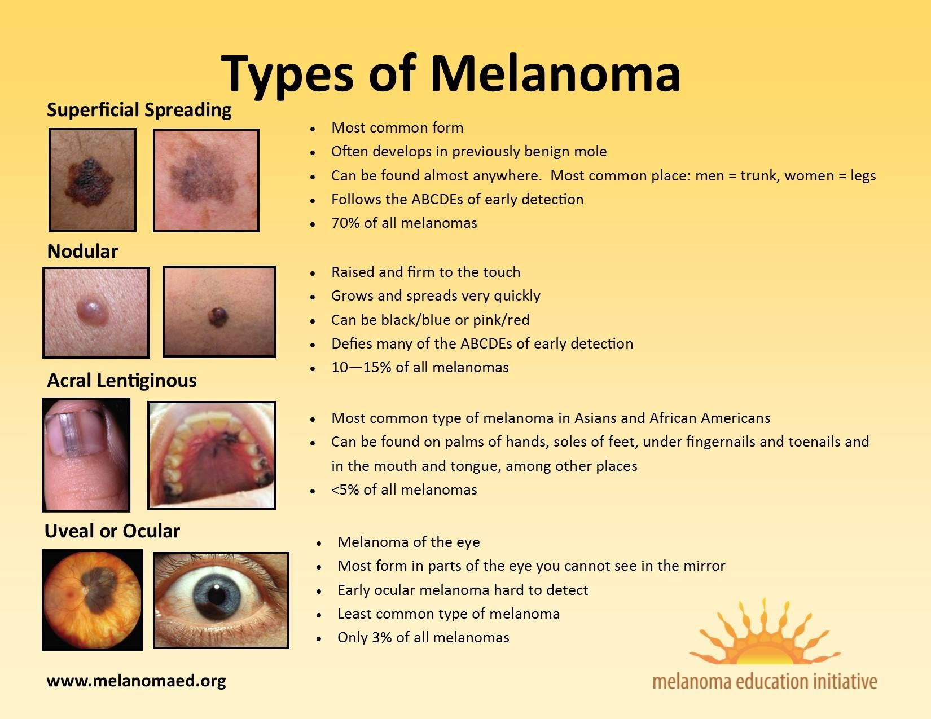

Slide 58
TNM - Based Staging Overview
Melanoma staging integrates:
T - tumor thickness and ulceration: Breslow depth is critical
N - Nodal involvement - number and type lymph nodes affected
M - metastasis - spread to distant organs

Slide 59
Melanoma stages - O-IV
O: Melanoma in situ - confined to epidermis (Tis), no Nodal involvement and no distant spread
I: <\= 2mm thick, maybe ulcerated, no Nodal or distant spread (T1-T2a, N0,M0)
II: > 2 mm thick, may be ulcerated, still no Nodal or distant spread (T2b-T4, N0, M0)
III: Any thickness, spread to regional lymph node or satellite/in-transit Mets (N1-N3, M0)
IV: Distance metastasis - skin, lymph nodes, lungs, Liver, brain etc any T/N, M1
Ulceration and breslow depth are prognostic modifiers
Substage eg IA, IIB, Depend on thickness and ulceration status

Slide 60
Breslow Thickness Categories
T1: <\= 1mm
T2: > 1-2 mm
T3: > 2-4 mm
T4: > 4 mm
Each T stage is further classified as
a: non ulcerated
b: ulcerated

Slide 61
Mnemonic - "BUMPS" for prognostic Factors
B: Breslow depth
U: Ulceration
M: Metastasis regional/distant
P: Pathologic vs clinical staging
S: Sentinel lymph node status

Slide 62
Station 6: Head Injury
Classification of head injury
Severerity assessment
Key imaging findings
Emergency management priorities
ICP management
Surgical indications
Monitoring and complications
Mnemonic "Head Trauma"

Slide 63
Classification of HI
Closed: No breach to skull or dura; includes concussion, contusion, hematomas
Open/penetrating: Skull fracture with dural tear or foreign object penetration
Primary injury: Direct mechanical damage at time of trauma eg confusion, DAI
Secondary Injury: Involving damage due to hypoxia, ischemia, raised ICP or inflammation

Slide 64
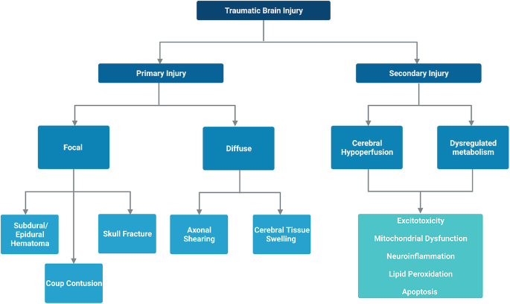

Slide 65
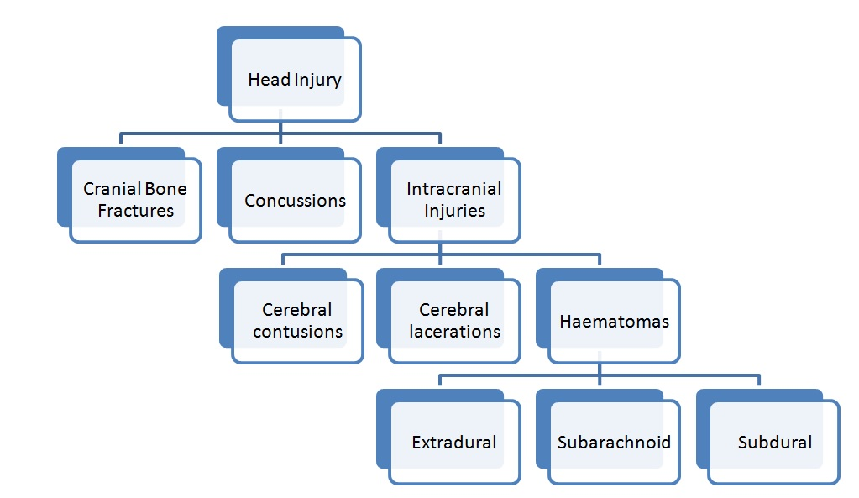

Slide 66
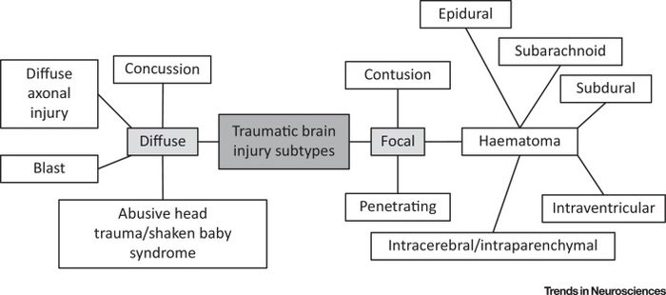

Slide 67
Severerity assessment
Using the Glasgow Coma Scale
<\= 8 GCS score is termed as severe; Tx: Intubation, ICU care, ICP monitoring
8-12 is termed as moderate: Tx ; Requires imaging and close monitoring
13-15: Mild: Often discharged with observation
GCS<8: Coma, consider airway protection
Serial GCS tracking is vital for detecting deterioration

Slide 68
Key Imaging Findings
CT Brain (non-contrast): First line for acute trauma
Extradural hematoma: Biconvex, arterial bleed (often middle meningeal)
Subdural hematoma: Crescent shaped, venous bleed
Contusions: Hyperdense areas, often frontal/ temporal lobes
Diffuse axonal Injury: May be subtle; MRI better for detection

Slide 69
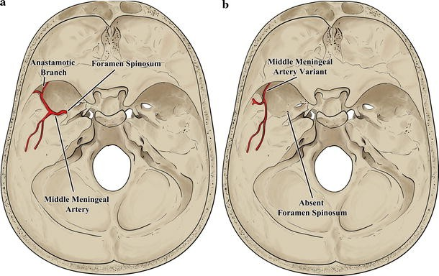

Slide 70
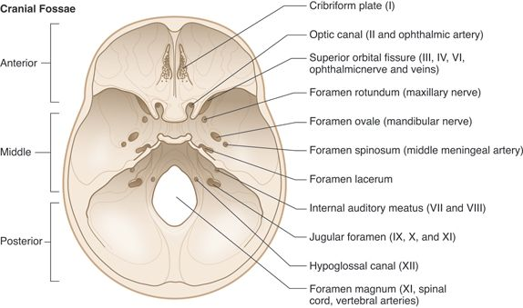

Slide 71
Emergency management priorities
ABCDE plus Neuro focus
Airway: intubate if GCS<\=8
Breathing: Prevent hypoxia (PaO2 > 60 mmHg)
Circulation: Avoid hypotension (SBP > 90 mmHg)
Disability: Rapid neural exam, pupil check, GCS
Exposure: Full trauma survey
Prevent secondary brain injury: Hypoxia plus hypotension = doubled mortality risk

Slide 72
ICP management
Head elevation (30°): Improves venous drainage
Hyperosmolar therapy: Mannitol or hypertonic saline for herniation
Sedation and analgesia: Reduces metabolic demand
Controlled ventilation: Maintain PaCO2~35 mmHg. Avoid hyperventilation
Surgical decompression: Craniectomy or hematoma evacuation

Slide 73
Surgical Indications
Extradural hematoma with midline shift > 5 mm
Subdural hematoma with mass effect
Depressed skull fracture > 1 cm
Open skull fracture with CSF leak
Intracerebral hematoma > 30 ml or causing herniation

Slide 74
Monitoring and Complications
ICP monitoring: Indicated if GCS is <\=8 with abnormal CT
Seizure prophylaxis: Phenytoin for 7 days in high risk cases
Post-Concussive Syndrome: Headache, memory loss, emotional lability
Neurogenic pulmonary edema: Rare but life threatening

Slide 75
Mnemonic _ Head Trauma
Hematoma - EDH, SDH, ICH
Edema: Edema - cerebral swelling
Axonal Injury - DAI
Depressed fracture
TBI classification - GCS
Raised ICP
Airway protection
Urgent CT
Monitoring - ICP, Vitals
Anticonvulsants if Indicated

Slide 76
Station 7: Types of Amputations
Major categories of Amputations
Lower limb amputation types
Upper limb amputation types
Special concept to know

Slide 77
Major Categories
Upper limb: Includes shoulder disarticulation, transhumeral, transradial and hand/finger Amputations
Lower limb: Most common in practice: Hip disarticulation, transfemoral (above knee), transtibial (below knee), foot/toe Amputations

Slide 78
LL Amputation Types
Transfemoral (above knee) Amputation:
Indications: Ischemia, infection and trauma
Challenges: Higher energy expenditure when walking with prosthesis
Transtibial (below knee) Amputation:
Preserves the knee joint - better mobility
Most preferred when feasible due to functional advantage
Symes Amputation:
Through the ankle joint
Retains heal pad - can ambulate without prosthesis for short distances

Slide 79
Chopart's Amputation:
Through the midtarsal joint
Risk of equinus deformity unless stabilized
Lisfranc's Amputation:
Torso-metatarsal level
Often leads to gait instability if not well-balanced
Forefoot/Toe Amputations:
Common in diabetic foot management
Lower morbidity, faster healing if vascular supply is adequate adequate

Slide 80
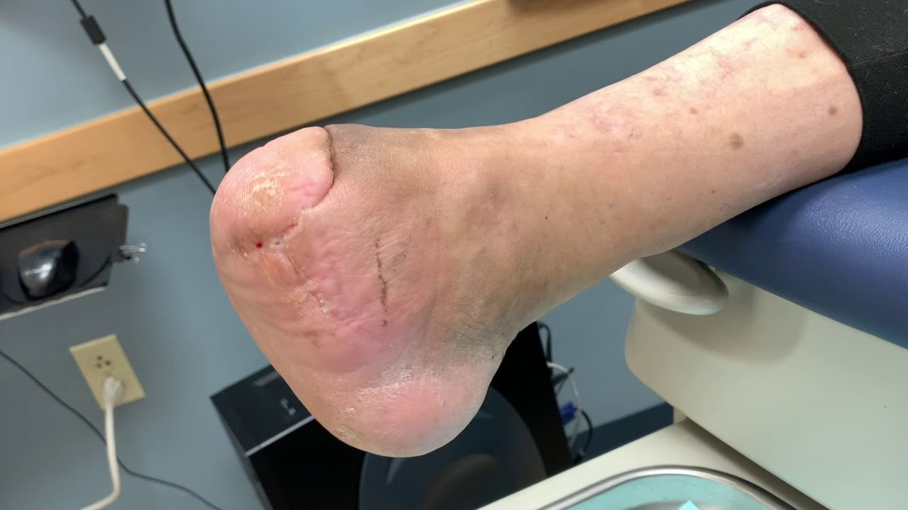

Slide 81
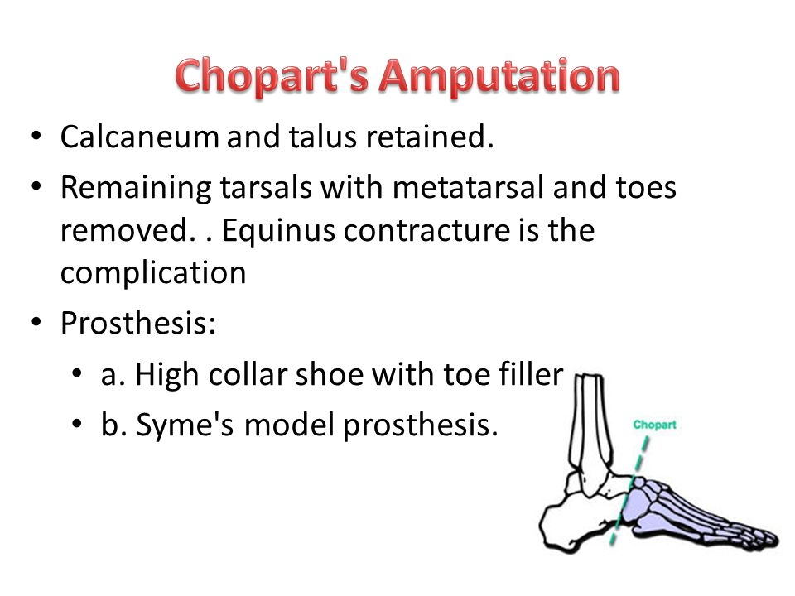

Slide 82
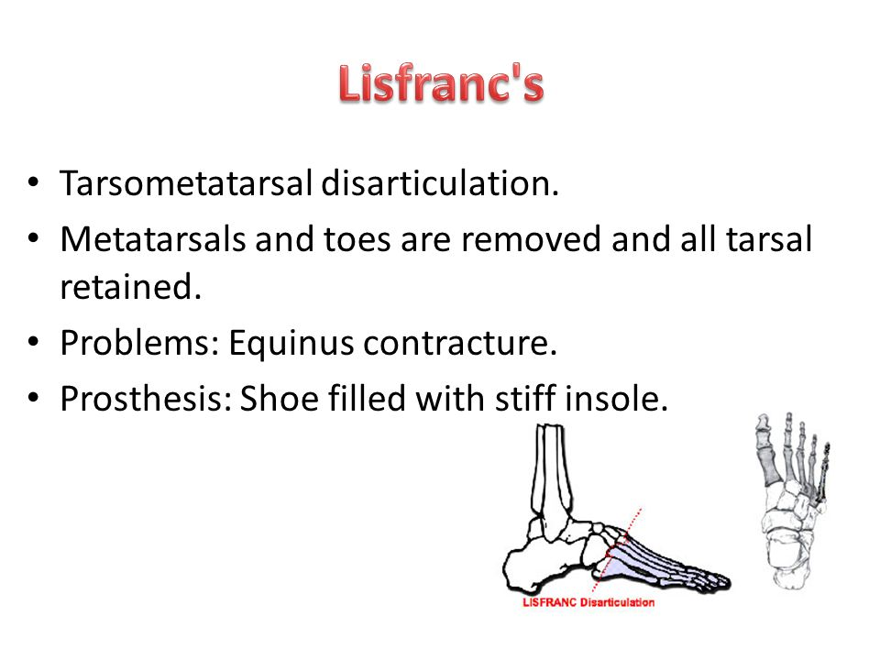

Slide 83
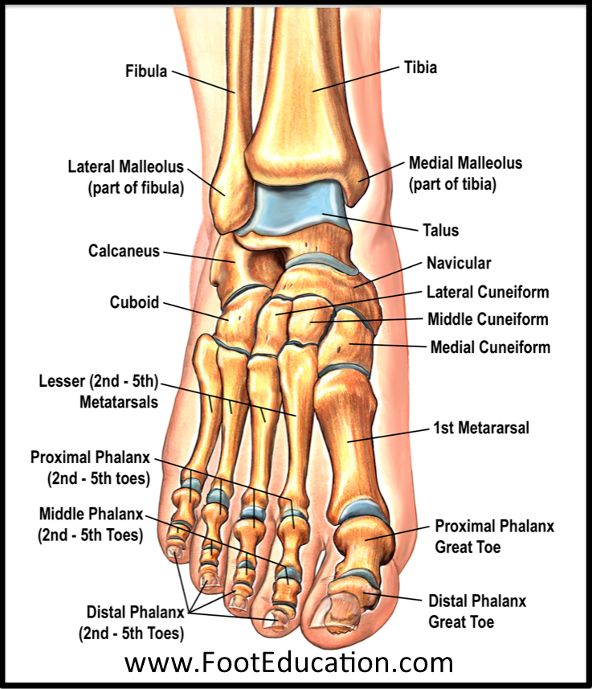

Slide 84
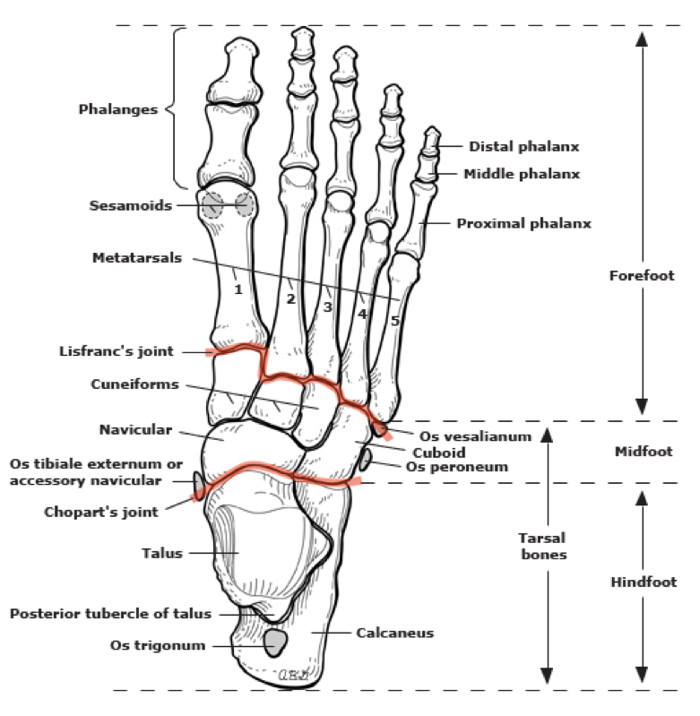

Slide 85
Special Concepts to know
Guillotine vs Closed Amputation:
Guillotine: Emergency, infected limb; left open initially
Closed: Planned procedure with flap closure
Levels of preservation:
Always aim to preserve the longest functional limb possible, especially joints eg Knee, elbow
Prosthetic Consideration:
Lower limb amputees benefit from energy conserving joints; upper limb prosthesis prioritize dexterity

Slide 86
Station 8: Breast Pathologies
Categories of breast Pathologies
Bonus yield nuggets

Slide 87
Categories of B-Ps
Inflammatory Conditions
Benign tumors
Malignant tumors
Developmental and congenital
Hormonal/functional disorders

Slide 88
Inflammatory Conditions
Mastitis: Painful, red, swollen breast _ common in lactating women. Often caused by staphylococcus aureus. May progress to abscess
Breast abscess: Localized collection of pus_fluctuant mass. Requires drainage
Duct Ectasia: Dilation of ducts with inspissated (thickened) secretions. Common in older women. May mimic carcinoma clinically
Fat Necrosis: Trauma-Induced. Hard lump, may mimic malignancy on imaging and exam

Slide 89
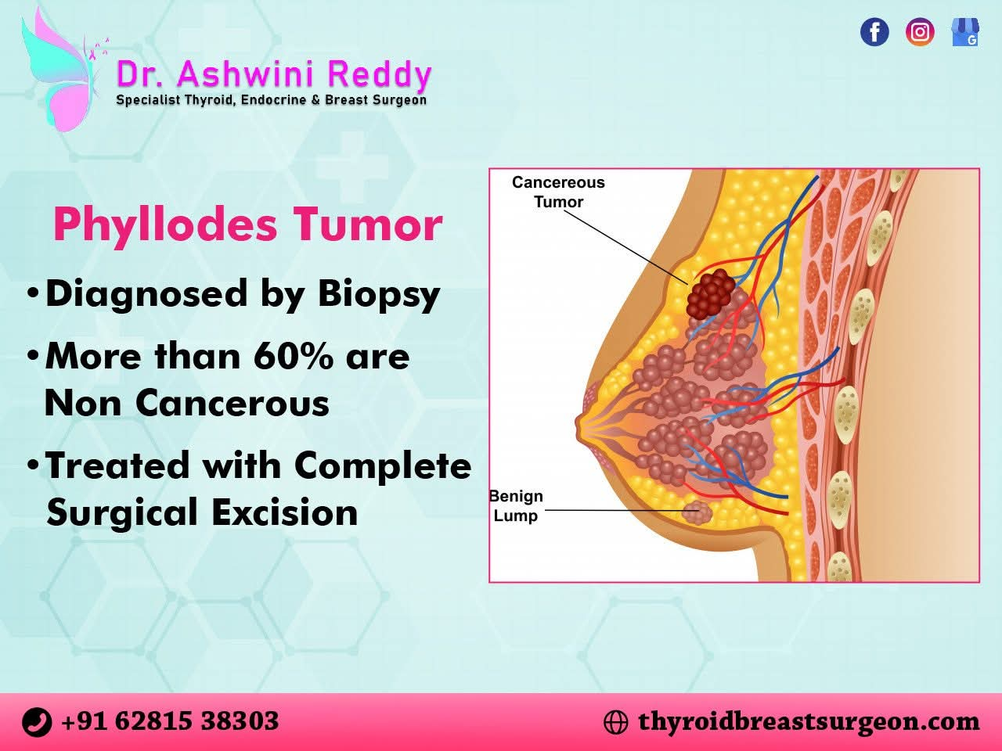

Slide 90
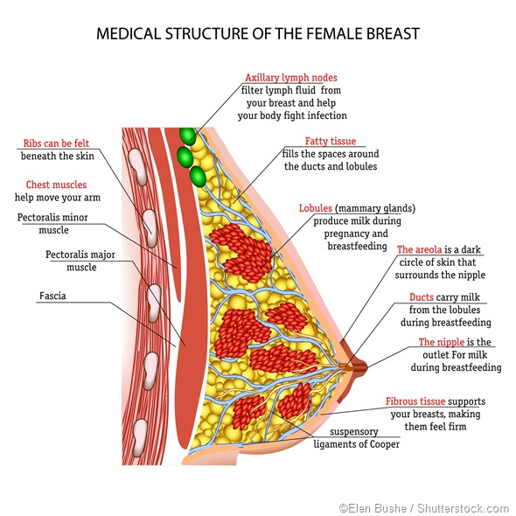

Slide 91
Benign Tumors
Fibroadenoma: Most common benign tumor in young females, mobile, firm_"Breast noise"
Phyllodes Tumor: Leaf-like growth pattern; may be benign or malignant; tends to grow rapidly
Intraductal Papilloma: Blood nipple discharge without mass; often central location near areola

Slide 92
Malignant Tumors
Ductal carcinoma in situ (DCIS): Non-invasive; confined to ducts, micro calcifications on mammogram
Invasive Ductal Carcinoma: Most common type of breast cancer; Firm irregular mass
Invasive Lobular carcinoma: Often Bilateral; subtle in imaging,"single-file" histology pattern
Inflammatory breast cancer: Aggressive; peau d' orange appearance; often without a palpable lump
Paget's disease of Nipple: Eczematous nipple changes; underlying DCIS or invasive cancer likely

Slide 93
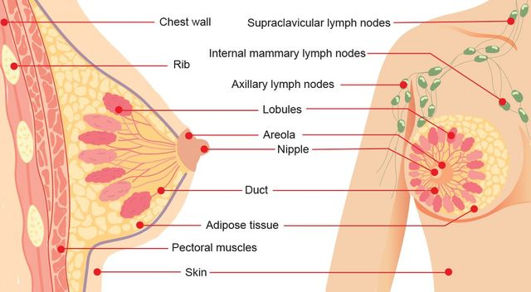

Slide 94
Developmental and Congenital
Accessory Breast Tissue: Occurs along embryonic milk line; may become symptomatic or neoplastic
Amastia/Amazia: Congenital Absence of breast tissue or nipple; rare

Slide 95
Hormonal/Functional Disorders
Fibricystic Changes: Premenstrual breast pain, lumpiness, Cystic formation; benign
Galactorrhea: Milky discharge outside lactation; consider hyperprolactinemia, medications

Slide 96
Bonus high yield nuggets
Triple assessment: For breast lump
Clinical examination
Imaging (US/ Mammogram)
Biopsy
Risk factors for malignancy: Early menarche, late menopause, nulliparity, BRCA mutation, radiation exposure
Staging tool: TNM system for breast cancer _Helps guide treatment

Slide 97
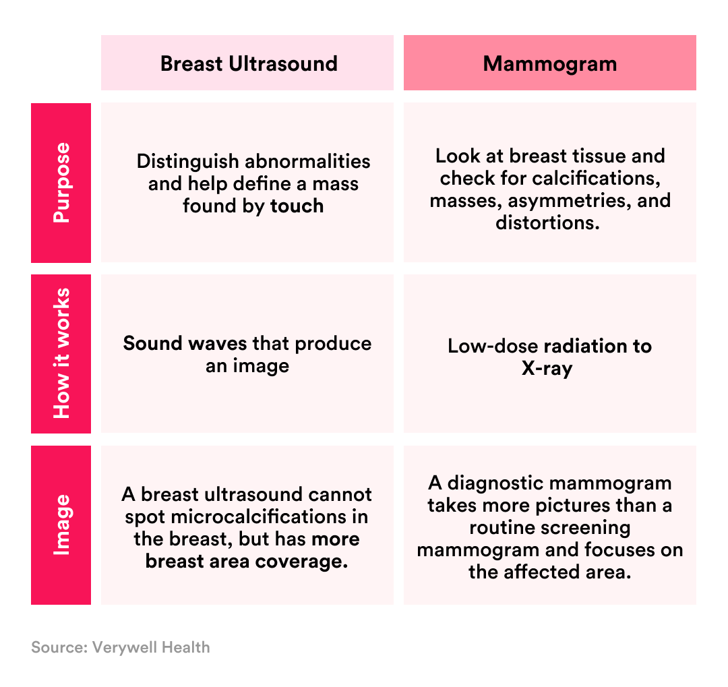

Slide 98
Station 9: Mondo's Disease
Definition and pathophysiology
Etiology and Epidemiology
Clinical presentation
Diagnosis
Management
Prognosis and Follow up

Slide 99
Definition and Pathophysiology
Mondor's Disease is a rare, benign sclerosing thrombophlebitis of superficial veins of the anterior chest wall
It presents as inflammation and clotting within the subcutaneous veins, leading to a palpable "cord" beneath the skin that gradually fibrosis over weeks
The pathophysiology involves direct trauma or pressure on the vein_such as stretching from muscle movement, tight clothing or surgical manipulation _calminating in stagnant flow and clot formation. Repetitive breast motion along contracting pectoral muscles also contributes to vein injury and thrombosis

Slide 100
Etiology and Epidemiology
Common triggers: vigorous exercise, breast or chest wall surgery including biopsies and reconstructions, tight bras, infection and blunt trauma
Rare site: Penis (penile mondor), groin, axilla (axillary web syndrome)
Incidence post_breast surgery/aesthetic mammoplasty:~1%
Predominantly affects women aged 30-60, with a female to male ratio of 3:1

Slide 101
Clinical Presentation
A sudden, tender cord-like structure under the skin of the breast or chest wall
Initial redness and pain, evolving into a firm, painless fibrous band with skin retraction
Symptoms when elevating the arm or applying pressure to the area

Slide 102
Diagnosis
Primarily clinical: Inspection and palpation reveal a subcutaneous string along venous channels
U/S may show a non compressible thrombosed vein, helping to exclude deep thrombophlebitis
Mammography and breast ultrasound are employed when malignancy must be ruled out, especially with risk factors or atypical features

Slide 103
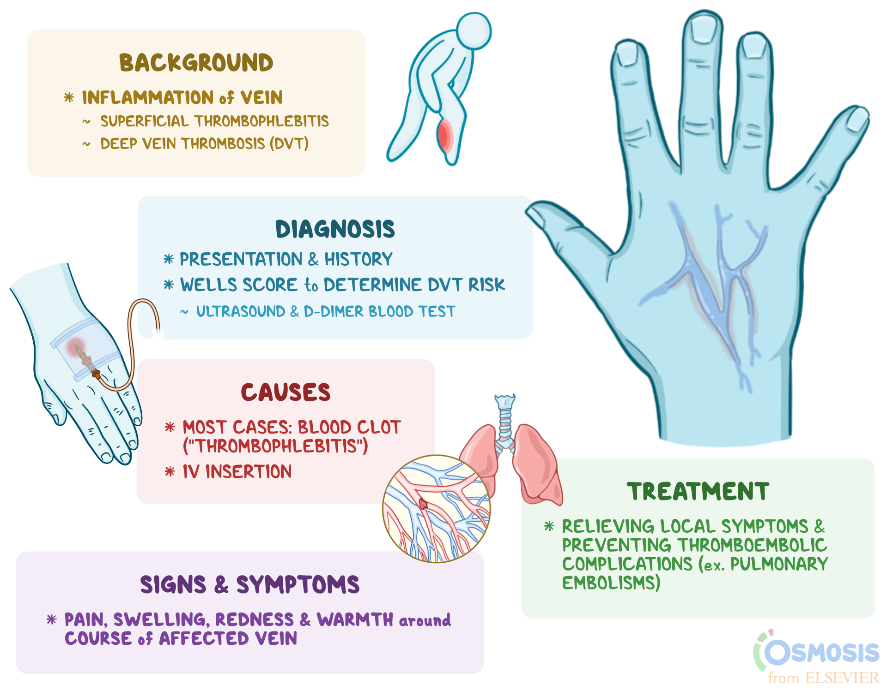

Slide 104
Management
Conservative and symptomatic:
Nonsteroidal anti-inflammatory drugs for pain relief
Warm compressions to enhance circulation
Well-fitting supportive bra or light compression
Rarely, anticoagulants are considered if extensive clotting or recurrent episodes occur

Slide 105
Prognosis and Follow up
It is self limited, resolves in 4-8 weeks without specific intervention. Recurrence is uncommon but warrants re-evaluation to exclude underlying pathology.
Although Mondor's Disease itself does not increase breast cancer risk, patients should maintain routine breast examinations and imaging as indicated

Slide 106
Station 10: Prostate Cancer
Definition and Anatomy
Epidemiology and risk factors
Pathogenesis and Histology
Clinical presentation
Screening and diagnostic workup
Grading and staging
Management strategies
Prognosis

Slide 107
Definition & Anatomy
Prostate Cancer arises from uncontrolled growth of glandular (Adenocarcinoma) cells within the prostate, a walnut sized gland located just below the bladder and Infront of the rectum
The prostate produces fluids that nourishes and transports sperm

Slide 108
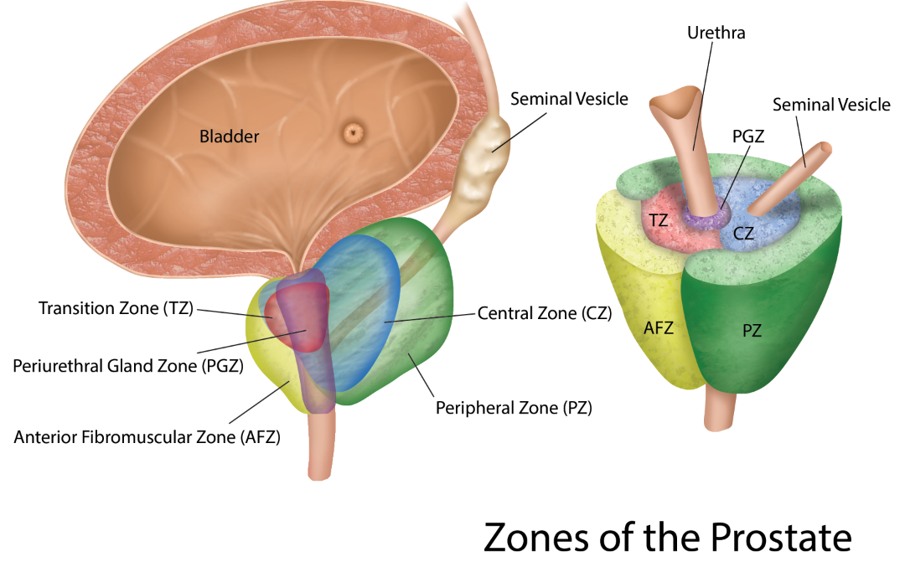

Slide 109
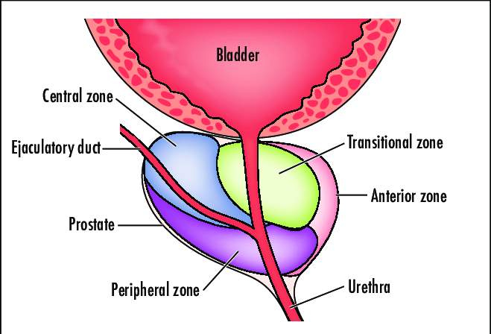

Slide 110
Epidemiology and Risk Factors
Most common non skin cancer in men; life time risk~13% in North America
Incidence increases sharply after age 50; peak diagnosis around 65-75 years
High risk in Black men and those with a first-degree relative affected (2-3× increase)
Genetic mutation (BRCA1/2, lynch syndrome), obesity, smoking and High fat diets contribute additional risk

Slide 111
Pathogenesis & Histology
Prostate Cancers are predominantly Adenocarcinomas originating in peripheral zone glandular cells.
These tumors often grow slowly, with early lesions confined to ducts (prostatic intraepithelial neoplasia may precede malignancy)
Gleason Grading ( Sum of two most prevalent patterns, each scored 1-5) predicts aggressiveness; scores 6-10 correlate with increasing risk of progression

Slide 112
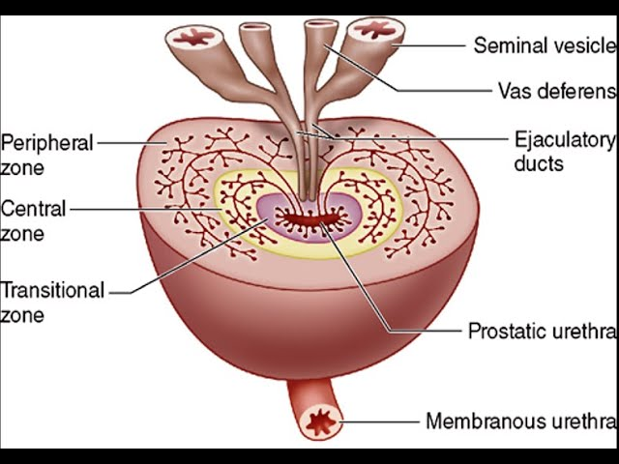

Slide 113
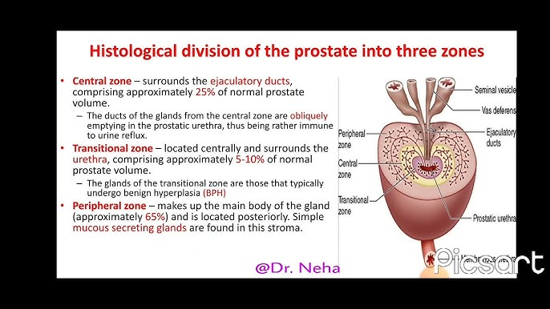

Slide 114
Clinical Presentation
Early stage disease often asymptomatic; many are detected by screening
Lower urinary tract symptoms (Weak stream, hesitancy, nocturia) may arise as gland enlarges
Hematuria or hematospermia can occur
Advanced/metastatic disease may present with bone pain (Spine, pelvis), unintentional weight loss, fatigue or lymphadenopathy

Slide 115
Screening & Diagnostic WU
Digital rectal examination (DRE) and Prostate-Specific Antigen (PSA) testing for initial screening
If PSA is elevated > 4 ng/ml or DRE is abnormal , proceed to imaging ( multipara metric MRI or trans-rectal ultrasound
Definitive diagnosis via ultrasound-guided needle biopsy, with sampling for Gleason scoring and molecular/genetic markers as indicated

Slide 116
Grading and Staging
Gleason score: sum of two common patterns (1-5 each); >\= 7 indicates intermediate to high risk
TNM staging
T1-T2: Organ confined
T3: extracapsular extension
T4: Invasion if adjacent structures
N0/N1: Absence/presence of regional lymph node metastasis
M0/M1: Absence/presence of distant metastases

Slide 117
Management Strategies
Localized disease (T1-T2, N0, M0)
Active surveillance for Gleason </= 6, low PSA, limited life expectancy
Radical prostectomy(open, laparoscopic or robotic) or external beam radiation therapy (EBRT). Brachytherapy radioactive seed implants in select low to intermediate risk Patients
Locally Advanced/Metastatic Disease: Androgen deprivation therapy (ADT) with LHRH agonists/antagonists+/-antiandrogens. Chemotherapy (docetaxel) for castration-resistant cases. Novel agents: aberaterone, enzalutamide, sipuleucel-T immunotherapy, PARP inhibitors for BRCA-mutant tumors. Palliative radiotherapy for symptomatic bone metastasis

Slide 118
Prognosis
5 year survival exceeds 99% for Localized disease
Prognosis worsens with higher Gleason score, PSA levels and presence of Nodal or distant metastasis
Even in metastatic settings, modern systemic therapies can extend median survival significantly beyond 2 years

Slide 119
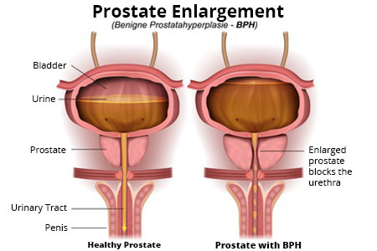

Slide 120
Station 11: Sept 1
Anal fistulas
Appendicitis
Burns
Cellulitis
Necrotizing fasciitis
Compartment syndrome
Fractures

Slide 121
Anal fistulas
An epithelial lined tract connecting the anal canal to the perianal skin
Near 2 per 10, 000 person-years, M > F, peak 30 to 50 years
Etiology
Cryptoglandular (90%) from anal gland obstruction/infection
Crohn's disease, tuberculosis, radiation, malignancy, trauma

Slide 122
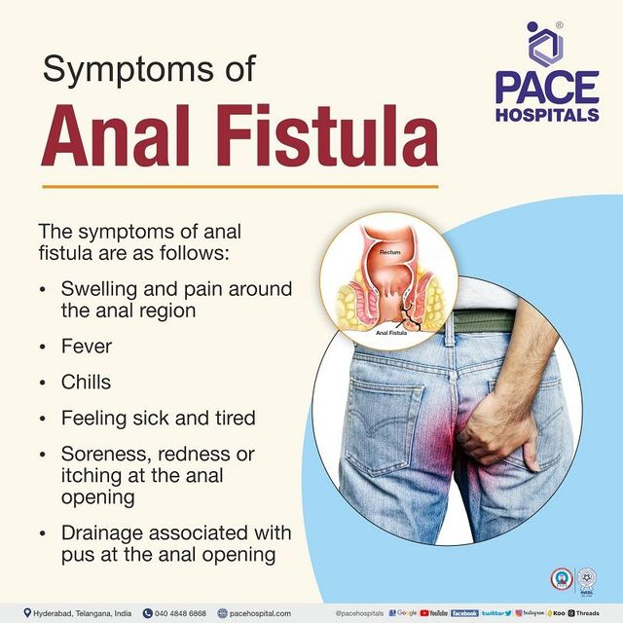

Slide 123
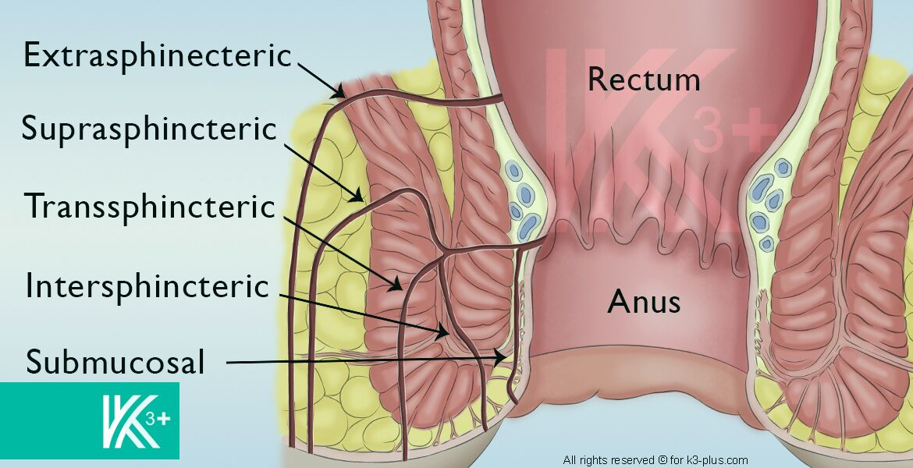

Slide 124
Classification (Parks, 1976)
Intersphincteric - tract between internal and external sphincters (70%)
Transsphincteric - through both sphincters into ischiorectal fossa (20%)
Suprasphincteric - over puborectalis then down to skin (5%)
Extrasphincteric - through the levator into ischiorectal fossa (< 5%)

Slide 125
A classic surgical principle used to predict the path of an anal fistula track (Goodsalls Rule)
Based on the location of it's external opening
It's is useful during clinical examination and surgical planning
Anterior External Opening: If within 3 cm of the anal verge it is likely to have a straight radial tract to the internal opening
If it's greater than 3 cm from the anal verge it may follow a curved tract to the posterior midline, like posterior fistulas
Posterior external openings: Behind the transverse anal line
Typically follow a curved tract to posterior midline of the anal canal

Slide 126
MRI is used to confirm the fistula anatomy when surgical intervention is planned

Slide 127
Key rules
Goodsall's rule: anterior opening < 3 cm track radially; posterior tract to midline
Anterior: within 3cm or 3.75cm: Straight: Beyond that radius, it's going to be curved.
All posterior ones are going to be curved.
High fistula involve > 1/3 of internal sphincter - Seton or sphincter preserving procedure
Clinical features
Chronic seropurulent discharge, perianal plain, intermediate abscess
Skin excoriation, external opening on exam; internal opening via anoscopy

Slide 128
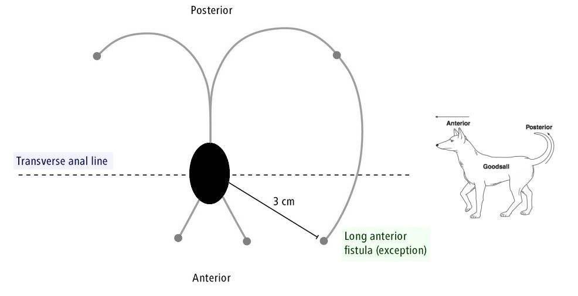

Slide 129
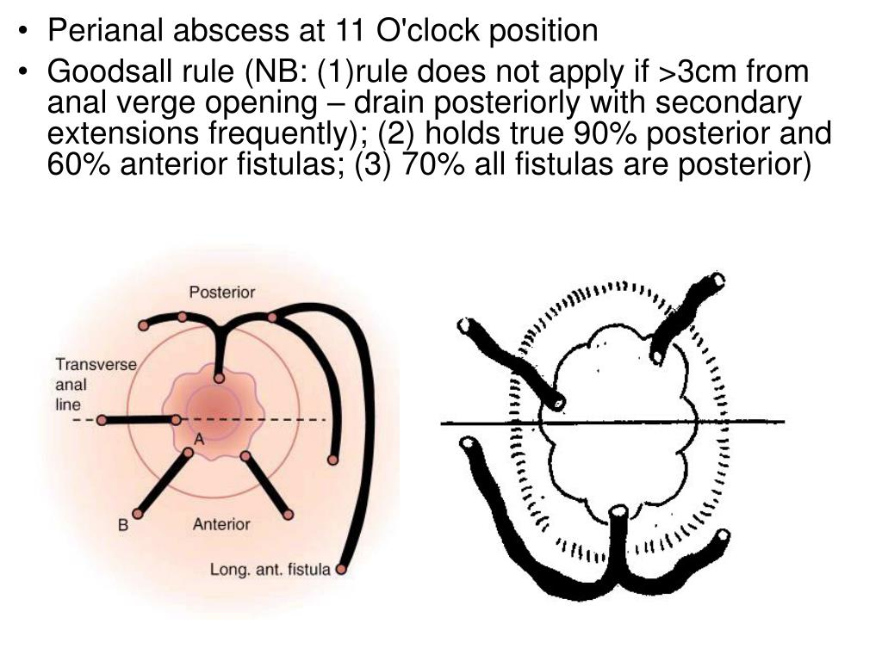

Slide 130
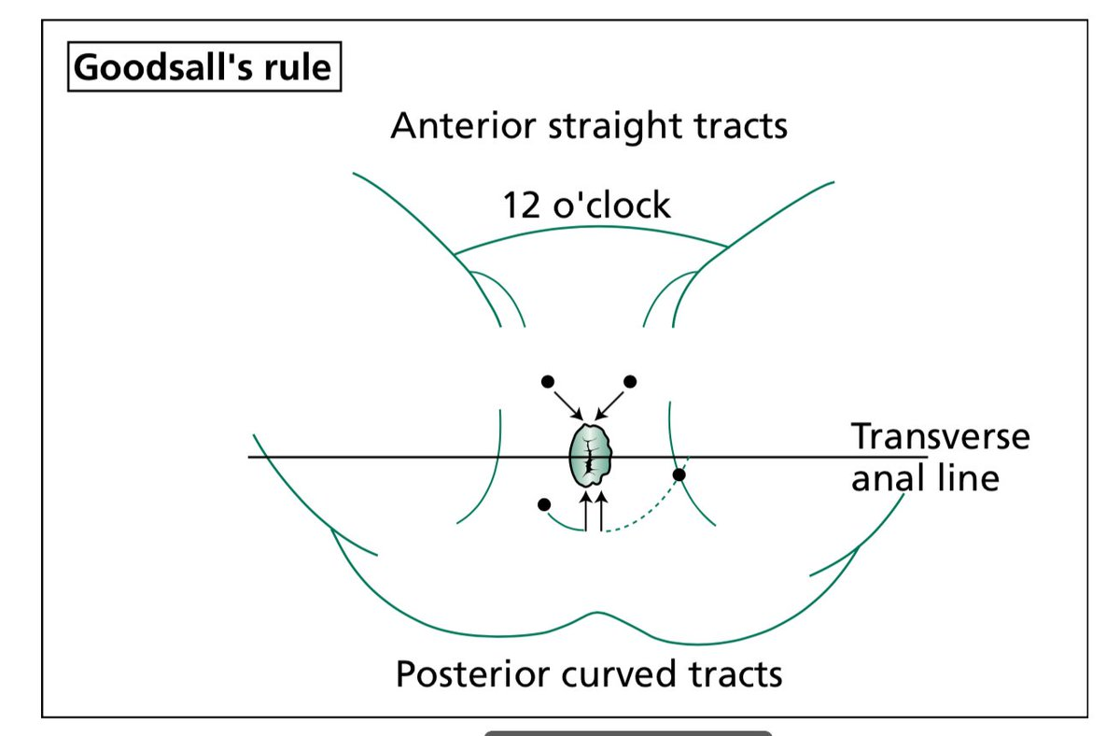

Slide 131
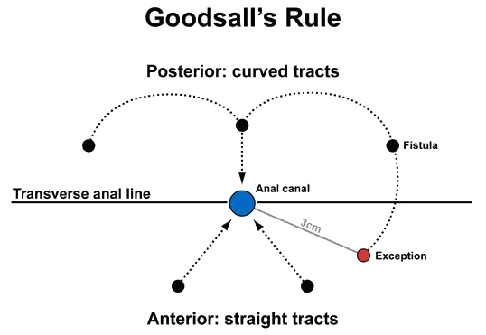

Slide 132
Diagnosis
Clinical examination plus probe under anesthesia
MRI +/- endoanal ultrasound defines complex tracts, secondary extensions
Management
Simple intersphincteric - fistulotomy (lay-open)
High/transsphincteric - draining Seton, Lift, endorectal advancement flap, FiLaC, VAAFT, mesenchymal - stem- Injection

Slide 133
Uncontrollable sepsis - staged drainage then definitive repair
Complications
Incontinence if sphincter divided too widely
Recurrence 5-30%- Higher with Crohn's
High-yield Pearls
Cryptoglandular ANC infection - intersphincteric abscess - fistula.
Always exclude Crohn's in recurrent cases

Slide 134
Acute Appendicitis
Epidemiology
Lifetime risk~7% (M > F)
Peak 10-30 years
Pathophysiology
Lumen obstruction (lymphoid hyperplasia, fecalith, neoplasm, parasites) - increased luminal pressure - venous stasis - ischemia - bacterial overgrowth - inflammation

Slide 135
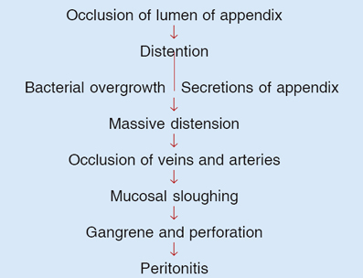

Slide 136
Presentation
Periumbilical pain - migrating to RUQ (McBurney's point)
Anorexia (80%), nausea (> 60%), low grade fever
Signs: McBurney's tenderness, Rovsing's sign, psoas/obturator signs
Lab and Imaging
WBC 10-18 × 10^3/uL with left shift; CRP increased

Slide 137
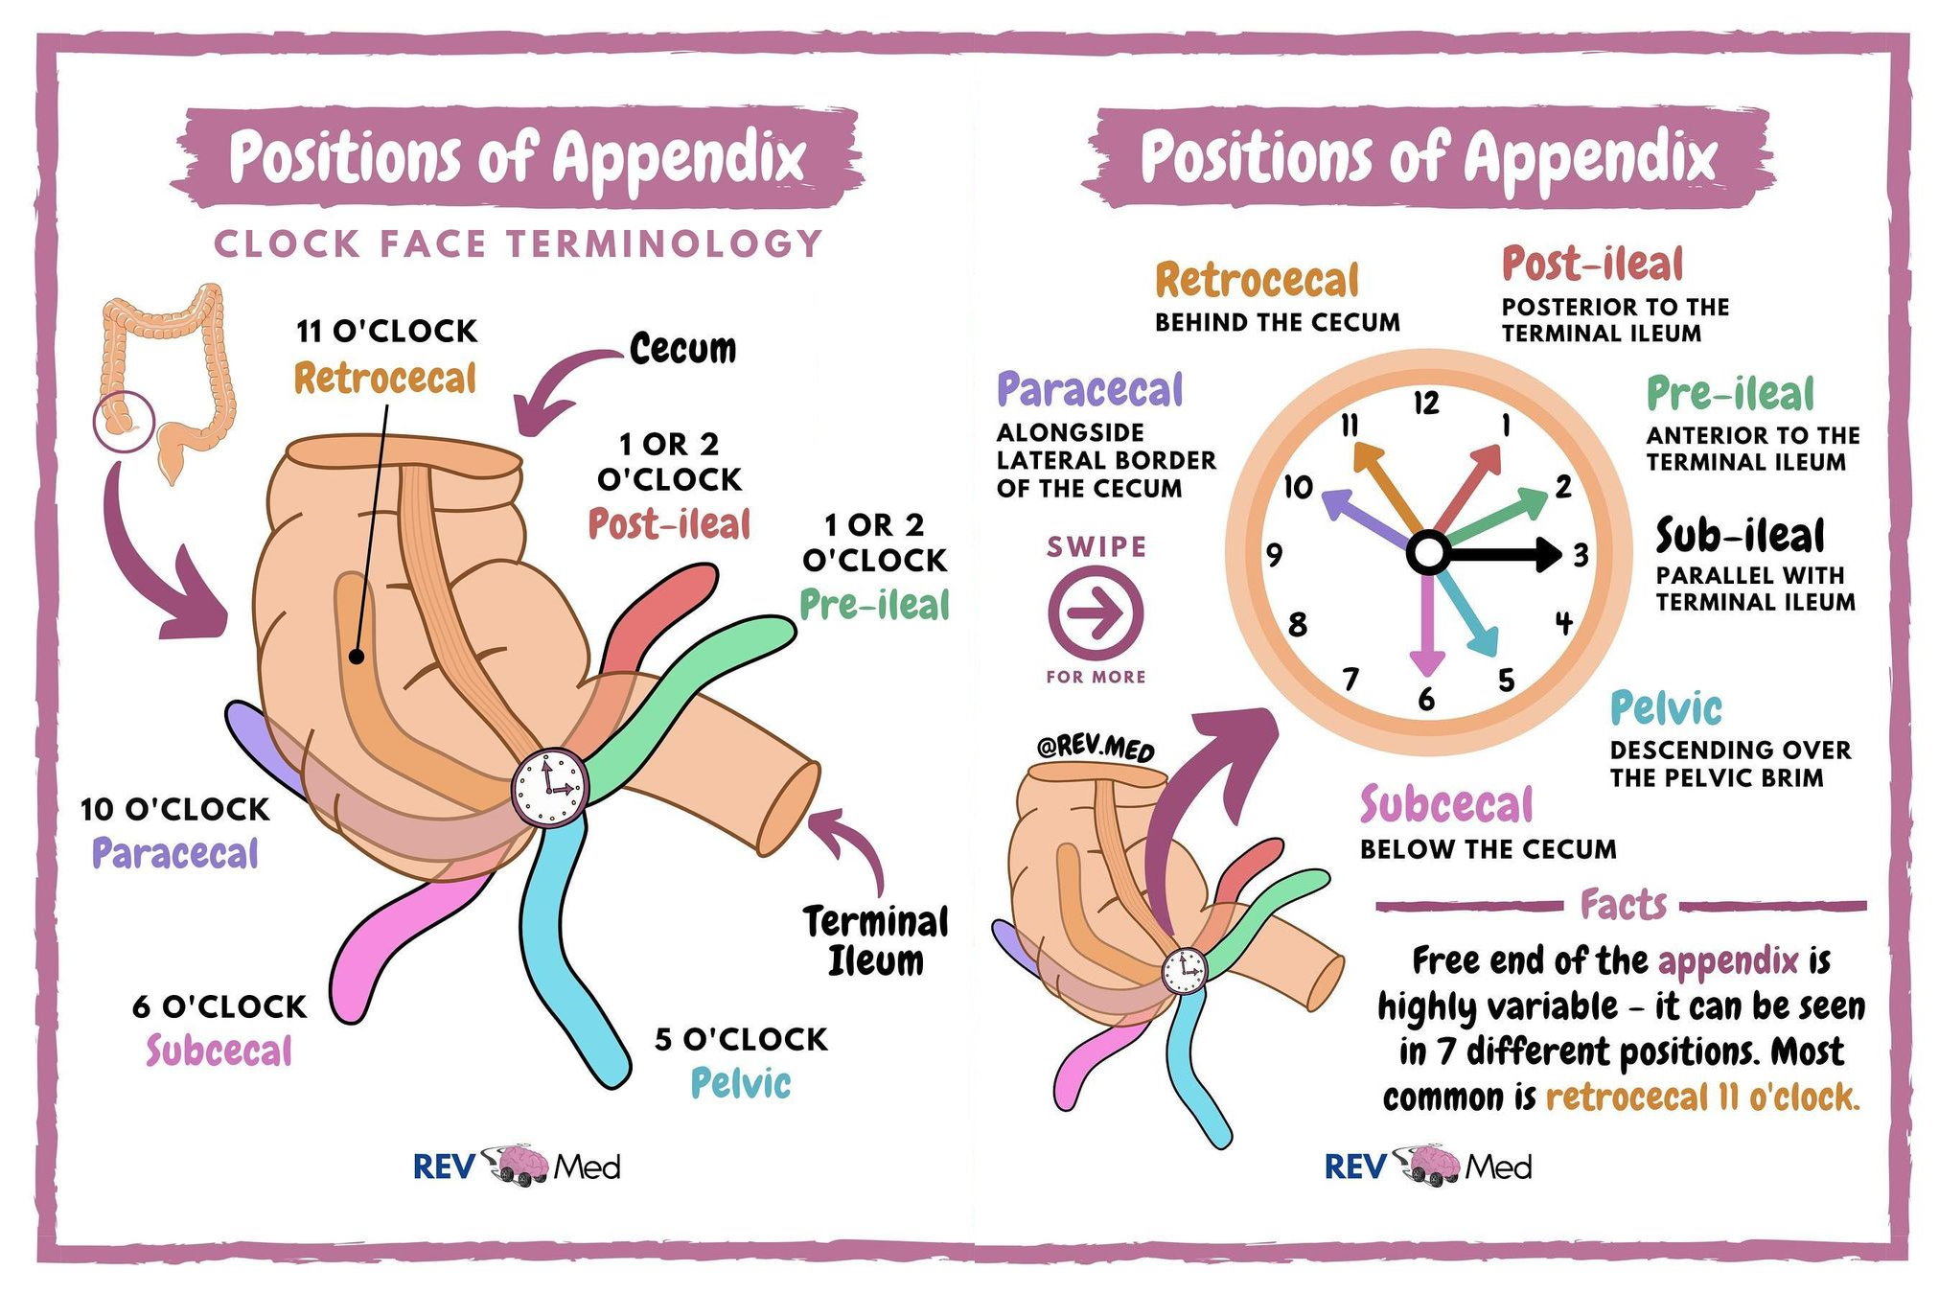

Slide 138
Reference points
Cecum:
Retro
Para
Sub
Ileum:
Pre
Post
Pelvis

Slide 139
Ultrasound in children/pregnancy: non compressible appendix > 95%
Management
Uncomplicated - laparoscopic appendectomy within 12 h
Antibiotic-only ( select cases, no fecalith, informed consent, ~ 30% Recurrence )
Perforated w/abscess - IV antibiotics plus percutaneous drain -+ interval appendectomy at 6-8 weeks

Slide 140
Complications
Perforation (10-20%), abscess, peritonitis, sepsis, SBO, pelvic abscess
High Yield Pearl
Alvarado score <\= 4 rules out,
>\= 7 rules in
Intermediate (5-6) - imaging

Slide 141
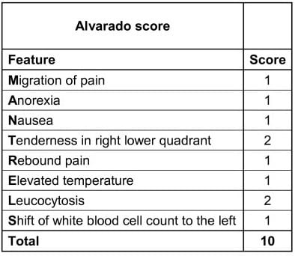

Slide 142
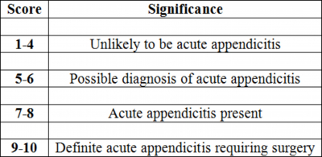

Slide 143
Burns
Classification by depth
Superficial (I): Epidermis only - red, painful, blanches, heals 5-7 days
Partial superficial (IIa): upper dermis - blister, very painful, heals 10-21 days, minimal scarring
Partial Deep: deep dermis - pale, less painful, > 21days, hypertrophic scars
Full thickness (III): Entire dermis - white/charred, painless, require grafting
Subdermal (IV): muscle/bone involvement

Slide 144
Extent - TBSA
Rule of nines, Lund-Browder chart (Children), palmar method (patient's palm~ 1% TBSA)
Pathophysiology
Local: fluid loss, edema, inflammatory mediators - zone of coag (Necrosis), stasis, hyperemia
Systemic: Hypovolemic shock (Capillary leak), systemic inflammatory response, Immunosuppression

Slide 145
Initial management
Stop burn source, cool w/ tepid water < 20 min
Airway: assess inhalation injury (facial burns, singled nasal hair, soot)
Circulation: IV access × 2 > 15% TBSA - LR fluid ( Parkland: 4 ml/kg × TBSA× Weight of the patient: half in 8 hr)
Analgesics: opioid, tetanus prophylaxis
Remove Jewelry/Clothing

Slide 146
Definitive care
Early excision/grafting of deep burns within 72 h - reduce mortality, scarring
Topical antimicrobial (Silver sulfadiazine, mafenide) on partial/full - IIb/III
Wound care, nutritional support (High - protein, high calorie), PT
Complications
Infection/sepsis, contractures, graft loss, renal failure, ARDS, hypermetabolic state

Slide 147
High Yield Pearl
Parkland formula is resuscitation guide; adjust for electrical burns and inhalation injury

Slide 148
Admission criteria for burns:
Admission criteria is based on burn severerity, patient factors and potential complications
General Principles:
Patients are admitted for;
Resuscitation
Pain control
Surgical intervention
Monitoring for complications eg inhalation injury, infection
Rehabilitation and psychosocial support

Slide 149
Admission criteria
ICU Admission
Adults with greater than or equal to 20% TBSA
Children under 5 years with greater/equal to 10% TBSA
Any paediatric patient with greater/equal to 15% TBSA
Full-thickness circumferential burns (risk of compartment syndrome)

Slide 150
Suspected inhalational injury or respiratory compromise
Hemodynamic instability (shock, arrhythmia)
High voltage electrical injuries
Ward Admission
>\= 5% TBSA partial thickness burns
Full thickness burns needing surgery within 24h
Infected burns

Slide 151
Uncontrolled pain
Elderly or frail patients
Unsafe discharge environment eg homeless, fire loss
Significant commodities or social stressors
Referral to burn center
Partial thickness burns > 10% TBSA
Burns involving the face, hands, feet, genitalia, perineum, or major joints

Slide 152
Full thickness burns > 5% TBSA
Electrical, chemical or inhalational injuries
Burns in patients with pre-existing medical conditions
Burns with concomitant trauma
Paediatric or geriatric patients with significant burns

Slide 153
Cellulitis
Definition
Acute spreading infection of dermis/subcutaneous (non purulent)
Epidemiology and risk factors
Increased incidence in adults aged 50-60 years; tinea pedis, lymphoedema, obesity, diabetes
Etiology
Group A streptococcus pyogenes > Staphylococcus aureus (MSSA/MRSA in purulent)

Slide 154
Presentation
Rapid onset erythema, warmth, swelling, tenderness, indistinct borders
Systemic: Fever, chills, lymphadenopathy
Diagnosis
Clinical: ultrasound to exclude abscess or DVT
Blood culture only if severe/systemic signs, immunocompromise, facial or hand involvement

Slide 155
Management
Non purulent: Cephalexin or dicloxacillin
Purulent: I&D + antibiotics targeting MRSA (TMS/SMX, Clindamycin, doxycycline)
IV therapy if severe: cefazolin plus vancomycin
Elevate limb, immobilization, analgesia
Complications
Abscess, necrotizing fasciitis, septic arthritis, Osteomyelitis, DVT

Slide 156
High Yield Pearl
Non purulent cellulitis seldom yields positive blood cultures (<5%).
Consider imaging for deeper infection

Slide 157
Necrotizing Fasciitis
Definition
Rapid progressive infection of fascia and subcutis - necrosis
Types
I (polymicrobial: anaerobes plus enterobacterales plus streptococci)
II (Minomicrobial: Group A Streptococcus -+ S. Aureus)
III ( vibrio, clostridial gas gangrene)
IV: Fungal (rare, immunocompromised host)

Slide 158
Key features
Rapid onset: hours to days
Severe pain: Often out of proportion to clinical findings
Skin changes: Erythema, edema, dusky or violaceous discoloration, bullae, necrosis
Systemic toxicity: Fever, hypotension, tachycardia, Altered mental status
Crepitus: May indicate gas forming organisms

Slide 159
Risk Factors
Diabetes, immunocompromised, obesity, alcoholism, NSAIDs use controversial, trauma, surgery
Clinical
Pain out of proportion, erythema - dusky, bullae, crepitus (type I), tense edema, anesthesia (late)
Systemic toxicity: Fever, hypotension, tachycardia - sepsis

Slide 160
Diagnosis
LRINEC score >\= 6 suggestive ( CRP, WBC, Hb, Na, Cr, Glucose)
Imaging: CT/MRI for facial enhancement, gas
Definitive: surgical exploration
Management
Emergent surgical debridement (Repeat 24-48h)
Broad-spectrum IV antibiotics: Carbapenem plus Clindamycin plus vancomycin

Slide 161
ICU support, fluid resuscitation, inotropes
Adjuncts: IVIG for streptococcal TSS, hyperbaric oxygen (Controversial)
Complications
Amputation, multiorgan failure, death (mortality 20%-40%)
High Yield Pearl
Clindamycin suppresses toxin production; always include for streptococcal/Staphylococcal NF

Slide 162
LRINEC Score
Laboratory Risk Indicator for Necrotizing Fasciitis
It is a clinical tool designed to help distinguish necrotizing fasciitis (NF) from other soft tissue infections using routine lab values
It's useful when diagnosis is uncertain
It is not a substitute for clinical judgement or surgical exploration

Slide 163
Scoring criteria
One of the parameters is CRP (mg/L), less 150 will give a 0 point
Greater/= 150 will give 4 points
WBCs
The other parameter is WBC
<15 will give 0 point
15-25 will give 1 point
> 25 will give 2 points

Slide 164
Hemoglobin (g/dL)
The other parameter is hemoglobin
>13.5 will give 0
11-13.5 will give 1 point
<11 will give 2 points
Sodium (mmol/L)
>\=135 will give 0
<135 will give 2 points

Slide 165
Creatinine (mg/l)
<\=1.6 will give 0 point
> 1.6 will give 2 points
Glucose (mg/L)
<\= 180 will give 0 points
> 180 will give 1 point
Interpretation
Less or equal to 6: High risk of NF
>\=8: Strongly predictive
< 6 : doesn't rule out necrotizing fasciitis

Slide 166
Acute Compartment Syndrome
Definition
Increased pressure in closed myofascial compartment - Capillary perfusion compromise
Epidemiology and causes
2-10% of tibial fractures, crush injuries, burns, tight casts, anticoagulation
Pathophysiology
Intracompartmental P > Capillary perfusion - ischemia - increased edema - vicious cycle - necrosis in 4 - 6 h

Slide 167


Slide 168
Clinical
5 Ps: Pain out of proportion, Paresthesia, Pallor, Paralysis (Late), Pulselessness (Late)
Tense, firm compartment: pain on passive stretch key
Diagnosis
Clinical diagnosis _ don't wait for pulse to disappear
Adjunct: Compartment pressure measurement, ∆P = DBP - tissue P < 30 mmHg - ischemia

Slide 169
Management
Emergent fasciotomy: decompress all involved compartments (leg × 4, forearm × 2/3)
Leave wounds open: delay closure or skin graft
Complications
Volkmann contracture, nerve injury, muscle necrosis, renal failure from rhabdomyolysis
High Yield Pearl
"If you think it, cut it" Don't delay fasciotomy for equivocal pressures if clinical picture fits

Slide 170


Slide 171
Bone Fractures
Classification
Traumatic: Closed vs Open (Gustilo-Anderson)
Pattern: Transverse, Oblique, Spiral, Comminuted, Segmental, Greenstick, Stress (fatigue vs Insufficiency)
Bone Healing
Inflammation (hematoma)
Soft callus (fibrocartilage)
Hard callus (Woven bone)
Remodeling (lamellar bone)

Slide 172


Slide 173


Slide 174
Diagnosis
Exam: deformity, crepitus, swelling, neurovascular exam
Imaging: X-ray (AP/Lateral), CT for occult or complex fractures, MRI for acute stress
Management
Reduction: closed (cast, traction) vs Open (plates, nails)
Stabilization: internal fixation ( plates/screws, intramedullary nails) or external fixators

Slide 175
Early mobilization vs weight bearing per fracture type
Complications
Non union, malunion, delayed union, infection (Osteomyelitis), fat embolism, compartment syndrome, VTE
Fracture Healing High-yield
Smoking, NSAIDS, diabetes impede healing
Compression plating, increase stability; dynamization of nails promote callus

Slide 176
Overall High Yield
Always consider anatomy and classification - guides management
Early recognition and decisive surgical intervention is key in NF and Compartment Syndrome
Utilize scoring (LRINEC, Alvarado) and measurements (∆P) only as adjunct to clinical judgement
Fluid resuscitation and metabolic support are cornerstones in burns and acute severe infections

Slide 177
Station 12: Deca
AO/OTA classification
Garden classification
Neer classification
Danis-webber classification
Salter-Harris classification
Gustilo-Anderson classification
Epicondylar fractures
Winquist and Hansen
Pauwels classification
Lauge-Hansen classification

Slide 178
AO/OTA Classification
Overview
A comprehensive, alphanumeric system all skeletal fractures and dislocations. Harmonizes the AO (Arbeitsgemeinschaft fur Osteosynthesefragen) and OTA (Orthopedic Trauma Association) schemes into one universal fracture language
Structure
Bone code - first number
1 = Humerus, 2 = Radius/Ulnar 3 = Femur, 4 = Tibia/Fibula, 5 = Spine, 6 = Pelvis, 7 = Hand, 8 = Foot, 9 = Craniofacial

Slide 179
Segmental code (second number)
1=proximal end, 2=Diaphysis, 3=Distal end
Type letter (A, B, C for Diaphysis; A, B, C for End segments)
Diaphysis
A=Simple (one fracture line)
B=Wedge (One intermediate fragment)
C=Multifragmentary (no cortical contact)

Slide 180
End segment
A=Extra-articular
B=Partial articular
C=complete articular
Group numbers (1-3) and subgroup (.1,.2,.3): further detail fracture geometry
Optional modifiers in square [ ] for displacement, soft-tissue injury, implant presence etc

Slide 181


Slide 182


Slide 183
Key points
Universal across all bones and age groups
Highly precise but complex - often used in research and registries
Encourages consistency in coding and data base retrieval

Slide 184
Garden Classification
Femoral neck fractures
Definition
Categorizes intracapsular femoral neck fractures by degree of displacement on AP radiograph
Types
Type I: Incomplete or valgus-impacted
Type II: Complete, nondisplaced
Type III: Complete and partially displaced
Type IV: Complete and fully displaced

Slide 185
Clinical relevance
Guides decision: I-II often head-preserving fixation; III-IV higher risk of avascular necrosis (AVN), consder arthroplasty in elderly
Fair inter-observer reliability except I vs II

Slide 186


Slide 187
Neer Classification
Proximal Humerus
Definition
Divides proximal Humerus fractures by numbers of "parts"
Four "Parts"
Humeral head
Greater tuberosity
Lesser tuberosity
Humeral shaft

Slide 188


Slide 189


Slide 190
Displacement Criterion
A fragment is a part if moved > 1 cm or angulated > 45°
Fracture types
One-part: No displacement
Two-part: One part displaced
Three-part: Two parts displaced
Four-part: Three parts displaced

Slide 191
Special pattern
Valgus-impacted four-part: Head impacted into shaft - better prognosis

Slide 192
Danis-Webber Classification
Ankle fractures
Definition
Classifies lateral malleolar fibular fractures by level relative to the syndesmosis
A: Below syndesmosis, syndesmosis is intact, it is stable, infrastndesmotic, Tx is cast
B: At syndesmosis (trans), syndesmosis is partially injured, variable stability, imaging stress views
C: Above syndesmosis, disrupted, unstable, suprasyndesmotic, ORIF often

Slide 193


Slide 194


Slide 195


Slide 196


Slide 197
Salter-Harris Classification
Physeal fractures
Mnemonic SALTR
S=slip (I), A=Above (II), L=Lower or below (III), T=Through (IV), R=Ram (V)
I: Through physis only, prognosis is excellent
II: Physis Plus Metaphysis, prognosis is excellent
III: Physis plus epiphysis intraarticular, prognosis fair-guarded
IV: Through the metaphysis, physis and epiphysis, prognosis is Guarded
V: Crush injury of physics - the prognosis is poor - growth arrest

Slide 198


Slide 199


Slide 200


Slide 201
Gustilo-Anderson Classification
Open fractures
I: <\=1cm, minimal soft tissue injury, contamination is low, cephalosporin plus early fixation, 1-2% infection risk
II:1-10cm, STI is moderate, moderate contamination, cephalosporin+fixation, ~10% IR
IIIA:>10%, extensive STI, cephalosporin plus aminoglycoside, IR is more than 20-30%
IIIB: IIIA+periosteal stripping, requires flap cover, contamination is high, C+A+flap, IR more than 30-50%
IIIC: any size plus vascular injury, C+A+Vascular, IR is more than 40-60%
Add penicillin and tetanus if farm contamination
3, 6, 9L respectively in washing

Slide 202


Slide 203
Epicondylar Fractures-Gartland Classification
Elbow apophyseal injuries
No universally standardized eponymous classification.
Clinically use displacement based staging
Type I: non displaced or less than or = 2 mm
Type II: Displacement > 2 mm to <\= 5mm
Type III: Displacement > 5mm
Type IV: Fragment incarcerated in joint or associated with elbow dislocation

Slide 204


Slide 205


Slide 206


Slide 207


Slide 208
Key points
Medial epicondyle avulsions in children; often managed non operatively unless incarcerated or highly displaced
Lateral epicondyle injuries are rare; similar displacement criteria apply

Slide 209
Winquist and Hansen Classification
0: non or tiny butterfly fragment, highly stable
I: Small butterfly fragment, less than 25% width, high stability
II: fragment<50% width, > 50% cortical contact, moderate stability
III: Fragment > 50%width, < 50% contact, stability is low
IV: Segmental communinution, no cortical contact, unstable
Guides choice of intermedulary nail vs Open reduction

Slide 210


Slide 211


Slide 212


Slide 213
Pauwels Classification
ANGLE OF FRACTURE VS HORIZONTAL AP RADIOGRAPH:
I: < 30°, the dominant force is compression, high union potential
II: 30-50°, shear+compression, intermediate union potential
III: > 50°, shear+varus, low union potential
More vertical fractures (Type III) leads to increased shear which leads to increased displacement risk which leads to consider rigid fixation or arthroplasty

Slide 214


Slide 215


Slide 216
Launge-Hansen Classification
Based on foot position at injury and direction of force
Stage 1:
Supination-adduction: Lateral ligament/tip of fibular
Supination-External Rotation: AITFL sprain/avulsion
Pronation-abduction: Deltoid lig. Tear/Medial malleolus
Pronation-External Rotation: Deltoid disruption/med. Malleolus fx

Slide 217


Slide 218


Slide 219
Stage 2:
Supination-adduction: Vertical fx of medial malleolus
Supination-External rotation: Spiral Oblique fibular fx
Pronation-abduction: P-malleolus avulsion
Pronation-External Rotation: AITFL tear/diastasis

Slide 220
Stage 3
Supination-adduction:
Supination-External rotatio: PITFL tear/post. Malleolus fx
Pronation-abduction: High fibular fx (> level synd.)
Pronation-External Rotation: High fibular fx

Slide 221
Stage 4
Supination-adduction:
Supination-External rotatio: Deltoid lig. Tear/medial malleolus fx
Pronation-abduction:
Pronation-External Rotation PITFL tear/Post. Malleolus fx

Slide 222
Predicts associated ligament injury and helps interpret subtle radiographic findings
Often used with webber classification for full ankle assessment

Slide 223
Station 13: Deca
Hernias
Breast examination
Examination of an Ulcer
BPH
Stomas
Obstructive Jaundice
Hemorrhoids
Snake bites
Dog bites
Testicular torsion

Slide 224
Hernias
A hernia occurs when an internal organ or tissue Protrudes through a weak spot in the surrounding muscle or connective tissue
Definition: The protrusion of an internal organ or tissue, through a weak spot in the surrounding muscle or connective tissue
Most commonly, this happens in the abdominal wall but can occur in various regions
Types: Inguinal, femoral, umbilical, hiatal, incisional
Pathophysiology: Pressure gradient vs fascial integrity

Slide 225
Key risk factors: aging, heavy lifting, chronic cough, surgical scars
Clinical pearls: reducibility, cough impulse, incarceration risk

Slide 226
Spermatic cord: 3 Arteries, 3 Nerves, 3 Fascias, 3 Other things
3 Arteries: Testicular Artery-from abdominal aorta, Artery to ductus deferens-from inferior vesical artery, Cremasteric artery - from inferior epigastric
3 Nerves: Genital Branch of genital femoral nerve-motor to cremaster, Symptomatic nerve fibers, Parasympathetic nerve fibers
Other structures: Ductus deferens (sperm transport), Pampiniform plexus (venous drainage and thermoregulation), Lymphatic vessels (drain to para-aortic nodes)

Slide 227
Fascial layers from the abdominal wall: External spermatic fascia (from external oblique aponeurosis), Cremasteric fascia and muscle (from internal oblique), Internal spermatic fascia (from transversalis fascia)
Mnemonic: Papers Don't Contribute To A Good Specialist Level, P=Pampiniform plexus, D=Ductus deferens, C=cremasteric artery, T=Testicular artery, A=Artery to ductus deferens, G=Genital Branch of genitofemoral nerve, S=Sympathetic fibers, L=Lymphatics

Slide 228
The Sac: The sac of the spermatic cord is the processus vaginalis
An out pouching of the peritoneum that descends with the testis during fetal development
It forms a tubular sac that accompanies the testis through the inguinal canal into the scrotum
After testicular decent, the upper part of the processus vaginalis obliterates

Slide 229
The lower portion remains as tunica vaginalis, a serous sac surrounding the anterior and lateral aspects of the testis
Is it the same sac that surrounds the spermatic cord?
Not quite
The sac that surrounds the spermatic cord is not the same as the processus vaginalis that surrounds the testis

Slide 230
Layers surrounding the spermatic cord:
The spermatic cord is enveloped by 3 fascial layers
Each derived from the abdominal wall testicular descent
External spermatic fascia: originates from external oblique, it is the outermost layer of the cord
Cremasteric fascia & muscle: Originates from the internal oblique muscle, Middle layer, Involved in cremasteric reflex

Slide 231
Internal spermatic fascia: Originates from transversalis fascia, Innermost layer surrounding cord contents
Deep Inguinal Ring:
Located above the midpoint of inguinal ligament
Which lies halfway between the Anterior superior iliac spines (ASIS) and the pubic tubercle
Anatomical landmark: it is lateral to the inferior epigastric vessels
Formed by invagination of transversalis fascia
It is an entry point into the inguinal canal for structures like spermatic cord and round ligament

Slide 232
Superficial Inguinal Ring:
Just above and medial to the pubic tubercle/ superolateral.
Formed by a triangular defect in aponeurosis of the external oblique muscle
It is the exit point of the inguinal canal
Where structures emerge into the scrotum or labia majora

Slide 233


Slide 234
Breast Examination
Breast examination is a disciplined ballet of inspection, palpitation and lymphatic assessment
It marries visual scrutiny with tactile expertise, seeking subtleties in contour, texture and symmetry to reveal hidden pathology
Inspection: Hands on hips, arm raised, pendulous view
Palpation techniques: Spirals, clock-face, vertical stripes

Slide 235
Evaluation of masses: Size, shape, consistency, mobility
Lymph nodes: Axillary, Supraclavicular, epitrochlear

Slide 236


Slide 237


Slide 238


Slide 239
Examination of an Ulcer
Ulcer examination is the forensic study of tissue loss _ every edge, floor and discharge tells a part of the story
It demands a systematic approach of Hx, Inspection, palpation, and Investigation
History: Onset, duration, pain, discharge, systemic illness
Inspection: Size, shape, position, edge type (punched out, undermined), margin changes
Palpation: Base induration, fluctuation, depth, arterial pulses

Slide 240
Investigation: Wound swab, Doppler, biopsy if malignancy suspected

Slide 241


Slide 243
Benign Prostatic Hyperplasia
BPH is benign yet impactful enlargement of the prostate's transition zone.
It exemplifies how gradual nodular growth can transform everyday urinary function into a landscape of obstruction and disruption
Pathophysiology: stromal and epithelial proliferation under Androgen influence
LUTS: Voiding (Hesitancy, weak stream), storage (frequency, nocturia)

Slide 244


Slide 245
Diagnosis: Digital rectal examination, uroflometry, post-void residual, PSA
Management: Alpha blockers, 5 alpha reductase inhibitors, surgical options

Slide 246


Slide 247


Slide 248


Slide 249


Slide 250


Slide 251
Stomas
A stoma is a deliberate breach in the body wall.
An engineered window that reroutes life' s essential excretions
It turns loss into managed output and demands meticulous care to preserve dignity and function
Types: Colostomy, Ileostomy, Urostomy
Indications: Malignancy resection, inflammatory bowel disease, bladder removal

Slide 252
Care essentials: Skin barrier integrity, pouch changes, hydration, diet modifications
Psychosocial aspects: Body image, intimacy, support networks

Slide 253


Slide 255


Slide 256
Obstructive Jaundice
Obstructive Jaundice is the cholestatic Crescendo of interrupted bile flow, where bilirubin accumulates to paint skin and sclera in ochre
It's a clinical siren signaling luminal, mural or extrinsic biliary blockage
Key causes: Choledocholithiasis, cholangiocarcinoma, pancreatic head mass
Symptoms: Jaundice, pruritus, dark urine, pale stool

Slide 257
Diagnostics: LFT pattern (Elevated ALP, GGT), ultrasound, MRCP/ERCP
Management: Endoscopic stenting, surgical bypass, stone extraction

Slide 258


Slide 259


Slide 260


Slide 261


Slide 262
Hemorrhoids
Hemorrhoids are vericose veins of the anal cushions
Distended portals of venous congestion that betray straining, stasis, and age
They challenge the patient with pain, bleeding and itch
Internal vs external: location and symptom profile
Presentation: painless bright red bleeding, perianal pain, prolapse

Slide 263
Treatment spectrum: Conservative (fiber, sitz bath), office procedures (banding, sclerotherapy), surgery (hemorrhoidectomy)
Prevention: avoid straining, maintain soft stools, pelvic floor exercises

Slide 264


Slide 265
Snake Bites
A snake bite is a stark encounter between a human and a serpent venom
Rapid evolutionary warfare
Understanding the venom's pharmacology unlocks targeted antivenom therapy and critical first aid measures
Venom types: Neurotoxic, Hemotoxic, Cytotoxic, Myotoxic
Clinical syndrome: Coagulopathy, Neuromuscular blockade, Local necrosis

Slide 266
First aid: Immobilize limb, rapid transport, avoid tourniquet or suction
Definitive care: Species-specific antivenom, supportive ICU measures

Slide 267


Slide 268
Dog Bites
A dog bite is a collision of canine force and human vulnerability, risking tissue disruption, infection and rabies transmission
Effective first aid and prophylaxis convert danger into manageable trauma
Wound care: through irrigation, antibiotic ointment, tetanus update
Infection risk: Pasteurella multocida, capnocytophaga, MRSA
Rabies considerations: Verify vaccination, post-exposure prophylaxis if unknown
Surgical care: Debridement, closure decisions, delayed primary closure

Slide 269


Slide 270


Slide 271
Testicular torsion
Testicular torsion is the torsional catastrophe of the spermatic cord
An Ischemic emergency where every minute counts in the battle for testicular viability
Anatomy predisposing factor: bell clapper deformity
Clinical triad: sudden scrotal pain, high ridding testis, absent cremasteric reflex
Diagnosis: clinical emergency, Doppler ultrasound as adjunct

Slide 272


Slide 273


Slide 274


Slide 275


Slide 276
Treatment: emergent surgical detorsion and bilateral orchiopexy within 6 hours

Slide 277


Slide 278


Slide 279
Station 14: Deca + 1
Types of wounds
Diabetic foot ulcer
Small bowel obstruction
Examination of a stoma
Urinary obstruction
Urethrogram
KUB X-RAY
Tracheostomy
ICD
Dysphagia
HypoK in DKA, In Diabetes without DKA

Slide 280
Types of Wounds
Abrasion: Superficial scrape of epidermis; minimal bleeding, high infection risk
Incision: Clean, sharp-edged cut; usually surgical or from glass/knife
Laceration: Irregular tear; often crush injury, higher bleeding and scarring
Puncture: Deep, narrow tract; risk of retained foreign body and infection
Avulsion: Tissue forcibly detached; requires debridement and possible reconstructions

Slide 281
Crush: compression injury causing tissue necrosis; monitor for compartment syndrome
Burns: Thermal, chemical, electrical; classified by depth (superficial to full thickness)
Pressure ulcers: Prolonged pressure over bony prominences; staged I-IV by depth and tissue loss

Slide 282


Slide 283


Slide 284


Slide 285
Diabetic foot ulcer
Pathogenesis: Peripheral neuropathy + Peripheral Artery Disease leads to lose of sensation, poor Healing
Assessment: Inspect daily; look for erythema, drainage; test monofilament sensation
Classification (Wagner):
0. Intact skin 1. Superficial ulcer 2. Deep tendon/Bone involvement 3. Abscess/Osteomyelitis; 4. Forefoot gangrene 5. Whole foot gangrene

Slide 286


Slide 287
What causes poor Healing in Diabetic patients?
Impaired blood flow
Neuropathy: Leads to injuries
Compromised immune function: High glucose causes Immunosuppression
Cellular dysfunction: Collagen synthesis is disturbed which affects reepitheliazation. High glucose inhibits the ability to close wounds.
Chronic inflammation: Chronic inflammation leads to tissue degradation. Wounds remain in inflammatory phase, delaying proliferation and remodeling.CI causes oxidative stress which hinder healing.

Slide 288
Management: Off-loading, wound debridement, infection Control (Culture-guided antibiotics) revascularization if Ischemic

Slide 289


Slide 290


Slide 291
Small Bowel Obstruction
Etiology: Adhesions, hernias, malignancy, Crohn's stricture
Clinical: Colicky abdominal pain, vomiting, obstipation, distension
COLICKY: Intermittent, crampy (twisting)
Examination: Hyperactive tinkling bowel sounds early; tympanic percussion
Imaging: Plain X-ray: Dilated small loops, air-fluid levels; CT: transition point, closed loop
Management: NPO, NG decompression, IV fluids; surgery if strangulation or no resolution in 48 h

Slide 292


Slide 293


Slide 294


Slide 295
Stoma Examination
Inspection: Color (Pink to Red moist mucosa), height (flush, protruding, retracted), peristomal skin
Palpation: Gentle assessment for firmness (tumor, hernia) and pain
Output: Note consistency, volume, frequency; relation to diet/medications
Care: Ensure appliance seal, skin barrier intact, educate patient on cleaning and measuring stoma size

Slide 296


Slide 297
Urinary Obstruction
Levels: Pre- renal (Hypovolemia, Sepsis and Heart failure), intrarenal (stones, tumors), Post renal ( bilateral ureteric blockage, Prostte and Urethra)
Symptoms: Flank pain, anuria/oliguria, distended bladder, hydronephrosis
Investigations: Ultrasound (hydronephrosis), CT urology, serum creatinine, bladder scan
Management: relieve obstruction (catheterization, stenting, nephrostomy), treat cause, prevent infection

Slide 298


Slide 299
Urethrogram
Retrograde urethrogram (RUG): Contrast injected at meatus - visualizes anterior urethra; best for stricture or trauma
Voiding cystourethrogram (VCUG): Bladder filled, images taken during Voiding - assesses posterior urethra and reflux
Indications: Urethral injury, strictures, vesicouteral reflux
Key findings: Filled- defect, extravasation, narrowing segment

Slide 300
What are the parts of the urethra?
Pre- prostatic urethra
Prostetic urethra
Membranous urethra
Penile urethra
The total length of the urethra is 18-20cm for male and 3-4cm for female

Slide 301
KUB X-ray
Definition: Kidney Ureters Bladder plain film; supine, non-contrast
Indications: Radiopaque renal stones, bowel obstruction, foreign bodies, stent position
Findings: Dilated loops, air-fluid levels, calcifications, organomegaly shadows

Slide 302


Slide 303
Tracheostomy
Indications: Prolonged ventilation, airway obstruction, secretion management
Procedure steps
Incision at 2nd-3rd tracheal ring
Create window/flap
Insert tracheostomy tube, secure cuff
Care: Humidified air, regular tube change, stoma cleaning, cuff pressure monitoring, speech/swallow assessment

Slide 304


Slide 305
Dysphagia
Types
Oropharyngeal: Difficulty initiating swallowing, nasal regurgitation, coughing
Esophageal: sensation of food sticking, regurgitation, odynophagia
Causes: Stroke, Zenker's diverticulum, achalasia, strictures, Carcinoma, scleroderma
Assessment: Barium swallow, endoscopy, manometry, neurological examination
Management: Treat underlying cause, swallow therapy, dilation, surgical correction

Slide 306


Slide 307


Slide 308


Slide 309
Hypokalemia in DKA &DM
DKA
Insulin deficiency - extracellular potassium shift out of cells
Osmotic diuresis - renal k + loss
Total body k + depleted despite normal/high serum levels initially
Insulin therapy - rapid intracellular k + shift unmasking hypokalemia

Slide 310
Lack of insulin prevents uptake of potassium
Counter regulatory hormones like glucagon, catecholamines further derive K out of the extracellular in the cells
Acidosis H+ ion enter the cells with exchange for K transiently rising serum K
Hyperglycemia exceeds renal threshold
Massive glucosuria
Glucose in tubular fluid drags water and electrolytes including K into urine
Polyuria accelerates urinary K excretion
Depleting total body stores

Slide 311
Frequent vomiting in DKA leads to further K loss
Diarrhea if present compounds depletion
Administration of insulin restoreds Na/K ATPase activity
This leads to rapid shift of K into the cell
Correction of acidosis reverses H/K exchange
Moving k into the cells
Continued diuresis in early fluid resuscitation phase perpetuates urinary K loss

Slide 312
Despite normal or high serum k on admission
Total K is markedly depleted
As insulin and fluids normalize serum glucose and ph
K shifts intracellularly and losses persist
Unmasking profound hypokalemia

Slide 313
DM
Some endogenous or exogenous insulin present - less K + shift out of cells
Mild osmotic diuresis can cause urinary K+ loss
Hypokalemia less pronounced; serum k+ often low to normal

Slide 314


Slide 315


Slide 317
Insulin
Insulin promotes Na+/K+ ATPase
These pumps move K into the cell and Na out
This maintains intracellular K levels
Insulin enhances cell membrane permeability to potassium vs secondary transporters
So when insulin is absent eg in DKA or Insulin resistance;
Na/K ATPase activity drops: K remains in the extracellular space

Slide 318
Serum K may appear normal or high but totally potassium is often depleted
Cells become functionally hypokalemic, especially in muscles or cardiac tissue
Why total Potassium is Depleted?
Renal: Diuretics, osmotic diuresis eg hyperglycemia
GI: Diarrhea, vomiting
Skin: Excessive sweating
Cellular shift: Insulin deficiency, acidosis - k shifts out of cells and H enters

Slide 319
In DKA, insulin deficiency and acidosis causes K to shift out of cells raising serum levels
But osmotic diuresis leads to massive urinary K loss
So even if serum k is 5.2 mmol/L , intracellular stores are depleted especially in muscle and cardiac cells
Total K is not equal to serum K

Slide 320
Glucagon and Catecholamines
Both glucagon and Catecholamines lower extracellular potassium by promoting cellular uptake not forcing it out
Subtle by key distinction
They do this primary through Beta-adrenergic signaling and insulin like pathways
Catecholamines (especially epinephrine):
Beta 2 receptor activation stimulates Na/K ATPASE pumps in skeletal muscle and other cells

Slide 321
This pump shifts potassium into cells in exchange for Na+ out
Rapid onset - useful in acute hyperkalemia, often exploited with nebulized salbutamol (b2-agonist)
Also reduces K+ via indirect insulin release (especially in high doses or stress states)
Glucagon:
Less prominent but still relevant:

Slide 322
Glucagon stimulates cAMP-mediated pathways, increasing Na/K ATPase activity
It may also trigger insulin release, contributing to K+ uptake (though it's clinical use for hyperkalemia is limited)
Major role in counter-regulation during hypoglycemia, but the K+ effect is physiologic, not therapeutic
Hyperkalemia Tx: Beta 2 agonists eg salbutamol is used to shift K+ into cells quickly

Slide 323
Stress response: Catecholamines lower serum K+ via B2 effects and insulin release
Glucagonoma: May show disturbances in glucose and electrolyte handling
Glucagon injection: Not standard for hyperkalemia but can mildly affect K+ dynamic

Slide 324
DM+Hypo/Hyper-Kalemia
Uncontrolled diabetes before full blown DKA
The most likely potassium status is normal to low (hypokalemia)
But it can tip towards hyperkalemia depending on cellular shifts and insulin levels
What happens in early and chronic uncontrolled diabetes:
Low insulin: Reduced Na/K ATPase leading to less K driven into cells leading to tendancy towards mild hyperkalemia

Slide 325
Osmotic diuresis (glucosuria); leads to K loss in urine. This promotes hypokalemia
Volume depletion and renin-aldosterone activation. Encourages K excretion in kidneys. This reinforces hypokalemia
Acidosis (if emerging): H+ enters cells, K exist. This can cause transient hyperkalemia.
Total body K+: often depleted even if serum K looks normal or high

Slide 326
In early DKA or poorly controlled Diabetes
Serum K may appear normal or even high but total body potassium is is deficient due to urinary losses
So in chronic poorly controlled Diabetes, hypokalemia is more likely
But as acidosis creeps in or insulin falls further, serum K may rise temporarily
A deceptive elevation masking underlying depletion

Slide 327
Station 15: Deca
Spigelian hernia
Ritcher's hernia
Litters hernia
Inguinal hernia
Hesselbachs triangle
Maydles hernia
Other hernias
Hydrocele
Epididymo-orchitis
Intercostal chest drainage

Slide 328
Spigelian hernia
A spigelian hernia is a ventral (abdominal wall) hernia through the spigelian fascia
The fibrous aponeurotic layer between between the lateral edge of the rectus abdominis and the semilunar line
It accounts for only 0.1-2% of all ventral hernias and typically occurs in the spigelian belt
A horizontal zone just below the umbilicus to the anterior superior iliac spines

Slide 329


Slide 330


Slide 331
Risk factors include anything that increases intra-abdominal pressure ( obesity, chronic cough, heavy lifting, multiple pregnancies) or weakened fascia tissues (aging, smoking, collagen disorders).
Clinically, patients may have lower abdominal pain without an obvious bulge because the hernia lies beneath the external oblique
U/S or CT is often required for diagnosis
With CT being the Gold standard

Slide 332
Definitive treatment is surgical repair
Either open or laparoscopic mesh reinforced repair because of high risk of incarceration and strangulation

Slide 333
Ritcher's Hernia
A Ritcher's hernia is a strangulation of only the antimesenteric wall the intestine through a small defect in the anterior abdominal wall
Unlike most hernias, it involves only part of the bowel circumference, so the lumen may remain patent, delaying signs of obstruction
It is termed as a partial enterocele
Mostly affects the terminal ileum
Mostly occurs at sites such as the femoral ring (36-88%), the inguinal canal (12-36%) and trocar sites for laparoscopic surgery

Slide 334


Slide 335


Slide 336
Because the trapped segment can necrose without overt obstruction, a high index of suspicion is needed in patients with groin swelling and unexplained sepsis or peritonitis
Gold standard diagnosis is made at surgery
CT and Ultrasound may show a focal protrusion of antimesenteric wall
Definitive management is prompt surgical reduction, resection of nonviable bowel and repair the defect

Slide 337
Litters Hernia
A litters hernia is a hernial sac that contains Meckel's diverticulum
It is named after Alex de Littre,
Who first reported an incarcerated femoral hernia containing a small bowel diverticulum in 1700
It is rare
It occurs in 2% of the population
Typical sites are inguinal (50%), umbilical (20%) and femoral (20%)

Slide 338


Slide 339


Slide 340
Patients present with groin or abdominal pain and a bulge
Which may strangulate both the diverticulum and adjacent bowel
Diagnosis is usually intraoperative
Treatment consists of hernia repair plus excision of the diverticulum
Mesh reinforcement is generally avoided if diverticular inflammation or perforation is present, but otherwise used per standard hernioplasty guidelines

Slide 341
Inguinal Hernia
An inguinal hernia is the protrusion of abdominal contents ( peritoneal sac plus omentum or bowel) through the inguinal canal
It is the most common hernia, comprising of 70%- 75% of abdominal wall hernias
With life time incidence of 27-43% in men and 3-6 in women
Indirect inguinal hernia: Passes laterally to the inferior epigastric vessels through the deep inguinal ring often congenital via a patent processus vaginalis

Slide 342


Slide 343
Direct inguinal hernia: Protrudes medially to the inferior epigastrics through a weakness in Hesselbachs triangle (transversalis fascia
Patients present with a groin bulge that increases on standing or straining and a dull ache or sharp pain
Complications include incarceration and strangulation
Treatment is surgical repair
Open (eg Lichtenstein tension-free mesh)

Slide 344
Or laparoscopic (TAPP or TEP)
Selected based on patient factors, hernia characteristics and surgeon expertise

Slide 345
Hesselbachs triangle
Hesselbachs triangle or inguinal triangle is a region of congenital weakness in the lower anterior abdominal wall where direct inguinal hernias protrude
It's borders are;
Medial: Lateral edge of the rectus abdominis muscle
Lateral: Inferior epigastrics vessels
Inferior: Inguinal ligament

Slide 346
Direct inguinal hernias pass through this triangle
Recognition of it's anatomy is critical during hernia repair to avoid injury to the epigastric vessels and ensure optimal mesh placement

Slide 347
Maydles Hernia
Maydles hernia is also termed as hernia in W
Contains two adjacent loops of small bowel in the sac, forming a W shaped with the central intra-abdominal loop at risk of strangulation
It accounts for about 2% of strangulated hernia
It has a high rate of intestinal necrosis
Because the tight ring compresses the middle loop first
The common sites are;

Slide 348
Femoral ring and inguinal canal
Patient present with an incarcerated hernia but may lack signs of obstruction, misleading clinicians
Diagnosis is usually at surgery, requiring careful inspection of intra-abdominal bowel proximal to the sac
Management is Emergency surgery with reduction and resection of non viable bowel

Slide 349
Other Hernias
Femoral Hernia: Through the femoral canal, below the inguinal ligament - more common in women; high strangulation risk
Umbilical hernia: Protrusion through the umbilical ring, common in infants (often resolves) but may require repair in adults
Incisional (Ventral) hernia; At a prior surgical scar
Seen in 10-20% of Laparotomies
Hiatal hernia: Protrusion of the stomach through the diaphragm, causing GERD

Slide 350
Classified into sliding (95%) and para esophageal types
Spigelian Hernia: Through the semilunar line aponeurosis, 1-2% of abdominal hernias
Obturator hernia: Through the obturator canal, rare, causes bowel obstruction in elderly women

Slide 351
Hydrocele
A hydrocele is a collection of serous within the tunica vaginalis surrounding the testicle
Causing painless scrotal swelling that transilluminates
This is usually congenital
Resolves by the age of 1-2 years
In adults hydrocele may arise idiopathically
Or secondary to infections, trauma, neoplasm

Slide 352
Physical exam and scrotal ultrasound confirm the diagnosis
Small asymptomatic hydroceles may be observed
But large and symptomatic one requires HYDROCELECTOMY
Which is surgical excision of the sac
Or aspiration with sclerotherapy
Complications include infection and recurrence

Slide 353


Slide 354
Epididymo-orchitis
Inflammation of the epididymis and testicle
Most often due to ascending bacterial infection
In men greater than 35, Neisseria gonorrhea and Chlamydia trachomatis predominate
In older men an children
E.coli and other coliforms are common
Presentation include acute unilateral scrotal pain, swelling, erythema, dysuria and fever

Slide 355
Examination shows a tender, swollen epididymis/testis and reactive hydrocele
Urinalysis, STI screen and Doppler ultrasound distinguish it from torsion
Treatment is targeted antibiotics eg Ceftriaxone plus doxycycline for STI
Fluoroquinolones for enteric organisms
Scrotal support, analgesia and ice
Complications include: Abscess, infertility and chronic pain

Slide 356
Intercostal Chest Drain
ICD uses flexible tube inserted through the chest wall into the pleural space to evacuate air (pneumothorax), blood (hemothorax), fluid (effusion), pus (Empyema), or chyle
The insertion site is the triangle of safety
Between the lateral border of pectoralis major, anterior border of latissimus dorsi, 5th ICS anterior to the Mid Axillary Line
Tubes are connected to an underwater seal drainage system

Slide 357
Allowing one way egress of air/fluid
Management principles include;
Ensuring no kink
Maintaining water seal at 2 cm H2O
Applying prescribed suction (-10 to -20cm H2O)
Monitoring swing, bubbling and output
Complications: Malposition, Infection, Organ injury
Mandate vigilance and prompt troubleshooting

Slide 359
Station 16: DECA
Acute abdomen
Lipoma and Cyst
Insertion of Cathete
Surgical instruments
1°, 2°&3° Survey
Osteomyelitis
Cieny mader classification
Types of Melanoma

Slide 360
Acute abdomen
The acute abdomen refers to the rapid onset of severe abdominal symptoms
Often indicating a surgical emergency that demands prompt evaluation to identify life threatening causes
Key red flags include peritonitis signs (guarding, rigidity), hemodynamic instability
Worse ever or tearing pain
Bilious or feculent vomiting

Slide 361


Slide 362
Green and Yellow Vomit:
These colors are usually due to bile, a digestive fluid produced by the liver
Green vomit is undigested bile from the duodenum
Seen in gastric outlet obstruction, bile reflux or early vomiting episodes
May follow vomiting after meals or in intestinal obstruction

Slide 363
Yellow Vomit is digested bile from the stomach
Common in stomach empty vomiting, Morning sickness, gastroenteritis, or food poisoning
Often benign unless persistent or accompanied by other symptoms
Orange indicates partially digested food
Seen in early stages of viral gastroenteritis, food poisoning, migraine or morning sickness
Usually not serious unless prolonged

Slide 364
Pink and red suggest hematemesis
Pink indicates small amounts of blood, possibly from mucosal irritation, esophagitis or Mallory - Weiss tears
May be mixed with food or mucus
Red indicates fresh undigested blood
Active upper GI bleeding from PUD, esophageal varices or gastric cancer
Requires urgent medical attention

Slide 365
Black vomit is caused by oxidized blood culture
Often described as "coffee ground" emesis
Associated with; Peptic ulcers, Gastritis, Esophageal varices, GI malignancy
Always warrants immediate evaluation
Clinical pearls
Color progression: vomit may change from orange to yellow/green to clear as the stomach empties

Slide 366
Red flags
Vomiting resembling coffee grounds
Persistent vomiting greater than 48 hours
Associated symptoms: severe pain, dehydration, dizziness, fever

Slide 367
Differential diagnosis span multiple organ system
Gastrointestinal: appendicitis, obstruction, perforation, Ischemia
Hepatopancreaticobiliary: Pancreatitis, cholecystitis, cholangitis
Urological: Ureteric colic, testicular torsion
Gynaecological: Ectopic pregnancy, ovarian torsion, PID

Slide 368
Vascular: Ruptured AAA, mesenteric ischemia
Medical: MI,DKA, Spontaneous bacterial peritonitis
Assessment follows ABCDE approach
Airway and C-spine: secure airway, inline neck protection
Breathing: Inspect, auscultate, chest imaging if needed
Circulation: Large-bore IV access, resuscitate, control external hemorrhage

Slide 369
Disability: GCS, rapid neural check
Exposure: Full abdominal examination, warm patient
Investigations
Labs: FBC, U&Es, LFTs, amylase, CRP, beta-HCG
Imaging: Urgent CT abdomen/pelvis with, ultrasound for gallbladder, FAST in unstable patients

Slide 370
FAST
FAST stands for Focused Assessment with Sonography for Trauma
It's is a rapid bedside ultrasound protocol used to detect free fluid
Typically blood in the peritoneal, pericardial, or pleural spaces especially in trauma or shock scenarios
Purpose of FAST in acute abdomen
Primary goal: identify life threatening internal bleeding

Slide 371


Slide 372
Used in: Blunt or penetrating trauma, hypotension or undifferentiated acute abdominal pain
Why it matters: Free fluid often signals severe pathology like hemorrhage, perforation or ruptured ectopic pregnancy
FAST Views
RUQ (Morison' s Pouch): between the liver and right kidney
LUQ (Splenorenal recess): Btwn the spleen and left kidney

Slide 373
Pelvis (Pouch of Douglas or rectovesical space): Behind the bladder
Subziphoid (Pericardial view): for pericardial effusion
Extended FAST (eFAST)
Adds;
Lung views: To detect pneumothorax or hemothorax
More cardiac view: for temponade or effusion

Slide 374
Clinical pearls for Acute abdomen
Positive fast= free fluid - consider urgent surgical consult
Negative FAST doesn't rule out injury - may need CT or serial exams
FAST is most useful in unstable patients where time is critical

Slide 375
Initial management
NPO, IV fluids (permissive hypertension until hemorrhage controlled)
Analgesics, antiemetics, Broad-spectrum antibiotics
NGT
Catheterization
Urgent surgical consultation for definitive treatment based on diagnosis

Slide 376
Lipoma and Cyst
Both are subcutaneous lumps
They differ in origin, texture and management
Lipoma:
Benign tumor of mature fat cells beneath the skin
Soft, rubbery and freely mobile (doughy)
Painless unless compression nerves; slow-growing (weeks to years)
Typically located on trunk, shoulders, arm or thighs

Slide 377


Slide 378
No Central punctinum; does not transilluminate
Cyst
Encapsulated sac with fluid, pus or keratin
Firmer or fluctuant, may be fixed or less mobile
Can become tender, red or warm if Infected
Common on face, scalp, neck or back; often has a central punctum
May transilluminate if filled with clear fluid; risks include rupture and infection

Slide 379


Slide 380
Diagnosis is clinical, aided by ultrasound or MRI if unclear
Treatment
Lipoma: observation unless symptomatic: surgical excision for discomfort or cosmetic concerns
Cyst: incision and drainage for infected cysts; surgical excision of the sac to prevent recurrence; antibiotics if Infected

Slide 381
Urinary Catheter Insertion
Must be performed under strict asepsis to prevent catheter associated UTIs (CAUTIs)
Components of a sterile insertion bundle include hand hygiene, sterile gloves, drapes, antiseptic cleaning, sterile lubricating jelly and a closed catheter kit with a drainage bag
Stepwise technique
Explain the procedure, obtain consent; position supine with legs apart

Slide 382
Don face protection and sterile gown; open catheter kit aseptically
Perform antiseptic periurethral cleaning; let area dry
Lubricate catheter tip; spread labia (females) or foreskin in males
Advance catheter through urethra until urine appears; insert a further 2-5 cm
Inflate balloon with 10 ml of sterile water if using Foley's catheter; gently retract until seated

Slide 383
Secure catheter to thigh; attach drainage bag below bladder level
Dispose of contaminated materials; perform hand hygiene
Maintenance
Daily meatle care with soap and water; avoid antiseptics
Keep drainage system closed; never disconnect unnecessarily

Slide 384
Regularly empty bag below bladder level; secure tubing to prevent traction
Change only if obstruction, leakage or contamination occurs
Assess daily for catheter necessity and remove when no longer indicated to reduce CAUTI risk

Slide 385
The length of time a catheter can remain in place varies
Ranges from 4 weeks to 12 weeks
Short term catheters should be removed after a month
Long term catheters should be removed after 3 months
Short term catheters: PTFE (Teflon)
Long term catheters: Silicone, Hydrogel, Silastic

Slide 386


Slide 387


Slide 388
Surgical Instruments
Surgical instruments are specialized tools designed to perform tasks such as cutting, dissecting, grasping, and retracting tissue with precision
Key categories include:
Cutting and Dissecting
Scalpel (#10, #11, #15 blade) for skin and fascia incisions
Scissors (Metzenbaum, Mayo) for tissue dissection

Slide 389


Slide 390


Slide 391
Clamping and Occluding
Hemostats (Kelly, mosquito) for vessel control
.Towel clamps, intestinal clamps
Grasping and Holding
Tissue forceps (Adson, DeBakey) for duplicate structures
Needle holders (Moyo-hegar) for suturing
Retracting and Exposing
Hand held retractors (Volkmann, Senn)

Slide 392

Hemostat forceps

Slide 393

Towel clamps

Slide 394

Intestinal clamp

Slide 395

Tissue forcep

Slide 396

Needle holder

Slide 397

Handheld Retractor

Slide 398
Self-retaining (Balfour, Weitlaner)
Suturing and stapling
Needle drivers, suture scissors
Skin staplers, endoscopic staplers for bowel anastomosis
Endoscopic and Minimally Invasive
Trocars, laparoscopic graspers, electrocautery probes

Slide 399

Self retaining retractor

Slide 400

Suture scissors

Slide 401

Trocars
A sharp pointed surgical instrument used to access body cavities
Most commonly during laparoscopic keyhole surgery
It serves as a portal for introducing cameras

Slide 402

Bone rongeur
It's a heavy duty surgical instrument with sharp-edged, scoop-shaped tips
It is designed to gnaw, cut or remove small pieces of bone
Rongeur is a french word which means gnawer
Fitting for it's rodent like action on bone

Slide 403
Specialized:
Bone rongeurs, osteotomes, periosteal elevators in orthopedics
Harmonic scalpel for ultrasonic cutting and coagulation
Poor sanitation, maintenance and ergonomic design are essential for optimal performance and patient safety

Slide 404
Primary, Secondary & Tertiary Survey in Trauma
Primary Survey
ABCDE
Airway with C-spine control
Breathing and Ventilation
Circulation and Hemorrhage control
Disability - GCS, Pupils
Exposure and Environmental Control
Perform interventions simultaneously eg needle decompression for tension Pneumothorax and repeat if patient detoriates

Slide 405

C-spine control
To prevent movement of the vertical vertebrae C1 to C7
This is to minimize the risk of spinal cord injury or worsening existing injuries
Hands placed on either side of the patient until cervical collar
This is called manual in line stabilization
Full spinal immobilization: Collar, Head blocks, and straps on the spinal board

Slide 406


Slide 407
Secondary survey
Once stable, perform a detailed head to toe evaluation and focused history using AMPLE (Allergies, Medications, Past Hx, Last Meal, Events) to identify all injuries
Tertiary Survey
Within 24 to 48 hours repeat comprehensive examination and review all imaging and labs to detect missed injuries from ~ 10% to < 5% in admitted trauma patients

Slide 408
Osteomyelitis
Osteomyelitis is bone infection, either acute (suppurative inflammation within days) or chronic (necrosis, sinus tracts over weeks to months).
Hematogenous: Seeding from blood stream, common in children's long bones and adult vertebrae
Contiguous: Spread from adjacent wound or surgical site, seen in diabetic foot ulcers
Direct inoculation: from open fractures to surgery

Slide 409


Slide 410


Slide 411

Acute, Subacute and Chronic Osteomyelitis
Acute: Less than 2 weeks
Subacute: 2 weeks to 2 months
Chronic is greater than 2 months

Slide 412
Clinical features
Acute: fever, bone pain, erythema, swelling
Chronic: Persistent sinus tract, non healing ulcer, deep bone pain without systemic signs
Investigations
Labs: Elevated WBCs, CRP, ESR (acute>chronic)
Imaging: X-ray: may lag 10-14 days before signs appear
MRI gold standard: 90% sensitivity for marrow edema and necrosis

Slide 413
CT: Cortical changes in chronic cases
Bone scan or PET for inconclusive MRI
Definitive: Bone biopsy with culture and histology
Management
Antibiotics for 4-6 weeks tailored to culture; IV initially, then oral for chronic cases eg Flucloxacillin for MSSA; Vancomycin for MRSA
Surgery: Debridement for necrotic tissue, abscess drainage, removal of hardware if Infected

Slide 414
Adjuncts: Off-loading diabetic foot, negative-pressure wound therapy

Slide 415
Cieny mader classification
Classifies chronic Osteomyelitis by anatomical involvement and host physiology
Type I: medullary, infection confined to the medullary cavity eg intramedullary rod infection
Type II: Superficial, infection of cortical surface only, adjacent to a Wound or sinus
Type III: Localized, Full-thickness cortical and medullary infection without loss of stability
Type IV: Diffuse, Segmental infection through out bone with loss of structural integrity

Slide 416


Slide 417


Slide 418


Slide 419
Host class
A: health, normal immune status and soft tissue
B: Compromised, local/systemic factors impair healing eg diabetes, PVD
C: Treatment risk>Benefit: Morbidity of treatment outweighs potential benefits

Slide 420
Types of Melanoma
Melanoma subtypes are based on growth pattern, location and histology
Superficial spreading:
~70% of cutaneous melanomas
Flat or slightly raised, irregular border, varied color
Grows horizontally before vertical inversion
Nodular
App 15%

Slide 421

Superficial spreading Melanoma

Slide 422

Nodular melanoma

Slide 423
Rapid vertical growth, dome-shaped nodule, black or amalanotic
Common on trunk and head/neck
Lentigo-Maligna:
Follows long radial growth phase on sun-exposed skin, then Invasive nodule
Often seen on faces of older adults
Acral Lentiginous:
1-3%

Slide 424

Lentigo-Maligna melanoma

Slide 425

Acro-lentigous

Slide 426
Appears on palms, soles, nailbeds, not uv related
More common in darker-skinned individuals
Rare subtypes
Desmoplastic: Often amalanotic, head/neck location
Spitzoid: Mimic benign Spitz nevus, occurs in children
Mucosa: arises on mucous membranes (sinonasal, oral, genital)
Ocular: Affects uvea or retina; risk factors include light eye color
Early detection using ABCDE criteria and prompt excision improves 5 year survival to > 90%

Slide 427


Slide 428


Slide 429


Slide 430


Slide 431
Station 17: Tetra-
Perforate Peptic Ulcer Disease
Acute diverticulitis
Acute pancreatitis
Mesenteric Ischemia

Slide 432
Perforate PUD
Perforated PUs occur when an acid peptic erosion transects the full thickness of the gastric or duodenal wall
Allowing air and gastric contents to spill into the peritoneal cavity
Lifetime risk of perforation among patients with peptic ulcer disease is about 5%
Mortality overall approaches 10% and arises sharply with delayed intervention, advanced age and morbidities

Slide 433
Clinical presentation;
Sudden, severe epigastric pain radiating across the abdomen
Board-like abdominal rigidity and rebound tenderness
Shoulder tip pain from Diaphragmatic irritation
Tachycardia, hypotension, oliguria in advanced cases
Diagnosis

Slide 434
Upright chest or abdominal radiograph showing free subdiaphragmatic air in 80% of cases
Contrast - enhanced CT detecting free air and fluid with 95-98% sensitivity
Laboratory findings: Leukocytosis, Elevated CRP, Metabolic acidosis if advanced
Management
Resuscitation with IV Crystalloids and correction of electrolytes

Slide 435
Broad-spectrum antibiotics covering gram negative and anaerobes plus high dose proton pump inhibitor
Nasogastric decompression and adequate analgesia
Surgical repair: Laparoscopic omental (Graham) patch if stable and symptom duration less than 24 hours; open repair if unstable
Non-operative management for sealed small perforations without peritonitis with serial exams and imaging

Slide 436
High Yield Pearls
Time to OR correlates inversely with survival
Free air on XR in an unstable patient warrants immediate surgery without CT
Always biopsy gastric ulcer margins to exclude malignancy

Slide 437
Acute Diverticulitis
Definition and Epidemiology
Acute diverticulitis arises when colonic diverticular become inflamed or Infected
Prevalence increases with age, affecting over half of patients older than 60.
Complications such as abscess or perforation occur in roughly 10% of cases
Clinical features
Steady, dull pain the left lower quadrant

Slide 438
Fever, tachycardia, Leukocytosis
Altered bowel habits, nausea, vomiting urinary symptoms
Diagnosis
CT abdomen with IV contrast: confirms wall thickening, pericolic fat stranding, abscess formation
Ultrasound alternative in early or low risk cases
Colonoscopy defered until 6-8 weeks post-recovery to exclude malignancy

Slide 439
Management
Uncomplicated cases: Outpatient oral antibiotics (Covering gram negatives and anaerobes), analgesia, dietary modifications
Hospitalize for IV fluids, IV antibiotics, bowel rest in complicated or high risk patients
Percutaneous drainage for abscess > 3 cm
Emergency surgery for generalized peritonitis, obstruction, or uncontrolled sepsis
Elective sigmoid resection after two episodes of complicated diverticulitis

Slide 440
High Yield Pearls
Distinguish microperforation from free perforation to guide management
Abscess < 3 cm often resolves with antibiotics alone
Delay colonoscopy until acute infection has settled

Slide 441
Acute Pancreatitis
Etiology and classification
Gallstones (40-70%) and ethanol abuse (25-30%) account for most cases
Other causes fit the mnemonic " I get smashed"
Severity is defined by the revised Atlanta Criteria
Mild: no organ failure and no local complications
Moderate: organ failure is transient less than 48 hours, local complications are; peripancreatic fluid collections, sterile necrosis

Slide 442
Severe: Persistent - organ failure is greater than 48 hours; Local complications - Infected necrosis, systemic complications
Clinical Presentation
Intense epigastric pain radiating to the back
Nausea, fever, vomiting, low grade fever
Epigastric tenderness, hypoactive bowel sounds, possible pleural effusion

Slide 443
Diagnosis
At least two of: Characteristic pain, amylase or lipase > 3× upper limit, Imaging Findings
CT only if diagnosis unclear or no improvement after 72 hours
Hemoconcentration (hematocrit > 44% ) and CRP > 150 mg/l at 48 hours predicts severe disease

Slide 444
Management
Aggressive fluid resuscitation: 20 ml/kg bolus then 3 ml/kg/hour
Early enteral nutrition within 48 hours
Adequate analgesia with opioids or ketorolac
ICU admission for persistent SIRS or organ dysfunction
ERCP within 24 hours for suspected cholangitis

Slide 445
Delay invasive necrosis management until walled-off stage (4-6 weeks)
High Yield Pearls
Early goal-directed fluids reduce morbidity
Avoid prophylactic antibiotics unless infection confirmed
Monitor for systemic complications: ARDS, Renal failure

Slide 446
Mesenteric Ischemia
Etiologic types and Risk Factors
Mesenteric Ischemia results from inadequate splanchnic perfusion
Major subtypes include embolic, thrombotic, non occlusive and venous thrombosis
Arterial Embolism:
The approximate % is about 40-50%, key features are sudden onset, often from arterial fibrilation

Slide 447
Arterial Thrombosis:
20-30%
Progressive symptoms on atherosclerotic background
Non occlusive (NOMI):
20%
Low flow states, vasopressor use, heart failure

Slide 448
Venous Thrombosis:
5-15%
Hypercoagulable states, intra-abdominal inflammation
Clinical Presentation
Severe pain out of proportion to abdominal findings
Nausea, vomiting, diarrhea, GI bleeding
Metabolic acidosis and elevated Lactate in advanced stages

Slide 449
Diagnosis:
CT angiography: Gold standard with > 90% sensitivity and specificity
Mesenteric duplex ultrasound if CT contraindicated
Elevated D dimer may prompt imaging in low risk patients
Management
Immediate IV fluids and correction of acid base disturbances

Slide 450
Broad-spectrum antibiotics to prevent bacterial translocation
Prompt revascularization: Embolectomy, surgical by pass, endovascular stenting, intra-arterial vasodilators in NOMI
Resection of non viable bowel with planned second look Laparotomy in 24-48 hours
Anticoagulation for mesenteric venous Thrombosis

Slide 451
High Yield Pearls
Maintain high suspicion in elderly patients with atrial fibrillation
Perform early CT angiography before peritoneal signs develop
Use damage control surgery with delayed anastomosis in unstable patients

Slide 452
Station 18: Deci
Pancreatic necrosis
Acute cholangitis
Biliary colic
Gall bladder Empyema
Hepatic abscess
Splenic rupture
Chronic cholelithiasis
Primary sclerosing cholangitis

Slide 453
Pancreatic Necrosis
Irreversible death of pancreatic tissue due to severe acute pancreatitis
Caused by gallstones, hypertriglyceridema, trauma
The pathophysiology is Ischemia plus autodigestion by activated enzymes will lead to necrosis with/without infection
Contrast enhanced CT after 72 hours; look for non enhancing areas
Complications include; infected necrosis, sepsis, hemorrhage, organ failure
Mx: sterile - supportive (fluids, analgesics, nutrition)
Infected: ABXs + drainage ( percutaneous, endoscopic or surgical)

Slide 454


Slide 455
Acute Cholangitis
Biliary tract infection due to obstruction - usually CBD stone
Classic triad: Fever, RUQ pain, Jaundice ( Charcot's triad)
Pentad: + Hypotension, altered mental status (Reynolds)
Etiology: Choledocholithiasis, malignancy, structure
Diagnosis: Clinical plus labs (^WBCs, ^Bilirubin, ^ALT) plus Imaging (US, MRCP)

Slide 456


Slide 457
Management
Resuscitation+IV antibiotics
Urgent biliary decompression (ERCP-/+stent)

Slide 458
Biliary Colic
Intermittent RUQ pain due to transient cystic duct obstruction by gallstones
Features: Postprandial pain esp fatty meals, lasts less than 6 hours, no systemic signs
Diagnosis: Clinical+RUQ ultrasound (gallstones, normal GB wall)
Mx: analgesia (NSAIDs), Elective laparoscopic cholecystectomy if recurrent

Slide 459
Gallbladder Empyema
Suppurative cholecystitis with pus in GB lumen
Etiology: Progression from acute cholecystitis; often obstructed cystic duct
Features: Severe RUQ pain, fever, Leukocytosis, sepsis
Diagnosis: US/CT shows distended GB with Debri , thick wall, pericholecystic fluid
Mx: urgent antibiotics, Emergency cholecystectomy or percutaneous drainage if unstable

Slide 460
Hepatic Abscess
Localized pus collection in Liver parenchyma
Pyogenic (bacterial), amebic (E. Histolytica), fungal (candida)
Etiology: Biliary infection, portal pyemia, trauma, post-op
Features: Fever, RUQ pain, hepatosplenomegaly, sepsis
Diagnosis: US/CT+Blood cultures.
Mx: IV antibiotics, percutaneous drainage+/-surgery

Slide 461
Splenic Rupture
Traumatic or spontaneous tear of splenic capsule
Etiology: Blunt trauma, infections (EBV), hematologic malignancy
Features: LUQ pain, Kehr's sign (refered shoulder pain), hypotension
Diagnosis: FAST scan, CT abdomen
Management
Hemodynamically stable: Observation+/-embolization
Unstable: Emergency Laparotomy+/-splenectomy

Slide 462
Chronic Cholelithiasis
Long standing gallstones with recurrent biliary symptoms
Chole- bile or gall, litho- stone, iasis process
Features: Recurrent biliary colic, dyspepsia, Postprandial pain
Complications: cholecystitis, Empyema, gallstone ileus, GB cancer
Diagnosis: RUQ ultrasound
Mx: Elective laparoscopic cholecystectomy

Slide 463
Choledocholithiasis
Stones in the common bile duct
Features: Jaundice, biliary colic, cholangitis, pancreatitis
Diagnosis: ^bilirubin , ^ALP, dilated CBD on US/MRCP/ERCP
Management
ERCP within stone extraction
Cholecystectomy after clearance

Slide 464
Primary Sclerosing Cholangitis
Chronic progressive inflammation and fibrosis of intra/extra hepatic bile ducts
Association: Ulcerative colitis
Features: Fatigue, pruritus, cholestatic LFTs, Jaundice
Diagnosis: MRCP/ERCP shows beading of ducts
Complications: Cholangiocarcinoma, cirrhosis, portal hypertension
Mx: no cure, supportive, liver transplant if end stage

Slide 465
Pancreatic Cyst
Types:
Pseudocyst: post- Pancreatitis, lacks epithelial lining
Neoplastic: serous cystadenoma, mucinous cystic neoplasm, IPMN
Features: Asymptomatic or abdominal pain, mass effect
Diagnosis: CT/MRI plus EUS with cyst fluid analysis

Slide 466
Management:
Pseudocyst: observe or drain if symptomatic
Neoplastic: Surgical resection if malignant potential

Slide 467
Station 19: Triquetra
Pancreatic carcinoma
Liver metastasis
Cirrhosis with portal hypertension

Slide 468
Pancreatic Carcinoma
Types: Mostly commonly pancreatic ductal adenoma (PDAC) from exocrine ducts.
Risk Factors: Smoking, chronic Pancreatitis, diabetes, BRCA mutations, age > 60
Symptoms: Painless jaundice, weight loss, epigastric/ back pain, new onset diabetes, steatorrhea
Signs: Courvoisier's sign, migratory thrombophlebitis (Trousseau's sign)

Slide 469


Slide 470


Slide 471
Diagnosis:
Imaging: CT pancreas protocol, EUS -/+biopsy
Tumor marker: CA19-9 not diagnostic, but useful for monitoring
Treatment
Resectable: Whipple procedure (pancreaticoduodenectomy)
Unresectable: Chemotherapy+/-radiotherapy eg FOLFIRINOX
Prognosis: Poor-Often diagnosed late; 5 year survival<10%

Slide 472
Liver Metastasis
Definition: Secondary liver tumors from hematogenous spread (Most commonly from GI, breast, lung)
Symptoms: Often asymptomatic; may present with hepatosplenomegaly, RUQ pain, weight loss, Jaundice
Diagnosis:
Imaging: Contrast enhanced CT/MRI, PET-CT
Biopsy: If primary unknown or atypical imaging

Slide 473


Slide 474
Treatment
Systemic: Chemotherapy tailored to primary
Local: Resection esp colorectal, RFA, TACE, or TARE
Prognosis: Depends on primary tumor biology and extent; colorectal liver Mets may be curable with resection

Slide 475
Cirrhosis with Portal HTN
Etiology: Alcohol, viral hepatitis (B/C), NAFLD, autoimmune, metabolic eg Wilson's disease
Pathophysiology: Fibrosis - increased intrahepatic resistance - portal pressure > 12 mmHg
Complications
Varices: Esophageal/gastric - risk of bleeding
Ascites: Due to splanchnic vasodilation and RAAS activation
Splenomegaly: Hypersplenism - cytopenias

Slide 476


Slide 477
Hepatic encephalopathy: Ammonia accumulation
Diagnosis
Clinical: Stigmata of chronic liver disease
Imaging: Doppler ultrasound, elastography
Endoscopy: variceal screening
Management
Non selective beta blockers: reduce variceal bleeding risk

Slide 478
Endoscopic banding: For large varices
Diuretics plus salt restriction: For ascites
Lactulose/Rifaximin: For encephalopathy
TIPS: For refractory variceal bleeding or ascites
Monitoring: MELD score,AFP for HCC surveillance

Slide 479
Station 20: Decagon
Colorectal carcinoma
Ulcerative colitis
Crohn's disease
Upper and lower GI Bleeding
PUD refractory to medical treatment
GERD with Barrettes Esophagus
Achalasia
Hiatal hernia
Esophageal carcinoma

Slide 480
Colorectal Carcinoma
Definition: Malignant epithelial tumor of the colon or rectum, most commonly adenocarcinoma.
Risk Factors:
Age > 50
Family history
IBD: UC > Crohn's
FAP
Lynch syndrome

Slide 481


Slide 482


Slide 483


Slide 484


Slide 485


Slide 486
Diety - low fiber, high red meat
Smoking
Presentation
Left sided: Change in bowel habits, obstruction, hematochezia
Right sided: Occult bleeding, iron deficiency anemia
Diagnosis
Surgical resection+/-adjuvant chemotherapy eg FOLFOX

Slide 487
Targeted therapy for metastatic disease eg anti-EGFR, anti-VEGFR

Slide 488
Ulcerative Colitis
Definition:
Chronic inflammatory bowel disease affecting the colon and rectum with continuous mucosal inflammation
Features:
Bloody diarrhea
Urgency
Tenesmus
Abdominal pain

Slide 489
Extra intestinal:
PCS
Arthritis
Uveitis
Erythema nodosum
DIAGNOSIS
Colonoscopy with biopsy (continuous inflammation)
^Fecal calpritectin: A non invasive stool test that measures the level of protein calprotectin, a marker of inflammation in intestinal wall.

Slide 490


Slide 491
MANAGEMENT
Mild to moderate: 5-ASA (Mesalazine)
Severe: Corticosteroids, immunomdulators, biologics
Surgical: Total proctocolectomy curative
COMPLICATIONS
Toxic mega colon
Colorectal cancer (Screening after 8 years)

Slide 492


Slide 493


Slide 494


Slide 495


Slide 496
Crohn's Disease
DEFINITION
Transmural inflammation affecting any part of the GIT (Mouth to Anus) with skip lessions
FEATURES
Diarrhea (+/-blood)
Weight loss
Abdominal pain
Fistulas
Strictures

Slide 497
Extra intestinal
Similar to UC
Diagnosis
Colonoscopy with biopsy (cobblestoning, granulomas)
MRI/CT enterography
Management
Mild to moderate: Budesonide, 5-ASA (limited role)

Slide 498
Severe: Corticosteroids, immunomdulators, biologics
Surgical: Reserved for complications eg obstruction, fistula
Complications
Malabsorption
Strictures
Fistulas
Abscess

Slide 499
Upper and lower GIB
Upper GI Bleeding
Source: Esophagus, Stomach, Duodenum
Presentation: Hematemesis, Melena
Causes: PUD, Varices, Mallory weiss, gastritis
Diagnosis: Endoscopy
Management: Resuscitation, PPI, endoscopic hemostats

Slide 500


Slide 501
Lower GI Bleeding
Jejunum, colon, rectum- source
Hematochezia - presentation
Causes : Diverticulitis, angiodysplasia, cancer, IBD, hemorrhoids
Diagnosis: Colonoscopy, embolization, surgery if needed

Slide 502
PUD (Refractory)
Definition:
Ulcer not healing after 8 to 12 weeks of PPI therapy
Causes
Persistent H. pylori
NSAIDs use
Smoking
Zollinger Ellison syndrome
Poor drug compliance

Slide 503
Diagnosis
Repeat endoscopy
H. Pylori testing (multiple modalities)
Fasting gastrin
Management
Medical: high dose PPI eradication, stop NSAIDs
Surgical: Vagotomy for refractory or complicated ulcers

Slide 504


Slide 505


Slide 506
GERD with Barrettes Esophagus
Definition
Chronic GERD leads to metaplasia of distal esophageal epithelium to intestinal type (Barrett's)
Risk Factors:
Chronic GERD
Male
Obesity
Smoking

Slide 507
Diagnosis
Endoscopy with biopsy (intestinal metaplasia)
Management
GERD: lifestyle, PPI
Barrett's: Surveillance endoscopy; dysplasia may require ablation or resection
Complications
Progression to esophageal adenocarcinoma

Slide 508
Achalasia
Definition
Failure of the LES relaxation and aperistalsis of esophageal body due to degeneration of myenteric plexus
Features
Dysphagia to solids and liquids
Regurgitation
Weight loss

Slide 509
Diagnosis
Manometry (gold standard)
Barium swallow (bird-beak)
Endoscopy to exclude malignancy
Management
Pneumatic dilation
Botulinum toxin (temporary)
POEM (Peroral Endoscopic Myotomy)

Slide 510
Gastrostomy Site MX
Indications
Long term enteral feeding
Decompression
Types
PEG - percutaneous endoscopic gastrostomy
Surgical
Care
Daily cleaning, rotation of tube
Monitor for leakage, infection, granulation tissue

Slide 511
Complications
Peristomal infection
Buried bumper syndrome
Dislodgement
Aspiration

Slide 512
Hiatal Hernia
Types
Sliding - type I: GE junction into thorax
Para esophageal - type III-IV: Fundus herniates beside GE junction
Features
Often asymptomatic
May present with GERD
Chest pain
Dysphagia

Slide 513
Diagnosis
Barium swallow
Endoscopy
Management
Sliding: Treat GERD
Para esophageal: Surgical repair if symptomatic or risk of volvulus

Slide 514
Esophageal Carcinoma
Types
Squamous cell: Upper/Mid esophagus; linked to smoking, alcohol
Adenocarcinoma: Lower esophagus; associated with Barrettes
Features
Progressive dysphagia
Weight loss
Odynophagia
Hoarseness

Slide 515
Diagnosis
Endoscopy with biopsy
Staging with CT/PET/EUS
Management
Localized: Surgery -/+ neo adjuvant chemo-radiotherapy
Advanced: Chemo-radiotherapy, palliative stenting

Slide 516
Station 20: Pentagon
Breast cyst
Gynecomastia
Benign and Malignant Thyroid Nodules
Graves disease
Thyroid carcinoma

Slide 517
Breast Cyst
Definition:
Fluid filled sac within breast tissue
Common in women aged 35-50, often hormone related
Diagnosis
Ultrasound: Anechoic, well-defined, posterior enhancement
FNA: Fine needle aspiration, diagnostic and therapeutic - clear/ yellow fluid

Slide 518


Slide 519
Types
Simple cyst: Purely fluid-filled, no risk of cancer
Complicated cyst: Internal echoes, irregular walls, low risk of cancer
Complex cyst: Solid components, septations, Up to 20%
Management
Observation if asymptomatic
FNA if painful or diagnostic uncertainty
Excision if complex or recurrent

Slide 520


Slide 521
Gynecomastia
Definition
Benign proliferation of male breast glandular tissue
Due to ^estrogen or ® Androgen effect
Causes
Physiologic: Neonatal, Pubertal, Aging
Pathologic: Liver disease, renal failure, hyperthyroidism
Drugs: Spironolactone, cimetidine, ketoconazole, estrogens
Tumors: Testicular, adrenal, hCG-secreting

Slide 522
Diagnosis
Clinical exam: Subareolar, firm , mobile mass
Labs: Testosterone, estradiol, LH, HCG, prolactin
Imaging: US if unilateral or suspicious
Management
Treat underlying cause
Tamoxifen for persistent/painful cases
Surgery for cosmetic or refractory cases

Slide 523
C&D Thyroid Nodules (B&M)
Benign
The growth is slow
Consistency is soft and cystic
Mobility is mobile
Asymptomatic
Ultrasound features: Isoechoic, spongiform
Uptake scan: Hot ^uptake
FNA Cytology: Thy2 (benign)

Slide 524


Slide 525
Malignant
Growth is rapid
Consistency is firm and hard
Mobility is fixed
Sx: Hoarseness, dysphagia, dyspnea
US features: Hypoechoic, micro calcifications
Uptake scan: Cold ® uptake
FNA Cytology: Thy 5 Malignant

Slide 526
Workup
TSH: if low - uptake scan
Ultrasound: TI-RADS scoring
FNA: Based on size and US features
Management
Benign: Monitor or excise if symptomatic
Malignant: Surgery -/+RAI-/+TSH suppression

Slide 527


Slide 528


Slide 529
Graves Disease
Definition:
Autoimmune stimulation of TSH receptor by TSI antibodies
Leads to hyperthyroidism, goitre, ophthalmopathy
Diagnosis
® TSH, ^T3/T4
Positive TSI or TRAb
Diffuse ^uptake on scan

Slide 530
Specific Features
Ophthalmopathy: Proptosis, diplopia
Dermopathy: Pretibial myxedema
Acropachy: Clubbing, periostitis
Management
Beta blockers: Symptomatic control
Thionamides: Carbimazole, propothyl uracil
RAI: Definitive, risk of worsening eye disease
Surgery: If compression or refractory

Slide 531


Slide 532
Thyroid Carcinoma
Types and Features
Papillary: 85%, lymphatic spread, key features: Orphan Annie nuclei, psammoma bodies
Follicular: 10%, Hematogenous spread, key features: Capsular/vascular invasion
Medullary: 5% , the spread is aggressive, Key features: Elderly, poor prognosis
Diagnosis
US+FNA: cytology (Bethesda system)

Slide 533


Slide 534


Slide 535


Slide 536


Slide 537


Slide 538


Slide 539
Calcitonin: For medullary
Genetics: RET mutation (MEN2)
Management
Surgery: Total or Hemi-thyroidectomy
RAI: For differentiated types
TSH suppression: Levothyroxine
Targeted therapy: For advanced medullary/anaplastic

Slide 540
Station 21: 10+1
Pheochromocytoma
Adrenal cortical carcinoma
Surgical causes of cushion syndrome
Epidermal cyst
Soft tissue carcinoma
Dislocation
Spinal cord injuries
Flail chest
Cardiac tempanode
PAD
DVTs

Slide 541
Pheochromocytoma
Origin: Catecholamines secreting tumor from adrenal medulla (chromaffin cells)
Classic triad: Episodic headache, sweating, palpitations
Other signs: Paroxysmal hypertension, anxiety, tremor, pallor
Diagnosis: ^Plasma/urine metanephrines; CT/MRI for localization
Associations: MEN 2A/2B, VHL, NF1
Treatment: alpha blockade (phenoxybenzamine) - beta blockade - surgical resection

Slide 542
Adrenal cortical carcinoma
Origin: Malignant tumor of adrenal cortex
Functioning tumors: May secret cortisol, aldosterone, Androgens - Cushing syndrome, virilization, Conn's syndrome
Non-functioning tumors: Mass effect symptoms
Diagnosis: Hormonal assay + CT/MRI
Treatment: Surgical resection+/-mitotane (adrenolytic); poor prognosis if metastatic

Slide 543
Surgical Causes of Cushion Syndrome
Iatrogenic: Adrenalectomy (contralateral adrenal hyperplasia), pituitary surgery (ACTH-producing adenoma)
Ectopic ACTH: Resection of ACTH secreting tumor eg small cell lung cancer
Post-op: Risk of adrenal insufficiency if cortisol not replaced

Slide 544
Epidermoid cyst
Origin: Occlusion of pilosebaceous unit - keratin filled cyst
Features: Firm, mobile, subcutaneous nodule with central punctum
Common sites: Face, neck, trunk, scrotum
Complications: Rupture, Infection, rare SCC transformation
Treatment: Excision with capsule, I&D if Infected

Slide 545


Slide 546


Slide 547
Soft tissue carcinoma
Also called Sarcoma
Types: Liposarcoma, leiomyosarcoma, rhabdomyosarcoma, UPS
Sites: Extremities, retroperitoneum
Presentation: Painless enlarging mass
Diagnosis: MRI + Biopsy
Treatment: Wide excision+/-radiotherapy+/-chemotherapy

Slide 548
Dislocation
Definition: Displacement of bones at a joint
Common sites: shoulder, hip, fingers
Signs: Deformity, pain, loss of function
Complications: Neuromuscular injury, recurrent instability
Treatment: Reduction - immobilization - rehab

Slide 549
Spinal Cord Injuries
Mechanism: Trauma - compression, transection, ischemia
Types:
Complete: No motor/sensory below lesion
Incomplete: Variable deficits eg central cord, anterior cord syndrome
Assessment: ASIA Scale
Management: Immobilization, steroid - controversial, surgical decompression, rehab

Slide 550
Flail Chest
Definition: >\=2 consecutive ribs fractured in >\=2 places - paradoxical chest wall movement
Signs: Respiratory distress, hypoxia, crepitus
Complications: Pulmonary contusion, ARDS
Treatment: Pain control, oxygen, positive pressure ventilation, surgical fixation if severe

Slide 551


Slide 552
Cardiac tempanode
Cause: Accumulation of fluid in pericardial sac - impaired ventricular filling
Beck's triad: Hypotension, muffled heart sounds, ^JVP
Other signs: Pulsus paradoxus, tachycardia
Diagnosis: Echo (RA/RV collapse), ECG (electrical alternans)
Treatment: Urgent pericardiocentesis

Slide 553
Pulsus paradoxus: Exaggerated drop in systolic blood pressure greater than 10 mmHg during inspiration
Despite the name, it's not truly paradoxical
Just counterintuitive

Slide 554
Peripheral Artery Disease
Cause: Atherosclerosis of peripheral arteries
Symptoms: Claudication, rest pain, ulcers, gangrene
Signs: ®Pulses, bruits, ABI < 0.9
Diagnosis: ABI, duplex US, CTA/MRA
Treatment: Risk factor control, antiplatelets, statins, exercise, revascularization

Slide 555


Slide 556


Slide 557
DVTs
Cause: Virchows triad: Stasis, endothelial injury, hypercoagulability
Symptoms: Unilateral leg swelling, pain, warmth
Diagnosis: D-dimer (screen), duplex US (Confirm)
Complications: PE, post- thrombotic syndrome
Treatment: Anticoagulation (DOACs, LMWH), compression socks

Slide 558
Station 22: Pentagon
Sinus and Fistulas
Surgical important infections
Familial polyposis
Anorectal abscess, pilonidal sinus, rectal prolapse
Imperforate anus

Slide 559
Sinus and Fistula
Sinus
It is a blind ending tract with one external opening
It is caused by chronic infection, trauma, pilonidal disease
Examples include pilonidal sinus, dental sinus
The diagnosis is Probe test, imaging (MRI, sonogram)
Treatment is excision of tract, antibiotics

Slide 560


Slide 561
Fistula
Abnormal communication between two epithelial surfaces
Common causes include Abscess rupture, Crohn's disease, surgery, TB
Examples include Anal fistula, arteriovenous fistula, enterocutaneous fistula
Diagnosis: Fistulogram, endoscopy, MRI pelvis
Tx: Fistulotomy, Seton placement, advancement flap, LIFT procedure

Slide 562
A sinus has one and ends blindly
A fistula connects two surfaces and often drains continuously

Slide 563
Surgically Important Infections
These are infections that directly impact surgical decision making, perioperative care or Wound Healing
Surgical site infections
Occurs within 30 days post-op or 1 year if implant present
Classified as superficial, deep or organ or space
Common pathogens include: Staph aureus, strep pyogenes, Pseudomonas

Slide 564
Necrotizing soft tissue infections
Rapidly spreading
Life threatening
Requires urgent debridement and Broad-spectrum antibiotics
Peritonitis
Primary (spontaneous bacterial), secondary eg perforated viscus, Tertiary (persistent)
Surgical emergency if secondary

Slide 565
Gas gangrene (Clostridium myonecrosis)
Caused by Clostridium perfringes
Crepitus, foul smelling discharge, systemic toxicity
Tetanus
Wound related neurotoxin-mediated disease
Requires wound care, antitoxin and suppurative therapy
Postoperative Pneumonia and UTI

Slide 566
Common nasocomial infections
Prevention include early mobilization, catheter care, and pulmonary hygiene
Familial Adenomatous Polyposis (FAP)
Autosomal dominant mutation in APC gene, chromosome 5q21
Features include hundreds to thousands of Adenomatous polyps in the colon by adolescence
Near 100% risk of colorectal cancer by age of 40 if untreated

Slide 567
Variants include;
Classic FAP: >100 polyps, early onset
Attenuated FAP: >100 polyps, later onset
Gardener syndrome: FAP + osteomas, dental anomalies, soft tissue tumors
Turcot syndrome: FAP plus CNS tumors
Mx: Regular colonoscopy from age 10 to 12
Prophylactic colectomy often required
Surveillance for duodenal, thyroid and other associated tumors

Slide 568
Anorectal abscess, Pilonidal sinus, Rectal prolapse
Anorectal abscess
Infection of anal glands will lead to pus collection
The types include; Perianal, Ischiorectal, Intersphincteric, Supra levator
Many progress to fistula in 40-50% cases
Tx: Incision and drainage
Pilonidal sinus
Hair containing sinus in natal cleft

Slide 569
Common in young males
Risk factors; Hirsutism, prolonged sitting
Tx: Excision+/-flap closure
Rectal Prolapse
Full thickness protrusion of rectum through Anus
Types: Mucosal vs Complete
Sx: Mass per anus
Tx: Rectopexy, perineal procedures (Delorme, Altemeier)

Slide 570
Imperforate Anus
Congenital Absence or abnormal location of anal opening
Classification:
Low: Rectum ends near perineum
High: Rectum ends higher, often with fistula to urinary or genital tract
Associated anomalies: VACTERL (Vertebral, Anorectal, Cardiac, Tracheoesophageal, Renal, Limb)

Slide 571
Diagnosis:
Clinical exam, invertogram, pelvic ultrasound, MRI
Treatment
Initial colostomy if high type
Definitive repair: Posterior sagittal anorectoplasty
Long term bowel management maybe needed

Slide 572
Station 23: Decagon
Infantile hypertrophic pyloric stenosis
Zollinger Ellison syndrome
Digital rectal examination
Lactational mastitis
Transillumination test
Bilateral malleolus fracture
Blood donation and blood transfusion
Thyroglossal cyst
Surgical knots
Endotracheal intubation

Slide 573
Infantile hypertrophic stenosis
Definition
A condition in infants characterized by hypertrophic and Hyperplasia of the pyloric muscle, leading to gastric outlet obstruction
Epidemiology
Incidence: ~1-3.5 per 1000 live births
More common in males especially first born
Typical onset: 2-8 weeks of age

Slide 574
Clinical features
Projectile vomiting, non-bilious vomiting after feeds
Palpable "olive" mass in epigastrium
Visible gastric peristalsis
Persistent hunger
Dehydration and weight loss
Investigations
Ultrasound: Diagnostic; shows thickened pyloric muscle (>3 mm) and elongated channel (>14mm)

Slide 575


Slide 576
Electrolytes: Hypochloremic, hypokalemic metabolic alkalosis
Management
Pre-op correction of fluid and electrolyte imbalance
Surgical: Ramstedt pyloromyotomy

Slide 577
Zollinger Ellison Syndrome
Definition
A rare condition caused by gastrin-secretin tumors (gastrinomas), leading to hypergastrinemia and gastric acid production
Etiology
Sporadic or associated with MEN1 (25% of cases)
Tumors typically in pancreas or duodenum

Slide 578
Clinical features
Refractory peptic ulcers
Diarrhea
GERD symptoms
Weight loss
Investigations
Serum gastrin: Elevated greater than 1000 pg/ml
Secreting stimulating test

Slide 579
Imaging: CT/MRI, somatostatin receptor scintigraphy
Management
PPIs: High-dose
Surgical resection is Localized
Octreotide for symptom control

Slide 580
Digital Rectal Examination
Purpose
Assess rectal tone, masses, prostate and pelvic structures
Technique
Patient in left lateral or lithotomy position
Gloved, lubricated finger insert into rectum
Evaluation:
Prostate (size, nodularity tenderness)
Rectal masses

Slide 581
Anal tone
Stool characteristics
Indications
Prostate assessment
Rectal bleeding
Suspected fecal impaction
Neurological evaluation eg spinal cord injury

Slide 582
Lactational mastitis
Definition
Inflammation of the breast tissue during breastfeeding, often due to milk stasis and or infection
Etiology
Milk stasis from poor latch or infrequent feeding
Bacterial infection (common Staph aureus)

Slide 583
Clinical features
Unilateral breast pain, erythema, warmth
Fever, malaise
Possible abscess formation
Management
Continue breastfeeding or expressing
Antibiotics: Flucloxacillin or Clindamycin
Analgesia: NSAIDs
Drainage if abscess forms

Slide 584
Transillumination Test
Use light to detect fluid or air in body cavities
Application
Scrotum: Differentiates hydrocele from solid masses
Head: In neonates, detects hydrocephalus or subdural effusion
Breast: Identifies cysts vs solid lessions
Technique
Performed in a dark room

Slide 585
Bright red source placed against the tissue
Fluid-filled structures allow light transillumination

Slide 586
Bilateral malleolar Fracture
Definition
Fracture of both Medial and lateral malleoli of the ankle
Mechanism
Twisting injury, often from falls or sports
May be part of bimalleolar or trimalleolar fracture pattern
Clinical features
Pain, swelling, deformity

Slide 587
Inability to bear weight
Possible open fracture or neurovascular compromise
Investigations
X-ray: AP, lateral, mortise views
CT: For complex or intra-articular involvement
Mx:
Surgical fixation: ORIF
Post-op: Immobilization, physiotherapy

Slide 588
BT and BD
Blood Transfusion
Indications: Anemia, Hemorrhage, Coagulopathy
Components: RBCs_oxygen delivery, Platelets_Henostasis, Plasma_Coagulation factors
Risks:
Hemolytic reactions, infections, TRALI, iron overload

Slide 589
Blood Donation
Voluntary or replacement
Screening for infections (HIV, HBV, HCV)
Donor eligibility: Age, weight, hemoglobin, medical history
Safety
WHO recommends voluntary, non-remunerated donation
Blood banks ensure compatibility and safety

Slide 590
Thyroglossal cyst
Congenital midline neck cyst from persistent thyroglossal duct
Location
Typically below the hyoid bone
Moves with swallowing or tongue protrusion
Clinical Features
Painless midline neck mass
May become Infected or form fistula

Slide 591
Investigations
Ultrasound: To confirm cyst and assess thyroid location
CT/MRI: if malignancy suspected
Management
Sistrunk procedure: Excision of cyst, tract and central hyoid

Slide 592
Endotracheal Intubation
Placement of a tube into the trachea to secure airway and enable ventilation
Indications
Airway protection, GCS<8
Respiratory failure
Surgery under anesthesia
Cardiac arrest

Slide 593
Technique
Pre-oxygenation
Laryngoscopy (direct or video)
Tube placement and cuff inflation
Confirmation: Capnography, Chest rise, auscultation
Complications
Dental trauma
Esophageal intubation

Slide 594
Hypoxia
Laryngospasm
Tracheal injury

Slide 595
Station 23: Decagon
Shoulder dislocation
Blood sample bottles
Contractures
Dermoid cyst
Phimosis
Paraphimosis
Skull fracture
Bladder stones
Gallstones

Slide 596
Shoulder Dislocation
Definition:
Displacement of the humeral head from the glenoid; can be complete (dislocation) or partial (subluxation)
The shoulder' s extreme mobility makes it the most frequently dislocated major joint
Types and Mechanism
Anterior (90-95): Often from abduction-external rotation eg fall on outstretched hand. Associated with with Bankard (labral) and hill-sachs (Posterosuperolateral humeral Head) lessions.

Slide 597
Posterior (2-4%): Classically after seizures/electrocution; arm held adducted and internally rotated; may be missed on AP x-ray
Inferior (luxatio erecta): Rare; arm fixed overhead
Key exam findings: Pain, deformity (loss of deltoid contour), limited motion; check axillary nerve (sensation over regimental badge) and distal pulses; posterior dislocation shows prominent posterior humeral head and internal rotation posture

Slide 598


Slide 599
Imaging: Pre- and Post-reduction x-rays (AP, Scapula Y, Axillary views) to confirm type and associated fractures; assess for Hill-sachs/Bankart lessions
Management (Acute): Prompt closed reduction (appropriate analgesia/sedation), Neuromuscular reassessment, immobilization (typically sling), early rehab. Recurrent instability risk is higher in younger patients; Some require surgical stabilization
Complications: Recurrent instability, rotator cuff tear (especially older adults), glenoid/humeral fractures, axillary nerve or vascular injury

Slide 600
Blood sample bottles
Purple/Lavender
EDTA ethylene diaminetetraacetic acid
Chelates calcium
Anticoagulant
Fxn: FBC, DC, VL, ESR, perpheral blood smear, Hb A1C, Reticulocyte count
Pink
EDTA
As above

Slide 601
Light Blue
Sodium citrate
Binds calcium
Anticoagulant
PT,
Red
Non or clot activator
Serum separation after clotting
Gold/Yellow (SST)
Clot activator plus gel
Serum separator
LFTs, UandEs, lipids, amylase, calcium, phosphate, Uric acid, drug levels, serology (HIV, hepatitis , syphilis), hormones, eg cortisol, Thyroid function

Slide 602
Green (Light green)
Lithium/sodium heparin
Inhibits thrombin (anticoagulant)
Grey
Sodium fluoride plus potassium oxalate
Antiglycolytic plus anticoagulant
Royal blue
Trace element EDTA or Heparin
As per additive

Slide 603
Black
Sodium citrate
Anticoagulant
Practical Notes:
Labeling/Transfusion: Pink tube requires meticulous bedside ID for transfusion samples; contact lab for urgent needs (Type-specific or O negative if Indicated)
Mixing: Invert anticoagulant tubes several times eg 8 times for EDTA to prevent clotting

Slide 604
Local Variation: Colors are standardized but some test allocations differ by laboratory. Always check local policy

Slide 605
Contractures
Permanent or semipermanent shortening and stiffening of muscles, tendons, Joint capsules or skin due to fibrosis/scaring, reducing range of motion causing deformity
Types
Scar/soft-tissue contractures: After burns, wounds; involve skin/subcutaneous tissues around joints
Muscle (myogenic) contractures: Shortened, stiff muscles eg after spasticity, myopathy, prolonged immobility
Joint (Capsular/arthrogenic) contractures: Fibrosis of joint capsule/Intraarticular structures eg adhesive capsulitis

Slide 606
Causes:
Burns and traumatic wounds, prolonged immobilization/casting, ischemia, neurological disorders (Stroke, cerebral palsy, spinal cord injury), postoperative and post traumatic states; congenital forms (Arthrogryposis, clubfoot
Clinical features:
Stiffness, visible thickened/tight tissue, pain, reduced ROM, gait chances, flexion deformities, muscle atrophy from disuse may coexist

Slide 607
Diagnosis: Clinical assessment of passive ROM and end range resistance; Imaging (X-ray/MRI) when bony or deep soft tissue involvement suspected
Management
Non surgical: Early positioning, splinting/orthoses, serial casting, physiotherapy (prolonged low-load stretching, strengthening), manage spasticity (botulinum toxin), electrical therapy; address causative factors and prevent recurrence

Slide 608
Surgical: Contracture release (fasciotomy/tenotomy, Capsular release), skin grafts/Z-plasties for burns, joint reconstruction or replacement in severe arthrogenic cases
Prevention: Early mobilization, proper positioning, ROM exercises during immobilization and proactive burn scar management

Slide 609
Dermoid cyst
Congenital inclusion cysts containing skin type elements (squamous epithelium with adbexa-hair follicles, sebaceous/sweat glands/orbital
Often recognized in childhood; >80% of cutaneous lessions on head/neck (Periorbital common). Ovarian dermoid (mature cystic teratoma) is a common adnexal mass in reproductive age female
It is firm, doughy, slow growing, usually Painless mass

Slide 610
May have a sinus tract
Location - specific symptoms eg periorbital bone remodeling, ovarian cyst - pelvic pain, spinal _ neurologic compression
Clinical examination for superficial lessions, ultrasound/CT/MRI to define extent and relation to critical structures; Pelvic ultrasound for ovarian lessions
Management: Surgical excision is Definitive; approach depends on site ( simple excision for superficial, careful resection for deep/intracavitary lessions to avoid rupture/complications

Slide 611
Phimosis
Definition and types:
Inability to retract the foreskin over the glans
Physiologic (normal in infants/chicken, resolves with age) versus pathologic ( Due to scaring/inflammation eg lichen sclerosus)
Epidemiology
Nearly all new born males have physiologic non-retractability; ~1% persist by age > 16; pathologic phimosis is less common

Slide 612
Symptoms/Complications
Tight preputial ring
Ballooning with Voiding
Dysuria
Painful erections
Recurrent balanitis/balanoposthitis
UTIs
Risk of paraphimosis if forcibly retracted
Chronic scaring increases penile cancer risk

Slide 613
Management
Physiologic: Reassurance; avoid forced retraction, gentle hygiene; natural sensations overtime
Pathologic: Topical cortical steroids eg betanethasone plus gentle stretching; treat underlying dermatosis; circumcision or preputioplasty if refractory/recurrent infections or severe scaring
Avoid: Forceful retraction in children can lead to tear and scaring
It can worsen phimosis

Slide 614
Paraphimosis
Definition and urgency:
Retracted foreskin trapped behind the glans, forming a constricting band
This leads to venous/lymphatic congestion, edema and risk of Ischemia/necrosis
Urological emergency requiring prompt reduction
Causes/risk factors: Iatrogenic (post-catheterization without replacing foreskin, tight phimotic ring,

Slide 615
Poor hygiene, prior episodes
Can occur at any age
More common in children and older adults
Clinical features
Painful swollen glans with edematous foreskin Collar and visible constricting band; discoloration with progress
Voiding difficulty/retention

Slide 616
Management (sequence)
Analgesia: Consider penile block; Calm environment
Edema reduction: Manual compression of the glans. If unsuccessful, needle puncture (Dundee multiple fenestrations) to express edema and retry
Surgical: Dorsal slit or emergency circumcision if non reducible or Ischemic changes; arrange definitive prevention (circumcision) given recurrent risk

Slide 617
Skull Fracture
Definition and Types
Break in cranial bones
Patterns include linear, depressed (inward displacement), basilar (skull base) and diastatic (suture widening)
Closed or Open (Compound) relates to scalp integrity and infection risk
Key signs
Local scalp swelling/laceration

Slide 618
Basilar signs - periorbital ecchimosis (racoon eye), mastoid ecchimosis (battle sign), CSF rhinorrhea
Neurological symptoms from associated TBI (Vomiting, confused, focal deficits, seizures)
Etiology: Blunt impact, falls, motor vehicle collisions, sports, assault
Children and the elderly are at higher for fractures/complications

Slide 619
Complications
Intracranial hemorrhage (epidural, subdural, subarachnoid)
Brain contusion, venous sinus thrombosis, meningitis (especially open/basilar), seizures, cosmetic deformity
Management
Trauma protocols (airway, C-spine, neural checks); non contrast head CT for diagnosis,

Slide 620
Neurosurgical consultation for depressed/open fractures, neurologic deficits or hemorrhage; antibiotics for open fractures; tetanus prophylaxis; seizure prophylaxis as indicated

Slide 621
Bladder Stones
Definition:
Mineral aggregates (calculi) formed in the bladder, typically due to urinary stasis leading to concentrated urine and crystalization
Risk Factors/Causes
Outlet obstruction (BPH)
Neurogenic bladder
Bladder diverticula
Cystocele

Slide 622
Dehydration
Foreign bodies/catheters
Inflammation
Occasionally a kidney stone migrates and enlarges in the bladder
Sx
Dysuria
Suprapubic
Frequency/urgency,

Slide 623
Hematuria
Cloudy/dark urine
Intermittent/retention
Recurrent UTIs
Small stones may be asymptomatic and pass spontaneously
Diagnosis
Urinalysis/culture
Imaging (ultrasound, x-ray, CT) to define size/number
Cystoscopy both diagnoses and allows Tx

Slide 624


Slide 625
Mx
Encourage hydration for small stones if emptying is adequate
Most require endoscopic cystotholapaxy (fragmentation and evaluation)
Open surgery for very large stones
Address underlying cause eg Tx BPH, repair diverticula to prevent recurrence
Complications
Recurrent infection, chronic bladder irritation, urinary retention, bladder wall changes

Slide 626
Osteogenic sarcoma (osteosarcoma)
Definition:
Primary malignant bone tumor producing osteoid (osteogenic sarcoma)
Most common primary bone cancer in children/teens but can occur at any age
Typical Sites
Metaphyses of long bones where growth is rapid, around the knee (distal femur, proximal tibia) and proximal Humerus; pelvic/axial bones more often in older adults

Slide 627
Clinical features
Progressive bone pain (often nocturnal)
Localized swelling or mass
Pathologic fracture
Respiratory symptoms if pulmonary metastasis is present
Work-Up
X-ray (sunburst/spiculated periosteal reaction, Codman triangle), MRI of bone and limb for local staging
Chest CT for lung metastasis

Slide 628
Biopsy for histologic confirmation and grading
Mx
Multi agent neo adjuvant chemo-radiotherapy
Limb-sparing wide resection (or amputation if necessary)
Adjuvant chemo-radiotherapy
Prognosis depends on stage
Response to Chemotherapy
And complete resection

Slide 629
Five year survival is higher when disease is Localized at diagnosis
Notes
Subtypes by grade (high/intermediate/low) guide treatment intensity

Slide 630
Gallstones
Definition and types: Hardened bile components forming stones in the gall bladder, two main types cholesterol stones most common and pigment stones bilirubin based. Sizes range from from sand like to golf ball single or multiple
Risk Factors: Female sex, age >\=40, obesity/metabolic syndrome, rapid weight loss, pregnancy/estrogen therapy, certain ethnicities eg American Indians, Mexican American. Diabetes, liver disease, hemolytic anemias, family history, high fat/high cholesterol/low fiber diet, sedentary lifestyle
Symptoms: Often silent. When obstructing a duct (Biliary colic), Sudden, intense RUQ/Epigastric pain (May radiate to right shoulder/back), nausea/Vomiting; episodes last minutes to hours. Seek urgent care for fever/Chills, Jaundice or persistent severe pain.

Slide 631
Complications: Acute cholecystitis, Choledocholithiasis with obstructive Jaundice/Cholangitis, gallstone pancreatitis
Management: Asymptomatic stones _expectant. Symptomatic/Uncomplicated biliary colic _ elective laparoscopic cholecystectomy. CBD stones _ ERCP for clearance plus cholecystectomy. Optimize metabolic risk and diet to reduce recurrence

Slide 632
Quick teaching pearls
Always examine nerves/vessels in shoulder dislocation (axillary nerve) before and after reduction; anterior is far more common but don't miss posterior after seizures
Send the right tube the first time: Purple for FBC, Blue for coagulation, Pink for Cross match, Invert and label carefully, especially for transfusion
Contractures are easier to prevent than to release: Start positioning, splints and ROM early. Especially in burns and after immobilization

Slide 633
Paraphimosis: reduce now, decongest first. And arrange definitive prevention because recurrence is likely
Basilar skull fracture signs (racoon eyes/battle sign): Signal higher complication risks. Get CT and involve neurosurgery
Bladder stones are a stasis problem: Treat the stone and the cause (BPH/neurogenic bladder) to prevent recurrence

Slide 634
Osteosarcoma pain that wakes a teen at night is a red flag-image and refer early; Chemo plus limb-sparing surgery is standard
Gallstones are common but often silent: Symptoms or complications warrant cholecystectomy; Beware red flags (Fever, Jaundice, Persistent pain)

Slide 635
Station 24: Triquetra
Fluid input and output Chart
Malignant Melanoma vs acral melanoma
Describe a mammogram

Slide 636
Fluid Input and Output Chart
A fluid input and output Chart is a bedside tool to monitor the patient's fluid balance
Accurate charting guides clinical decisions in fluid therapy, renal function assessment and early detection of fluid overload or depletion
Key components
Patient identifiers
Date and time stamps
Input entries

Slide 637
Oral fluids eg water, juice, enteral feeds
Intravenous fluid eg Crystalloids, colloids, blood products
Medications administered in fluid form
Output entries;
Urine measured via urometer or graduated container
Vomitus, diarrhea, drain (NG, chest, Surgical)
Insensible losses (estimate for burns and high fevers)

Slide 638
How to Record
At each shift change, compare running totals against the prescribed fluid plan
Use clear units (millilitres) and strike through errors with a single line; Initial corrections
Report cumulative balance (Input minus Output) in nursing handover
Normal Daily Volumes
Oral intake: 1,500-2,000 ml

Slide 639
Intravenous maintenance: 25-30/kg/day
Urine OUTPUT: >\= 0.5 ml/kg/hour
Insensible losses: ~500-1000 ml/day
Tips and Pitfalls
Ensure all drains and vomitus are measured, not estimated
Record immediately. Delay produces inaccurate balances
Flag urine output<30 ml/hour for prompt review

Slide 640
Malignant Melanoma vs Acral
A comparison of conventional cutaneous malignant Melanoma with acral subtype highlights differences in epidemiology, clinical features and management considerations
Malignant Melanoma
Predominantly fair-skinned; sun exposure as a major risk factor [Epidemiology]
[Common subtypes] Superficial spreading, nodular, lentigo maligna, Acral Lentiginous (rare in sun-exposed melanoma

Slide 641
Irregular pigmented lesions with ABCDE features; Asymmetry, Border irregularities, Color Variegation, Diameter > 6 mm, Evolution
Radial growth phase, vertical invasion; high mitotic rate in nodular type
Prognosi: Depends on Breslow thickness and ulceration; Early detection yields high survival
Mx: Wide local Excision; Sentinel lymph node biopsy for>\=1mm thickness; adjuvant immunotherapy for high risk disease

Slide 642
Acral Melanoma-
Epidemiology: Occurs on palms, soles, nail beds; no UV link; more common in darker skin types
Common subtypes: Acral Lentiginous Melanoma only
Presentation: Dark streak under nail, palmar/plantar pigment patch; often misdiagnosed at deeper Breslow thickness due to delay

Slide 643
Generally poor prognosis at Presentation due to Diagnostic delay
Mx: same surgical principles
Nail matrix excision for subungual lessions
Consider more extensive resection margins due to anatomical constraints

Slide 644
Mammogram
A mammogram is a radiographic study of the breast using low-dose X ray to screen for and diagnose breast pathophysiology
Indications
Routine screening in women >\= 40-50 years depending on national guidelines
Investigation of the breast symptoms: lump, nipple discharge, skin changes
Follow-up of previous abnormalities

Slide 645
Image Acquisition
Two standard view per breast
A. Craniocaudal oblique view
B. Mediolatera oblique view
Compression plates evenly flatten breast tissue to;
A. Reduce motion blur
B. Improve tissue separation
C. Minimize radiation dose

Slide 646
Additional views or spot compression for areas of concern
Interpretation frame work
Density categories (ACR BI-RADS)
A. Almost entirely fatty
B. Scattered fibroglandular densities
C. Heterogeneous dense
D. Extremely dense

Slide 647
Lesion descriptors:
Mass (Shape, margin, density)
Calcifications (morphology, distribution)
Asymmetries or architectural distortions
BI-RADS Assessment Categories:
0: Incomplete (need additional imaging)
1-2: Negative/Benign findings
3: Probably benign (Short-interval follow-up)
4: Suspicious (biopsy recommended)

Slide 648
5: High suggestive of malignancy
6: Known biopsy - proven malignancy
Reporting
Include breast density, lession characteristics, BI-RADS category and management recommendation
Compare with prior mammograms to assess for interval change

Slide 649
Further insights
Digital tools such as mobile charting apps can automate fluid balance calculations and generate alerts for critical thresholds
Genetic profiling (eg BRAF, KIT mutations) is increasing relevant in melanoma subtyping and targeted therapy selection
Tomosynthesis (3D mammography) reduces tissue overlap and can improve cancer detection rates in dense breasts

Slide 650
Simulation workshops, using moulage or virtual reality, enhance student competency in charting and mammogram interpretation before clinical rotations

Slide 651
Station 25: Decagon
Venipuncture
Types of suturing and suture materials
Manipulation under anesthesia
Small bowel obstruction
Examination of stoma
Skin traction
Skeletal traction
Gastrostomy
Suprapubic cystostomy
NGT insertion
2 way and 3 way catheter

Slide 652
Venipuncture
Definition: Puncture of a vein for blood sampling or IV access
Key steps
Hand hygiene, consent, check Identity
Apply tourniquet proximal to site, palpate vein (antecubital fossa common)
Clean with antiseptic (30s, allow it to dry)
Insert needle bevel up at ~15-30°
Release tourniquet once blood flows / cannula
Apply pressure post-removal

Slide 653


Slide 654
Complications: Hematoma, phlebitis, nerve injury, infection, arterial puncture
Pearl: Choose largest palpable vein: avoid sites distal to infection or on side of lymphoedema/AV fistula

Slide 655
Types of Suturing and Suture materials
Suturing technique:
Interrupted: Each stitch tied separately - high security, good for contaminated wounds
Continuous: Faster, Les material-good for long clean incisions
Mattress (Vertical/Horizontal): Tension relief, everts edges
Subcuticular: Cosmetic closure in clean wounds
Purse-string: Circular closure eg stoma maturation

Slide 656
Suture materials:
Absorbable:
Natural: Catgut (plain/chronic) - rapid loss of tensile strength
Synthetic: Vicryl (Polyglactin), PDS (Polydioxanone), monocryl-predictable absorption
Non absorbable:
Silk, nylon, propylene (Prolene), polyester-permanent, used for skin, fascia, vascular anastomosis
Pearl: March material' s strength/duration to tissue healing time- fascia takes longer than skin

Slide 657
Manipulation Under Anesthesia (MUA)
Definition: Manual movement of a joint or fracture or fragment while patient is under general/regional anaesthesia
Indications
Post traumatic stiffness
Adhesive capsulitis
Fracture reduction
Risks: Soft tissue injury, fracture, haemarthrosis
Pearl: Always image before and after; ensure neurovascular status Pre- and Post- procedure

Slide 658
Small Bowel Obstruction
Causes: Adhesions (most common), hernias, tumors, Crohn's, Intussusception
Clinical triad: Colicky Abdominal pain, Vomiting, Abdominal distension; Constipation/Obstipation later
Diagnosis:
X-ray: Multiple air-fluid levels, central dilated loops
CT: Transition point, cause

Slide 659
Management
Resuscitation: NGT, fluids, electrolyte correction
Treat cause (Surgery if strangulation/perforation suspected)
Strangulation sign: Continuous pain, tachycardia, fever, Leukocytosis, peritonitis

Slide 660
Examination of stoma
Inspection: Type (End/Loop, Ileostomy/colostomy), location, spout length, appliance fit.
Access: Color (pink/red = healthy; dusky/black=Ischemia), output amount/consistency, peristomal skin
Pearl: New stoma - high risk for retraction, prolapse, necrosis; document meticulously

Slide 661
Skin traction
Definition: Traction through skin adhesion or foam with weights
Uses: Temporary fracture immobilization in children, pre-op adult fracture
Limits: Max ~4 to 6 kg; For short term only
Pearl: Watch for skin break down; Neuromuscular check is essential

Slide 662
Skeletal Traction
Definition: Traction via a pin/wire drilled into bone, connected to weights
Uses: Femoral shaft fractures, cervical traction
Advantages: Greater weight/Tension possible
Risks: Pin traction infection, Neuromuscular damage

Slide 663


Slide 664
Gastrostomy
Definition: Creation of an opening into stomach for feeding/Drainage
Types
Surgical: open or laparoscopic
Endoscopic (PEG)
Indications: Long term enteral feeding, esophageal obstruction
Complications: Infection, leakage, peritonitis, tube blockage

Slide 665
Suprapubic Cystostomy
Definition: Catheterization of bladder via lower abdominal wall
Indications: Urethral injury, long-term catheterization, prostate surgery
Pearl: Ultrasound guidance reduces bowel injury risk

Slide 666


Slide 667
NGT insertion
Purpose: Gastric decompression, feeding, lavage
Steps:
Measure from tip of the nose to ear love to xiphisternum
Lubricate, insert via nostril to oropharyngeal, advance while swallowing
Confirm by aspiration ph/x-ray
Complications: Misplacement (lung), trauma, epi stasis

Slide 668
2 Way and 3 Way Catheters
2-way Foley's Catheter: Drainage Lumen plus Balloon inflation lumen (Routine bladder drainage)
3-way Foley's Catheter: Above plus Irrigation lumen. For continuous bladder irritation Post TURP/Bleeding)
Pearl: Always check balloon integrity before insertion; maintain closed drainage system

Slide 669
Station 26: Decagon
Guerdal airway
Endotracheal intubation
KUB-X ray
Hematuria history taking
Intercostal Chest Drain
Dysphagia history taking
Club foot

Slide 670
Guerdal airway
Definition: Curved plastic device that prevents the tongue from Occluding the airway by sitting between the tongue and hard palate
Indications:
Unconscious patient without gag reflex eg post-ictal, post- anaesthesia
Airway maintenance during bag-mask ventilation

Slide 671
Contraindications:
Intact gag reflex_risk of vomitin/aspiration
Steps:
Size Selection: Measure from corner of mouth to the angle of mandible
Insertion:
Adult: Insert up-side (Concavity up), then rotate 180°past tongue base

Slide 672
Paediatrics: Insert directly Concavity down with tongue depressor (no rotation)
Confirm patency: Visible chest rise with ventilation
Pearls:
Too small: Ineffective; too large _ may injure epiglottis/larynx
Use only temporary airway adjunct; definitive airway still required if Indicated

Slide 673
Endotracheal Intubation
Definition: Placement of tube into trachea via mouth/nose to secure airway
Indications: Airway protection, ventilation, suction access, anesthesia delivery
Preparation (3 Ps)
Patient: Preoxygenate 3-5 min
Position: "Sniffing" position (ear to sternal notch alignment)
Plan: Airway difficult assessment plus backup plan

Slide 674
Steps:
Assemble: Tube (7.0-8.0 mm ID adult), laryngoscope, stylet, suction, CO2 detector
Induction+/-neuromuscular blockade (RSI if Indicated)
Laryngoscopy _ visualize vocal cords, inflate cuff
Confirm position: Auscultate (5 points), Capnography (gold standard)
Secure tube, note depth at incisors

Slide 675
Pearls:
Avoid prolonged attempts > 30s; oxygenate between attempts
In trauma, keep inline cervical stabilization

Slide 676
KUB XRAYs
Kidney, Ureter, Bladder
Definition: Plain abdominal radiograph. Usually AP supine. Assessing urinary tract
Indications: Suspected renal/ureteric calculi, obstruction, foreign body, baseline before contrast studies
High-yield points
Coverage: From Diaphragm (include renal outlines) to public symphysis

Slide 677
Findings:
Radiopaque stones: calcium oxalate, phosphate, struvite
Soft tissue: Renal size, psoas shadow
Gas patterns: Bowel Obstruction vs perforation signs
Limitations: Cannot detect radiolucent uric acid stones; overlying bowel gas may obscure

Slide 678
Hematuria Hx Taking
Key targets:
Onset and duration: First episode vs recurrent; post-exercuse
Character:
Timing in stream: Initial (urethral), terminal (bladder neck/prostate), total (bladder/upper tract)
Clots present? Shape of clots (warm like - lower tract)

Slide 679
Associated symptoms: Dysuria, frequency, flank pain, fever, weight loss
Risk Factors: Smoking, occupational dyes/chemicals, TB exposure, stones, Trauma, Bleeding disorders, anticoagulants
Past history: UTIs, malignancy, surgeries, catheterization
Systemic Review: Bruising, nosebleeds, rash, joint pain

Slide 680
Intercostal Chest Drain
Definition: Tube placed in pleural space to drain air/fluid
Indications: Pneumothorax, Hemothorax, Empyema, Post- thoracic surgery
Safe triangle: Lateral border of pectoralis major, anterior border of latissimus dorsi, nipple line (5th ICS) inferiorly, apex below axilla
Steps:
Consent plus analgesia
Prep and drape, infiltrate local anesthetic down to pleura

Slide 681
Incision over rib above target ICS (avoid Neuromuscular bundle)
Blunt dissection with forceps until pleura entered
Finger sweep for adhesions
Insert tube towards apex (air)or base to underwater seal, secure with sutures
CXR to confirm

Slide 682
Pearls:
Never clump bubbling chest tube in pneumothorax
Keep drainage system below the chest level

Slide 683
Dysphagia Hx Taking
Key steps
Onset: Sudden vs Gradual
Progression: Solid - liquids (mechanical obstruction), Solid plus liquids from start (Neuromuscular)
Localization: Oro-pharyngeal vs esophageal
Associated: Odynophagia, regurgitation, nasal regurgitation,voice change, cough, aspiration, weight loss
Risk factors: Stroke, Parkinson's, head/neck cancer, reflux, caustic ingestion

Slide 684
Past Hx: Surgery, radiation, strictures, motility disorders
Red Flags: Rapid Progression, weight loss, hematemesis

Slide 685
Club Foot
Definition: Complex congenital deformity of foot/ankle
Hindfoot equinus and varus, forefoot adduction, midfoot cavus
Epidemiology: ~ 1-2/1000 live births, bilateral in ~50%
Pathoanatony:
Tight posterior/anterior tibial tendons, Achilles shortening
Medial displacement of navicular, calcaneus in equinus and varus

Slide 686
Diagnosis: Clinical - foot cannot be passively corrected to neutral
Management (Gold standard): Poseti method - serial manipulation and casting - Achilles tenotomy - bracing
High-yield:
Early treatment - best outcome
Untreated leads to gait abnormalities, callosities, pain

